Slide 1



Model-driven Fault-tolerance Provisioning for Component-based Distributed Real-time Embedded Systems
Ph.D. Proposal, April 2010
Sumant Tambe
sutambe@dre.vanderbilt.edu
www.dre.vanderbilt.edu/~sutambe
Department of Electrical Engineering & Computer Science
Vanderbilt University, Nashville, TN, USA
Notes:
1

Slide 2
Presentation Road Map
Technology Context Overview
Related Research & Unresolved Challenges
Research Progress → Model-driven Fault-tolerance Provisioning for Component-based DRE Systems
Proposed Research
Research Contributions & Dissertation Timeline
Concluding Remarks
Notes:
2

Slide 3
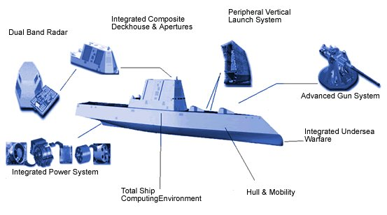
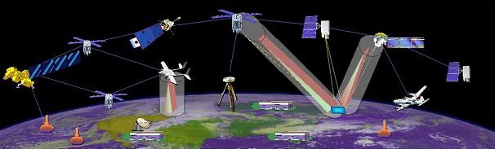

Context: Distributed Real-time Embedded (DRE) Systems
Heterogeneous soft real-time applications
Stringent simultaneous QoS demands
  High availability, Predictability (CPU & network) etc
  Efficient resource utilization
Operation in dynamic & resource-constrained environments
  Process/processor failures
  Changing system loads
Examples
  Total shipboard computing environment
  NASA’s Magnetospheric Multi-scale mission
  Warehouse Inventory Tracking Systems
Component-based development
  Separation of Concerns
  Composability
  Reuse of commodity-off-the-shelf (COTS) components
(Images courtesy Google)
Notes:
3

Slide 4
Operational Strings & End-to-end QoS
Operational String model of component-based DRE systems
  A multi-tier processing model focused on the end-to-end QoS requirements
  Functionality is a chain of tasks scheduled on a pool of computing nodes
  Resources, QoS, & deployment are managed end-to-end
End-to-end QoS requirements
  Critical Path: The chain of tasks that is time-critical from source to destination
  Need predictable scheduling of computing resources across components
  Need network bandwidth reservations to ensure timely packet delivery
  Failures may compromise end-to-end QoS
Must support highly available operational strings!
Notes:
Particularly of interest is the component-based operational string model….
An important notion in operational string is that of a critical path….
To ensure critical path meets its deadline, two things have to happen.

Slide 5
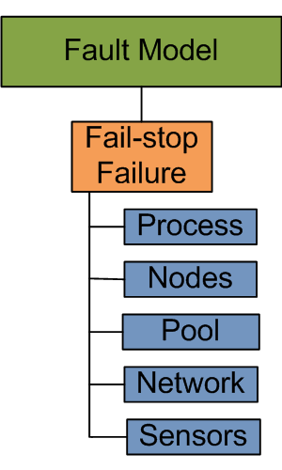

Availability Requirements of DRE Operational Strings(1/4)
The fault-model consists of fail-stop failures
  Cause delays & requires software/hardware redundancy
  Recovery must be quick to meet the deadline (soft real-time)
What are reliability alternatives?
  Roll-back recovery
    Transactional
  Roll-forward recovery: replication schemes
    Active replication (multiple concurrent executions)
    Passive replication (primary-backup approach)
Roll-back recovery | Active Replication | Passive Replication
Resources
Needs transaction support (heavy-weight) | Resource hungry (compute & network) | Less resource consuming than active (only network)
Non-determinism
Must compensate non-determinism | Must enforce determinism | Handles non-determinism better
Recovery time
Roll-back & re-execution (slowest recovery) | Fastest recovery | Re-execution (slower recovery)
Notes:
While discussing availability, we must consider a fault-model….
In terms of resources …. In terms of non-determinism ….
In terms of recovery-time, active replication is the fastest & passive replication comes second,
the goal here is identify a tradeoff to recovery as fast as possible without consuming as many resources

Slide 6
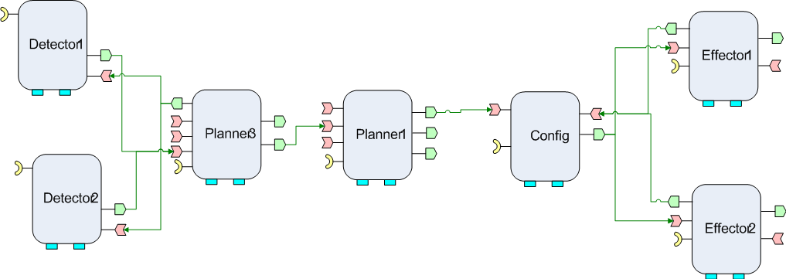
Availability Requirements of DRE Operational Strings(2/4)
What is failover granularity for passive replication?
  Single component failover
  Larger than a single component
Scenario 1: Must tolerate catastrophic faults (DoD-centric)
  Pool Failure
  Network failure
N
N
N
N
N
N
N
Whole operational string must
failover
Pool 1
N
N
Replica
N
Clients
N
N
N
N
N
Pool 2
Notes:
Conventionally …. The granularity of failover….
However, I’ll present 3 scenarios here that argue for failover granularity larger than a single component.

Slide 7
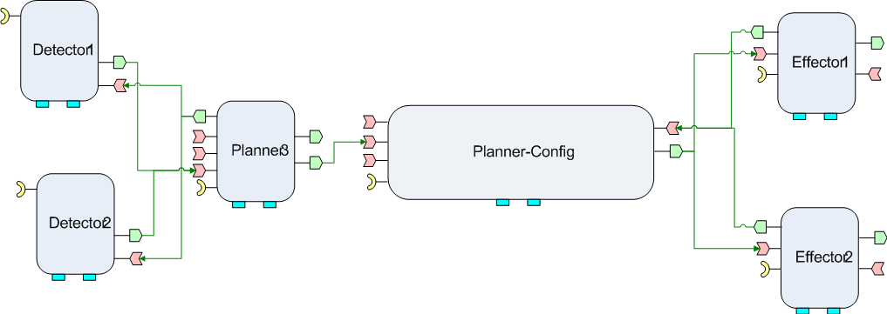
Availability Requirements of DRE Operational Strings(3/4)
Scenario 2: Must tolerate Bohrbugs
  A Bohrbug repeats itself predictably when the same state reoccurs
Preventing Bohrbugs: Reliability through diversity
  Diversity via non-isomorphic replication
Non-isomorphic
work-flow
and
implementation
of Replica
Different
End-to-end
QoS
(thread pools, deadlines, priorities)
Whole operational string must failover

Slide 8
Availability Requirements of DRE Operational Strings(4/4)
Scenario 3: Must tolerate non-determinism
  Sources of non-determinism in DRE systems
    Local information (sensors, clocks), thread-scheduling, timers, timeouts, & more
  Enforcing determinism is not always possible
Scenario 3a: Must tolerate side-effects of replication + non-determinism
  Problem: Orphan request & orphan state
  Solution based on single component failover require costly roll-backs
Fault-tolerance provisioning should be transparent
  Separation of availability concerns from the business logic
  Improves reusability, productivity, & perceived availability of the system
Non-determinism
Replication
Potential orphan state
High availability of operational strings need
transparent group failover with passive replication!
Notes:
At the end: From these scenarios & availability requirements we realize that high availability of operational strings need transparent group failover with passive replication!

Slide 9
Integrating Availability in Component-based Development Lifecycle
Development Lifecycle
Answers needed in all phases of development
How to specify FT & end-to-end QoS requirements?
Specification
Composition
How to compose & deploy application components & their replica?
How to configure the underlying middleware to provision QoS?
Deployment
Configuration
How to deal with the side effects of replication & non-determinism at run-time?
Run-time
Notes:
All the earlier requirements must be realized in the context of the development lifecycle of component-based systems. On the left here we see a typical component-based development lifecycle. Provisioning availability needs solutions at all the stages of lifecycle. For instance, in the specification phase…..

Slide 10
Presentation Road Map
Technology Context Overview
Related Research & Unresolved Challenges
Research Progress → Model-driven Fault-tolerance Provisioning for Component-based DRE Systems
Proposed Research
Research Contributions & Dissertation Timeline
Concluding Remarks
Notes:
10
With those questions in mind, I’ll now review the existing research work & the unresolved challenges.

Slide 11
Related Research: QoS & FT Modeling
Category | Related Research (QoS & FT Modeling)
Using UML | UML Profile for Schedulability, Performance, & Time (SPT) UML Profile for Modeling Quality of Service & Fault Tolerance Characteristics & Mechanisms (QoS&FT) UML Profile for Modeling & Analysis of Real-Time & Embedded Systems (MARTE) Component Quality Modeling Language by J. ÃŸyvind Aagedal Modeling & Integrating Aspects into Component Architectures by L. Michotte, R. France, & F. Fleurey A Model-Driven Development Framework for Non-Functional Aspects in Service Oriented Architecture by H. Wada, J. Suzuki, & K. Oba
Using domain-specific languages (DSL) | Model-based Development of Embedded Systems: The SysWeaver Approach by D. de Niz, G. Bhatia, & R. Rajkumar A Modeling Language & Its Supporting Tools for Avionics Systems by G. Karsai, S. Neema, B. Abbott, & D. Sharp High Service Availability in MaTRICS for the OCS by M. Bajohr & T. Margaria Modeling of Reliable Messaging in Service Oriented Architectures by L. Gönczy & D. Varró Fault tolerance AOP approach by J. Herrero, F. Sanchez, & M. Toro
Recovery block modeling
and
QoS for SOA
Lightweight &
Heavyweight
UML extensions
MoC = service logic graphs, state machine,
Java extension
11
Notes:
With those questions in mind, I’ll now review the existing research work & the unresolved challenges.

Slide 12
Unresolved Challenges: QoS & FT Modeling
Development Lifecycle
  Crosscutting availability requirements
    Tangled with primary structural dimension
    Tangled with secondary dimensions (deployment, QoS)
  Composing replicated & non-replicated functionality
  Example: Replicas must be modeled, composed, & deployed
Imposes modeling overhead
Supporting non-isomorphic replication
  Reliability through diversity (structural & QoS)
  Supporting graceful degradation through diversity
Specification
Composition
Deployment
Imposes modeling overhead
Configuration
Composing connections
Run-time
Composing
replicas
Notes:
In spite of this research there are several unresolved challenges in the specification & composition phases.
The problem of crosscutting availability requirement is not solved satisfactorily….. For instance, consider & operation string consisting components A,B,C. Replicas of these components must be modeled…. These extra steps impose modeling overhead Moreover, we have seen earlier that non-isomorphic replication is often desirable to support diversity & graceful degradation. Support for this is still missing in earlier work.

Slide 13
Unresolved Challenges: QoS & FT Modeling
Development Lifecycle
Variable granularity of failover
  Whole operational string, sub-string, or a component group
Variable QoS association granularity
Network-level QoS specification (connection level)
  Differentiated service based on traffic class & flow
    Example: High priority, high reliability, low latency
  Bidirectional bandwidth requirements
Specification
Port-level
Connection-level
Composition
Component-level
Deployment
Configuration
Run-time
Notes:
Traffic flowing between component may be classified as HP, LL, etc. There could be bidirectional bandwidth requirements to ensure timely packet delivery.
Lets move on to the next two phase of development lifecycle….

Slide 14
Related Research: Transparent FT Provisioning
Category | Related Research (Transparent FT Provisioning)
Model-driven | Aspect-Oriented Programming Techniques to support Distribution, Fault Tolerance, & Load Balancing in the CORBA(LC) Component Model by D. Sevilla, J. M. García, & A. Gómez CORRECT - Developing Fault-Tolerant Distributed Systems by A. Capozucca, B. Gallina, N. Guelfi, P. Pelliccione, & A. Romanovsky Automatic Generation of Fault-Tolerant CORBA-Services by A. Polze, J. Schwarz, & M. Malek Adding fault-tolerance to a hierarchical DRE system by P. Rubel, J. Loyall, R. Schantz, & M. Gillen
Using AOP languages | Implementing Fault Tolerance Using Aspect Oriented Programming by R. Alexandersson & P. Öhman Aspects for improvement of performance in fault-tolerant software by D. Szentiványi Aspect-Oriented Fault Tolerance for Real-Time Embedded Systems by F. Afonso, C. Silva, N. Brito, S. Montenegro
Meta-Object Protocol (MOP) | A Multi-Level Meta-Object Protocol for Fault-Tolerance in Complex Architectures by F. Taiani & J.-C. Fabre Reflective fault-tolerant systems: From experience to challenges by J. C. Ruiz, M.-O. Killijian, J.-C. Fabre, & P. Thévenod-Fosse
M2M transformation & code generation
Performance improvement for FT using AOP
Performance improvement for FT using AOP
14

Slide 15
Unresolved Challenges: Transparent FT Provisioning
Not all the necessary steps are supported coherently
  Automatic component instrumentation for fault-handling code
  Deciding placement of components & their replicas
  Deploying primaries, replicas, & monitoring infrastructure
  Platform-specific metadata synthesis (XML)
Missing domain-specific recovery semantics (run-time middleware)
  Group failover is DRE-specific & often neglected
  Costly to modify the middleware
  Application-level solutions lose transparency & reusability
Missing transparent network QoS provisioning (D&C middleware)
  Configuration of network resources (edge routers)
  Configuration of containers for correct packet marking
Development Lifecycle
Specification
Composition
Deployment
Configuration
How to add domain-specific recovery semantics in COTS middleware retroactively?
How to automate it to improve productivity & reduce cost?
Run-time
Notes:
(after explaining the stepes) While all these steps are necessary, it assumes that the necessary middleware support is available. However, group failover is DRE-specific & often neglected in COTS middleware.

Slide 16
Presentation Road Map
Technology Context Overview
Related Research & Unresolved Challenges
Research Progress → Model-driven Fault-tolerance Provisioning for Component-based DRE Systems
Proposed Research
Research Contributions & Dissertation Timeline
Concluding Remarks
Notes:
16

Slide 17
Overview of the Solution Approach
Resolves challenges in
Component QoS Modeling Language (CQML)
  Aspect-oriented Modeling for Modularizing QoS Concerns
Specification
Composition
Generative Aspects for Fault-Tolerance (GRAFT)
  Multi-stage model-driven development process
  Weaves dependability concerns in system artifacts
  Provides model-to-model, model-to-text, model-to-code transformations
Deployment
Configuration
End-to-end Reliability of Non-deterministic Stateful Components
  Proposed research
Run-time
Notes:
Here is the overview of the solution approach. I’ll first present CQML …. go leftwards from there
Finally, we’ll look at the run-time issues related to end-to-end reliability of non-deterministic stateful components, which will be my proposed research.

Slide 18
Resolution 1: QoS Specification
Resolves challenges in
Component QoS Modeling Language (CQML)
  Aspect-oriented Modeling for Modularizing QoS Concerns
Specification
Composition
Deployment
Configuration
Run-time
Notes:
Here is the overview of the solution approach. I’ll first present CQML …. go leftwards from there
Finally, we’ll look at the run-time issues related to end-to-end reliability of non-deterministic stateful components, which will be my proposed research.

Slide 19
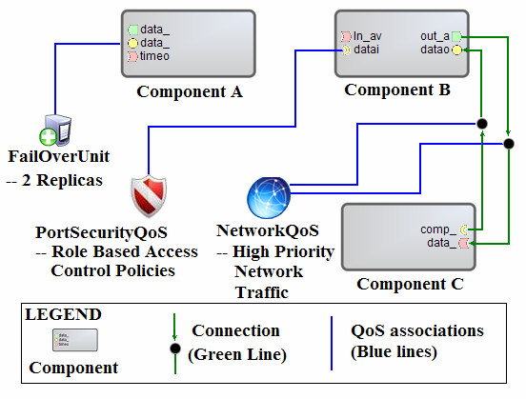
Resolution 1: QoS Specification
Component QoS Modeling Language (CQML)
  A modeling framework for declarative QoS specification
  Reusable for multiple composition modeling languages
Failover unit for Fault-tolerance
  Capture the granularity of failover
  Specify # of replicas
Network-level QoS
  Annotate component connections
  Specify priority of communication traffic
  Bidirectional bandwidth requirements
Security QoS
Real-time CORBA configuration
Event channel configuration
Notes:
Our goal while developing CQML was to create a modeling framework for declarative QoS specification that can be reused across multiple composition modeling languages

Slide 20
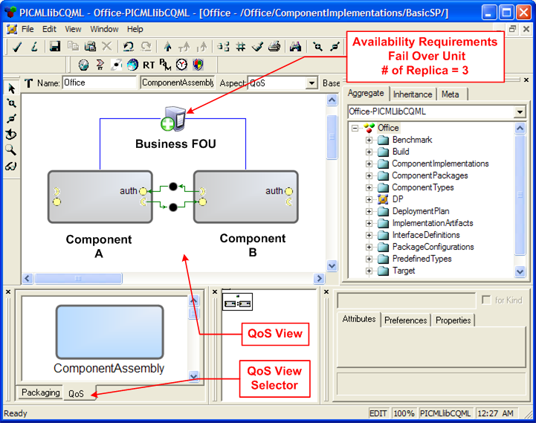
Separation of Concerns in CQML
Resolving tangling of functional composition & QoS concerns
Separate Structural view from the QoS view
GRAFT transformations use aspect-oriented model weaving to coalesce both the views of the model
Notes:
Separation of concerns is achieved using GME’s aspect feature. QoS annotations are always done in the QoS-view, which is separate from the structural view. GRAFT transformation that we will see later, coalesce the two views together.

Slide 21
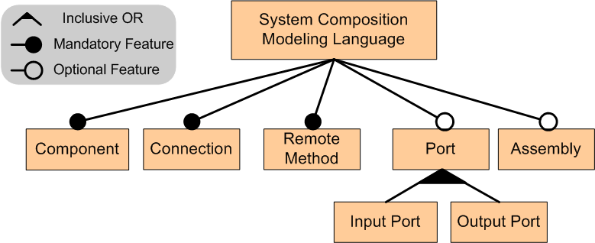
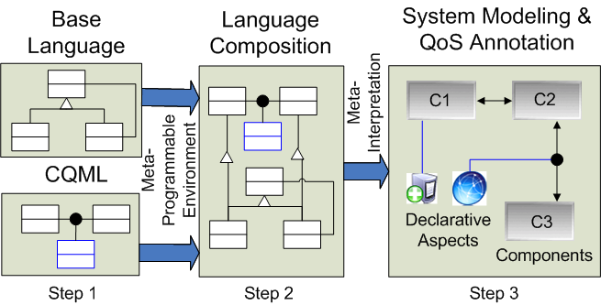
Resolving Granularity of QoS Associations in CQML
Commonality/Variability analysis of composition modeling languages
  e.g., PICML for CCM, J2EEML for J2EE, ESML for Boeing Bold-Stroke
Feature model of composition modeling languages
Dictates QoS association granularity
Composition Modeling Language
Enhance composition language to model QoS
  GME meta-model composition
Notes:
To determine the granularity of QoS association, we did commonality/variability analysis of the composition modeling languages… We chose PICML, J2EEML, & ESML. The outcome of the analysis was this feature model of composition modeling languages. We used these structural invariants to guide the design of CQML.
Next we’ll see how we use metamodel composition to enhance the composition modeling language with the QoS modeling capability. Here is an overview of the process…

Slide 22
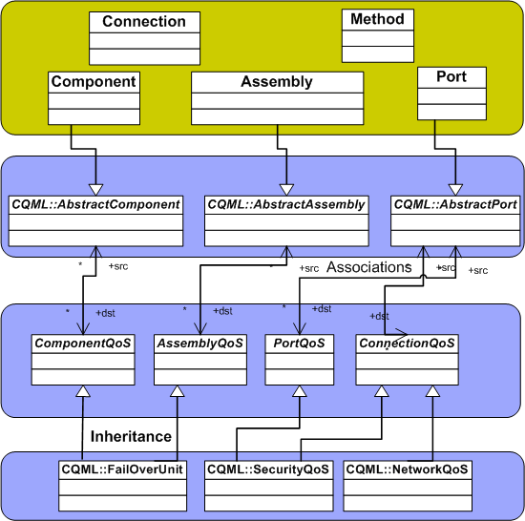



Composing CQML (1/3)
PICML or J2EEML or ESML
Composition Modeling Language
Goal: Create reusable & loosely coupled associations
ConcreteQoS Elements
CQML
Notes:
So one side we have the structural elements of the composition modeling language & concrete QoS elements of CQML on the other side. Our goal is to create associations that are reusable & loosely coupled

Slide 23
Composing CQML (2/3)
PICML or J2EEML or ESML
Composition Modeling Language
Dependency Inversion Principle
CQML Join-point Model
CQML
ConcreteQoS Elements
Notes:
To achieve that we introduce CQML join-point model. It is a layer of abstraction that is a collection of abstract structural elements. This set is based on the feature model of composition modeling languages we saw earlier. The concrete structural elements inherit from the abstract structural elements. This is nothing but an application of DIP at the metamodeling level. DIP says that.…

Slide 24
Composing CQML (3/3)
PICML or J2EEML or ESML
Composition Modeling Language
CQML Join-point Model
Grouping of QoS elements using is-a relationship
Abstract QoS Elements
CQML
ConcreteQoS Elements
Notes:
We still need to connect abstract structural elements to the concrete QoS elements. We simply group the QoS elements depending upon where they can be associated to. For example …. Network QoS can be associated with connections only whereas FOU can be associated with component & assemblies.

Slide 25
Composing CQML (3/3)
PICML or J2EEML or ESML
Composition Modeling Language
CQML Join-point Model
Abstract QoS Elements
CQML
ConcreteQoS Elements
Notes:
This is also an application of DIP at the metamodeling level. This two level indirection allows us to reuse CQML on multiple composition modeling languages.

Slide 26
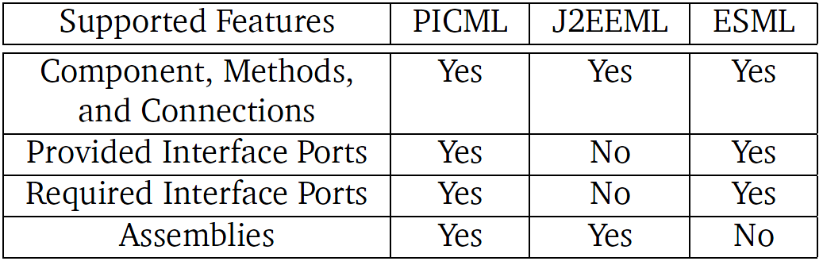
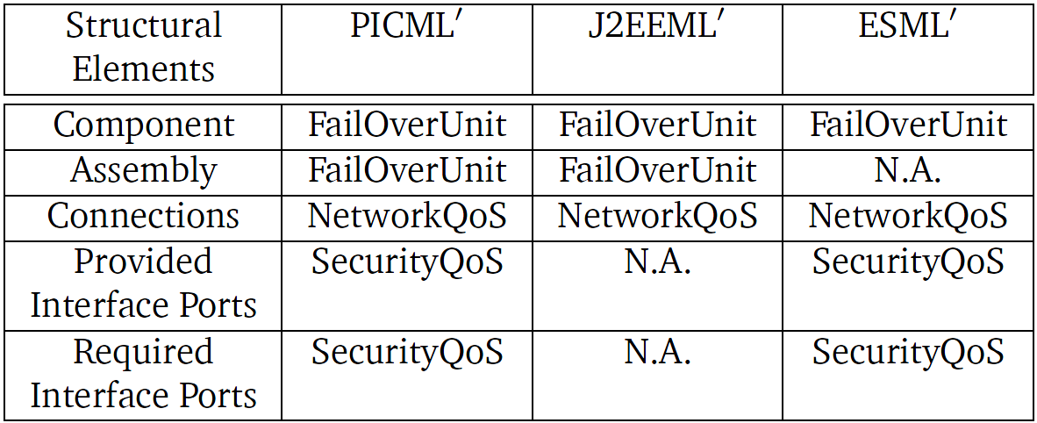
Evaluating Composability of CQML
Three composition modeling languages
  PICML
  J2EEML
  ESML
Available feature-set determines the extent of applicability of the join-point model
Three composite languages with varying QoS modeling capabilities
  PICML’
  J2EEML’
  ESML’
Notes:
We now evaluate the composability of CQML. We chose three

Slide 27
Relevant Publications
CQML: Aspect-oriented Modeling for Modularizing & Weaving QoS Concerns in Component-based Systems, ECBS 2009
Towards A QoS Modeling & Modularization Framework for Component-based Systems, AQuSerM 2008
Model-driven Engineering for Development-time QoS Validation of Component-based Software Systems, RTWS 2006
First-author

Slide 28
Resolution 2: Post-specification Phases of the
Development Lifecycle
Resolves challenges in
Specification
Composition
Generative Aspects for Fault-Tolerance (GRAFT)
  Multi-stage model-driven development process
  Weaving Dependability Concerns in System Artifacts
  Provides model-to-model, model-to-text, model-to-code transformations
Deployment
Configuration
Run-time

Slide 29
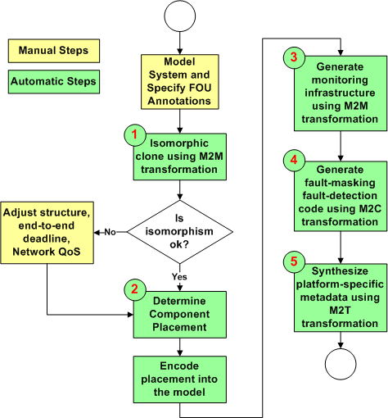
Generative Aspects for Fault Tolerance (GRAFT)
Multi-stage model-driven generative process
Incremental model-refinement using transformations
  Model-to-model
  Model-to-text
  Model-to-code
Weaves dependability concerns in system artifacts
Notes:
Here is an overview of GRAFT

Slide 30
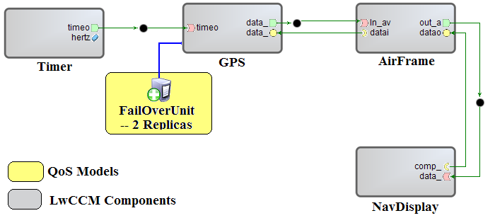
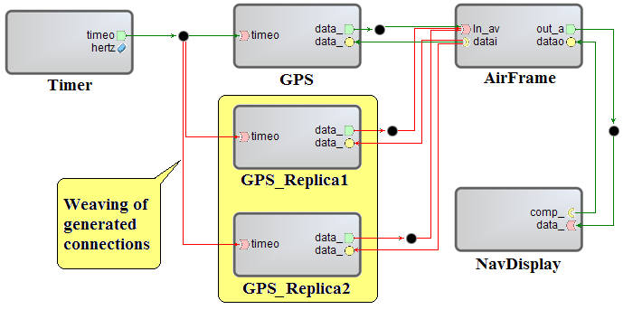
Stage 1: Isomorphic M2M Transformation
Step1: Model structural composition of operational string
Step2: Annotate components with
failover unit(s) marking them “fault-tolerant” in the QoS view
Step3: Use aspect-oriented M2M transformation developed using Embedded Constraint Language (ECL) of C-SAW
Step4: Component replicas & interconnections are generated automatically
Step 5: FOU annotations are removed but other QoS annotations are cloned (uses Dependency Inversion Principle of CQML)
Step 6: Isomorphic clone can be modified manually (reliability through diversity)
QoS View
M2M Transformation
Structural View

Slide 31
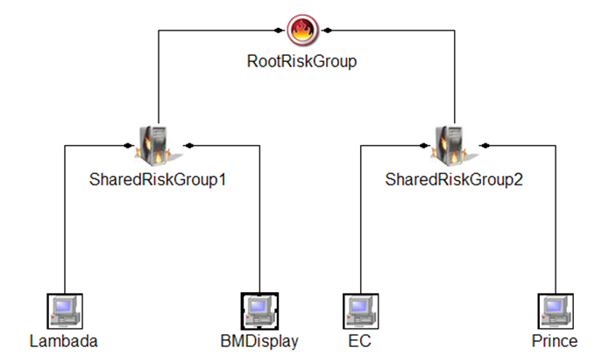
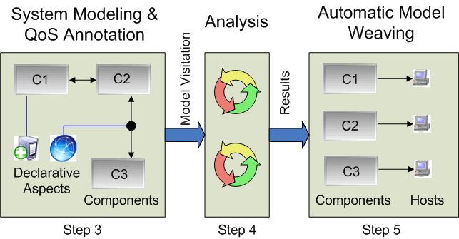
Stage 2: Determine Component Placement
Strategic placement of components
  Improves availability of the system
  Several constraint satisfaction algorithms exist
Placement comparison heuristic
  Hop-count between replicas
  Formulation based on the co-failure probabilities captured using Shared Risk Group (SRG)
    E.g., shared power supply, A/C, fire zone
  Reduces simultaneous failure probability
GRAFT transformations weave the decisions back into the model
RootRiskGroup
SRG
SRG
R
P
Notes:
During the course of this research, we came up with a placement comparison heuristic that is based on hop-count between replicas. Hop-count is nothing but the number of tree edges between the primary & the replica. Larger the hop count better is the placement. This formulation based on the models of co-failure probabilities & shared risk groups. RootRiskGroup is a comparatively large structures such as a ship or a building. Two SRGs can be two data-centers. If one replica is placed in one data center & another replica in different data center the probability of both replicas being unavailable reduces dramatically. This heuristic could be used as an additional constraint in determining placement.

Slide 32
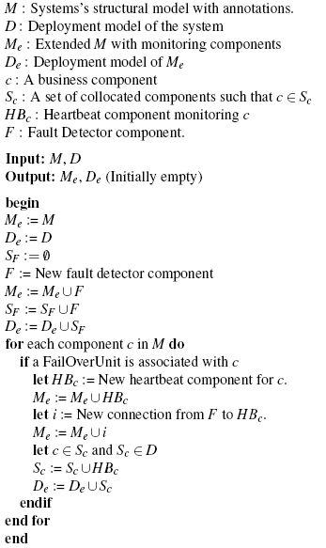


Stage 3: Synthesizing Fault Monitoring Infrastructure
Transformation Algorithm
Failover unit
QoS View
M2M Transformation
Structural View
Fault Detector
Collocated Heartbeat Components
Notes:
Once the placement is known if it possible to generate the fault-monitoring infrastructure.

Slide 33
Stage 4: Synthesizing Code for Group Failover (1/2)
Code generation for fault handling
  Reliable fault detection
  Transparent fault masking
  Fast client failover
Location of failure determines handling behavior
Head
Tail
FOU
Head component failure | Tail component failure
Client-side code detects the failure | Only other FOU participants detect the failure. Client waits.
--- | Trigger client-side exception by forcing FOU to shutdown
Client-side code does transparent failover | Client-side code detects passivation of the head component & does transparent failover
FOU shutdown is achieved using seamless integration with D&C middleware APIs
  e.g., Domain Application Manager (DAM) of CCM
Shutdown method calls are generated in fault-handling code
Notes:
Code needs to be generated for three reasons. However, in case of operational strings, the location of the failure also become significant & determines the fault handling code. To allow quick client-side exception, one way is to shutdown the FOU….. So in the case of tail component failure, there is this extra step of shutting down the FOU

Slide 34
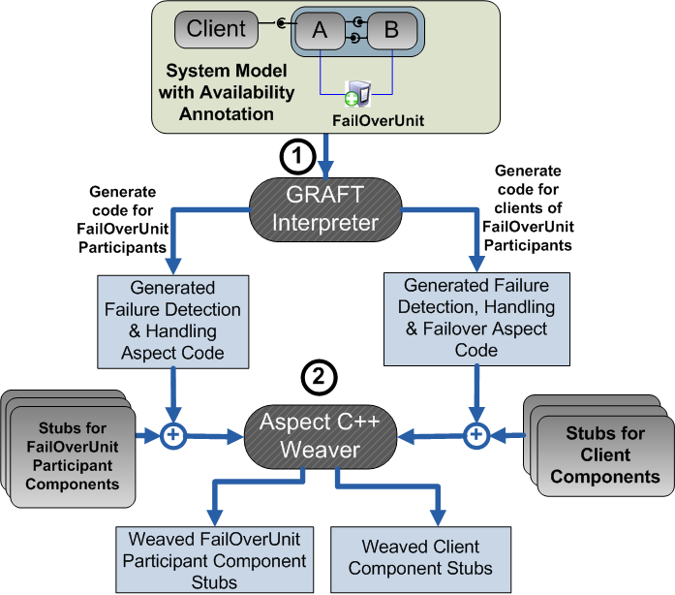
Stage 4: Synthesizing Code for Group Failover (2/2)
Two behaviors based on component position
FOU participant’s behavior
  Detects the failure
  Shuts down the FOU including itself
FOU client’s behavior
  Detects the failure
  Does an automatic failover to a replica FOU
  Optionally shuts down the FOU to save resources
Generated code: AspectC++
AspectC++ compiler weaves in the generated code in the respective component stubs

Slide 35
Stage 5: Synthesizing Platform-specific Metadata
Component Technologies use XML metadata to configure middleware
Existing model interpreters can be reused without any modifications
  CQML’s FT modeling is opaque to existing model interpreters
  GRAFT model transformations are transparent to the model interpreters
GRAFT synthesizes the necessary artifacts for transparent
FT provisioning for DRE operational strings
Notes:
Due to GRAFT transformations, it is not possible to distinguish whether the models were hand-crafted or auto-generated.

Slide 36
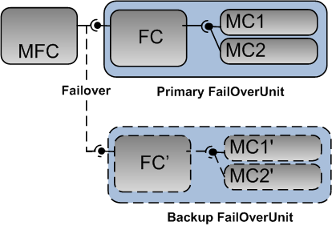
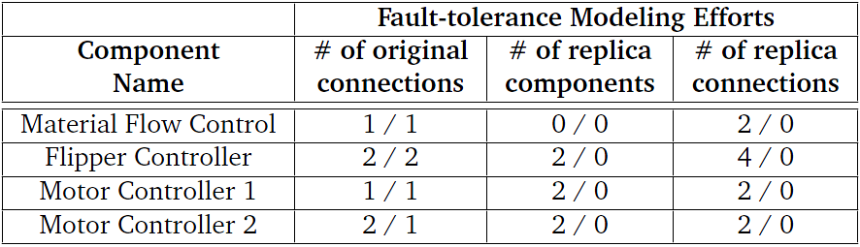
Evaluating Modeling Efforts Reduction Using GRAFT
Case-study - Warehouse Inventory Tracking System
GRAFT’s isomorphic M2M transformation eliminates human modeling efforts of replicas
  Components
  Connections
  QoS requirements
Notes:
We now move on to evaluating the effectiveness of GRAFT. It can be evaluated based on the reduction in modeling efforts & in programming efforts.

Slide 37
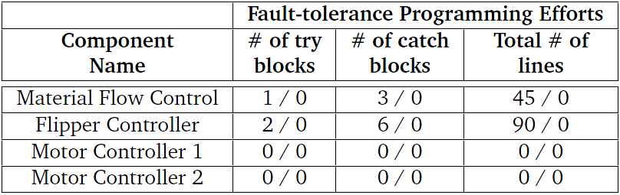
Evaluating Programming Efforts Reduction Using GRAFT
GRAFT’s code generator reduces human programming efforts
Code for fault-detection, fault-masking, & failover
  # of try blocks
  # of catch blocks
  Total # of lines

Slide 38
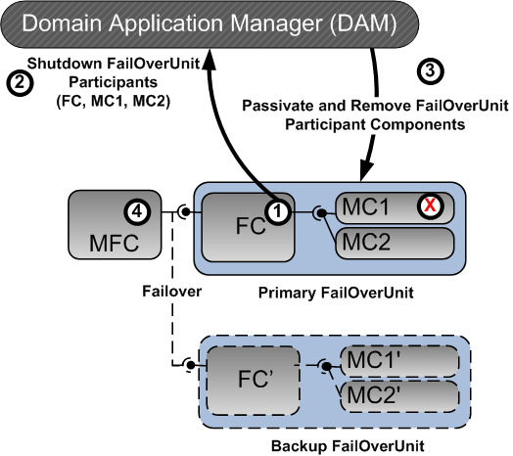
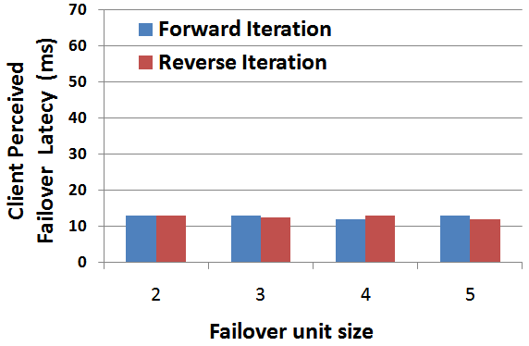
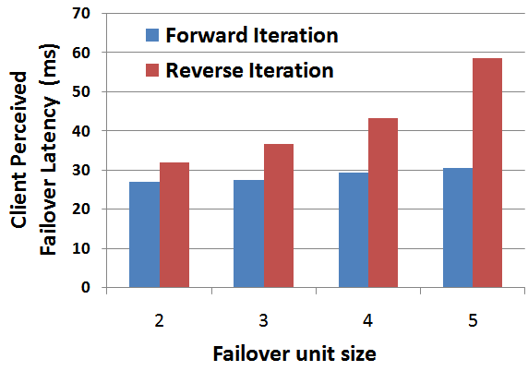
Evaluating Client Perceived Failover Latency Using GRAFT
Client perceived failover latency
  Sensitive to the location of failure
  Sensitive to the implementation of DAM
Head component failure
  Constant failover latency
Tail component failover
  Linear increase in failover latency
Head component failure
Tail component failure
Notes:
Finally, we also evaluate the client-perceived failover latency while using graft. Note that it is sensitive to ….

Slide 39
Relevant Publications
Fault-tolerance for Component-based Systems – An Automated Middleware Specialization Approach, ISORC 2009
MDDPro: Model-Driven Dependability Provisioning in Enterprise Distributed Real-Time & Embedded Systems, ISAS 2007
Supporting Component-based Failover Units in Middleware for Distributed Real-time & Embedded Systems, JSA Elsevier (under submission)
First-author
Other

Slide 40
Presentation Road Map
Technology Context Overview
Related Research & Unresolved Challenges
Research Progress → Model-driven Fault-tolerance Provisioning for Component-based DRE Systems
Proposed Research
Research Contributions & Dissertation Timeline
Concluding Remarks
Notes:
40

Slide 41
Proposed Research: End-to-end Reliability of
Non-deterministic Stateful Components
Development Lifecycle
Specification
Composition
Deployment
End-to-end Reliability of Non-deterministic Stateful Components
  Proposed research
Configuration
Run-time
Notes:
Run-time issues related to …

Slide 42
Execution Semantics & High Availability
Execution semantics in distributed systems
  May-be – No more than once, not all subcomponents may execute
  At-most-once – No more than once, all-or-none of the subcomponents will be executed (e.g., Transactions)
    Transaction abort decisions are not transparent
  At-least-once – All or some subcomponents may execute more than once
    Applicable to idempotent requests only
  Exactly-once – All subcomponents execute once & once only
    Enhances perceived availability of the system
Exactly-once semantics should hold even upon failures
  Equivalent to single fault-free execution
  Roll-forward recovery (replication) may violate exactly-once semantics
    Side-effects of replication must be rectified
State Update
State Update
State Update
Partial
execution
should seem
like no-op
upon recovery
Notes:
To understand the run-time issues, we have to closely examine execution semantics in distributed systems…. Even in case of failures, it should appear that everything executed exactly once. However, roll-forward recovery makes it particularly harder. Although parts of the request are executed multiple time physically, the outcome should be as if everything executed exactly once.

Slide 43
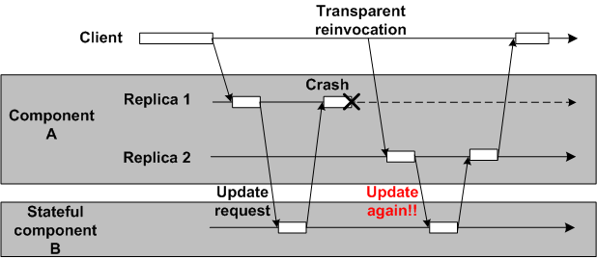
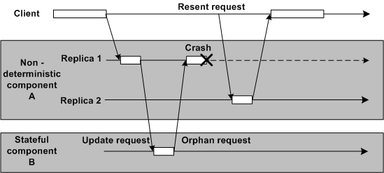
Exactly-once Semantics, Failures, & Determinism
Deterministic component A
  Caching of request/reply at component B is sufficient
Caching of
request/reply
rectifies the problem
Non-deterministic component A
Two possibilities upon failover
  No invocation
  Different invocation
Caching of request/reply does not help
  Non-deterministic code must re-execute
Orphan request & orphan state
Notes:
Solution to rectify the side-effects of replication depends upon whether system is deterministic or non-deterministic.

Slide 44
Related Research: End-to-end Reliability
Category | Related Research (QoS & FT Modeling)
Integrated transaction & replication | Reconciling Replication & Transactions for the End-to-End Reliability of CORBA Applications by P. Felber & P. Narasimhan Transactional Exactly-Once by S. Frølund & R. Guerraoui ITRA: Inter-Tier Relationship Architecture for End-to-end QoS by E. Dekel & G. Goft Preventing orphan requests in the context of replicated invocation by Stefan Pleisch & Arnas Kupsys & Andre Schiper Preventing orphan requests by integrating replication & transactions by H. Kolltveit & S. olaf Hvasshovd
Enforcing determinism | Using Program Analysis to Identify & Compensate for Nondeterminism in Fault-Tolerant, Replicated Systems by J. Slember & P. Narasimhan Living with nondeterminism in replicated middleware applications by J. Slember & P. Narasimhan Deterministic Scheduling for Transactional Multithreaded Replicas by R. Jimenez-peris, M. Patino-Martínez, S. Arevalo, & J. Carlos A Preemptive Deterministic Scheduling Algorithm for Multithreaded Replicas by C. Basile, Z. Kalbarczyk, & R. Iyer Replica Determinism in Fault-Tolerant Real-Time Systems by S. Poledna Protocols for End-to-End Reliability in Multi-Tier Systems by P. Romano
Database in the last tier
Deterministic scheduling
Program analysis to compensate nondeterminism
44

Slide 45
Unresolved Challenges: End-to-end Reliability of
Non-deterministic Stateful Components
Integration of replication & transactions
  Applicable to multi-tier transactional web-based systems only
  Overhead of transactions (fault-free situation)
    Join operations in the critical path
    2 phase commit (2PC) protocol at the end of invocation
Join
Join
Join
State Update
State Update
State Update

Slide 46
Unresolved Challenges: End-to-end Reliability of
Non-deterministic Stateful Components
Integration of replication & transactions
  Applicable to multi-tier transactional web-based systems only
  Overhead of transactions (fault-free situation)
    Join operations in the critical path
    2 phase commit (2PC) protocol at the end of invocation
  Overhead of transactions (faulty situation)
    Must rollback to avoid orphan state
    Re-execute & 2PC again upon recovery
  Complex tangling of QoS: Schedulability & Reliability
    Schedulability of rollbacks & join must be ensured
  Transactional semantics are not transparent
    Developers must implement: prepare, commit, rollback (2PC phases)
State Update
State Update
State Update
Potential
orphan
state
growing
Orphan state bounded in B, C, D

Slide 47
Unresolved Challenges: End-to-end Reliability of
Non-deterministic Stateful Components
Integration of replication & transactions
  Applicable to multi-tier transactional web-based systems only
  Overhead of transactions (fault-free situation)
    Join operations in the critical path
    2 phase commit (2PC) protocol at the end of invocation
  Overhead of transactions (faulty situation)
    Must rollback to avoid orphan state
    Re-execute & 2PC again upon recovery
  Complex tangling of QoS: Schedulability & Reliability
    Schedulability of rollbacks & join must be ensured
  Transactional semantics are not transparent
    Developers must implement all: commit, rollback, 2PC phases
Enforcing determinism
  Point solutions: Compensate specific sources of non-determinism
    e.g., thread scheduling, mutual exclusion
  Compensation using semi-automated program analysis
    Humans must rectify non-automated compensation

Slide 48
Proposed Research: Protocol for End-to-end Exactly-once Semantics with Rapid Failover
Rethinking Transactions
  Overhead is undesirable in DRE systems
  Alternative mechanism needed to rectify the orphan state
Proposed research: A distributed protocol that
  Supports exactly-once execution semantics in presence of
    Nested invocations
    Non-deterministic stateful components
    Passive replication
  Ensures state consistency of replicas
  Does not require intrusive changes to the component implementation
    No need to implement prepare, commit, & rollback
  Supports fast client failover that is insensitive to
    Location of failure in the operational string
    Size of the operational string
Evaluation Criteria
  Less communication overhead during fault-free & faulty situations
  Nearly constant client-perceived failover delay irrespective of the location of the failure
Notes:
So for this dissertation, I would like to propose a protocol for end-to-end exactly-once semantics with fast failover. To resolve this problem we need to rethink transactions.

Slide 49
Role of Object Structure Traversals in the Development Lifecycle
Model-driven Development Lifecycle
Object structure traversals
  Needed in all the phases of development lifecycle.
Specification
Model transformation
Composition
Model Traversals
Model interpretation
Object Structure Traversals
Deployment
XML Processing
XML Tree Traversals
Configuration
XML Processing
Run-time
Notes:
During the course of this research, I observed that object structure traversals are needed in all the phases of lifecycle. They manifest in two forms. First is model traversals needed for model transformation & model interpretation. Secondly, for XML processing for configuration of middleware.

Slide 50
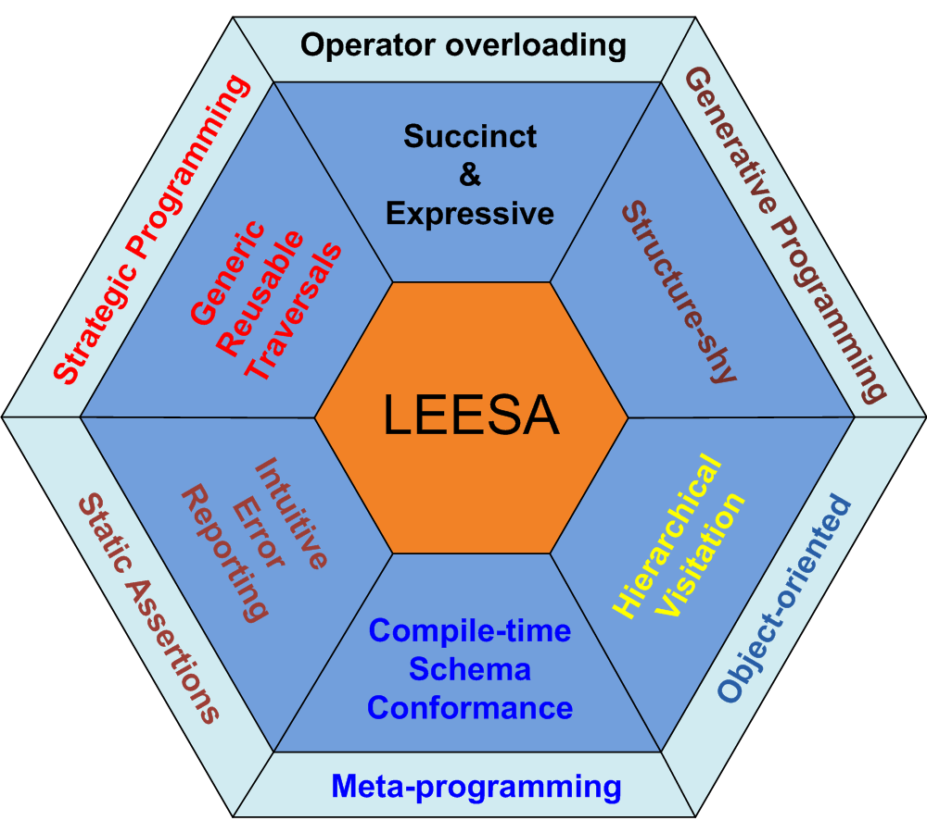
Overcoming the Impediments in
OO-biased Object Structure Traversals
Multi-paradigm Solution
Object structure traversals
  Manipulate richly-typed hierarchical object structures (e.g., models, XML documents)
  Governed by statically know schema
  APIs biased towards OO paradigm
Consequences of OO-biased APIs
  Verbose traversal code
  Lack of flexible, reusable traversal control
  Tightly coupled with the underlying structure (impedes maintainability)
Language for Embedded Query & Traversal

Slide 51
Relevant Publications
LEESA: Embedding Strategic & XPath-like Object Structure Traversals in C++, DSLWC 2009
Toward Native XML Processing Using Multi-paradigm Design in C++ (under submission), IEEE Software
First-author

Slide 52
Presentation Road Map
Technology Context Overview
Related Research & Unresolved Challenges
Research Progress → Model-driven Fault-tolerance Provisioning for Component-based DRE Systems
Proposed Research
Research Contributions & Dissertation Timeline
Concluding Remarks
Notes:
52

Slide 53
Venue | Overall Research Contributions
ISORC 2009 | Fault-tolerance for Component-based Systems - An Automated Middleware Specialization Approach
ECBS 2009 | CQML: Aspect-oriented Modeling for Modularizing & Weaving QoS Concerns in Component-based Systems
ISAS 2007 | MDDPro: Model-Driven Dependability Provisioning in Enterprise Distributed Real-Time & Embedded Systems
DSLWC 2009 | LEESA: Embedding Strategic & XPath-like Object Structure Traversals in C++
AQuSerM 2008 | Towards A QoS Modeling & Modularization Framework for Component Systems
RTWS 2006 | Model-driven Engineering for Development-time QoS Validation of Component-based Software Systems
DSPD 2008 | An Embedded Declarative Language for Hierarchical Object Structure Traversal
IEEE Software (submitted) | Toward Native XML Processing Using Multi-paradigm Design in C++
RTAS 2009 | Adaptive Failover for Real-time Middleware with Passive Replication
RTAS 2008 | NetQoPE: A Model-driven Network QoS Provisioning Engine for Distributed Real-time & Embedded Systems
IEEE Software July-Aug 2009 | Improving Domain-specific Language Reuse through Software Product-line Configuration Techniques
ECBS 2007 | Model-driven Engineering for Development-time QoS Validation of Component-based Software Systems
JSA Elsevier 2010 (submitted) | Supporting Component-based Failover Units in Middleware for Distributed Real-time Embedded Systems
First-author
Other

Slide 54
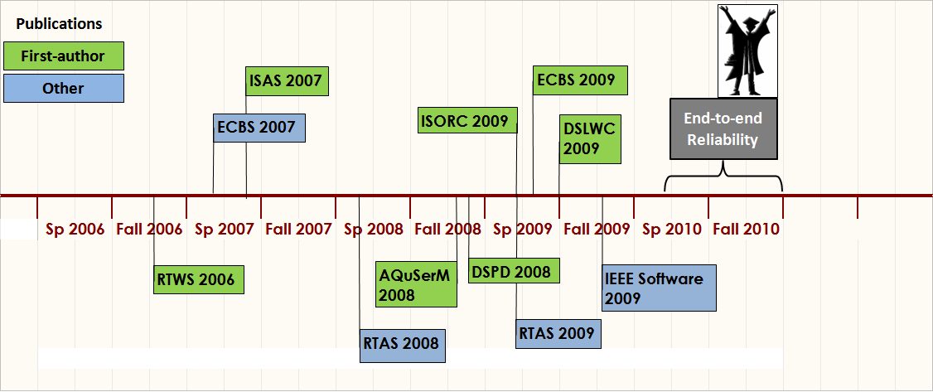
Dissertation Timeline

Slide 55
Concluding Remarks
Operational string is a component-based model of distributed computing focused on end-to-end deadline
Operational strings need group failover
  Not provided out-of-the-box in contemporary middleware
Solution:
  Component QoS Modeling Language (CQML) for end-to-end QoS specification
    Failover unit modeling
  Generative Aspects for Fault-Tolerance (GRAFT) for transparent FT provisioning
    M2M, M2C, & M2T transformations
Proposed research: End-to-end reliability of non-deterministic stateful components
  Protocol to rectify orphan state problem allowing fast failover

Slide 56

Questions

Slide 57
Backup

Slide 58
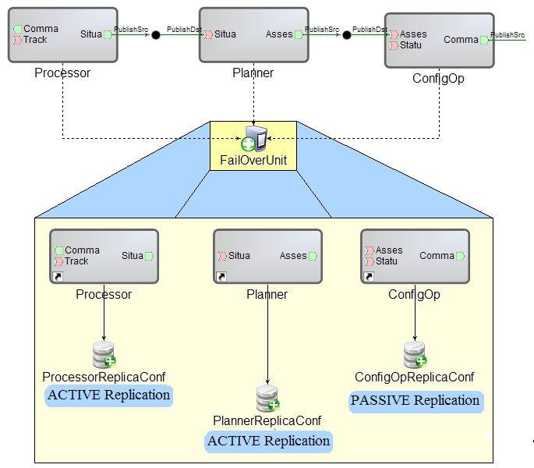
Fault-Tolerance Modeling using CQML & PICML
PICML as a base language
Annotate system structure with QoS annotations
  FOU for granularity of failover
A FOU is a model containing
  Heartbeat frequency
  Replication groups
  Heartbeat frequency for fault-monitoring
Replication group captures
  Replication style
  State synchronization rate
Models group failover & mixed-mode replication styles

Slide 59
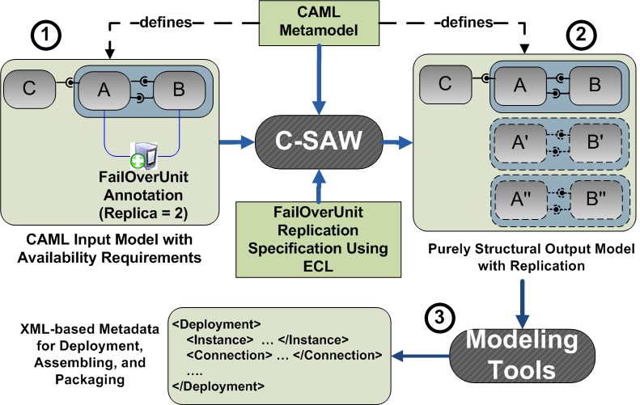
Using GRAFT for Isomorphic M2M Transformation
Automated Structural FT Weaving
Composite Metamodel
CQML

Slide 60
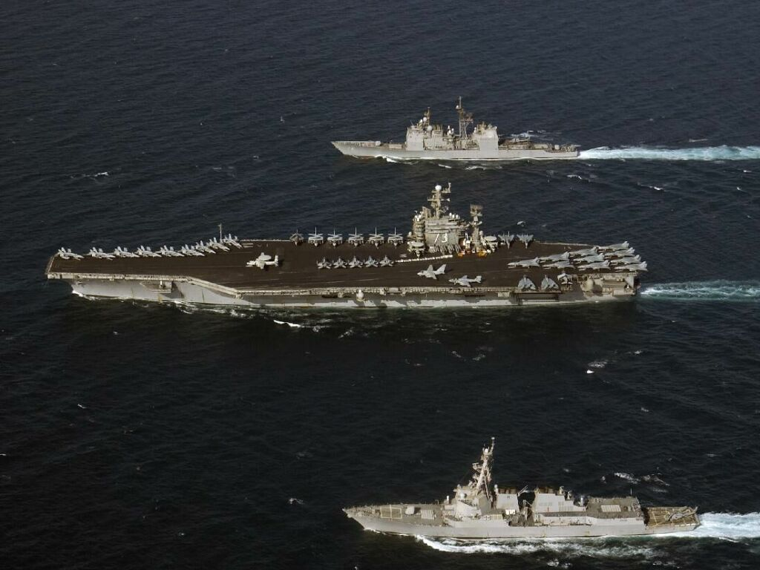
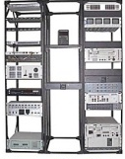
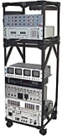
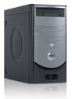
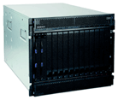
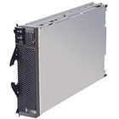
Step 2: Determine Component Placement
DoD-centric case study (Total Shop-board Computing Environment)
Reliability analysis determines co-failure probabilities due to shared risks
Consider a heuristic placement constraint on replicas
  Distance between primary & replicas = # of tree edges
  Larger the better
DataCenter1_SRG
RootRiskGroup
DataCenter2_SRG
Rack1_SRG
Rack2_SRG
Node1
(blade31)
Node2
(blade32)
Shelf1_SRG
Shelf2_SRG
P
Shelf1_SRG
Blade30
Blade34
Blade29
Blade33
Blade36
R
R

Slide 61
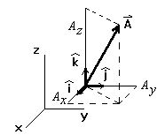

Step 2: Heuristics for the Replica Placement Problem
Algorithm comparing two placements
  Compute the distance from each of the replicas to the primary for a placement.
  Record each distance as a vector, where all vectors are orthogonal.
  Add the vectors to obtain a resultant.
  Compute the magnitude of the resultant.
  Use the resultant in all comparisons (either among placements or against a threshold)
  Apply a penalty function to the composite distance (e.g. pair wise replica distance or uniformity)
R2
P
R3
R1

Slide 62
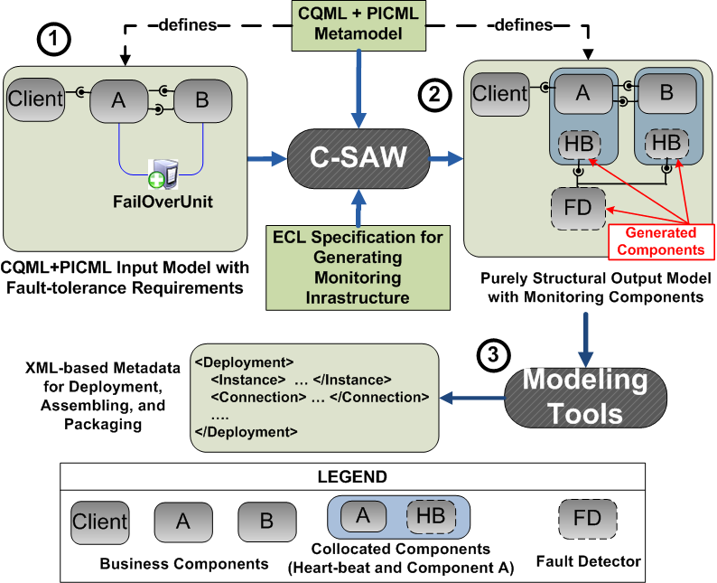
Step 3: Using GRAFT for M2M Transformation
Problem: Generating fault-monitoring infrastructure from CQML’s fault-tolerance modeling (FailOverUnit) capabilities
Step1: Model structural composition of component
Step2: Annotate components with FailOverUnit(s) marking them “protected”
Step3: Use aspect-oriented M2M transformation (described next) developed using Embedded Constraint Language (ECL)
Step4: Fault detector & heart-beat components are generated for “protected” components
Step5: Use existing interpreters of the base language to generate platform-specific metadata.

Slide 63
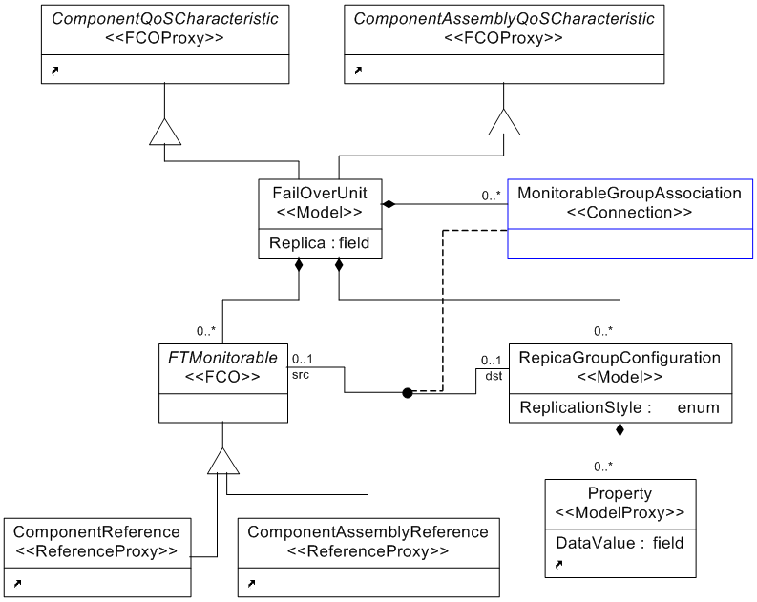


Fault-tolerance Modeling Abstractions in CQML
Fail-over Unit (FOU)
  Models variable failover granularity
    Components, Assembly
  Attribute = degree of replication
Shared Risk Group (SRG)
  Models simultaneous failure risk
    E.g., Shared power supply, shared LAN, fire zone (DoD)
  Used to constrain replica deployment
RootRiskGroup
SRG
SRG
Notes:
Among several QoS annotations that are possible in CQML, these two are the most relevant for our today’s discussion. Shared Risk Group is a way of modeling simultaneous failure risk.

Slide 64
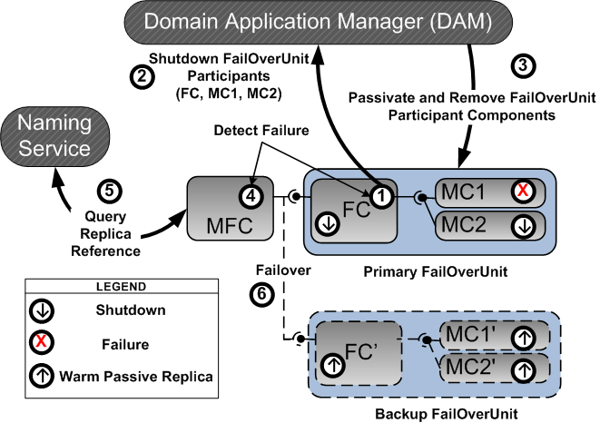
Stage 4: Run-time Coordination of Fault-detection &
Fault-masking modules
Case-study: Warehouse Inventory Tracking System (ITS)
  FOU participant detects the failure of another participant
  Requests shutdown of the primary FOU
  Deployment infrastructure (DAM) passivates the components
  Clients detect the passivation of FOU
  Clients obtain the replica references from the naming service
  Successful failover of all the clients
MC1 = Motor Controller 1
MC2 = Motor Controller 2
FC = Flipper Controller
MFC = Material Flow Controller
Notes:
Here is an illustration of how run-time coordination.

