Slide 1
Techniques & Tools for Managing Cyber-Physical System Complexity
Dr. Christopher Jules White
jules@dre.vanderbilt.edu
www.dre.vanderbilt.edu/~jules
Research Assistant Professor
Vanderbilt University
Nashville, Tennessee
Sponsors: NSF, DARPA, DSTO, Air Force Research Lab, Lockheed Martin Advanced Technology Lab, Lockheed Martin Advanced Technology Center, Lockheed Martin Aeronautics, Raytheon, Siemens Corporate Technology, & Siemens Corporate Research
Notes:
Got phd 1 year ago & have been working as a research assistant professor since then
Jules, I color coded the sponsors according to whether they were federal funding, DoD company funding, or commercial funding.

Slide 2
Summary of My Research Area
Complex/Large Scale CPS Systems
Notes:
Jules, please also emphasize that your work spans the gamut of theory, tools, & experimentation “at scale”.
Build, optimize, & validate CPS
Animate – bring together

Slide 3
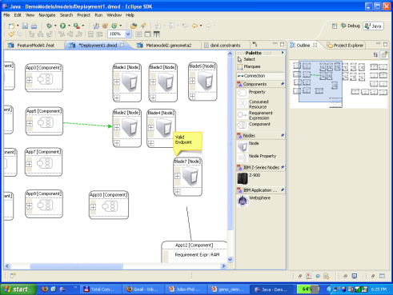
Summary of My Research Area
Complex/Large Scale CPS Systems
Modeling
Notes:
Jules, please also emphasize that your work spans the gamut of theory, tools, & experimentation “at scale”.
Build, optimize, & validate CPS
Animate – bring together

Slide 4
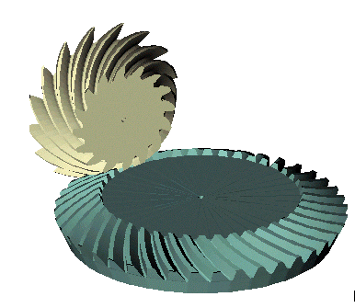
Summary of My Research Area
Algorithms/Automation
Complex/Large Scale CPS Systems
Modeling
My work focuses on using modeling, algorithms, & automation to deal with the complexity of designing/optimizing Cyber-Physical Systems (CPS)
My work spans the gamut of theory, tools, & experimentation “at scale”
Notes:
Jules, please also emphasize that your work spans the gamut of theory, tools, & experimentation “at scale”.
Build, optimize, & validate CPS
Animate – bring together

Slide 5
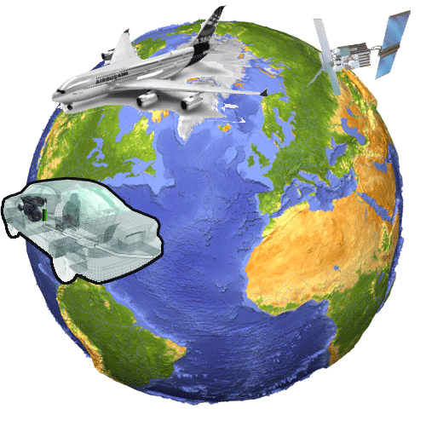
Cyber-Physical Systems & Quality of Service
A Cyber-Physical System (CPS) involves close coordination between the system's computational & physical elements
CPS applications are essential in mission- & safety-critical domains, such as aerospace, automotive, chemical processes, civil infrastructure, energy, entertainment, healthcare, manufacturing, & transportation
CPS applications must adhere to complex sets of Quality of Service (QoS) constraints, such as real-time scheduling, to ensure safety & efficiency
Cyber-Physical Systems

Slide 6
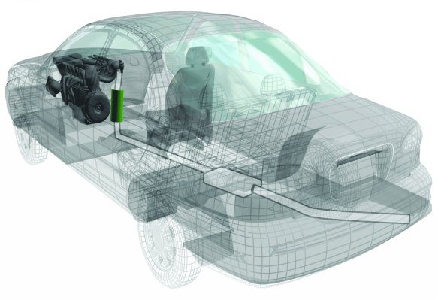
Physical World Interaction Requires Strict QoS
Since a CPS interacts with the physical world, it’s not enough for it compute the right answer, it must also compute:
Fast enough to keep up with real-world processes
Efficiently enough to run for long periods of time without wasting resources
Safely to prevent damage to the physical world
The complexity of interacting with the physical world with the correct Quality of Service (QoS), makes CPS design & optimization hard
Software developer uses slower algorithm for higher accuracy & improved safety but needs faster processor
Notes:
Mention: Ariane 5 rocket, F22 software, Toyota’s possible software glitch
The right answer delivered too late is the wrong answer
Animate & emphasize tradeoffs on right-hand side

Slide 7
Physical World Interaction Requires Strict QoS
Since a CPS interacts with the physical world, it’s not enough for it compute the right answer, it must also compute:
Fast enough to keep up with real-world processes
Efficiently enough to run for long periods of time without wasting resources
Safely to prevent damage to the physical world
The complexity of interacting with the physical world with the correct Quality of Service (QoS), makes CPS design & optimization hard
Software developer uses slower algorithm for higher accuracy & improved safety but needs faster processor
Design changed to use smaller power supply for weight reduction
Notes:
Mention: Ariane 5 rocket, F22 software, Toyota’s possible software glitch
The right answer delivered too late is the wrong answer
Animate & emphasize tradeoffs on right-hand side

Slide 8
Physical World Interaction Requires Strict QoS
Since a CPS interacts with the physical world, it’s not enough for it compute the right answer, it must also compute:
Fast enough to keep up with real-world processes
Efficiently enough to run for long periods of time without wasting resources
Safely to prevent damage to the physical world
The complexity of interacting with the physical world with the correct Quality of Service (QoS), makes CPS design & optimization hard
Software developer uses slower algorithm for higher accuracy & improved safety but needs faster processor
Slower processor used to improve power efficiency & reduce cost
Design changed to use smaller power supply for weight reduction
Notes:
Mention: Ariane 5 rocket, F22 software, Toyota’s possible software glitch
The right answer delivered too late is the wrong answer
Animate & emphasize tradeoffs on right-hand side

Slide 9
Physical World Interaction Requires Strict QoS
Since a CPS interacts with the physical world, it’s not enough for it compute the right answer, it must also compute:
Fast enough to keep up with real-world processes
Efficiently enough to run for long periods of time without wasting resources
Safely to prevent damage to the physical world
The complexity of interacting with the physical world with the correct Quality of Service (QoS), makes CPS design & optimization hard
Software developer uses slower algorithm for higher accuracy & improved safety but needs faster processor
Real-time scheduling deadline missed
Slower processor used to improve power efficiency & reduce cost
Design changed to use smaller power supply for weight reduction
CPS designers need models, methods, & algorithms to help them design systems that meet the QoS demands of interacting with the physical world
Notes:
Mention: Ariane 5 rocket, F22 software, Toyota’s possible software glitch
The right answer delivered too late is the wrong answer
Animate & emphasize tradeoffs on right-hand side

Slide 10
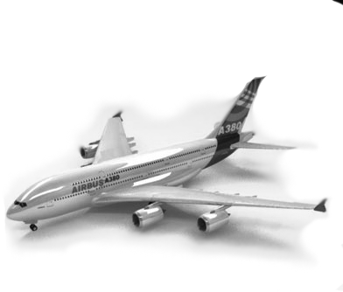
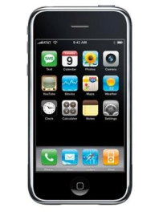
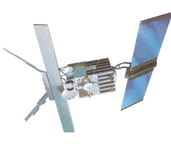
Part 1: CPS Research Overview
Part 1: Overview of CPS research challenges & applications I worked on
CPS Research Overview
CPS Deployment Optimization
Mobile CPS Applications
Concluding Remarks
Notes:
Links at end of talk for pointers & more information

Slide 11
Part 2: CPS Deployment Optimization
Part 2: CPS deployment optimization research funded by NSF & AFRL
CPS Research Overview
CPS Deployment Optimization
Mobile CPS Applications
Concluding Remarks

Slide 12
Part 3: Ongoing & Future Work
Part 3: Ongoing & future research building CPS Applications
using mobile Internet devices (e.g., iPhone, iPad, Android)
CPS Research Overview
CPS Deployment Optimization
Mobile CPS Applications
Concluding Remarks

Slide 13
Part 4: Concluding Remarks
Part 4: Concluding remarks
CPS Research Overview
CPS Deployment Optimization
Mobile CPS Applications
Concluding Remarks

Slide 14
Part 1: CPS Research Overview
Part 1: Overview of CPS research challenges & applications I worked on
CPS Research Overview
CPS Deployment Optimization
Mobile CPS Applications
Concluding Remarks

Slide 15
Research Overview
Research Overview: Selections from my past & current research on CPS Systems
Research Overview
Modeling
Automation
Algorithms
Mobile CPS

Slide 16
Selections from My CPS Modeling Research
Modeling
Automation
Algorithms
Mobile CPS
Modeling & multi-model synchronization techniques for hardware/software
Many algorithms based on heuristic bin-packing for multiprocessor scheduling
Techniques for rapid creation of domain-specific modeling languages
Synchronization of assumptions across software/hardware models
Generative & analytical methods to model self-adaptive systems
Avionics - Lockheed Aero, Lockheed ATL, AFRL
Collaboration with
UC Berkeley & UIUC
Selected Publications (2 of 10):
Brian Dougherty, Jules White, Jaiganesh Balasubramanian, Chris Thompson, & Douglas C. Schmidt, Deployment Automation with BLITZ, 31st International Conference on Software Engineering, May 16-24, 2009 Vancouver, Canada.
Jules White, James Hill, Jeff Gray, Sumant Tambe, Douglas C. Schmidt, Anirrudha Gokhale, Improving Domain-specific Language Reuse through Software Product-line Configuration Techniques, IEEE Software Special Issue on Domain-Specific Languages & Modeling July/August, 2009, Volume 26, Number 4, pgs. 47-53
First Author
Second Author
Notes:
Theme for how they all fit together
Text hard to read

Slide 17
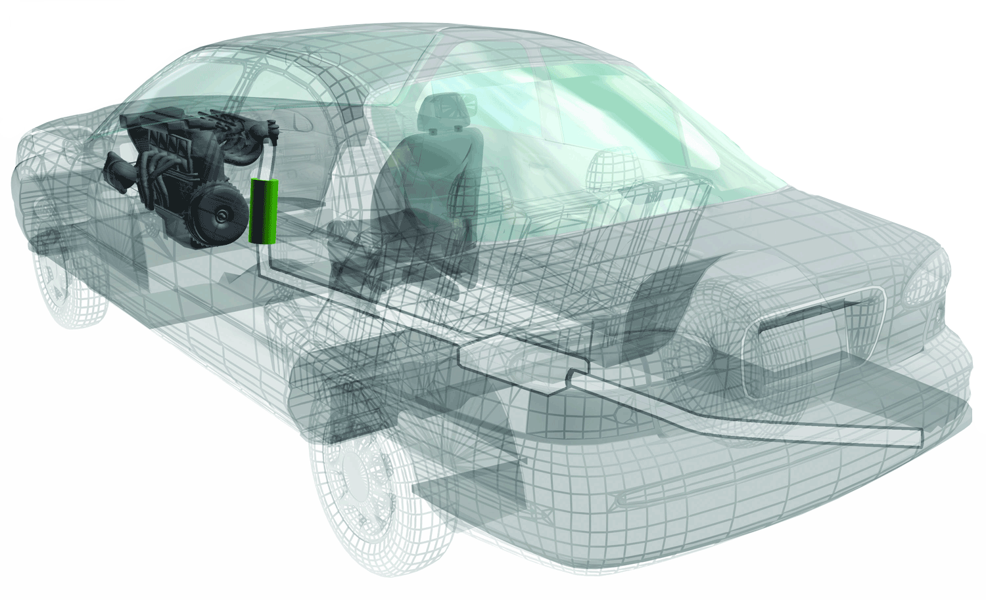
Selections from CPS Design Automation Research
Algorithms
Mobile CPS
Modeling
Automation
Optimization
Integration
Multiple Constraints
No Single Alg.
Design conflict resolution & software configuration optimization across software/hardware
Diagnose & optimize design conflicts in a distributed development process
Optimize software/hardware configuration in the face of competition for resources
Automobiles – Siemens CT, NSF
Collaboration with
U. Waterloo, Canada U. Seville, Spain
U. Nantes, France
Selected Publications (2 of 9):
Jules White, Douglas C. Schmidt, David Benavides, Pablo Trinidad, Antonio Ruiz-Cortez, Automated Diagnosis of Product-line Configuration Errors in Feature Models, Software Product Lines Conference (SPLC), 10pgs., September, 2008, Limmerick, Ireland (30% Acceptance Rate)
***Received the Best Paper Award***
Jules White, David Benavides, Douglas C. Schmidt, Pablo Trinidad, Antonio Ruiz-Cortes, Brian Doughtery, Automated Diagnosis of Feature Model Configurations, Journal of Systems & Software, 2010 (to appear)
Notes:
Theme for how they all fit together
Text hard to read

Slide 18
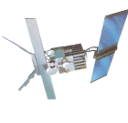
Selections from My CPS Algorithms Research
Multiple Constraints
No Single Alg.
Optimization
Integration
Modeling
Automation
Algorithms
Mobile CPS
Modeling & optimization of distributed real-time & embedded systems
Deployment optimization to reduce network traffic & weight of DRE systems
Software configuration optimization
Software/hardware co-design with shared resources
Spatial deployment optimization for power concerns
Fractionated
Spacecraft – AFRL, DARPA, Lockheed ATC
Selected Publications (2 of 10):
Jules White, Brian Doughtery, Douglas C. Schmidt, ASCENT: An Algorithmic Technique for Designing Hardware & Software in Tandem, IEEE Transactions on Software Engineering Special Issue on Search-based Software Engineering, 2010 (to appear)
Jules White, Brian Dougherty, Chris Thompson, Douglas C. Schmidt, ScatterD: Spatial Deployment Optimization with Hybrid Heuristic / Evolutionary Algorithms, ACM Transactions on Autonomous & Adaptive Systems Special Issue on Spatial Computing, 2010 (to appear)
Notes:
Theme for how they all fit together
Text hard to read

Slide 19
Selections from My Mobile CPS Research
Algorithms
Mobile CPS
Modeling
Automation
Optimization
Integration
Multiple Constraints
No Single Alg.
Modeling, building, & optimizing CPS applications for mobile Internet devices
Traffic accident detection, augmented reality, & remote patient monitoring with smartphones
Find software/hardware configurations that meet complex resource constraints
Software configuration optimization to minimize power consumption/cost
Smartphones – Siemens CT
Collaboration with Siemens, Trinity College Dublin,
University of Maryland
Selected Publications (2 of 6):
Jules White, Sibohan Clarke, Brian Dougherty, Chris Thompson, Douglas C. Schmidt, R&D Challenges & Solutions for Mobile Cyber-Physical Applications & Supporting Internet Services, Springer Journal of Internet Services & Applications, 2010 (to appear)
Jules White, Douglas C. Schmidt, Egon Wuchner, Andrey Nechypurenko, Optimizing & Automating Product-Line Variant Selection for Mobile Devices, 11th Annual Software Product Line Conference (SPLC), 10pgs., September 10-14, 2007, Kyoto, Japan
Notes:
Theme for how they all fit together
Text hard to read

Slide 20
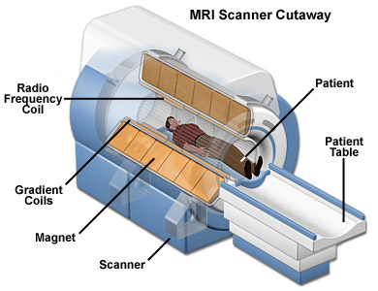
Selections from my Research on Aiding CPS Designers
Avionics - Lockheed Aero, Lockheed ATL, AFRL
Automobiles – Siemens CT, NSF
Smartphones – Siemens CT
This talk will focus on deployment optimization for CPS
Medical Imaging –
Siemens CR
Fractionated
Spacecraft - AFRL

Slide 21
Selections from my Research on Aiding CPS Designers
I will also discuss ongoing & future work developing CPS applications using mobile Internet devices
Avionics - Lockheed Aero, Lockheed ATL, AFRL
Automobiles – Siemens CT, NSF
Smartphones – Siemens CT
Medical Imaging –
Siemens CR
Fractionated
Spacecraft - AFRL

Slide 22
Part 2: CPS Deployment Optimization
Part 2: CPS deployment optimization research funded by NSF & AFRL
CPS Research Overview
CPS Deployment Optimization
Mobile CPS Applications
Concluding Remarks

Slide 23
CPS Deployment Optimization: Goal
Goal: Help designers automate the deployment of software to hardware processors to minimize hardware footprint & network bandwidth consumption
Impact: Reduced cost, power consumption, weight, maintenance
Goal
Challenge 1: Multiple
Constraints
Challenge 2: Modeling
for Metaheuristic Algs.
Challenge 3:
Metaheuristic Evolution
Deployment
Overview
Avionics
Challenge
Prevalence
In CPS

Slide 24
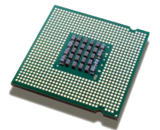
Deployment Optimization Overview
Problem Overview
Challenge
Prevalence
CPS Software Components
CPS Hardware Platform
Notes:
Software/ ? / Hardware -> What is the mapping

Slide 25
Deployment Optimization Overview
Problem Overview
Challenge
Prevalence
How do you map CPS software components to the hardware platform without violating CPS constraints?
CPS Software Components
CPS Hardware Platform

Slide 26
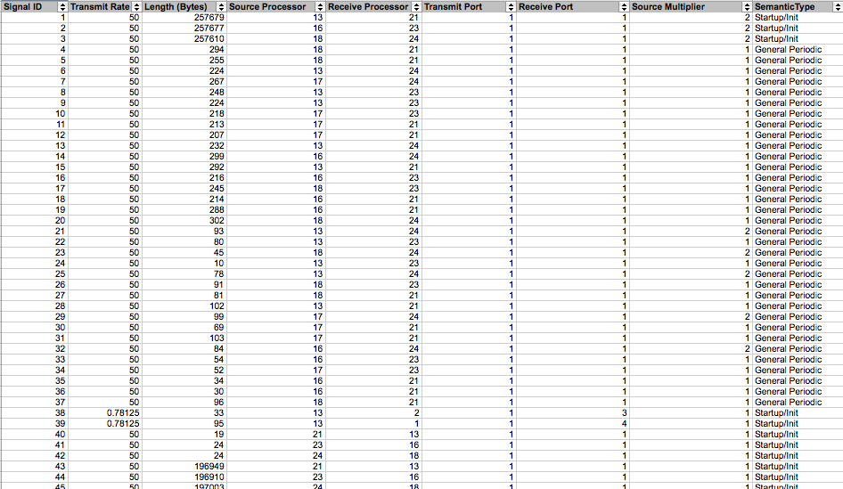
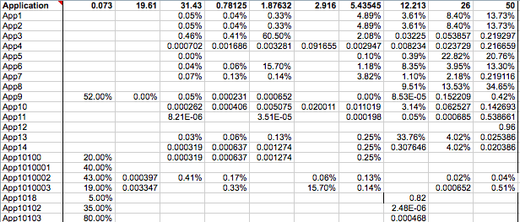
Challenge Problem: Mission Avionics
Problem Overview
Challenge
Prevalence
~150 Real-time Tasks
~14,000 Messaging Interactions
41 Processors
Motivation: In planes, each 1lb of processing infrastructure adds roughly 4lbs of supporting infrastructure as well as power, cost, & maintenance complexity to the system
Avionics Challenge Problem Setup:
Mission avionics system data from Lockheed Martin Aeronautics comprising 41 processors, 41 software components, ~150 real-time tasks, & ~14,000 component interactions
Minimize total processors used & minimize total network bandwidth consumed

Slide 27
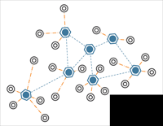
This Problem is Prevalent in CPS
Problem Overview
Challenge
Prevalence
Deployment optimization is important in a variety of CPS domains besides avionics
Avionics - Lockheed Aero, Lockheed ATL, AFRL
Automobiles – Siemens CT, NSF
Medical Imaging –
Siemens CR
Fractionated
Spacecraft - AFRL
Sensor Networks - NSF

Slide 28
CPS Deployment Optimization: Challenge Roadmap
Challenges
Multiple constraint types - no single algorithm is applicable
Modeling deployment for metaheuristic optimization
Metaheuristic evolution inefficiency
Goal
Challenge 1: Multiple
Constraints
Challenge 2: Modeling
for Metaheuristic Algs.
Challenge 3:
Metaheuristic Evolution
Multiple Layers
of Constraints
Identification
of Solution Algs.
Unified
Problem Design
Solution Approach:
Black Box Bin-packing
Evaluation
Notes:
Phrase this all in the context of the LMCO challenge problem
…but is not point solution

Slide 29
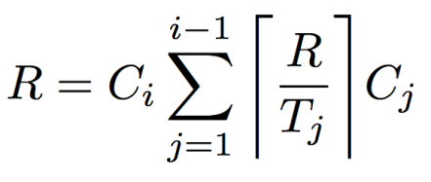
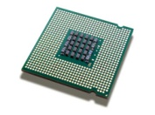
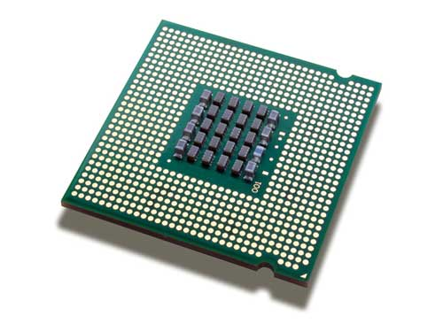
Software Deployment Real-time Constraints
Multiple Constraints
Solution Algs.
Problem
Design
Black Box
Bin-packing
Evaluation
Software Components with Real-time Scheduling Constraints
A very common type of constraint in CPS systems is a set of real-time scheduling requirements
e.g. the brake controller must execute on time
Existing Approaches:
Many algorithms based on heuristic bin-packing for multiprocessor scheduling
Typically use Response Time Analysis or Liu & Layland Bound to derive schedulable sets of tasks
Heuristic Bin-Packing
w/ Response Time Analysis
Processors
Notes:
Slide before that shows multiprocessor scheduling

Slide 30
Software Deployment Real-time Constraints
Multiple Constraints
Solution Algs.
Problem
Design
Black Box
Bin-packing
Evaluation
Software Components with Real-time Scheduling Constraints
A very common type of constraint in CPS systems is a set of real-time scheduling requirements
e.g., software to actuate flight control surfaces must execute on time
Existing Approaches:
Many algorithms based on heuristic bin-packing for multiprocessor scheduling
Typically use Response Time Analysis or Liu & Layland Bound to derive schedulable sets of tasks
Heuristic Bin-Packing
w/ Response Time Analysis
Processors
Notes:
Slide before that shows multiprocessor scheduling

Slide 31
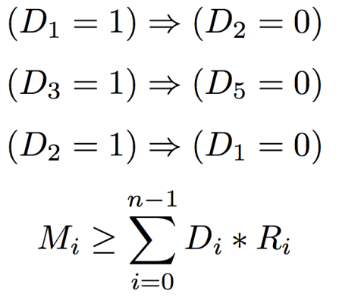
Co-location/Fault-tolerance Constraints
CSP
Multiple Constraints
Solution Algs.
Problem
Design
Black Box
Bin-packing
Evaluation
Co-location constraints ensure that specific tasks are not assigned to the same processor
e.g. do not assign the backup flight control component to the same processor as the primary
Existing Approaches:
These types of problems are often modeled using Constraint Satisfaction Problems (CSPs)
Constraint Solvers used to derive solutions
Don’t typically scale well for real-time scheduling constraints
Neither CSP nor bin-packing is ideally suited for
Co-location / Fault-tolerance Constraints
Real-time Scheduling Constraints

Slide 32
Multiple Layers of Constraints
Multiple Constraints
Solution Algs.
Problem
Design
Black Box
Bin-packing
Evaluation
Physical Placement Constraints
Safety Constraints
Minimize Network Communication
Good algorithms & techniques exist for each layer of the CPS avionics problem, but you need multiple techniques & algorithms to cover the layers
Memory Constraints
Co-location / Fault-tolerance Constraints
Real-time Scheduling Constraints

Slide 33
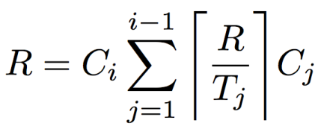
Challenge 1: Handling Layers of Constraints
Multiple Constraints
Solution Algs.
Problem
Design
Black Box
Bin-packing
Evaluation
Nth Constraint Layer
…..
Physical Placement Constraints
Safety Constraints
Minimize Network Communication
If the layers of CPS constraints are arbitrary, how do you provide a flexible stack of algorithms & an integration approach?
Memory Constraints
Co-location / Fault-tolerance Constraints
?
Integrated
Technique
+ + =
Real-time Scheduling Constraints

Slide 34
Challenge 1 Approach: Identification of Solution Algorithms
Multiple Constraints
Solution Algs.
Problem
Design
Black Box
Bin-packing
Evaluation
CSP / Constraint Propagation
Physical Placement Constraints
First step is to identify techniques that can be used to model a large set of the constraints
Solution Approach:
Combine CSP / Constraint Propagation & First-fit Bin-packing in to a hybrid algorithm
Modified algorithm uses constraint propagation to manage non-cumulative constraints, such as co-location
Bin-packing heuristics are used for resource allocation / cumulative cons
Safety Constraints
Co-location / Fault-tolerance Constraints
+
Heuristic Bin-packing
Memory Constraints
Real-time Scheduling Constraints
Publication:
Brian Dougherty, Jules White, Jaiganesh Balasubramanian, Chris Thompson, & Douglas C. Schmidt, Deployment Automation with BLITZ, 31st International Conference on Software Engineering, May 16-24, 2009 Vancouver, Canada

Slide 35
Challenge 1 Approach: Problem Representation
Multiple Constraints
Solution Algs.
Problem
Design
Black Box
Bin-packing
Evaluation
We use a tuple model of a deployment problem to join the two representations
Constraints are hidden behind functions
Deployment Problem:
Correctness Constraints:
is a deployment topology described as a vector where the ith position holds the index of the node that ith component is deployed to (e.g., Component 1 to Node3,T₁=3)
- is the set of components to deploy
- is the set of hardware processors
s(T) – function which returns a positive integer indicating number of cumulative constraints violated
r(T), p(T), …e(T – functions that maintain constraint networks & use constraint propagation to indicate number of non-cum. constraints violated

Slide 36
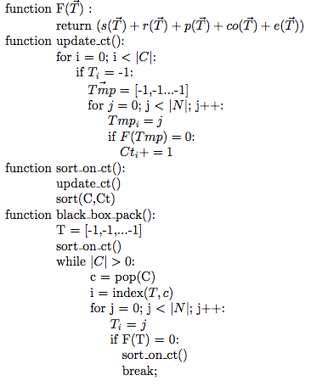
Challenge 1 Approach: Black Box Bin-Packing
Multiple Constraints
Solution Algs.
Problem
Design
Black Box
Bin-packing
Evaluation
Hybrid Algorithm:
We use a unified tuple model of a deployment problem to join the two representations
“Fitting” into a bin is modified to be a black box function based on the sum the outputs of the functions:
Internally, these functions can use constraint propagation
The first-fit sorting heuristic is changed to be based on the number of bins an item can fit into after each iteration of the algorithm
Notes:
Break algorithm out into multi-slide animation

Slide 37
Standard Bin-Packing Approach
Multiple Constraints
Solution Algs.
Problem
Design
Black Box
Bin-packing
Evaluation
Processors are modeled as “bins,” where the goal is to fit items into as few bins as possible
Component 1
Component 3
Component 2
Notes:
Break algorithm out into multi-slide animation

Slide 38
Standard Bin-Packing Approach
Multiple Constraints
Solution Algs.
Problem
Design
Black Box
Bin-packing
Evaluation
Software items have a *size*, which is typically some metric, such as CPU utilization
Component 1
Component 3
Component 2
Notes:
Break algorithm out into multi-slide animation

Slide 39
Standard Bin-Packing Approach
Multiple Constraints
Solution Algs.
Problem
Design
Black Box
Bin-packing
Evaluation
Items sorted based on size
Component 1
Component 2
Component 3
Notes:
Break algorithm out into multi-slide animation

Slide 40
Standard Bin-Packing Approach
Multiple Constraints
Solution Algs.
Problem
Design
Black Box
Bin-packing
Evaluation
First item placed on first processor where it *fits*
Component 1
Component 2
Component 3
Notes:
Break algorithm out into multi-slide animation

Slide 41
Standard Bin-Packing Approach
Multiple Constraints
Solution Algs.
Problem
Design
Black Box
Bin-packing
Evaluation
Second item placed on first processor where it *fits*
Component 2
Component 1
Processor is now *full*
Component 3
Notes:
Break algorithm out into multi-slide animation

Slide 42
Standard Bin-Packing Approach
Multiple Constraints
Solution Algs.
Problem
Design
Black Box
Bin-packing
Evaluation
Component 2
Third item placed on first processor where it *fits*
Component 1
Component 3
Processor is *full*
Notes:
Break algorithm out into multi-slide animation

Slide 43
Black Box Bin-Packing Approach
Multiple Constraints
Solution Algs.
Problem
Design
Black Box
Bin-packing
Evaluation
With the Black Box Bin-Packing Approach, we have a series of functions that govern what *fits* in a bin
Component 1
Component 2
Component 3
Notes:
Break algorithm out into multi-slide animation

Slide 44
Black Box Bin-Packing Approach
Multiple Constraints
Solution Algs.
Problem
Design
Black Box
Bin-packing
Evaluation
No obvious *size* of an item since we do not know the implementation of the functions
Component 1
Component 2
Component 3
Notes:
Break algorithm out into multi-slide animation

Slide 45
Black Box Bin-Packing Approach
Multiple Constraints
Solution Algs.
Problem
Design
Black Box
Bin-packing
Evaluation
Instead, we use the functions to determine how many processors each item can fit on
Fits on 1
Fits on 3
Fits on 2
Component 1
Component 2
Component 3
Notes:
Break algorithm out into multi-slide animation

Slide 46
Black Box Bin-Packing Approach
Multiple Constraints
Solution Algs.
Problem
Design
Black Box
Bin-packing
Evaluation
Instead, we use the functions to determine how many processors each item can fit on
Fits on 1
Fits on 3
Fits on 2
Component 1
Component 2
Component 3
Notes:
Break algorithm out into multi-slide animation

Slide 47
Black Box Bin-Packing Approach
Multiple Constraints
Solution Algs.
Problem
Design
Black Box
Bin-packing
Evaluation
Sorted in increasing order based on the number of processors that the item fits on
Fits on 1
Fits on 3
Fits on 3
Component 1
Component 3
Component 2
Notes:
Break algorithm out into multi-slide animation

Slide 48
Black Box Bin-Packing Approach
Multiple Constraints
Solution Algs.
Problem
Design
Black Box
Bin-packing
Evaluation
Item placed
Component 1
Fits on 3
Fits on 3
Component 3
Component 2
Notes:
Break algorithm out into multi-slide animation

Slide 49
Black Box Bin-Packing Approach
Multiple Constraints
Solution Algs.
Problem
Design
Black Box
Bin-packing
Evaluation
Component 1
Update *fit* counts
Fits on 3
Fits on 2
Component 3
Component 2
Notes:
Break algorithm out into multi-slide animation

Slide 50
Black Box Bin-Packing Approach
Multiple Constraints
Solution Algs.
Problem
Design
Black Box
Bin-packing
Evaluation
Component 1
Sort the items again
Fits on 2
Fits on 3
Component 2
Component 3
Notes:
Break algorithm out into multi-slide animation

Slide 51
Black Box Bin-Packing Approach
Multiple Constraints
Solution Algs.
Problem
Design
Black Box
Bin-packing
Evaluation
Place item on first
processor where it fits
Component 1
Component 2
Fits on 3
Component 3
Notes:
Break algorithm out into multi-slide animation

Slide 52
Black Box Bin-Packing Approach
Multiple Constraints
Solution Algs.
Problem
Design
Black Box
Bin-packing
Evaluation
Component 1
Component 2
Continue repeating process until all items placed
Fits on 3
Component 3
Notes:
Break algorithm out into multi-slide animation

Slide 53
Black Box Bin-Packing Flexibility/Extensibility
Multiple Constraints
Solution Algs.
Problem
Design
Black Box
Bin-packing
Evaluation
*Fits* can be modified to use domain-specific constraints like “it fits if the processor is 21 inches from the perimeter of the airframe”
Since “fits” is a black box function, it can be modified to incorporate new types of constraints without breaking the heuristic
Functions can be added or removed from the definition of F(T) to change constraints
Internally, functions can use own methods to determine output
Allows designers to customize the algorithm to the domain
Publications:
Jules White, Brian Dougherty, Chris Thompson, Douglas C. Schmidt, ScatterD: Spatial Deployment Optimization with Hybrid Heuristic / Evolutionary Algorithms, ACM Transactions on Autonomous & Adaptive Systems Special Issue on Spatial Computing, 2010 (to appear)

Slide 54
Results on Avionics Challenge Problem 1
Generates Valid Solutions with:
Hybrid
Algorithm
Real-time Scheduling
✔
Real-time Scheduling + Co-location
✔
Real-time Scheduling + Co-location + Safety
✔
Real-time Scheduling + Co-location + Safety + Fault-tolerance
✔
Real-time Scheduling + Co-location + Safety + Fault-tolerance + Physical Placement
✔

Slide 55
CPS Deployment Optimization: Challenge Roadmap
Challenges:
Multiple constraint types - no single algorithm is applicable
Modeling deployment for metaheuristic optimization
Metaheuristic evolution inefficiency
Goal
Challenge 1: Multiple
Constraints
Challenge 2: Modeling
for Metaheuristic Algs.
Challenge 3:
Metaheuristic Evolution
Metaheuristic
Algorithms
Problem Modeling
Need for
Improvement
Solution Approach:
Seeding with Bin-Packing
Evaluation
Notes:
Phrase this all in the context of the LMCO challenge problem
…but is not point solution

Slide 56
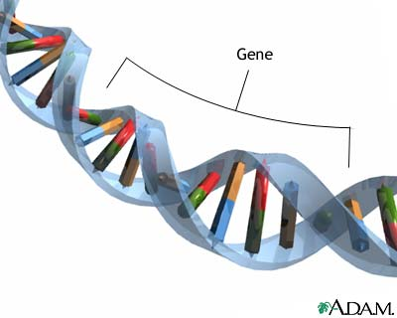
Challenge 2 Approach: Identification of Optimization Approach
Metaheuristic
Algs.
Problem
Modeling
Need
Improvement
Bin-Packing
Seeding
Evaluation
No single problem-specific heuristic algorithm can adequately cover the deployment constraint space
Solution Approach:
Use a metaheuristic algorithm, such as Particle Swarm Optimization, as the optimization technique
Possible to use other metaheuristic algorithms, such as genetic algorithms
Metaheuristic algorithms have broadly applicable optimization heuristics
Particle Swarm Optimization (PSO)
Genetic Optimization

Slide 57
Challenge 2 Approach: Application to Deployment Optimization
Metaheuristic
Algs.
Problem
Modeling
Need
Improvement
Bin-Packing
Seeding
Evaluation
How do you apply a metaheuristic optimization technique to deployment optimization?
Initial Approach:
Deployment plans (T) are modeled as vectors
Leverage metaheuristic algorithms to explore design space for deployment plans that minimize bandwidth
Competing deployment plans evolve over series of generations to find an optimized solution
Best deployment plan(s) is presented to the developer
Particle Swarm Optimization (PSO)
Genetic Optimization
Notes:
Discuss evolutionary algorithms & swarm intelligence

Slide 58
Challenge 2 Approach: Application to Deployment Optimization
Metaheuristic
Algs.
Problem
Modeling
Need
Improvement
Bin-Packing
Seeding
Evaluation
This talk focuses on PSO, though all the integration techniques discussed can be applied to genetic algorithms & other metaheuristic techniques
Particle Swarm Optimization (PSO)
Genetic Optimization
Notes:
Discuss evolutionary algorithms & swarm intelligence

Slide 59
Overview of Particle Swarm Optimization (PSO)
Metaheuristic
Algs.
Problem
Modeling
Need
Improvement
Bin-Packing
Seeding
Evaluation
Particle’s Personal Best
Current Global Best
Possible Flight Path
Each particle is *pulled* towards a combination of its personal best solution & the global best solution:
Velocity Calculation Formula:
Particle

Slide 60
Challenges Applying PSO
Metaheuristic
Algs.
Problem
Modeling
Need
Improvement
Bin-Packing
Seeding
Evaluation
Challenges Applying PSO:
How do you represent deployment plans as particle positions?
How do you randomly generate valid initial deployment plans?
How do you modify the particle flight plans to adhere to deployment constraints & use heuristic information?
Metaheuristic algorithms degenerate to random search for many problems!!!

Slide 61
Particle Position Approach: Deployment Vectors
Metaheuristic
Algs.
Problem
Modeling
Need
Improvement
Bin-Packing
Seeding
Evaluation
Node 1
Node 2
Deployment topologies are represented as vectors:
Example: 2, 1, 1

Slide 62
Permuting Deployment Plans
Metaheuristic
Algs.
Problem
Modeling
Need
Improvement
Bin-Packing
Seeding
Evaluation
Design at Step i + 1
Design at Step i
Node 1
Node 2
Node 1
Node 2
2, 1, 2
Velocity = 1, -1, 0
1, 2, 2

Slide 63
Power Optimization Comparisons w/ Bin-Packing
Metaheuristic
Algs.
Problem
Modeling
Need
Improvement
Bin-Packing
Seeding
Evaluation
Avionics Deployment Optimization w/ Varying Processor & Network Comm. Power Consumption Rates
In all scenarios tested, bin-packing produces superior solutions
In all scenarios tested, bin-packing produces superior solutions
Publications:
Jules White, Brian Doughtery, Douglas C. Schmidt, ASCENT: An Algorithmic Technique for Designing Hardware & Software in Tandem, IEEE Transactions on Software Engineering Special Issue on Search-based Software Engineering, 2010 (to appear)

Slide 64
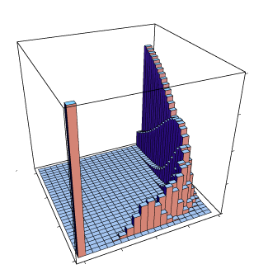
Need for Integration with Black Box Bin-packing
Metaheuristic
Algs.
Problem
Modeling
Need
Improvement
Bin-Packing
Seeding
Evaluation
Relatively Sparse Valid Solution Population
X
Invalid Solutions Dominate Space
Most of the solution space represents invalid solutions
The evolutionary & swarm intelligence algorithms degenerate into random searches with poor results!
Need to integrate heuristic information from black box bin-packing to improve search

Slide 65
Black Box Bin-packing Seeding for PSO
Metaheuristic
Algs.
Problem
Modeling
Need
Improvement
Bin-Packing
Seeding
Evaluation
By using black box bin-packing to start most of the particles on valid solution points, we can help focus the search to valid points

Slide 66
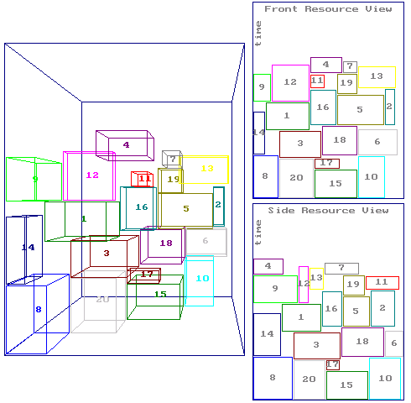
Random Deployment Plan Generation
We used our black box bin-packing algorithm with randomization to generate the initial particle positions
Bin-packer is forced to deploy a random subset of the components first
Bin-packer is forced to use a random ordering for those components
Remaining components are deployed normally with the bin-packer
A Particle Represents
A Deployment Topology
Metaheuristic
Algs.
Problem
Modeling
Need
Improvement
Bin-Packing
Seeding
Evaluation
Particle Seeding
Semi-Randomized
Bin-Packing
Particle Swarm

Slide 67
Power Optimization Comparisons with Hybrid Algorithm
Metaheuristic
Algs.
Problem
Modeling
Need
Improvement
Bin-Packing
Seeding
Evaluation
Avionics Deployment Optimization w/ Varying Processor & Network Comm. Power Consumption Rates
Empirical data showed ~45% improvement over bin-packing
Publications:
Jules White, Brian Dougherty, Chris Thompson, Douglas C. Schmidt, ScatterD: Spatial Deployment Optimization with Hybrid Heuristic / Evolutionary Algorithms, ACM Transactions on Autonomous & Adaptive Systems Special Issue on Spatial Computing, 2010 (to appear)

Slide 68
CPS Deployment Optimization: Challenge Roadmap
Challenges:
Multiple constraint types - no single algorithm is applicable
Modeling deployment for metaheuristic optimization
Metaheuristic evolution inefficiency
Goal
Challenge 1: Multiple
Constraints
Challenge 2: Modeling
for Metaheuristic Algs.
Challenge 3:
Metaheuristic Evolution
Evolution
Inefficiency
Solution Approach:
Guardrail
Integrating Black
Box Bin-Packing
Evaluation
Challenge
Problem Results
Notes:
Phrase this all in the context of the LMCO challenge problem
…but is not point solution

Slide 69
Challenge 3: Design Evolution Inefficiency
Evolution
Inefficiency
Guardrail
Bin-Packing
Integration
Evaluation
Challenge
Results
In the process of flying towards a more optimal solution, a particle may fly out of the valid solution space

Slide 70
Challenge 3 Approach: Add “Guardrail” to Solution Space
Evolution
Inefficiency
Guardrail
Bin-Packing
Integration
Evaluation
Challenge
Results
Our next approach was to try & add a “guardrail” to do a better job of restricting the search to valid solutions
We want to integrate black box bin-packing to create the railing

Slide 71
Guardrail: Hybrid Solution Space Representation
Evolution
Inefficiency
Guardrail
Bin-Packing
Integration
Evaluation
Challenge
Results
Changed vectors to represent bin-packing orderings
Example pack C3, C1, & then C2
3, 1, 2
Bin-Packer
Node 1
Node 2
Deployment Topology

Slide 72
Avionics Challenge Problem Power Optimization
Evolution
Inefficiency
Guardrail
Bin-Packing
Integration
Evaluation
Challenge
Results
Avionics Deployment Optimization w/ Varying Processor & Network Comm. Power Consumption Rates
~69% improve-ment over just bin-packing seeding
Publications:
Jules White, Brian Dougherty, Chris Thompson, Douglas C. Schmidt, ScatterD: Spatial Deployment Optimization with Hybrid Heuristic / Evolutionary Algorithms, ACM Transactions on Autonomous & Adaptive Systems Special Issue on Spatial Computing, (to appear)

Slide 73
Results on Avionics Communication Optimization Challenge
Evolution
Inefficiency
Guardrail
Bin-Packing
Integration
Evaluation
Challenge
Results
Baseline
Deployment
Optimized
Deployment
Is it possible to reduce # of required processors?
41 Processors
35 Processors
~15% Improvement
Is it possible to reduce network bandwidth?
Is it possible to derive the solution faster?

Slide 74
Results on Avionics Communication Optimization Challenge
Evolution
Inefficiency
Guardrail
Bin-Packing
Integration
Evaluation
Challenge
Results
Baseline
Deployment
Optimized
Deployment
Is it possible to reduce # of required processors?
41 Processors
35 Processors
~15% Improvement
Is it possible to reduce network bandwidth?
57.9 X 10^7
44.0 X 10^7
~25% Improvement
Is it possible to derive the solution faster?

Slide 75
Results on Avionics Communication Optimization Challenge
Evolution
Inefficiency
Guardrail
Bin-Packing
Integration
Evaluation
Challenge
Results
Baseline
Deployment
Optimized
Deployment
Is it possible to reduce # of required processors?
41 Processors
35 Processors
~15% Improvement
Is it possible to reduce network bandwidth?
57.9 X 10^7
44.0 X 10^7
~25% Improvement
Is it possible to derive the solution faster?
Average of 9 seconds (Laptop)
Weeks or Months

Slide 76
Results on Extended Communication Optimization Challenge
Evolution
Inefficiency
Guardrail
Bin-Packing
Integration
Evaluation
Challenge
Results
Baseline
Deployment
Optimized
Deployment
Is it possible to reduce # of required processors?
46 Processors
28 Processors
~40% Improvement
Is it possible to reduce network bandwidth?
Is it possible to derive the solution faster?

Slide 77
Results on Extended Communication Optimization Challenge
Evolution
Inefficiency
Guardrail
Bin-Packing
Integration
Evaluation
Challenge
Results
Baseline
Deployment
Optimized
Deployment
Is it possible to reduce # of required processors?
46 Processors
28 Processors
~40% Improvement
Is it possible to reduce network bandwidth?
57.9 X 10^7
38.2 X 10^7
~33% Improvement
Is it possible to derive the solution faster?

Slide 78
Results on Extended Communication Optimization Challenge
Evolution
Inefficiency
Guardrail
Bin-Packing
Integration
Evaluation
Challenge
Results
Baseline
Deployment
Optimized
Deployment
Is it possible to reduce # of required processors?
46 Processors
28 Processors
~40% Improvement
Is it possible to reduce network bandwidth?
57.9 X 10^7
38.2 X 10^7
~33% Improvement
Is it possible to derive the solution faster?
Average of 30 seconds (Laptop)
Weeks or Months
Upcoming joint DACS webinar with LMCO Aero on Challenge Problem Success Story

Slide 79
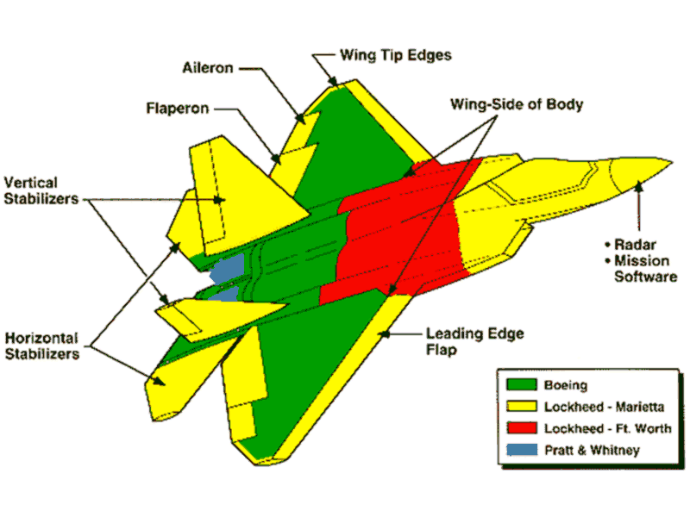
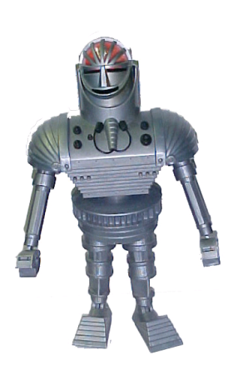
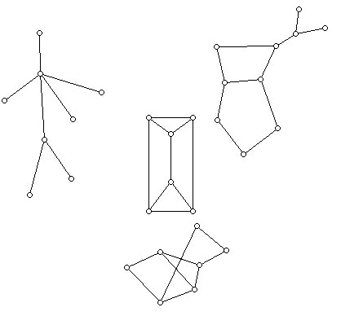
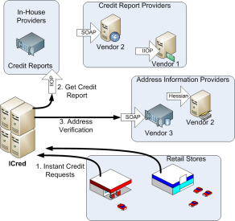
Evolutionary Deployment Automation
Results:
Developers can rapidly generate highly optimized deployment configurations
Integrated algorithmic technique is flexible
The intelligent techniques improved the manually created design of a large-scale avionics system
Improved deployment design reduces:
Hardware cost
Power consumption
Fuel consumption
Network load
Integrated algorithmic approach can improve manually produced deployments & generate new ones

Slide 80
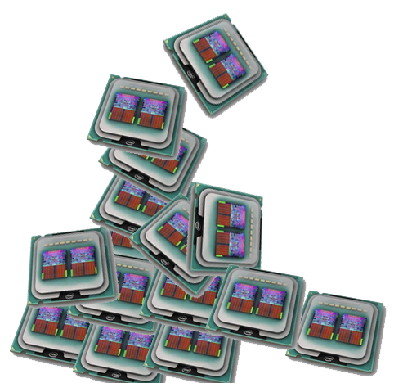
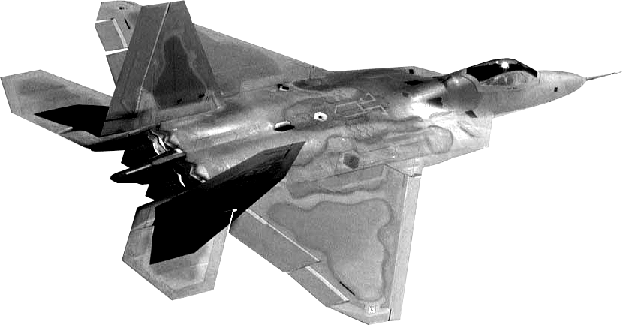
Deployment Ongoing & Future Work
80 Embedded Processors
Multicore Processors
The hard deployment problems now, may become the standard in a few years
Now
5 years
To make chips more power efficient, multicore designs are being used
Follow on work with AFRL & LMCO for extending deployment optimization techniques to leverage cache effects
Adaptation of deployment algorithms to manage resource allocation in cloud computing environments in collaboration with VMWare & Savvis

Slide 81
Ongoing & Future Work on Mobile CPS Applications
Part 3: Ongoing & future research building CPS Applications using
using mobile internet devices & supporting internet services
CPS Research Overview
CPS Deployment Optimization
Mobile CPS Applications
Concluding Remarks
Notes:
Work started for phd vs. work in last 6mos

Slide 82
Mobile CPS Applications: Goal
Goal: Help designers to leverage the increased computational power, sensor capabilities, & networking abilities of mobile Internet devices
Impact: Reduced cost, wider distribution, & more ubiquitous use of CPS applications
Challenges & Initial Research Solutions
Goal
Challenges
Mobile CPS
Overview
Vanderbilt
Mobile CPS

Slide 83
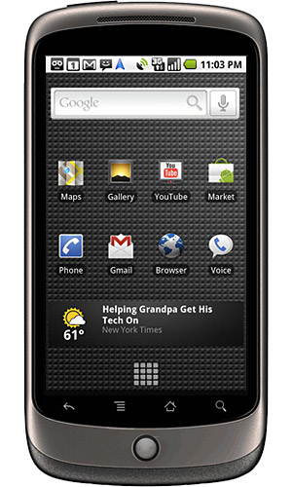
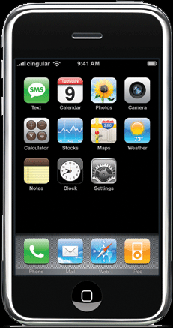
Mobile CPS Applications
Overview
Accident
Detection
Augmented
Reality
Patient Monitoring
Vanderbilt
Apps
The latest mobile Internet devices (e.g. iPhone, iPad, Android), possess the sensors, processing capabilities, & networking abilities to serve as platforms for mobile CPS applications
Example Benefits:
Reduced software implementation complexity
Ubiquitous hardware
Maintenance by hardware owner
Travels with owner
Unified software distribution stores
Standard TCP/IP networking over cellular & WiFi connections
Access to non-traditional CPS information, like social media
Ability to aggregate data from external sensors
Notes:
Combine challenges/apps to motivate where the challenges are coming from

Slide 84
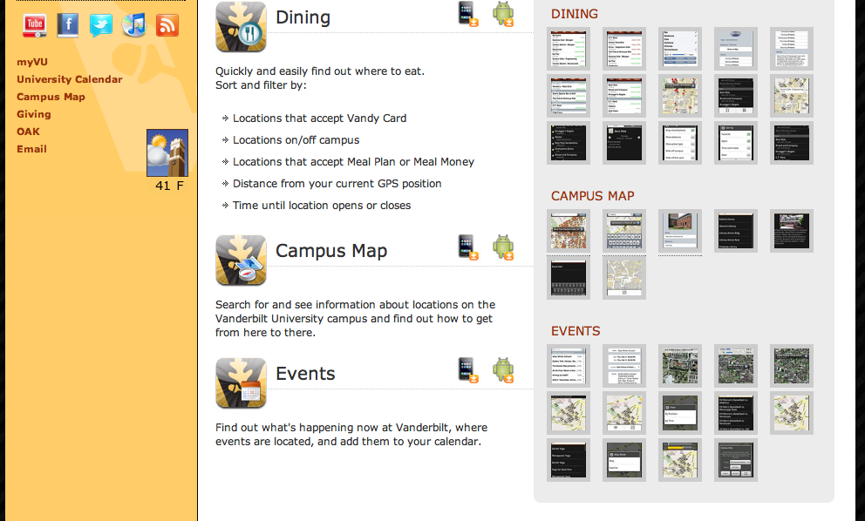
Undergraduate CPS Research & Development
Overview
Accident
Detection
Augmented
Reality
Patient Monitoring
Vanderbilt
Apps
Much of the mobile CPS research has been done with undergraduates.
Funded by EECS department to revamp networking course to focus on smartphones
Doubled enrollment
Featured in Inside Higher Ed., Tech News World, Nashville Business Journal, Vanderbilt View, Vanderbilt Hustler
Helped found & mentor the Vanderbilt Mobile Application Team (VMAT)
vanderbilt.edu/apps
Four undergraduate research publications since the summer
Notes:
The work before was with grad students
This particular project is with undergrads

Slide 85
Mobile CPS Applications: Challenge Roadmap
Challenges:
Modeling, analysis, & optimization of ultra large-scale mobile CPSs
Real-time processing & aggregation of massive & highly variable sensor data streams
Cross-platform modeling, analysis, & optimization of CPS application software
Goal
Challenges & Initial Research Solutions
Large-scale
Modeling/Opt.
Real-time
Sensor Data Proc.
Multi-platform
Software Opt.

Slide 86
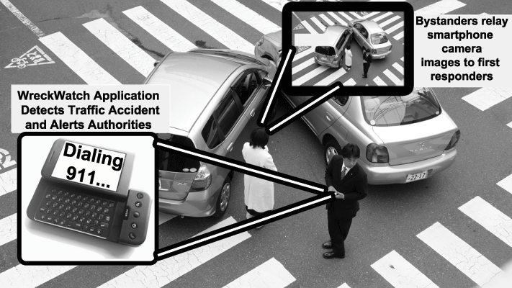
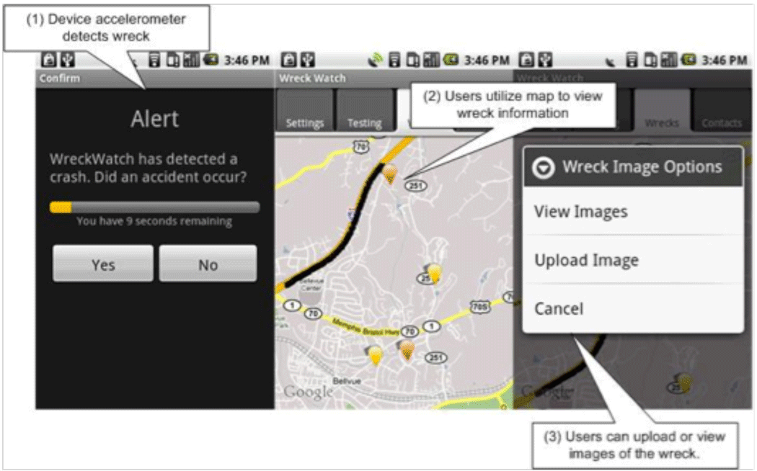
Modeling & Analysis of Ultra-large Scale CPSs
Overview
Accident
Detection
Augmented
Reality
Patient Monitoring
Vanderbilt
Apps
How do you model, analyze, & optimize large-scale mobile CPS systems?
Capture & reason about hundreds of thousands of mobile CPS app instances
Optimize sensor usage decisions from a global perspective for coverage
Ensure safe interactions with physical world
Built WreckWatch, a system for detecting traffic accidents & providing situational awareness to first-responders as a test platform
Publications:
Chris Thompson, Jules White, Brian Dougherty, Adam Albright, & Douglas C. Schmidt, Using Smartphones & Wireless Mobile Networks to Detect Car Accidents & Provide Situational Awareness to Emergency Responders, submitted to the Third International ICST Conference on MOBILe Wireless MiddleWARE, Operating Systems, & Applications (Mobilware 2010), June 30-July 2, 2010, Chicago, IL. (submitted)
Hamilton Turner, Jules White, Chris Thompson, Krzysztof Zienkiewicz, Scott Campbell, Douglas C. Schmidt, Building Mobile Sensor Networks Using Smartphones & Web Services: Ramifications & Development Challenges, Handbook of Research on Mobility & Computing: Evolving Technologies & Ubiquitous Impacts, edited by Maria Manuela Cruz-Cunha & Fernando Moreira, IGI Global, Hershey, PA, USA 2009 (Accepted Proposal)
Notes:
Challenge/solution flavor

Slide 87
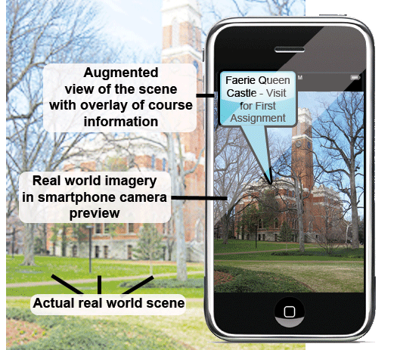
Real-time Processing of Massive Sensor Data Streams
Overview
Accident
Detection
Augmented
Reality
Patient Monitoring
Vanderbilt
Apps
How do you build server-side systems to provide data aggregation & processing for hundreds of thousands of mobile CPS apps?
Must ensure QoS over a range of loads
Must remain power efficient in the face of bursty workloads
Intelligent partitioning of workload across devices & servers
Built Augmented Reality platform using smartphones to fuse virtual & real-world imagery in smartphone camera preview
Publications:
J. Benjamin Gotow, Krzysztof Zienkiewicz, Jules White, & Douglas C. Schmidt, Addressing Challenges in Delivering Augmented Reality Applications to Smartphones, submitted to the Third International ICST Conference on MOBILe Wireless MiddleWARE, Operating Systems, & Applications (Mobilware 2010), June 30-July 2, 2010, Chicago, IL. (submitted)
Collaboration with the English & Visual Art Departments at Vanderbilt
Notes:
Add collaboration with Jay/Humanities

Slide 88
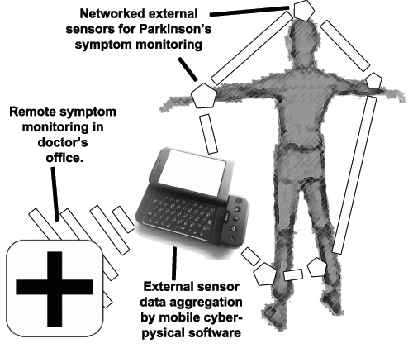
Multi-platform Software Optimization
Overview
Accident
Detection
Augmented
Reality
Patient Monitoring
Vanderbilt
Apps
How do you optimize mobile CPS performance & battery usage across multiple platforms
Major variations in hardware/software
Need to optimize wireless communication application protocols & patterns
Balance & optimize sensor data usage against needed accuracy
Global optimization of mobile CPS apps to improve overall system coverage
Building body area network platform using smartphones for remote patient symptom monitoring
Publications:
Jules White, Sibohan Clarke, Brian Dougherty, Chris Thompson, Douglas C. Schmidt, R&D Challenges & Solutions for Mobile Cyber-Physical Applications & Supporting Internet Services, Springer Journal of Internet Services & Applications (to appear)
Collaboration with Vanderbilt Medical Center
Notes:
Add collaboration with med center

Slide 89
Open Deployment & Configuration Problems in CPS
Part 4: Concluding remarks
CPS Research Overview
CPS Deployment Optimization
Mobile CPS Applications
Concluding Remarks

Slide 90
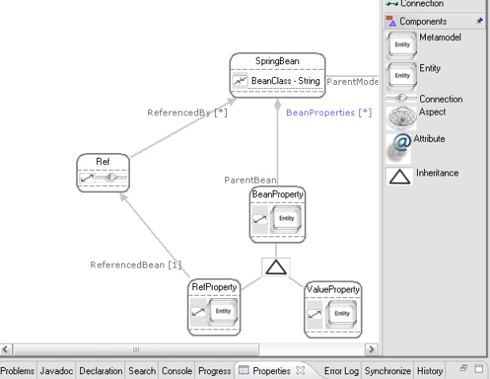
Concluding Remarks
Intelligent modeling & optimization techniques can help designers find solutions to complex CPS design problems
Many of these real-world design problems require new theoretical & tooling advances to work at scale & with CPS constraint types
Scale is major challenge in current & future systems, but automation can help significantly
Good tooling is critical for transitioning the theoretical advances to CPS system designers & teaching the techniques to students
CPS
Automation /
Algorithms
Modeling
Notes:
Move urls to GEMS page
Move bullets to left & add pictures

Slide 91
Summary of Journal Publications
Jules White, Brian Dougherty, Chris Thompson, Douglas C. Schmidt, ScatterD: Spatial Deployment Optimization with Hybrid Heuristic / Evolutionary Algorithms, ACM Transactions on Autonomous & Adaptive Systems Special Issue on Spatial Computing, 2010 (to appear)
Jules White, Brian Doughtery, Douglas C. Schmidt, ASCENT: An Algorithmic Technique for Designing Hardware & Software in Tandem, IEEE Transactions on Software Engineering Special Issue on Search-based Software Engineering, 2010 (to appear)
Jules White, Sibohan Clarke, Brian Dougherty, Chris Thompson, Douglas C. Schmidt, R&D Challenges & Solutions for Mobile Cyber-Physical Applications & Supporting Internet Services, Springer Journal of Internet Services & Applications, 2010 (to appear)
Jules White, David Benavides, Douglas C. Schmidt, Pablo Trinidad, Antonio Ruiz-Cortes, Brian Doughtery, Automated Diagnosis of Feature Model Configurations, Journal of Systems & Software, 2010 (to appear)
Jules White, James Hill, Jeff Gray, Sumant Tambe, Douglas C. Schmidt, Anirrudha Gokhale, Improving Domain-specific Language Reuse through Software Product-line Configuration Techniques, IEEE Software Special Issue on Domain-Specific Languages & Modeling July/August, 2009, Volume 26, Number 4, pgs. 47-53
Jules White, Brian Doughtery, Douglas C. Schmidt, Selecting Highly Optimal Architectural Feature Sets with Filtered Cartesian Flattening, Journal of Systems & Software, August 2009, Volume 82, Number 8, Pages 1268-1284
Jules White, Jeff Gray, Douglas C. Schmidt, Constraint-based Model Weaving, Springer Transactions on Aspect-Oriented Programming Special Issue on Aspects & Model-Driven Engineering, 2009, Volume 5560, Number 6, Pages 153-190
Jules White, Douglas C. Schmidt, Automating Deployment Planning with an Aspect Weaver, IET Software Special Issue on Domain-specific Modeling Languages for Aspect-Oriented Programming, Volume 3, Issue 3 , p. 167-183, June 2009
Jules White, Harrison Strowd, Douglas C. Schmidt, Creating Self-healing Service Compositions with Feature Models & Microrebooting, International Journal of Business Process Integration & Management, Special issue on Model-Driven Service-Oriented Architectures, Inderscience Publishers, pages 35-46, Volume 4, Number 1, 2009
Jules White, Douglas C. Schmidt, Andrey Nechypurenko, Egon Wuchner, Model Intelligence: an Approach to Modeling Guidance, UPGRADE Journal, Volume 9, Number 2, pgs. 22-28, April 2008
*(Spanish Translation of #6) Jules White, Douglas C. Schmidt, Andrey Nechypurenko, Egon Wuchner, Inteligencia de modelos: un enfoque para guiar el modelado, Novatica, Number 192, pgs. 21-27, April 2008, (one of five Finalists for the Novatica "Best Paper of the Year" Award), 2008
Jules White, Douglas C. Schmidt, Egon Wuchner, Andrey Nechypurenko, Automatically Composing Reusable Software Components for Mobile Devices, Journal of the Brazilian Computer Society Special Issue on Software Reuse, SciELO Brasil, Volume 14, Number 1, pgs. 25-44, March, 2008
Jules White, Douglas Schmidt, Aniruddha Gokhale, Simplifying Autonomic Enterprise Java Bean Applications via Model-driven Engineering & Simulation, Journal of Software & Systems Modeling, Springer, Volume 7, Number 1, pgs. 3-23, May, 2007 (9th most cited & 11th most downloaded Software & Systems Modeling paper as of Oct. 2009)
Notes:
Two columns

Slide 92
Summary of Conference Publications
Yu Sun, Jules White, Jeff Gray, Model Transformation by Demonstration, Proceedings of MODELS 2009, ACM/IEEE 8th International Conference on Model Driven Engineering Languages & Systems, October 4-9, 2009, Denver, Colorado (16% Acceptance Rate)
Jules White, David Benavides, Brian Dougherty, Douglas C. Schmidt, Automated Reasoning for Multi-step Software Product-line Configuration Problems, Software Product-lines Conference (SPLC), 10pgs. August 24-28, 2009, San Francisco, CA (30% Acceptance Rate)
Jules White, Douglas C. Schmidt, David Benavides, Pablo Trinidad, Antonio Ruiz-Cortez, Automated Diagnosis of Product-line Configuration Errors in Feature Models, Software Product Lines Conference (SPLC), 10pgs., September, 2008, Limmerick, Ireland (30% Acceptance Rate), ***Received the Best Paper Award***
Brian Dougherty, Jules White, Jaiganesh Balasubramanian, Chris Thompson, & Douglas C. Schmidt, Deployment Automation with BLITZ, 31st International Conference on Software Engineering, May 16-24, 2009 Vancouver, Canada
Brian Dougherty, Jules White, Chris Thompson, & Douglas C. Schmidt, Automating Hardware & Software Evolution Analysis, 16th Annual IEEE International Conference & Workshop on the Engineering of Computer Based Systems (ECBS), April 13-16, 2009 San Francisco, CA USA.
J. White & D. Schmidt, Model-Driven Product-Line Architectures for Mobile Devices, Proceedings of the 17th Conference of the International Federation of Automatic Control, Seoul, Korea, July 6-11, 2008.
J. White & D. Schmidt, Automated Configuration of Component-based Distributed Real-time & Embedded Systems from Feature Models, Proceedings of the 17th Conference of the International Federation of Automatic Control, Seoul, Korea, July 6-11, 2008.
J. White, D. Schmidt, E. Wuchner, A. Nechypurenko, Optimizing & Automating Product-Line Variant Selection for Mobile Devices, 11th Annual Software Product Line Conference (SPLC), Sept. 10-14, 2007, Kyoto, Japan
A. Nechypurenko, E. Wuchner, J. White, & D. Schmidt, Application of Aspect-based Modeling & Weaving for Complexity Reduction in the Development of Automotive Distributed Realtime Embedded Systems, Proceedings of the Sixth International Conference on Aspect-Oriented Software Development, Vancouver, British Columbia, March 12-16, 2007.
J. White & D. Schmidt, Reducing Enterprise Product Line Architecture Deployment Costs via Model-Driven Deployment & Configuration Testing, 13th Annual IEEE International Conference & Workshop on the Engineering of Computer Based Systems (ECBS '06), March 27th-30th, 2006, Potsdam, Germany.
J. White, D. Schmidt, & A. Gokahle, Simplifying Autonomic Enterprise Java Bean Applications via Model-driven Development: a Case Study, Proceedings of MODELS 2005, ACM/IEEE 8th International Conference on Model Driven Engineering Languages & Systems, Half Moon Resort, Montego Bay, Jamaica, October 5-7, 2005. (Selected as a best paper)
J. White, D. Schmidt, & A. Gokahle, The J3 Process for Building Autonomic Enterprise Java Bean Systems, Proceedings of the International Conference on Autonomic Computing (ICAC 2005), Seattle, WA, June 2005 (short paper).
Jules White, Boris Kolpackov, Balachandran Natarajan, & Douglas C. Schmidt, Reducing Code Complexity With Vocabulary-Specific XML Language Bindings,Proceedings of the 43nd ACM Southeastern Conference, 7pgs., Atlanta, GA, March 2005.
J. White, K. Czarnecki, D. Schmidt, G. Lenz, C. Wienands, E. Wuchner, & Ludger Fiege, Automated Model-based Configuration of Enterprise Java Applications, EDOC 2007, October, 2007, Annapolis, Maryland
Conference “Best Paper” Award
Jules White, Douglas C. Schmidt, David Benavides, Pablo Trinidad, Antonio Ruiz-Cortez, Automated Diagnosis of Product-line Configuration Errors in Feature Models, Software Product Lines Conference, Sept, 2008, Limmerick, IR

Slide 93
Summary of Other Publications
Book Chapters
J. White, A. Nechypurenko, E. Wuchner, & D. Schmidt, Reducing the Complexity of Designing & Optimizing Large-scale Systems by Integrating Constraint Solvers with Graphical Modeling Tools, Designing Software-Intensive Systems: Methods & Principles, edited by Dr. Pierre F. Tiako, Langston University, Oklahoma, USA, 2010 (to appear)
Jules White, Douglas C. Schmidt, Andrey Nechypurenko, & Egon Wuchner, Reducing the Complexity of Modeling Large Software Systems, Software Applications: Concepts, Methodologies, Tools, & Applications, edited by Pierre F. Tiako, IGI Global, Hershey, PA, USA, 2009 (originally published in Designing Software-Intensive Systems: Methods & Principles)
Jules White, Brian Doughtery, Harrison Strowd, & Douglas C. Schmidt, Using Filtered Cartesian Flattening & Microrebooting to Build Enterprise Applications with Self-adaptive Healing, Software Engineering for Self-Adaptive Systems, edited by Betty H. C. Cheng, Rogerio de Lemos, Holger Giese, Paola Inverardi, & Jeff Magee, 2010 (to appear)
Workshop Publications (cont.)
J. White, D. Schmidt, Sean Mulligan, The Generic Eclipse Modeling System, Model-Driven Development Tool Implementer's Forum, TOOLS '07, June, 2007, Zurich Switzerland
A. Nechypurenko, J. White, E. Wuchner, & D. Schmidt, Applying Model Intelligence Frameworks for Deployment Problem in Real-time & Embedded Systems, Proceedings of MARTES: Modeling & Analysis of Real-Time & Embedded Systems to be held on October 2, 2006 in Genova, Italy in conjunction with the 9th International Conference on Model Driven Engineering Languages & Systems, MoDELS/UML 2006.
J. White, A. Nechypurenko, E. Wuchner, & D. Schmidt, Intelligence Frameworks for Assisting Modelers in Combinatorically Challenging Domains, Proceedings of the Workshop on Generative Programming & Component Engineering for QoS Provisioning in Distributed Systems, October 23, 2006, Portland, Oregon.
J. White & D. Schmidt, Simplifying the Development of Product-line Customization Tools via Model Driven Development, MODELS 2005 workshop on MDD for Software Product-lines: Fact or Fiction?, October 2, 2005, Jamaica.
Workshop Publications
Chris Thompson, Jules White, Brian Dougherty, & Douglas C. Schmidt, Optimizing Mobile Application Performance with Model-Driven Engineering, Proceedings of the 7th IFIP Workshop on Software Technologies for Future Embedded & Ubiquitous Systems (SEUS 2009), November 16-18, 2009, Newport Beach, California.
Jules White, Douglas C. Schmidt, Filtered Cartesian Flattening: An Approximation Technique for Optimally Selecting Features while Adhering to Resource Constraints, First International Workshop on Analyses of Software Product Lines at the 12th International Software Product Line Conference, Limerick, Ireland, September 12, 2008
James Hill, Jules White, Sean Eade, & Douglas C. Schmidt, Towards a Solution for Synchronizing Disparate Models of Ultra-Large-Scale Systems, Proceedings of the 2nd International Workshop on Ultra-Large-Scale Software-Intensive Systems at the 30th IEEE/ACM International Conference on Software Engineering, May 10-11, 2008, Leipzig, Germany.

Slide 94
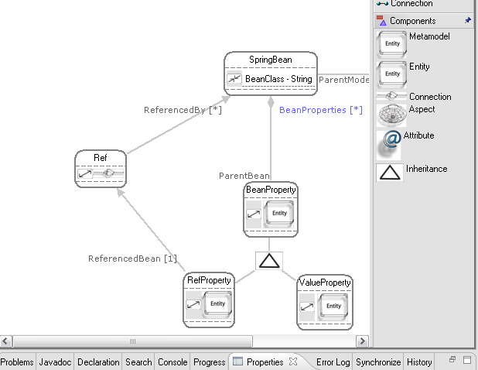
Other Impact
Generic Eclipse Modeling System (GEMS)
The Generic Eclipse Modeling System (GEMS) has been incorporated into the Eclipse Foundation & is distributed by over 45 mirrors in North America, Europe, Asia, & South America
Articles on GEMS have been written in both English & German & published in key trade publications, such as Eclipse magazine & OBJEKT Spektrum
I have also presented tutorials on GEMS at OOPSLA, ICSE, OOP, & MODELS
Teaching as Research Grant
Received a Vanderbilt “Teaching as Research” grant to introduce my research on modeling topics to undergraduates
GEMS is available through the Eclipse Foundation at:
www.eclipse.org/gmt/gems
Optimization algorithms available from:
code.google.com/p/ascent-design-studio
Notes:
Gems url
Many tools build on gems

Slide 95
CPS QoS Spans System Layers & Design Disciplines
Because a CPS is often large scale & involves achieving desired QoS across hardware & software, design decisions:
Often conflict (e.g. processing power vs. hardware)
Span hardware/software & multiple disciplines (e.g. physical safety, software design)
Produce complex interactions across design dimensions that are hard to manage & optimize
Software developer uses slower algorithm for higher accuracy for safety but assumes faster processor
Safety
Constraints
Real-time Scheduling
Constraints
Real-time scheduling deadline missed
Slower processor used to improve power efficiency & reduce cost
Cost
Constraints
Power
Constraints
Design changed to use smaller power supply for weight reduction
Flexible techniques are needed to aid designers manage CPS QoS across a range of design decisions in multiple layers & disciplines

Slide 96
Model/Algorithm Integration Needed
Flight Avionics
Medical Imaging
Systems
Fractionated
Spacecraft
QoS requirements vary across CPS systems
Many algorithms/models exist that work under closed sets of assumptions
Need to use multiple models/algorithms
Hard to integrate models/techniques to handle QoS requirements that span layers
Integration techniques are needed for marrying design techniques together to deal with varying CPS QoS & optimization requirements

Slide 97
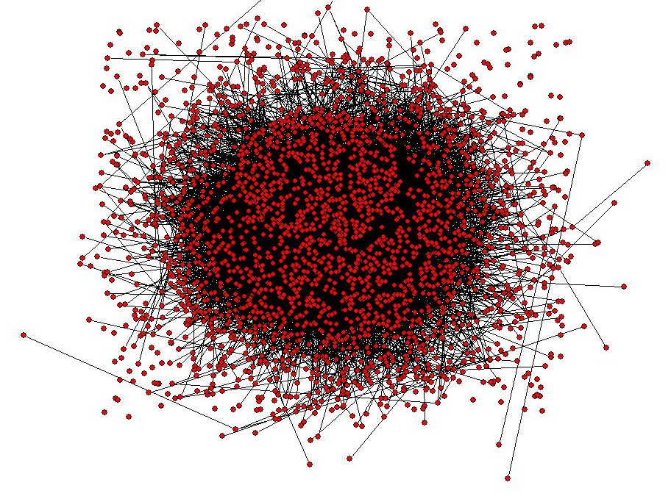
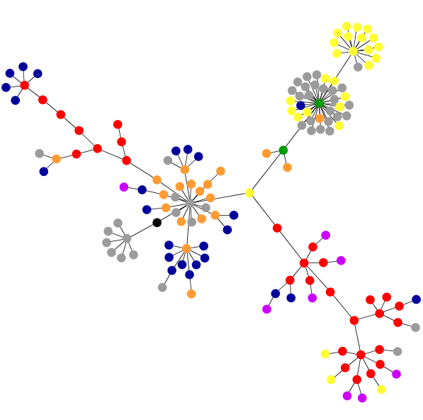
Software/Hardware Design Productivity Gap
Complexity Current CPS Tools Can Handle
Emerging CPS Complexity
The 1999 International Technology Roadmap for Semiconductors estimated that design complexity is increasing at 58% per year, while designer productivity is trailing at 21%
The difference between these is the design productivity gap
Something similar is happening in software
e.g., BMW estimates that software development now accounts for 20-28% of the cost of a car
We need scalable design tools & techniques to close this gap
We need tools that can do smart analysis & optimization for designers

