Slide 1




MDE4DRE: Model Driven Engineering for
Distributed Real-time & Embedded Systems
Dr. Aniruddha S. Gokhale
a.gokhale@vanderbilt.edu
Assistant Professor, EECS
Vanderbilt University
Nashville, TN, USA
Dr. James H. Hill
hillj@cs.iupui.edu
Assistant Professor, CSCI
Indiana Univ/Purdue Univ at Indianapolis
Indianapolis, IN, USA
Presented at IEEE/ACM MODELS 2009
Denver, CO
October 6, 2009
Sponsors: DARPA PCES, DARPA ARMS, NSF CSR-SMA, Raytheon, LMCO, Siemens, BBN, Telcordia

Slide 2
Tutorial Outline
Introduction
DRE Use Cases
DRE System Lifecycle Challenges
Modeling Basics
Assembly & Packaging
QoS Modeling and Analysis
Deployment Planning
Middleware Configuration
Continuous QoS Validation
Middleware Customization
Future directions/Work-in-progress
Concluding Remarks
Images in several figures in this tutorial were downloaded from the web

Slide 3
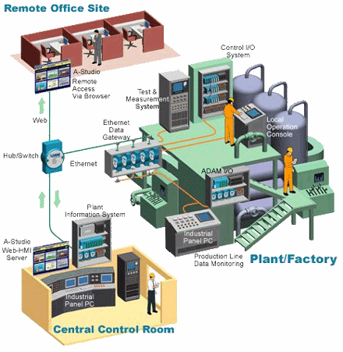
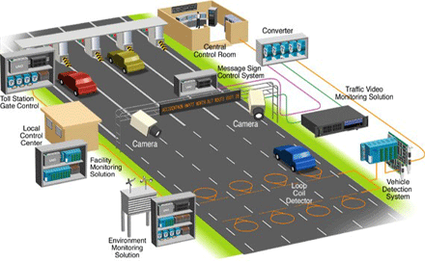
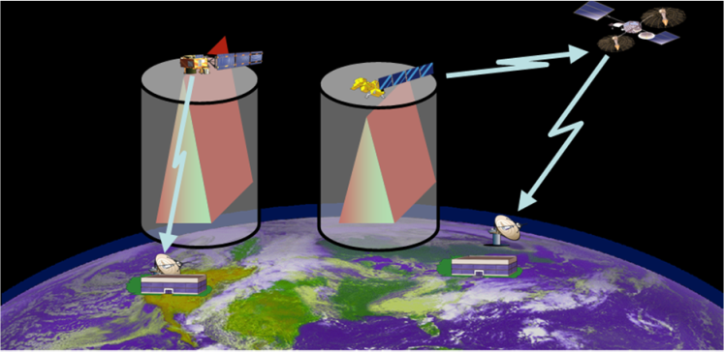
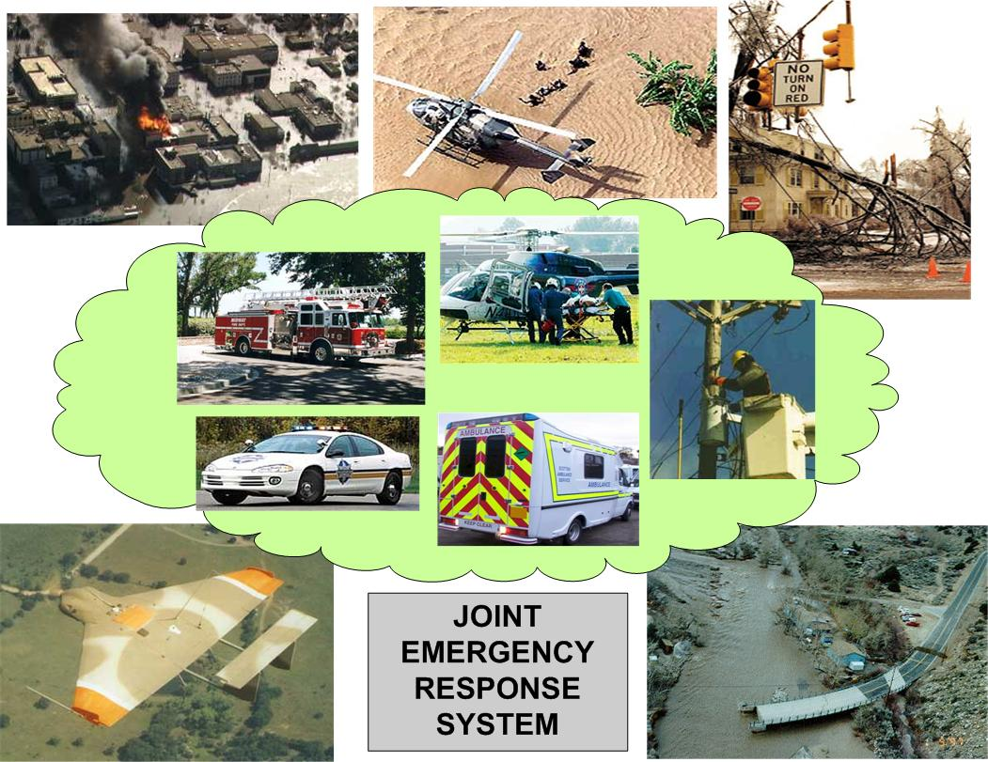
Distributed Real-time & Embedded (DRE) Systems
Network-centric and large-scale “systems of systems”
  e.g., industrial automation, emergency response
Different communication semantics
  e.g., pub-sub
Satisfying tradeoffs between multiple (often conflicting) QoS demands
  e.g., secure, real-time, reliable, etc.
Regulating & adapting to (dis)continuous changes in runtime environments
  e.g., online prognostics, dependable upgrades, keep mission critical tasks operational, dynamic resource mgmt
DRE systems increasingly adopting service oriented architectures
Notes:
Jai, here are my comments on this slide:
Please redraw the example application to focus on something from the context of ARMS than a general-purpose enterprise system. The reasons for this are that (1) Ken Birman works in the space of general-purpose enterprise systems & he’s got a LOT more experience/clout in the area of survivability than we do at this point so it’s pointless to try & go up against him head-to-head since he’s got ~5-10 big successes in this area over the past two decades & (2) we should focus on things that we really understand better than focus like Ken, i.e., namely enterprise DRE systems, such as ARMS. Please see
Please try to emphasize multi-dimensional QoS properties explicitly in the middle set of bullets in these slides. It’s implicit in what you say here, but please make it explicit since it ought to be a key focus to differentiate from the kinds of work that Ken does.

Slide 4
Part 1
Examples of DRE Systems
Bold Stroke
Robot Assembly
NASA Space Mission
Shipboard Computing
Modern Office
Stock Application

Slide 5
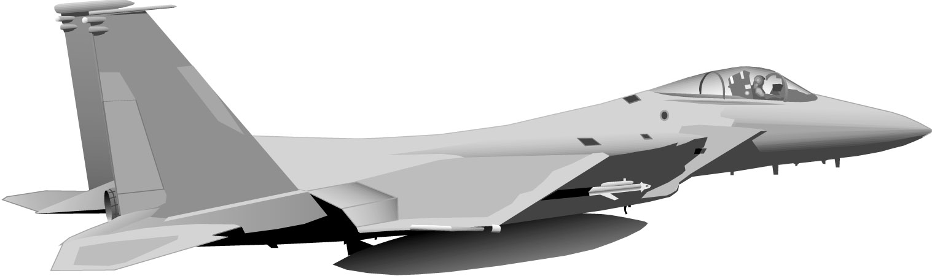

DRE System Example 1: Boeing Bold Stroke
Nav Sensors
Vehicle
Mgmt
Mission
Computer
Data Links
Expendable
Management
Radar
Expendables
Bold
Stroke Architecture
Mission Computing Services
Middleware Infrastructure
Operating System
Networking Interfaces
Hardware (CPU, Memory, I/O)
Avionics mission computing product-line architecture for Boeing aircraft, e.g., F-18 E/F, 15E, Harrier, UCAV
DRE system with 100+ developers, 3,000+ software components, 3-5 million lines of C++ code
Based on COTS hardware, networks, operating systems, & middleware
Used as Open Experimentation Platform (OEP) for DARPA IXO PCES, MoBIES, SEC, MICA programs

Slide 6
DRE System Example 1: Boeing Bold Stroke
Nav Sensors
Vehicle
Mgmt
Mission
Computer
Data Links
Expendable
Management
Radar
Expendables
Bold
Stroke Architecture
Mission Computing Services
Middleware Infrastructure
Operating System
Networking Interfaces
Hardware (CPU, Memory, I/O)

Slide 7

DRE System Example 2: Robot Assembly
Conveyor
Power Switching
Unit
Conveyor
Drive System
Management
Work
Instructions
Radio
Intrusion Alarm
Discretes
Pallet
Present
Switches
Human
Machine
Interface*
Watch
Setting
Manager*
Pallet
Conveyor
Manager
Pallet
Release
Switch
Off Enable
Off Enable
Fast
Assembly
Area
Intrusion
Robot
Manager*
Control Station
Robot in
Work
Area
Storage
Device
Controller
Disk Storage
Clock
Handler

Slide 8
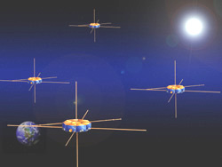
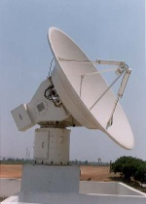
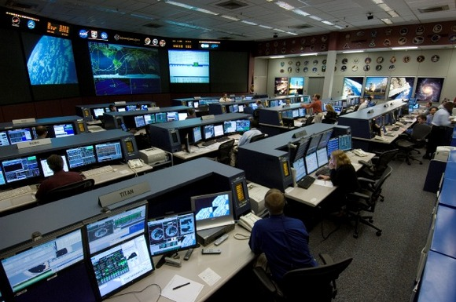
DRE System Example 3: NASA MMS Mission
NASA’s Magnetospheric MultiScale (MMS) space mission consists of four identically instrumented spacecraft & a ground control system
  Collect mission data
  Send it to ground control at appropriate time instances
Spacecraft 1
Bus Processor
(VxWorks Node)
MMS application components are bundled together into hierarchical assemblies
Assembly package metadata conveys component interconnections & implementation alternatives
Payload Processor
(Linux Node)
Sensor Suite
(Linux node)
Science
Agent
Gizmo
Agent
Algorithm
Comm
Agent
Sensor 1
Gizmo
Agent
Gizmo
Agent
Algorithm
GNC
Agent
Sensor 2
Gizmo
Agent
Sensor 3
Exec
Agent
Comm
Agent
Exec
Agent
Sensor 4
Ethernet (802.3)
Ethernet (802.3)
Notes:
11/17/2009
8

Slide 9
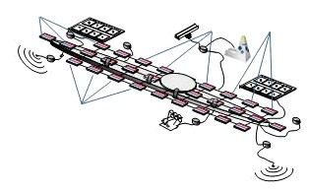
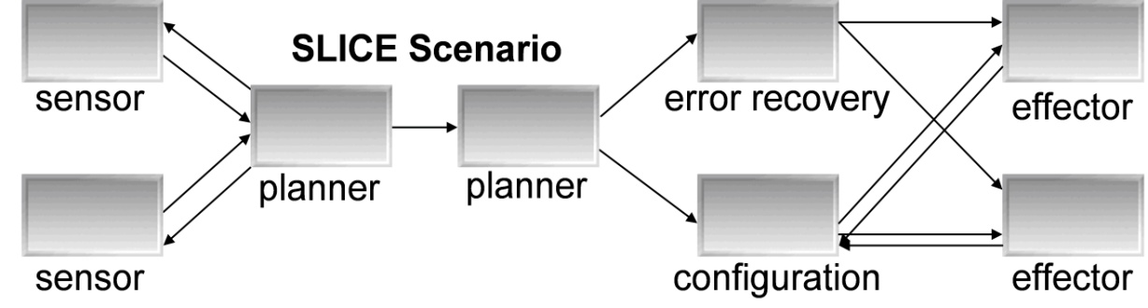
DRE System Example 4: Shipboard Computing
Use case drawn from DARPA ARMS program
Dynamic resource management for mission critical applications
Multiple application workflows replicated in multiple data centers
SLICE scenario depicts an application workflow

Slide 10
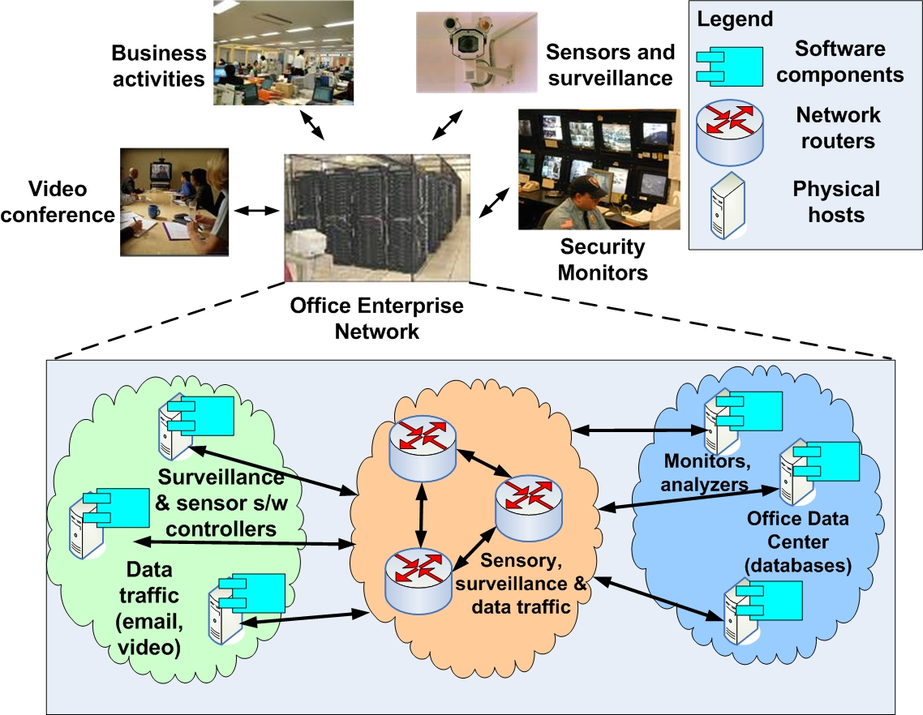
DRE System Example 5: Modern Office
Office traffic operates over IP networks & Fast Ethernets
Multiple application flows:
  Email
  Videoconferencing
  Sensory (e.g., fire alarms)
Differing network QoS requirements
  Fire alarm – highest priority
  Surveillance – multimedia
  Temperature sensing – best effort
QoS provisioned using DiffServ
Network QoS Provisioning Steps
Specify network QoS requirements for each application flow
Allocate network-level resources and DiffServ Code Points (DSCP) for every application flow joining two end points
Mark outgoing packet with the right DSCP values

Slide 11
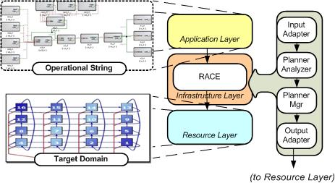



DRE System Example 6: RACE Baseline Scenario
The Resource Allocation & Control Engine (RACE) is an infrastructure-level component-based DRE system that manages application-level assemblies
RACE supports two types of application-level deployments
  Static – deployments created offline where components are pre-assigned to hosts
  Dynamic – deployments created online such that components are assigned at runtime
    e.g., based on operating conditions
Baseline Scenario Requirement - higher priority application-level assemblies must have longer lifetime than lower priority ones
  e.g., under low resource availability

Slide 12
Part 2
Design & Operationalization Challenges
Challenges in assuring functional and quality of service (QoS) properties of DRE systems across the lifecycle

Slide 13
Technology Enablers for DRE systems: Component Middleware
“Write Code That Reuses Code”
Components encapsulate application “business” logic
Components interact via ports
  Provided interfaces, e.g., facets
  Required connection points, e.g., receptacles
  Event sinks & sources
  Attributes
Containers provide execution environment for components with common operating requirements
Components/containers can also
  Communicate via a middleware bus and
  Reuse common middleware services
…
…
…
…
Container
Container
Middleware Bus
Replication
Security
Persistence
Notification
A/V Streaming
Scheduling
Load Balancing

Slide 14
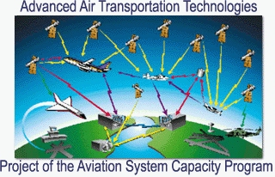
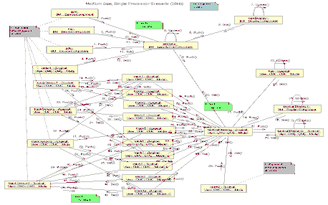
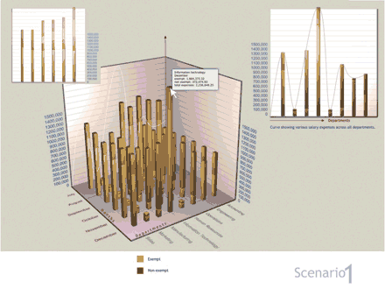
Overview of DRE Systems Development Lifecycle
…
…
composition & packaging
…
specification
deployment planning & QoS provisioning
configuration & optimization
analysis, validation & verification, testing

Slide 15
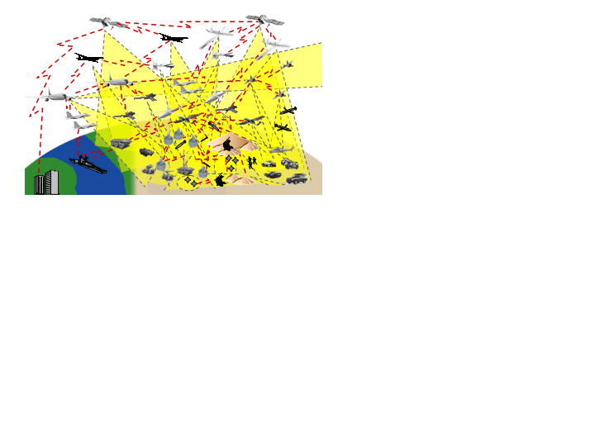
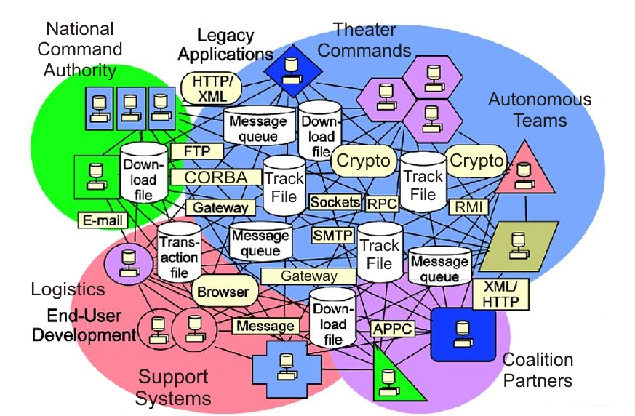
Challenges in Realizing DRE Systems
Variability in the problem space (domain expert role)
Functional diversity
Composition, deployment and configuration diversity
QoS requirements diversity
Variability in the solution space (systems integrator role)
Diversity in platforms, languages, protocols & tool environments
Enormous accidental & inherent complexities
Continuous evolution & change
Mapping problem artifacts to solution artifacts is hard

Slide 16
Challenges in DRE Lifecycle (1/6)
Understand the sources of variability in the problem/solution space
Find solutions to automate the mapping of the problem space to solution space
Per-component issues
  Problem space: Functionality often supplied as third party COTS solutions
  Solution space: Implementations for different platforms and languages
  P->S mapping challenges:
    Implementations must match platform and language choice
    Choice of implementation impacts end-to-end QoS

Slide 17
Challenges in DRE Lifecycle (2/6)
Models of computation issues
  Problem space: Choice of models of computation (Data Flow, Discrete Event, Publish-Subscribe, Reactive)
  Solution space: Diversity in implementation techniques and communication mechanisms e.g., RPC (CORBA IIOP, Java RMI), pub-sub(DDS, Event channels)
  P->S mapping challenges:
    Identifying the right mechanisms to support the model of computation
    Decoupling application logic from the mechanisms to avoid invasive code changes

Slide 18
Challenges in DRE Lifecycle (3/6)
Assembly concerns
  Problem space: Identifying the right services and composing them together
  Solution space: Identifying services with the right interfaces and semantics
  P->S mapping challenges:
    Ensure functional and systemic compatibility in composition
    Heterogeneity in platforms and languages in composition impacts functionality and QoS

Slide 19
Challenges in DRE Lifecycle (4/6)
Deployment issues
  Problem space: Identify resource needs, e.g., CPU, memory, bandwidth, storage
  Solution space: Diversity in resource types and their configurations
  P->S mapping challenges:
    How to select and provision resources such that end-to-end QoS is realized?
    How to (re)allocate resources to maintain end-to-end QoS?
    How to minimize procurement and operational costs

Slide 20
Challenges in DRE Lifecycle (5/6)
Configuration issues
  Problem space: Identify QoS requirements that are compatible with functionality
    What is the unit of failover? What is the replication degree? Are entire assemblies replicated?
    How to define access control rights?
    Determining system task partitioning, schedulability, priorities
    Defining network resource needs

Slide 21
Challenges in DRE Lifecycle (6/6)
Configuration issues (continued)
  Solution space: Platforms provide high degree of configuration flexibility for each requirement
  P->S mapping challenges:
    What configuration options control a specific dimension of QoS?
    How do different configuration options interact with each other?
    How to configure heterogeneous platforms?
    What impact deployment decisions have on configurations?

Slide 22
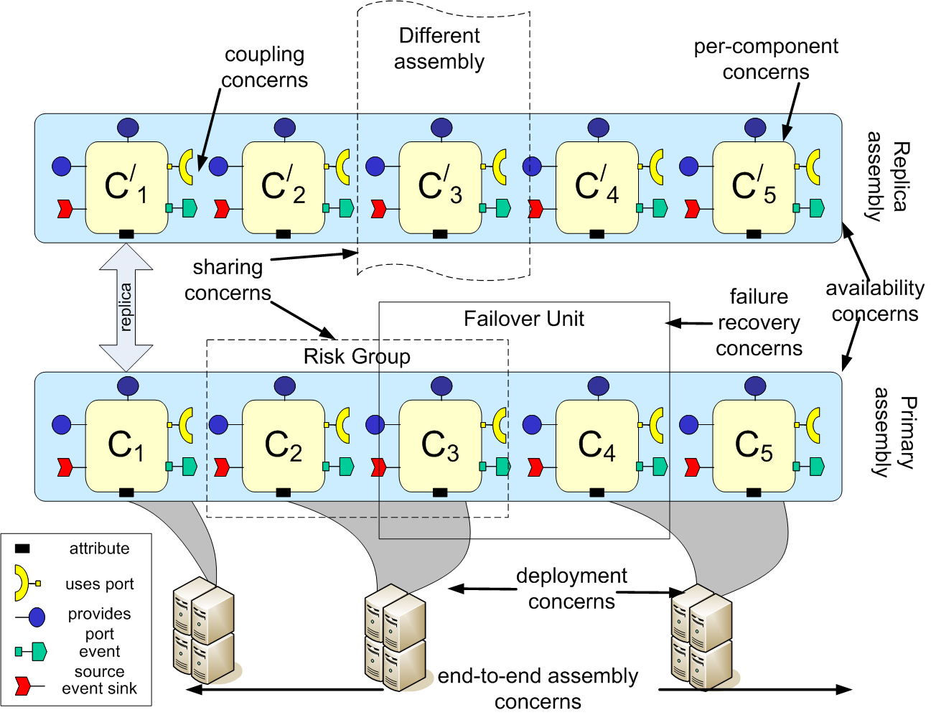
A Single Perspective: Tangling of Lifecycle Issues
Demonstrates numerous tangled lifecycle issues
Significant sources of variability that affect end-to-end QoS & functionality
Span the entire lifecycle
Lifecycle-wide separation of concerns (SoC) & variability management is the key
Ability to continuously validate the system
Design-time
Deployment-time
Run-time

Slide 23

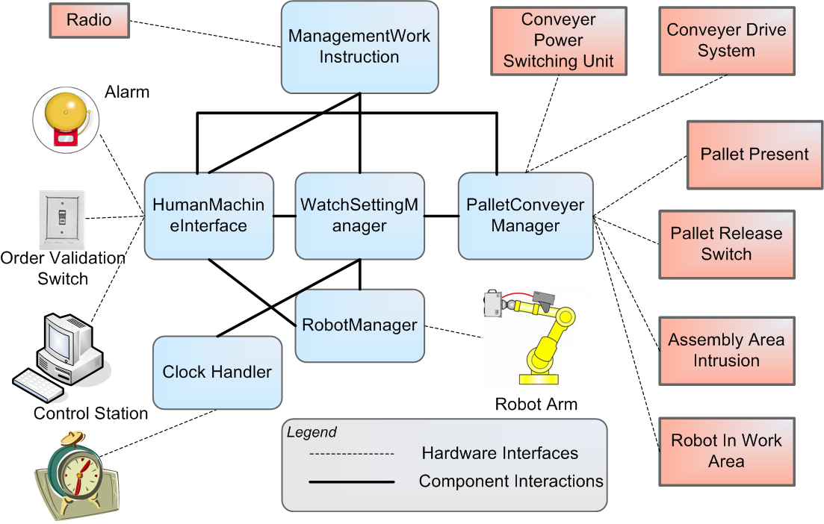
Requirements of a Solution Approach
Need expressive power to define QoS intent in the problem space, and perform design-time analysis
  Intuitive abstractions needed for separation of concerns
  Be able to weave these holistically
Need to decouple DRE system functionality from systemic capabilities in the solution space
  Maximize reuse and avoid invasive changes to business logic
Need to automate the mapping from problem to solution space
  Tooling needed to automate the (re)deployment and (re)configuration of system
Need to provide a hosting platform with dynamic adaptation capabilities
  Need algorithms and mechanisms in runtime infrastructure

Slide 24
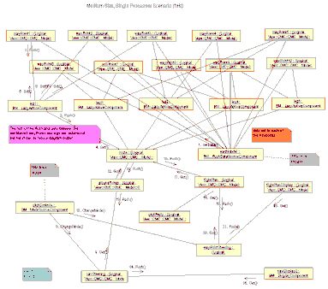
Solution Approach: Model Driven Engineering (MDE)
Develop, validate, & standardize generative software technologies that:
  Model
  Analyze
  Synthesize &
  Provision
multiple layers of middleware & application components that require simultaneous control of multiple quality of service properties end-to-end
Specialization is essential for inter-/intra-layer optimization & advanced product-line architectures
DRE Applications
Middleware
Services
<CONFIGURATION_PASS>
<HOME> <…>
<COMPONENT>
<ID> <…></ID>
<EVENT_SUPPLIER>
<…events this
component supplies…>
</EVENT_SUPPLIER>
</COMPONENT>
</HOME>
</CONFIGURATION_PASS>
Middleware
Operating Sys
& Protocols
Hardware &
Networks
Goal is not to replace programmers per se – it is to provide higher-level domain-specific languages for middleware/application developers & users

Slide 25
Leveraging Standards: OMG D&C Specification
Specification & Implementation
  Defining, partitioning, & implementing appln functionality as standalone components
Assembly & Packaging
  Bundling a suite of software binary modules & metadata representing app components
Installation
  Populating a repository with packages required by app
Configuration
  Configuring packages with appropriate parameters to satisfy functional & systemic requirements of an application without constraining to physical resources
Planning
  Making deployment decisions to identify nodes in target environment where packages will be deployed
Preparation
  Moving binaries to identified entities of target environment
Launching
  Triggering installed binaries & bringing appln to ready state
QoS Assurance & Adaptation
  QoS validation, runtime (re)configuration & resource management to maintain end-to-end QoS
  OMG Deployment & Configuration (D&C) specification (ptc/05-01-07)

Slide 26
Our MDE Solution: CoSMIC Tool chain
CoSMIC tools e.g., PICML used to model application components, CQML for QoS
Captures the data model of the OMG D&C specification
Synthesis of static deployment plans for DRE applications
Capabilities being added for QoS provisioning (real-time, fault tolerance, security)
CoSMIC can be downloaded at www.dre.vanderbilt.edu/cosmic

Slide 27
Part 3
The Basics
Underlying Tools & Technologies

Slide 28
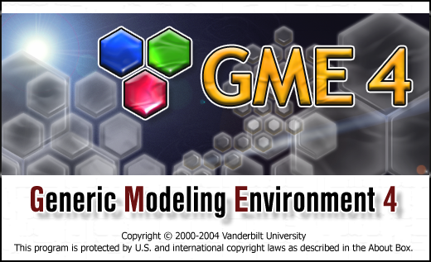
Technology Enabler: Generic Modeling Environment (GME)
“Write Code That Writes Code That Writes Code!”
GME Architecture
Application Developers (Modelers)
Decorator
Decorator
COM
GME Editor
COM
Browser
Constraint
Manager
Add-On(s)
COM
Translator(s)
XML
Metamodel
GModel
GMeta
MDE Tool
Developer
(Metamodeler)
XML
UML / OCL
CORE
Paradigm Definition
XML
ODBC
DB #1
…
XML
…
DB #n
Storage Options
Goal: Correct-by-construction DRE systems
www.isis.vanderbilt.edu/Projects/gme/default.htm

Slide 29
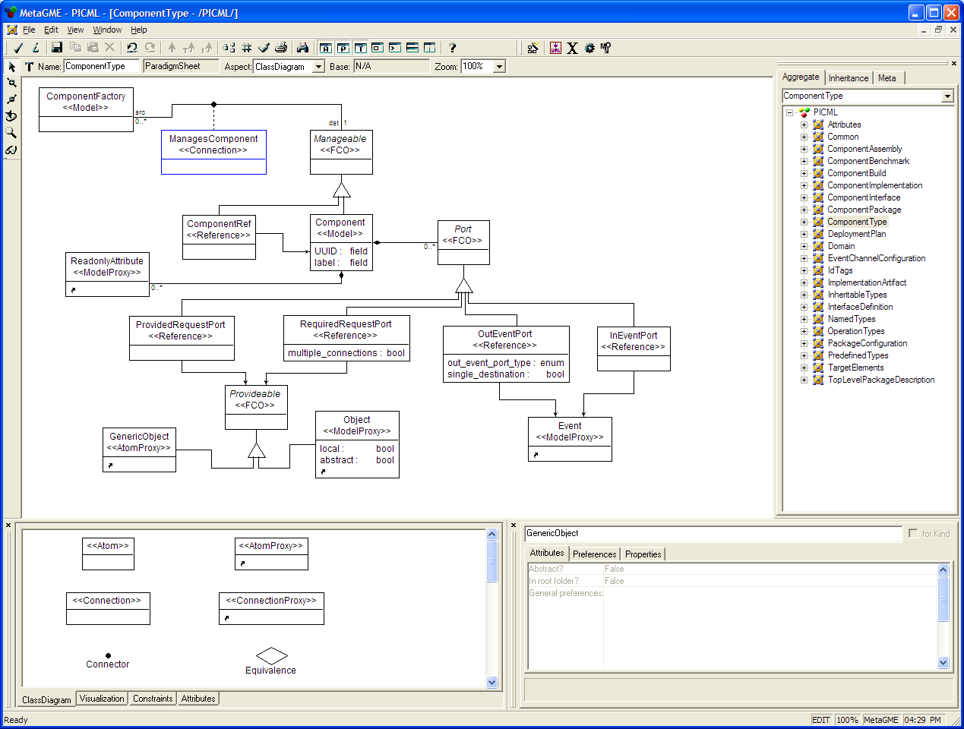
MDE Tool Development in GME
Tool developers use MetaGME to develop a domain-specific graphical modeling environment
  Define syntax & visualization of the environment via metamodeling

Slide 30
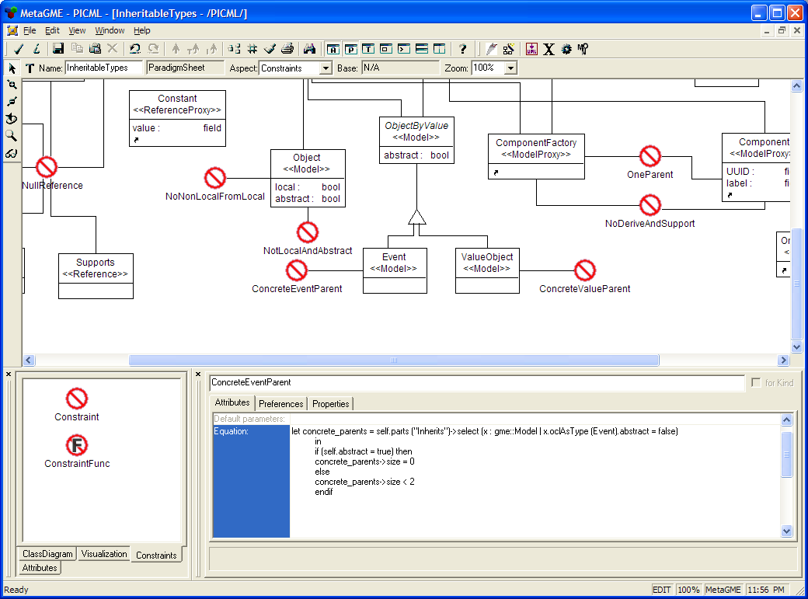
MDE Tool Development in GME
Tool developers use MetaGME to develop a domain-specific graphical modeling environment
  Define syntax & visualization of the environment via metamodeling
  Define static semantics via Object Constraint Language (OCL)

Slide 31
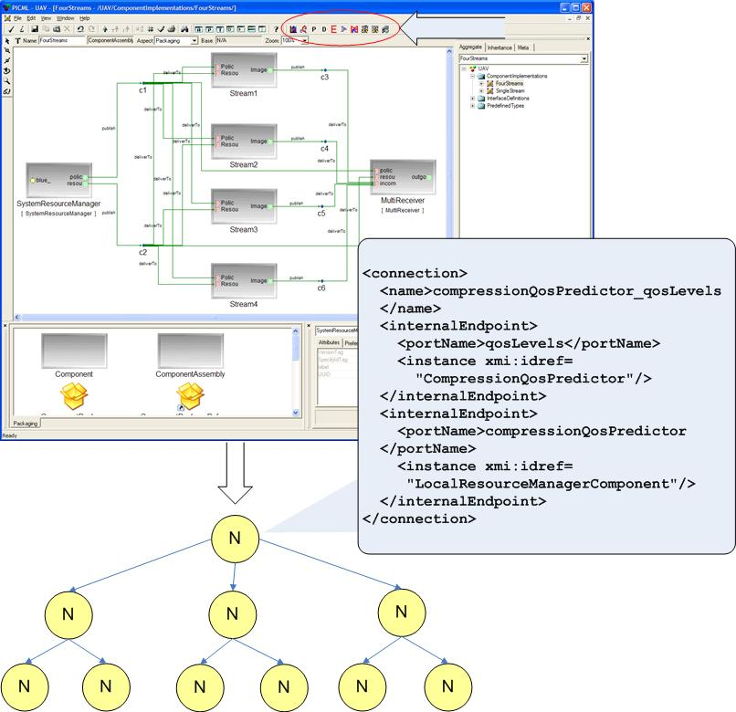
MDE Tool Development in GME
Tool developers use MetaGME to develop a domain-specific graphical modeling environment
  Define syntax & visualization of the environment via metamodeling
  Define static semantics via Object Constraint Language (OCL)
  Dynamic semantics implemented via model interpreters

Slide 32
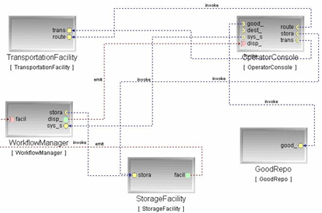
MDE Tool Development in GME
Tool developers use MetaGME to develop a domain-specific graphical modeling environment
  Define syntax & visualization of the environment via metamodeling
  Define static semantics via Object Constraint Language (OCL)
  Dynamic semantics implemented via model interpreters

Slide 33
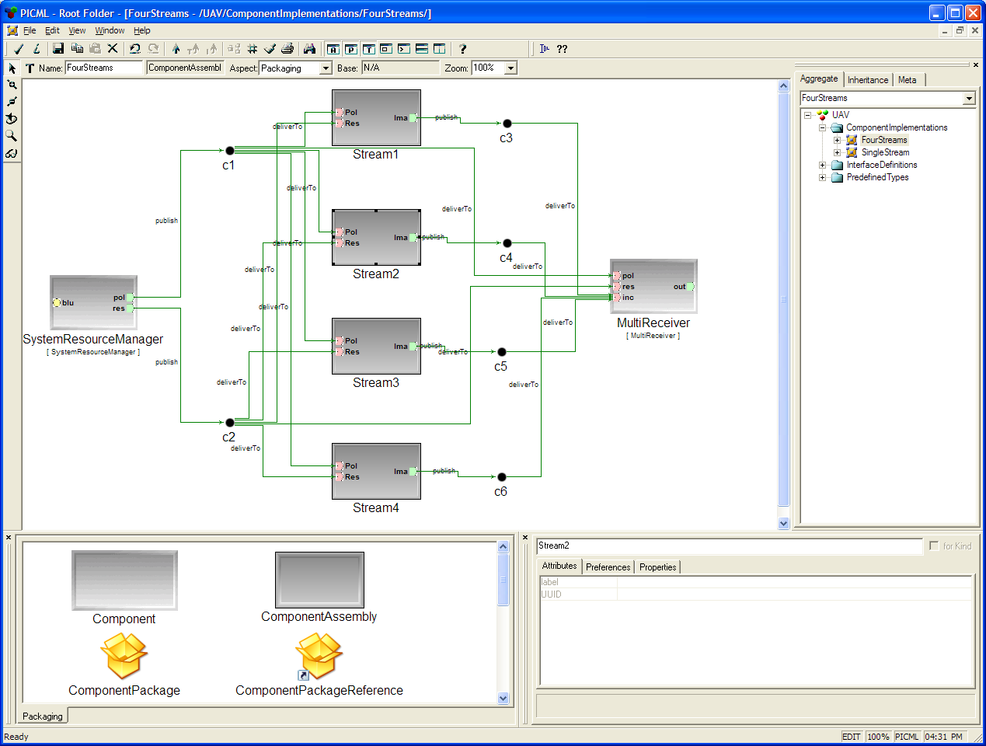
MDE Application Development with GME
Application developers use modeling environments created w/MetaGME to build applications
  Capture elements & dependencies visually

Slide 34
MDE Application Development with GME
Application developers use modeling environments created w/MetaGME to build applications
  Capture elements & dependencies visually

Slide 35
MDE Application Development with GME
Application developers use modeling environments created w/MetaGME to build applications
  Capture elements & dependencies visually
  Model interpreter produces something useful from the models
    e.g., code, simulations, deployment descriptions & configurations

Slide 36
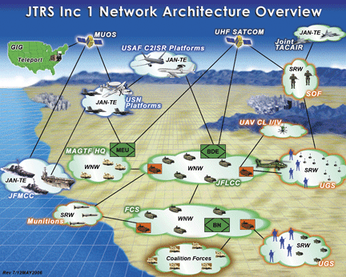
Part 4
Modeling DRE Application Workflows
Assembly & Packaging

Slide 37
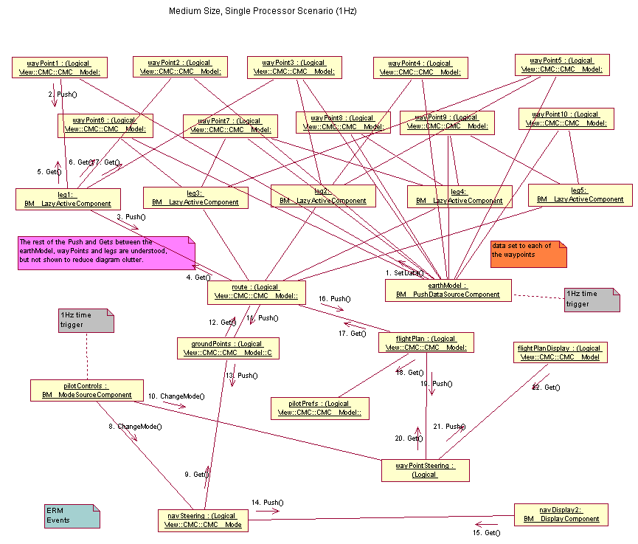
Assembly & Packaging Problem
Application components are bundled together into assemblies
Several different assemblies tailored towards delivering different end-to-end QoS and/or using different algorithms can be part of the package
  e.g., large-scale DRE systems require 100s-1,000s of components
Packages describing the components & assemblies can be scripted via XML descriptors
Notes:
Assembling tools are like composer. Modeling tools are one such example.

Slide 38
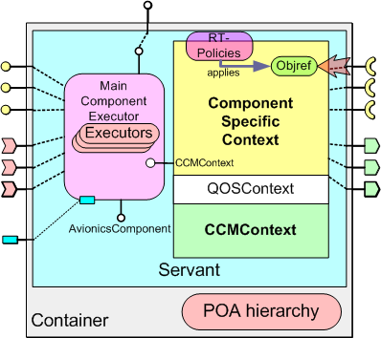
Assembly & Packaging Challenges (1/2)
Ad hoc techniques for ensuring component syntactic & semantic compatibility
RT Event
Channel
Ad hoc means to determine event notification support
Distribution & deployment done in ad hoc manner
Notes:
Assembling tools are like composer. Modeling tools are one such example.

Slide 39
Assembly & Packaging Challenges (2/2)
Existing practices involve handcrafting XML descriptors
<!– Associate components with impls -->
<componentfiles>
<componentfile id=“RateGenerator">
<fileinarchive name=“HouseRateGen.csd"/>
</componentfile>
<componentfile id=“HiResGPS">
<fileinarchive name=“aGPS.csd"/>
</componentfile>
<componentfile id=“cockpitDisplay">
<fileinarchive name=“navDisplay-if.csd"/>
</componentfile>
</componentfiles>
XML file in excess of 3,000 lines, even for medium sized scenarios
Modifications to the assemblies requires modifying XML file
Notes:
Assembling tools are like composer. Modeling tools are one such example.

Slide 40
CoSMIC MDE Solution for Assembly & Packaging
Platform-Independent Component Modeling Language (PICML)
Developed in Generic Modeling Environment (GME)
Core of Component Synthesis using Model-Integrated Computing (CoSMIC) tool chain
Capture elements & dependencies visually
Define “static semantics” using Object Constraint Language (OCL)
Define “dynamic semantics” via model interpreters
  Also used for generating domain specific meta-data
“Correct-by-construction”

Slide 41
Example Metadata Generated by PICML
Component Interface Descriptor (.ccd)
  Describes the interface, ports, properties of a single component
Implementation Artifact Descriptor (.iad)
  Describes the implementation artifacts (e.g., DLLs, OS, etc.) of one component
Component Package Descriptor (.cpd)
  Describes multiple alternative implementations of a single component
Package Configuration Descriptor (.pcd)
  Describes a configuration of a component package
Top-level Package Descriptor (package.tpd)
  Describes the top-level component package in a package (.cpk)
Component Implementation Descriptor (.cid)
  Describes a specific implementation of a component interface
  Implementation can be either monolithic- or assembly-based
  Contains sub-component instantiations in case of assembly based implementations
  Contains inter-connection information between components
Component Packages (.cpk)
  A component package can contain a single component
  A component package can also contain an assembly
  Based on OMG (D&C) specification (ptc/03-06-03)

Slide 42
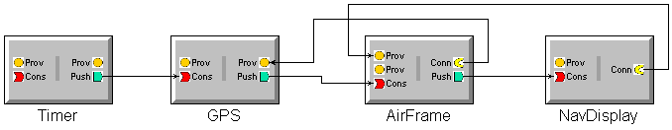
Example Output from PICML
A Component Implementation Descriptor (*.cid) file
<ComponentAssemblyDescription id="a_HUDDisplay">
...
<connection>
<name>GPS-RateGen</name>
<internalEndPoint>
<portName>Refresh</portName>
<instance>a_GPS</instance>
</internalEndPoint>
<internalEndPoint>
<portName>Pulse</portName>
<instance>a_RateGen</instance>
</internalEndPoint>
</connection>
<connection>
<name>NavDisplay-GPS</name>
<internalEndPoint>
<portName>Refresh</portName>
<instance>a_NavDisplay</instance>
</internalEndPoint>
<internalEndPoint>
<portName>Ready</portName>
<instance>a_GPS</instance>
</internalEndPoint>
</connection>
...
</ComponentAssemblyDescription>
Describes a specific implementation of a component interface
Contains inter-connection information between components
<!–-Component Implementation Descriptor(.cid) associates components with impl. artifacts-->
<Deployment:ComponentImplementationDescription>
<label>GPS Implementation</label>
<UUID>154cf3cd-1770-4e92-b19b-8c2c921fea38</UUID>
<implements href="GPS.ccd"/>
<monolithicImpl>
<primaryArtifact>
<name>GPS Implementation artifacts</name>
<referencedArtifact href="GPS.iad"/>
</primaryArtifact>
</monolithicImpl>
</Deployment:ComponentImplementationDescription>

Slide 43
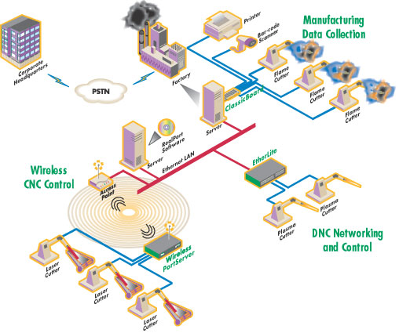
Part 5
DRE System QoS Management
QoS Modeling

Slide 44
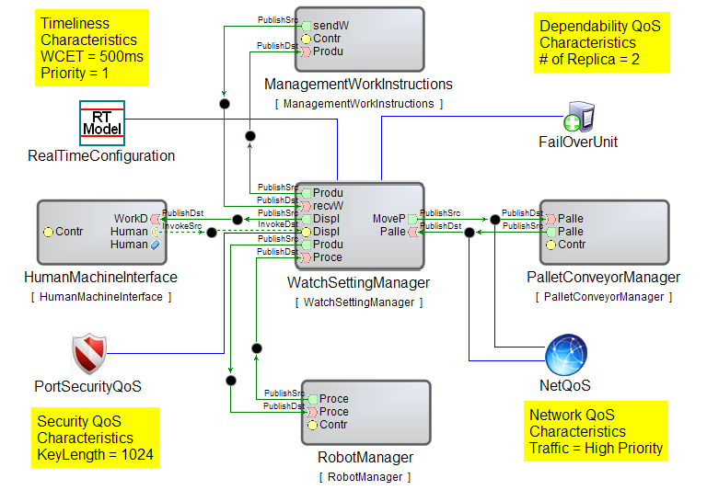
Component QoS Modeling Language (CQML)
Objectives:
Express QoS design intent
Model crosscutting QoS concerns
Perform design-time QoS tradeoff analysis
Capabilities:
Intuitive QoS abstractions
Separation as well as unification of QoS concerns
4 types of QoS modeling capabilities: Real-time, Fault tolerance, Security, Network QoS
Developed as overlay on a composition modeling language
Facility to integrate behavioral modeling
Unified internal mechanism for QoS integration
Pluggable back end analysis tools for QoS tradeoff analysis
  e.g., Times tool

Slide 45
Example of Group Failover Intent
Primary Component
A
B
C
“Client”
primary IOR
container/component server
container/component server
container/component server
Primary FOU
secondary IOR
A’
B’
C’
Replica Component
container/component server
container/component server
container/component server
Replica FOU

Slide 46


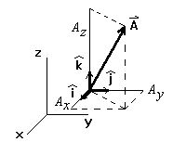
CQML FT Modeling Abstractions
QoS Enhancements to PICML (Platform Independent Component Modeling Language) Metamodel
Fail-over Unit (FOU): Abstracts away details of granularity of protection (e.g. Component, Assembly, App-string)
Replica Group (RPG): Abstracts away fault-tolerance policy details (e.g. Active/passive replication, state-synchronization, topology of replica)
Shared Risk Group (SRG): Captures associations related to risk. (e.g. shared power supply among processors, shared LAN)
Protection granularity concerns
State-synchronization concerns
Component Placement constraints
Model Interpreter (component placement constraint solver): Encapsulates an algorithm for component-node assignment based on replica distance metric
Replica Distance Metric

Slide 47






CQML RT & NetQoS Modeling Abstractions
Real-time modeling provided by the RT-Model element
  Leverages known patterns of real-time programming usage:
    e.g., real-time CORBA
  Enables modeling of:
    Priority models, Banded connections, Thread pools, Thread pools with Lanes
    Resources e.g., CPU, memory
Network QoS modeling allows modeling QoS per application flow
  Classification into high priority, high reliability, multimedia and best effort classes
  Enables bandwidth reservation in both directions
  Client propagated or server declared models

Slide 48
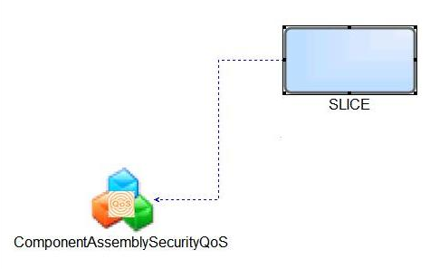
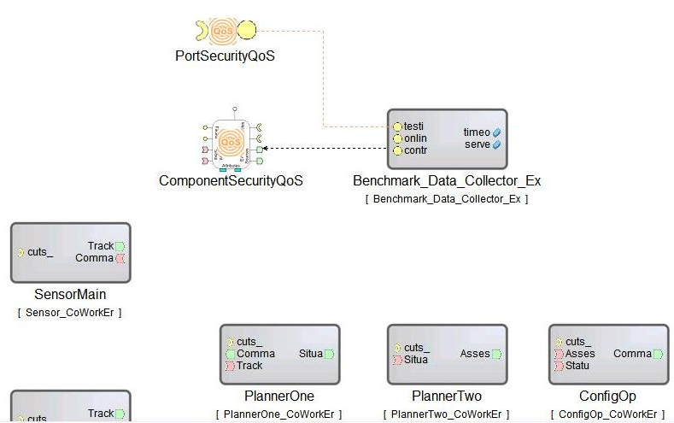
CQML Security Modeling Abstractions
Focus on role based access control
Fine-grained:
  Interface Operation
  Assembly Property
  Component Attribute
Coarse-grained:
  Interface
  Set of Operations
  Class of Operations (based on Required Rights - corba:gsum)
  Inter-Component Execution Flow (Path in an Assembly)

Slide 49
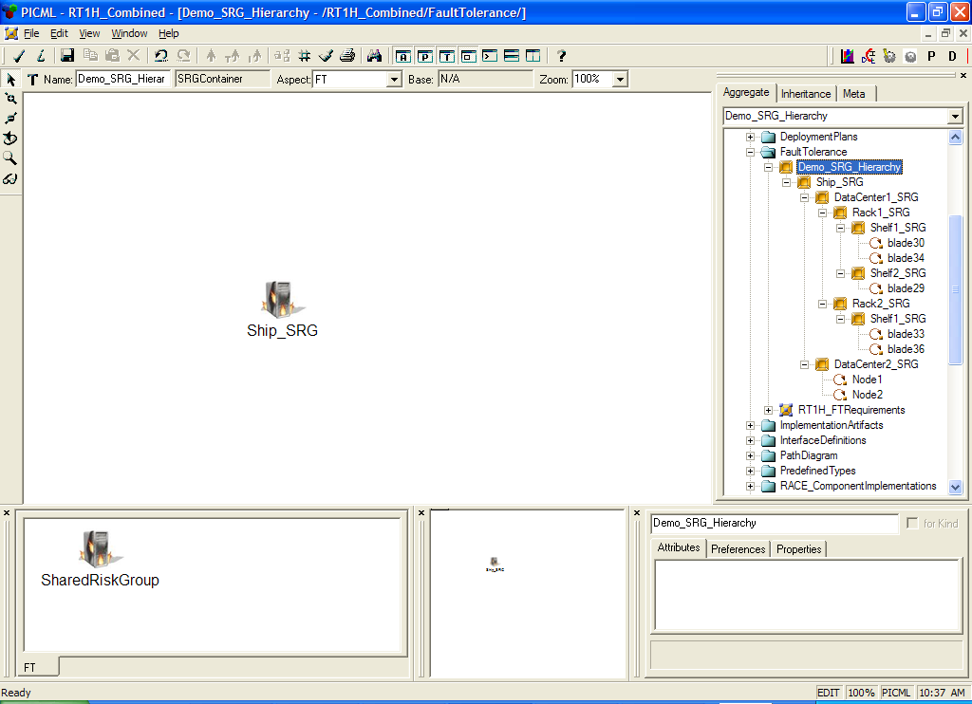
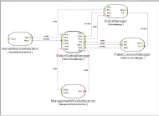


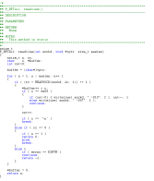
Modeling & Generative Steps in CQML
Model components and application strings in PICML
e.g., Model Fail Over Units (FOUs) and Shared Risk Groups (SRGs) using CQML
Generate deployment plan
GME/PICML
Model Information
Domain, Deployment, SRG, and FOU
FT Interpreter
model
injection
Replica Placement Algorithm
Augmented Deployment Plan
Interpreter automatically injects
replicas and associated CCM IOGRs
5. Distance-based constraint algorithm determines replica placement in deployment descriptors.

Slide 50
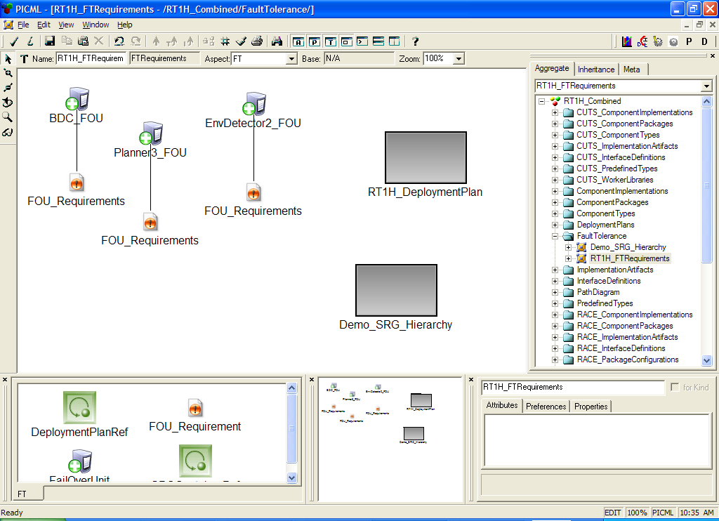
Example: FT Requirements Modeling in CQML
Component FOU
Replication Style = Active
Deployment plan to be augmented
LEGEND
FOU: Fail Over Unit
SRG: Shared Risk Group
Replica = 3
Min Distance = 4
Shared Risk Group (SRG) hierarchy

Slide 51
Automated Sample FT QoS Provisioning
Automatic Injection of replicas
  Augmentation of deployment plan based on number of replicas
Automatic Injection of FT infrastructure components
  E.g. Collocated “heartbeat” (HB) component with every protected component.
Automatic Injection of connection meta-data
  Specialized connection setup for protected components (e.g. Interoperable Group References IOGR)
HB
Container

Slide 52
Automated Heartbeat Component Injection
Collocated heartbeat component
Primary Component
FPC
intra-FOU
heartbeat
HB
HB
HB
A
B
C
“client”
primary IOR
container/component server
container/component server
container/component server
IOGR
Primary FOU
periodic FPC heartbeat
FPC
secondary IOR
HB
HB
HB
Connection
Injection
A’
B’
C’
Replica Component
container/component server
container/component server
container/component server
Replica FOU

Slide 53
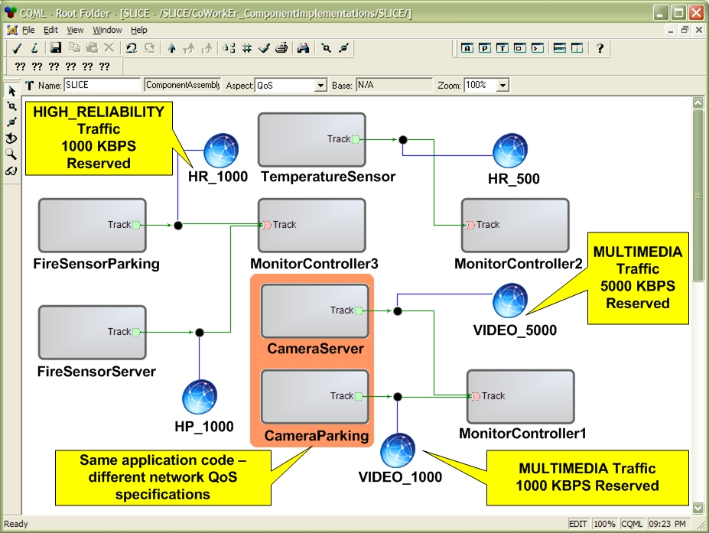
Example: NetQoS Modeling in CQML
Expressing QoS intent for application flows
Multiple connections sharing QoS can use same element

Slide 54
QoS Analysis Challenges
How to analyze and tradeoff the modeled QoS requirements?
How do you correlate QoS requirements of packages to resource needs
How do you minimize resources and allocate them?
How do you ensure that the selected targets will deliver required QoS

Slide 55
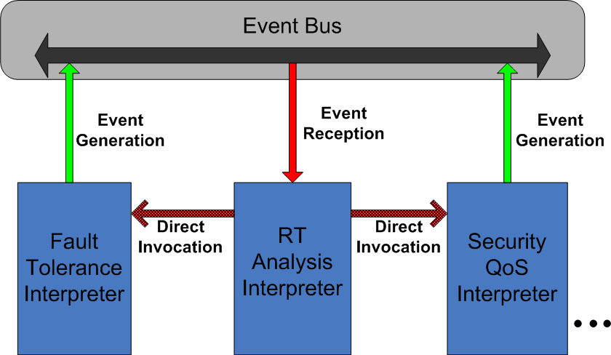
CQML QoS Unification & Tradeoff Analysis
Leverages QoS and behavioral models
Each QoS dimension publishes its modeled QoS requirements
A particular QoS dimension is chosen as the driver, e.g., real-time
  Acts as subscriber of events generated by other dimensions
  Driver interpreter integrates other QoS dimensions making tradeoffs on the way
Pluggable back end analysis and generative tools

Slide 56
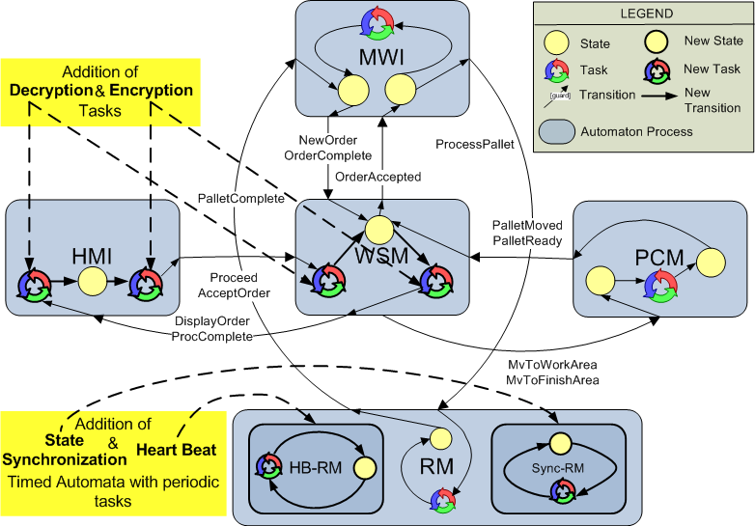
Example: QoS Tradeoff Analysis using TIMES tool
CQML EventBus architecture weaves in FT and Security concerns into RT concerns
Feeds to backend schedulability analysis tools e.g., Times

Slide 57
Part 6
DRE System Deployment Planning
Placement Algorithms

Slide 58
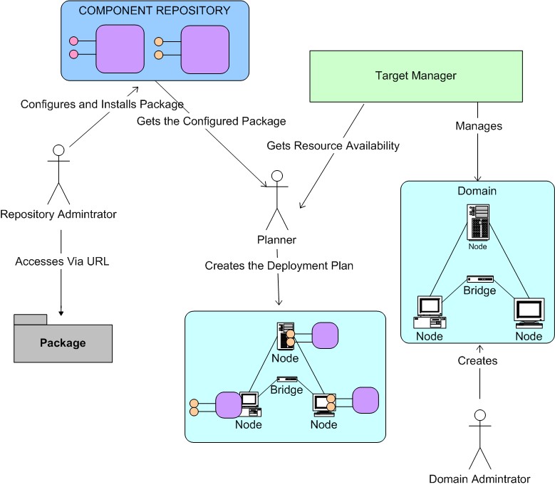
Deployment Planning Problem
Component integrators must make appropriate deployment decisions, including identifying the entities (e.g., CPUs) of the target environment where the packages will be deployed
Select the appropriate package to deploy on selected target
Determine current resource allocations on target platforms
Select appropriate target platform to deploy packages

Slide 59
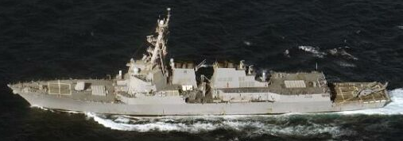
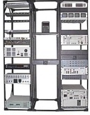
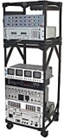
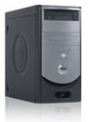
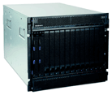
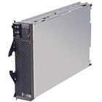
Example of Shared Risk Group Intent
DataCenter1_SRG
Ship_SRG
DataCenter2_SRG
Rack1_SRG
Rack2_SRG
Node1
(blade31)
Node2
(blade32)
Shelf1_SRG
Shelf2_SRG
Shelf1_SRG
Blade30
Blade34
Blade29
Blade33
Blade36

Slide 60
Example Replica Placement Algorithm
Define N orthogonal vectors, one for each of the distance values computed for the N components (with respect to a primary) and vector-sum these to obtain a resultant. Compute the magnitude of the resultant as a representation of the composite distance captured by the placement .
Compute the distance from each of the replicas to the primary for a placement.
Record each distance as a vector, where all vectors are orthogonal.
Add the vectors to obtain a resultant.
Compute the magnitude of the resultant.
Use the resultant in all comparisons (either among placements or against a threshold)
Apply a penalty function to the composite distance (e.g. pair wise replica distance or uniformity)
R2
P
R3
R1

Slide 61
Example: Automated Component Placement
DataCenter1_SRG
Ship_SRG
DataCenter2_SRG
Rack1_SRG
Rack2_SRG
Node1
(blade31)
Node2
(blade32)
Composite Distance
Shelf1_SRG
Shelf2_SRG
Shelf1_SRG
Primary
Advanced placement combining FT and RT along with resource minimization available.
Blade30
Blade34
Blade29
Blade33
Blade36
Replica
1
Replica
3
Replica
2

Slide 62
Part 6
Configuring Middleware for DRE Systems
Middleware Configuration Options

Slide 63
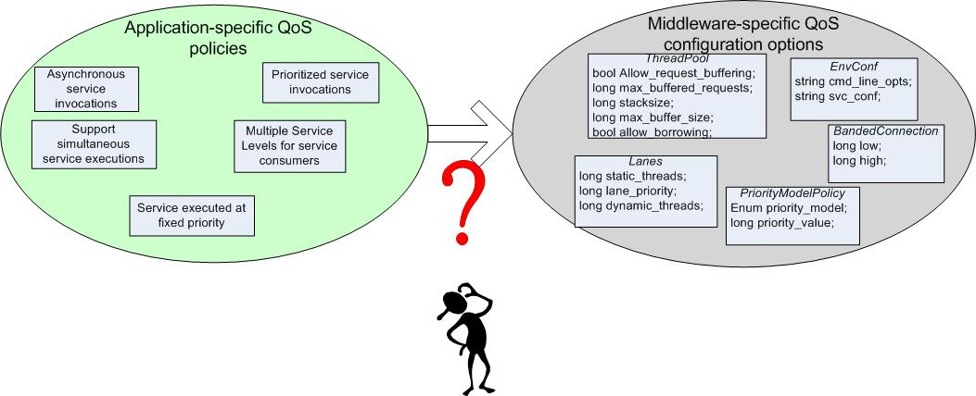
Translating QoS Policies to QoS Options
Prioritized service invocations (QoS Policy) must be mapped to Real-time CORBA Banded Connection (QoS configuration)
Large gap between application QoS policies & middleware QoS configuration options
  Bridging this gap is necessary to realize the desired QoS policies
The mapping between application-specific QoS policies & middleware-specific QoS configuration options is non-trivial, particular for large systems
63
Notes:
11/17/2009
63

Slide 64

Challenge 1: Mapping QoS Policies to QoS Options
Conventional mapping approach requires deep understanding of the middleware configuration space
  e.g., multiple types/levels of QoS policies require configuring appropriate number of thread pools, threadpool lanes (server) & banded connections (client)
Client Propagation & Server Declared Priority Models
Static Scheduling
Service
Standard
Synchonizers
Request
Buffering
Explicit Binding
Thread Pools
Portable Priorities
Protocol
Properties
Notes:
11/17/2009
64

Slide 65

The Multilayer Configuration Problem
Component-based software must be configurable at many levels
  e.g., application components & containers, component servers, & middleware services & infrastructure
Configuration of components & assemblies
Configuration of component server
Configuration of event notifiers
Configuration of the middleware bus
Configuration of component containers
Notes:
This is the CCM Solution. Don’t go into details here…. Just emphasize that components are just local interface implementations, as we will see later
Container mediated CORBA services

Slide 66
Example: The M/W Bus Configuration
Component middleware is characterized by a large configuration space that maps known variations in the application requirements space to known variations in the middleware solution space
Hook for marshaling strategy
Hook for the request demuxing strategy
Hook for the event demuxing strategy
Hook for the connection management strategy
Hook for the concurrency strategy
Hook for the underlying transport strategy

Slide 67

Challenge 2: Choosing QoS Option Values
  Individually configuring component QoS options is tedious & error-prone
    e.g., ~10 distinct QoS options per component & ~140 total QoS options for entire NASA MMS mission prototype
  Manually choosing valid values for QoS options does not scale as size & complexity of applications increase
67
Notes:
11/17/2009
67

Slide 68

Example: Configuring Container Policies
Determine various middleware policies for server objects e.g., security, lifetime, replication
Determine thread pool sizes; how are they shared; number of lanes and their priorities; if borrowing is enabled
Determine right buffer sizes
Determine end-to-end priority propagation model to use
Determine the server object management policies
Ensure semantic compatibility among chosen configurations
server object
management
middleware
Existing techniques for metadata configurations rely on ad hoc manual configurations e.g., CORBA server-side programming
This “glue code” is traditionally handcrafted
Notes:
This is the CCM Solution. Don’t go into details here…. Just emphasize that components are just local interface implementations, as we will see later
Container mediated CORBA services

Slide 69
Challenge 3: Validating QoS Options
  Each QoS option value chosen should be validated
    e.g., Filter priority model is CLIENT_PROPAGATED, whereas Comm priority model is SERVER_DECLARED
  Each system reconfiguration (at design time) should be validated
    e.g., reconfiguration of bands of Analysis should be validated such that the modified value corresponds to (some) lane priority of the Comm
69
Notes:
11/17/2009
69

Slide 70

Challenge 4: Resolving QoS Option Dependencies
ThreadPool priorities of Comm should match priority bands defined at Gizmo
  “QoS option dependency” is defined as:
    Dependency between QoS options of different components
  Manually tracking dependencies is hard – or in some cases infeasible
    Dependent components may belong to more than one assembly
    Dependency may span beyond immediate neighbors
  Empirically validating configuration changes by hand is tedious, error-prone, & slows down development
    Several iterations before desired QoS is achieved (if at all)
70
Notes:
11/17/2009
70

Slide 71

Solution Approach: Model-Driven QoS Mapping
QUality of service pICKER (QUICKER)
  Model-driven engineering (MDE) tools model application QoS policies
  Provides automatic mapping of QoS policies to QoS configuration options
  Validates the generated QoS options
  Automated QoS mapping & validation tools can be used iteratively throughout the development process
71
Notes:
11/17/2009
71

Slide 72

QUICKER Enabling MDE Technologies
Enhanced Platform Independent Component Modeling Language (PICML), a DSML for modeling component-based applications
QoS mapping uses Graph Rewriting & Transformation (GReAT) model transformation tool
Customized Bogor model-checker used to define new types & primitives to validate QoS options
72
Notes:
11/17/2009
72

Slide 73


QUICKER Enabling MDE Technologies
Enhanced Platform Independent Component Modeling Language (PICML), a DSML for modeling component-based applications
QoS mapping uses Graph Rewriting & Transformation (GReAT) model transformation tool
Customized Bogor model-checker used to define new types & primitives to validate QoS options
CQML Model Interpreter
Bogor Input Representation
CQML Model interpreter generates Bogor Input Representation (BIR) of DRE system from its CQML model
73
Notes:
11/17/2009
73

Slide 74


QUICKER: Transformation of QoS policies(1/2)
Platform-Independent Modeling Language (PICML) represents application QoS policies
  PICML captures policies in a platform-independent manner
  Representation at multiple levels
    e.g., component- or assembly-level
RequirementProxy can be per component or assembly instance
74
Notes:
11/17/2009
74

Slide 75

QUICKER: Transformation of QoS policies(1/2)
Platform-Independent Modeling Language (PICML) represents application QoS policies
  PICML captures policies in a platform-independent manner
  Representation at multiple levels
    e.g., component- or assembly-level
Component QoS Modeling Language (CQML) represents QoS options
  CQML captures QoS configuration options in a platform-specific manner
75
Notes:
11/17/2009
75

Slide 76

QUICKER: Transformations of QoS policies(2/2)
Translation of application QoS policies into middleware QoS options
  Semantic translation rules specified in terms of input (PICML) & output (CQML) type graph
    e.g., rules that translate multiple application service requests & service level policies to corresponding middle-ware QoS options
  QUICKER transformation engine maps QoS policies (in PICML) to QoS configuration options (in CQML)
Level 1
Service Request
Provider
Level 2
Level 3
Provider Service Levels
Multiple Service Requests
Service Levels
Priority Model Policy
Lanes
Thread Pool
76
Notes:
11/17/2009
76

Slide 77

QUICKER: Validation of QoS Options (1/2)
Representation of middleware QoS options in Bogor model-checker
  BIR extensions allow representing domain-level concepts in a system model
  QUICKER defines new BIR extensions for QoS options
    Allows representing QoS options & domain entities directly in a Bogor input model
      e.g., CCM components, Real-time CORBA lanes/bands are first-class Bogor data types
  Reduces size of system model by avoiding multiple low-level variables to represent domain concepts & QoS options
77
Notes:
11/17/2009
77

Slide 78

QUICKER: Validation of QoS Options (2/2)
Representation of properties (that a system should satisfy) in Bogor
  BIR primitives define language constructs to access & manipulate domain-level data types, e.g.:
    Used to define rules that validate QoS options & check if property is satisfied
Automatic generation of BIR of DRE system from CQML models
Rule determines if ThreadPool priorities at Comm match priority bands at Analysis
Model interpreters auto-generate Bogor Input Representation of a system from its CQML model
78
Notes:
11/17/2009
78

Slide 79

Soln: Translating Policies to Options (1/2)
Expressing QoS policies
  PICML modes application-level QoS policies at high-level of abstraction
    e.g., multiple service levels support for Comm component, service execution at varying priority for Analysis component
  Reduces modeling effort
    e.g., ~25 QoS policy elements for MMS mission vs. ~140 QoS options
79
Notes:
11/17/2009
79

Slide 80

Soln: Translating Policies to Options (2/2)
Mapping QoS policies to QoS options
  GReAT model transformations automate the tedious & error-prone translation process
Transformations generate QoS configuration options as CQML models
  Allow further transformation by other tools
    e.g., code optimizers & generators
  Simplifies application development & enhances traceability
80
Notes:
11/17/2009
80

Slide 81



Soln: Ensuring QoS Option Validity
CQML model interpreter generates BIR specification from CQML models
BIR primitives used to check whether a given set of QoS options satisfies a system property
  e.g., fixed priority service execution, a property of Comm component
Supports iterative validation of QoS options during QoS configuration process
QUICKER
81
Notes:
Kitty, could you please animate the first bullet, i.e., illustrate how the model interpreter generates the BIR spec from CQML models?
Doug, I have added the animation.
11/17/2009
81

Slide 82

Soln: Resolving QoS Option Dependencies
Dependency structure maintained in Bogor used to track dependencies between QoS options of components, e.g.:
  Analysis & Comm are connected
  Gizmo & Comm are dependent
Detect mismatch if either values change
Dependency Structure of MMS Mission Components
Change(s) in QoS options of dependent component(s) triggers detection of potential mismatches
  e.g., dependency between Gizmo invocation priority & Comm lane priority
82
Notes:
11/17/2009
82

Slide 83
Part 8
Continuous System QoS Validation using “What If” Analysis
MDE for Analysis and Emulation Techniques

Slide 84



Serialized Phasing in Development Problem (1/3)
Infrastructure components under development; need applications for testing
Application components waiting to be developed
Level of Abstraction
(design)
Software Lifecycle Timeline
(production)

Slide 85
Serialized Phasing in Development Problem (2/3)
Level of Abstraction
Integration testing cannot begin until the system is entirely developed
(design)
Software Lifecycle Timeline
(production)

Slide 86

Serialized Phasing in Development Problem (3/3)
Integration Surprises
Level of Abstraction
(design)
Software Lifecycle Timeline
(production)

Slide 87
Solution Approach: System Execution Modeling Tools
System execution modeling (SEM) tools help developers & testers understand concerns for a system under development via:
  Techniques for validating system specifications & requirements
  Techniques for validating system conforms to specification & requirements
  Techniques for evaluating concerns of the system under development
    e.g., “what if” scenarios
Conventional SEM tools are analytical and/or simulation model based that cannot account for all complexities of large-scale DRE systems
e.g., target architecture & environment

Slide 88



CUTS System Execution Modeling Tool
  Our solution approach is realized in a SEM tool named the Component Workload Emulation (CoWorkEr) Utilization Test Suite (CUTS)
Results
(database)
    Developers & testers use CUTS by:
    Use DSMLs to model behavior & workload, respectively
    Use generative programming techniques transform models into source code
    Use DSMLs to analyze QoS metrics collected during test runs
    Determine action plans based on auto-generated QoS graphs
    Use continuous integration environments to manage CUTS process & facilitate continuous system integration testing
2
.cs
.java
.cpp
Source Files
➔ Executables
3
Behavior/workload
Analytics
1
QoS Unit Test Graph
4
    http://www.cs.iupui.edu/CUTS

Slide 89
Example: RACE Baseline Scenario
The Resource Allocation & Control Engine (RACE) is an infrastructure-level component-based DRE system that manages application-level assemblies
RACE supports two types of application-level deployments
  Static – deployments created offline where components are pre-assigned to hosts
  Dynamic – deployments created online such that components are assigned at runtime
    e.g., based on operating conditions
Baseline Scenario Requirement - higher priority application-level assemblies must have longer lifetime than lower priority ones
  e.g., under low resource availability

Slide 90

Realistic Behavior & Workload Modeling
Behavior & workload may change
How to model its behavior?
Characteristics of Requirement
Realistic behavior & workload for components currently under development
Need to be lightweight & adaptable
  e.g., agile development principles
Limitations of Existing Work
Behavior & structure of system are separate models
Do not capture first-class concerns of component-based distributed systems
  e.g., environment, composition, packaging, etc.
Do not have well-defined behavior/workload modeling semantics
  e.g., the Action Language

Slide 91
DSML-based SEM Tools
Used domain-specific modeling languages (DSMLs) to model behavior & workload of component-based DRE systems
Underlying semantics defined by Timed Input/Output Automata (TIOA)
  Extended to support action/state sequencing
public class ConfigOp {
// ...
public void
receiveTarget (Event ev) {
++ this.eventCount_;
//...
this.logger_.log (INFO, “Hello”);
// ...
}
// ...
// logging utility
private Logger logger_;
// counter (state variable)
private int eventCount_;
}
BM = (V, S, Θ, I , O, A, E, T)
Standard TIOA…
Set of interval variables V
Set of states S
Starting state Θ
Set of input I, output O, & internal actions A
Set of effects E
Our addition…
Set of of transitions T
Hill, J. H., et. al (2007). Model-driven engineering for early QoS validation of component-based software systems. Journal of Software (2).

Slide 92

DSML-based SEM Tools
(modeled as)
Component Behavior Modeling Language (CBML) & Workload Modeling Language (WML)
BM = (V, S, Θ, I , O, A, E, T)
Standard TIOA…
Set of interval variables V
Set of states S
Starting state Θ
Set of input I, output O, & internal actions A
Set of effects E
Our addition…
Set of of transitions T
Hill, J. H., et. al (2007). Model-driven engineering for early QoS validation of component-based software systems. Journal of Software (2).

Slide 93
Modeling RACE Baseline Scenario
Representative Model of Application-Level Assembly Managed by RACE
Experiment Design
Constructed 10 identical application-level assemblies with different importance values using CBML & WML
  Assemblies A – H: Importance 90; Assemblies I – J: Importance 2
Generated source code for components in each application-level assembly
DSML-based SEM tool required substantially less amount of time & effort than manually implementing each application-level assembly

Slide 94

Validating RACE Baseline Scenario QoS
Evaluation Criteria | Description
Evaluating RACE QoS Requirements | Hypothesize that UNITE can ensure RACE is improving lifetime of dynamically deployed applications by 10%
Application Lifetime Graph

Slide 95

Validating RACE Baseline Scenario QoS
System Trace Reconstruction for a Static Deployment of the RACE Baseline Scenario

Slide 96

Validating RACE Baseline Scenario QoS
System Trace Reconstruction for a Dynamic Deployment of the RACE Baseline Scenario

Slide 97
Validating RACE Baseline Scenario QoS
QoS validation result was a 10.051% improvement between static vs. dynamic deployment using equations provided in the project specification
System Trace Reconstruction for a Dynamic Deployment of the RACE Baseline Scenario
System Trace Reconstruction for a Static Deployment of the RACE Baseline Scenario

Slide 98

Continuous Validation of RACE QoS
Single validation of RACE QoS
Continuous Testing of a Single QoS Unit Test
Performed after a Commit within 30 Minute Time Intervals
Percentage Improvement
In Lifetime using RACE
Test Execution

Slide 99
Continuous Validation of RACE QoS
Located error in evaluation equation proposed in project specification
Continuous Testing of a Single QoS Unit Test
Performed after a Commit within 30 Minute Time Intervals
Percentage Improvement
In Lifetime using RACE
Test Execution

Slide 100
Continuous Validation of RACE QoS
Ensured the percentage improvement was near our target continuously throughout the software lifecycle of RACE
Continuous Testing of a Single QoS Unit Test
Performed after a Commit within 30 Minute Time Intervals
Percentage Improvement
In Lifetime using RACE
Test Execution
Overcome the serialized-phasing development problem & enabled QoS evaluation continuously throughout the software lifecycle

Slide 101
Part 9
Usecase-driven Middleware Optimizations
Feature Oriented CUStomizer (FOCUS)
&
Pattern Oriented Software Architecture Modeling Language (POSAML)

Slide 102
Optimizations for Product-line Architectures
A/V 8-B
product
variant
F/A 18
product
variant
UCAV
product
variant
F-15
product
variant
Air
Frame
FLIR
HUD
GPS
AP
Nav
IFF
Domain-specific Services
Common Middleware Services
Distribution Middleware
Host Infrastructure Middleware
Product-line architecture
OS & Network Protocols
Hardware (CPU, Memory, I/O)
PLAs define a framework of components that adhere to a common architectural style with a clean separation of commonalities and appropriate provisions for incorporating variations
Middleware factors out many reusable general-purpose & domain-specific services from traditional DRE application responsibility
Standards middleware is a key technology candidate for supporting and sustaining vision of software product-lines
Notes:
Arvind, is it not yet suitable for DRE systems or DRE PLAs.
Arvind, I think it’s “PLA-based DRE systems”
I ask this because PLA is our focus & the context is DRE systems.

Slide 103






Middleware Structure & Functionality
There are layers of middleware, just like there are layers of networking protocols
Standards-based COTS middleware helps:
  Control end-to-end resources & QoS
  Leverage hardware & software technology advances
  Evolve to new environments & requirements
  Provide a wide array of reusable, off-the-shelf developer-oriented services
Problem
  Manually provisioning middleware is tedious, error-prone, & costly over system lifecycles
Need an intuitive, visual and declarative mechanism for middleware provisioning.

Slide 104

Technology Gaps in Middleware for PLAs
PLAs have very “focused but crosscutting” requirements of underlying middleware infrastructure
  Optimized for the platform
  Lean footprint
  Efficient configuration & deployment
  Support run-time adaptations & reconfigurations

Slide 105
Technology Gaps in Middleware for PLAs
PLAs have very “focused but crosscutting” requirements of underlying middleware infrastructure
  Optimized for the platform
  Lean footprint
  Efficient configuration & deployment
  Support run-time adaptations & reconfigurations
Standards middleware development & optimizations philosophy catered to maintaining “generality, wide applicability, portability & reusability”
  OS, compiler and hardware independent
  e.g., CORBA, J2EE. .NET
These technology gaps are hindering PLA progress => adverse economic and societal consequences
  e.g. shortcomings of pre-postulated middleware [Jacobsen 04]
Need to tailor and optimize standards middleware for PLAs while continuing to provide standards compliance, portability and flexibility

Slide 106

Middleware Specialization Catalog
Specification-imposed specializations
  Layer-folding
  Constant propagation
  Memoization
Framework specializations
  Aspect Weaving techniques
    Bridge →Reactor
    Template method → Protocol
    Strategy →Messaging, Wait, Demultiplexing
Development of reusable specialization patterns
Deployment platform specializations
  Unroll copy loops
  Use emulated exceptions
  Leverage zero-copy data transfer buffers
Identifying specialization points in middleware where patterns are applicable
Domain-specific language (DSL) tools & process for automating the specializations
Notes:
Arvind, please fix this ORB diagram to be consistent with the other diagrams earlier!

Slide 107
Feature Oriented CUStomizer (FOCUS)
FOCUS addresses specialization challenges by building specialization language, tool, & process to capture & automate middleware specializations
Middleware Instrumentation Phase
Capture specialization transformations via FOCUS specialization language
Annotate middleware source code with specialization directives
Create a domain-specific language (DSL) to capture middleware variability
~1,000 Perl SLOC Parser + weaver
~2,500 XML SLOC specialization files
~50 (files) annotations
Middleware Specialization Phase
Analyzes & determines the type of specializations applicable
FOCUS transformation engine selects the appropriate transformations & uses the annotations to automate specializations

Slide 108
FOCUS Specialization Language (FSL)
FOCUS uses an XML DTD to create a DSL for capturing specializations
Capability to specialize base implementations
Framework specialization requires code
to be copied from derived to base classes
FSL Approach
<copy-from-source>: Copy code from a specific
point to a specific point between different files
<start-hook> → start copying
<end-hook> → hook to stop copying
<dest-hook> → destination
Capability to perform code
substitutions
Devirtualize interfaces
Replace base classes with derived
class
FSL Approach
<substitute>: Capability to do
<search> … <replace> on code
Capability to weave code at
specified points
The layer folding specializations
require code to be woven in along
the request processing path
FSL Approach
<add>: <hook> that specifies the
annotated point; <data> where
data is specified
FSL
<substitute>
<search>ACE_Reactor_Impl</search>
<replace>ACE_Select_Reactor_Impl</replace>
</substitute>
<copy-from-source>
<source>Select_Reactor.h</source>
<copy-hook-start>HOOK-START </copy-hook-start>
<copy-hook-end>HOOK-END </copy-hook-end>
<dest-hook>HOOK-COPY</dest-hook>
</copy-from-source>
<add> <hook>FORWARD_DECL</hook>
<data>#include “Select_Reactor.h”</data>
<add>

Slide 109

Cumulative Specialization Results
Applied to Bold Stroke BasicSP
Specification related
  Layer folding
  Memoization
  Constant propagation (ignoring endianess)
Framework
  Aspect weaving (Reactor + protocol)
Deployment
  Loop unrolling + emulated exceptions
Layer folding, deployment platform, memoization, constant propagation
Average end-to-end measures improved by ~43%
Worst-case measures improved by ~45%
Jitter results twice as good as general-purpose optimized TAO
End-to-end client side throughput improved by ~65%.
Results exceeded the hypothesis & evaluation criteria

Slide 110

Automation Tool Requirements (1/2)
Criteria 1: Intuitive management of middleware variabilities that impact performance in significant ways
Tool must account for Compositional Variability
  Incurred due to variations in the compositions of mw building blocks
  Need to address compatibility in the compositions and individual configurations
  Dictated by needs of the domain
  E.g., Leader-Follower makes no sense in a single threaded Reactor
Must account for Per-Block Configuration Variability
  Incurred due to variations in implementations & configurations for a patterns-based building block
  E.g., single threaded versus thread-pool based reactor implementation dimension that crosscuts the event demultiplexing strategy (e.g., select, poll, WaitForMultipleObjects
Notes:
Discuss that although middleware helps address many accidental complexities, it also introduces many newer sets of challenges that arise from the need to configure it appropriately to suit the context of the application. These challenges stem from the variability in the configuration and customization of individual building blocks and their compositions. For example, a reactor could be single threaded or thread pool based. It can be used to demultiplex events in a windowing system or for networking system (using select or poll).
The compositions of blocks also gives rise to challenges since there is a lot of variation in how you can compose things and each one will impact performance in different ways.

Slide 111

Automation Tool Requirements (2/2)
Criteria 2: Visual separation of concerns within the Unified Framework
Separation of concerns
  Unified framework must separate the provisioning and validating stages
  Different actors should be able to use the visual aids in different stages of the application lifecycle
Criteria 3: Unified framework for middleware provisioning and QoS validation
Unified framework for provisioning and validating
  Provisioning decisions should be coupled with QoS validation
  Decisions at one stage drive decisions at the next stage
workload
system
Notes:
Discuss that although middleware helps address many accidental complexities, it also introduces many newer sets of challenges that arise from the need to configure it appropriately to suit the context of the application. These challenges stem from the variability in the configuration and customization of individual building blocks and their compositions. For example, a reactor could be single threaded or thread pool based. It can be used to demultiplex events in a windowing system or for networking system (using select or poll).
The compositions of blocks also gives rise to challenges since there is a lot of variation in how you can compose things and each one will impact performance in different ways.

Slide 112


POSAML: A Visual Provisioning Tool
Metamodel for the POSA pattern language
POSAML – GME-based modeling language for middleware composition
Provides a structural composition model
Captures variability in blocks
Generative programming capabilities to synthesize different artifacts e.g., benchmarking, configuration, performance modeling.
Feature modeling metamodel in POSAML

Slide 113



POSAML Unified Framework
Unified visual view enables modeling the middleware composition as a set of interacting patterns
Individual patterns can be visually configured
  E.g., reactor and acceptor-connector patterns
POSAML languages conforms to the POSA pattern language enabling error-free composition of building blocks.

Slide 114


POSAML Separation of Concerns
POSAML separates pattern feature modeling from pattern benchmarking
Feature model allows selecting features of each pattern
  E.g., reactor and acceptor-connector shown with concurrency models
Benchmarking view separated from feature view
  E.g., selecting parameters for elements of the pattern
Views are unified under the hood

Slide 115
Part 10
Closing Remarks

Slide 116
Research Impact & Future Work
Advanced MDE
Current progress stems from years of iteration, refinement, & successful use
CoSMIC
Model driven
middleware
Shape the standards e.g., OMG’s Model Driven Architecture (MDA) for DRE systems
RT/CCM
ACE+TAO
CORBA Component
Model (CCM)
Component
Models (EJB)
Long-term Research Directions
Heterogeneous component systems
Automated QoS configurations
Runtime model feedback
Automated inference of bottlenecks
Synthesis of QoS management policies
Synthesis of autonomic survivability
Real-time (RT)
CORBA
CORBA & DCOM
DCE
Micro-kernels
RPC
Internet
1970
2000
2005
2010
Year

Slide 117
Acknowledgments
This research was possible due to our sponsors, efforts of students, and collaborations
Current/Past DOC Students & Staff
  Krishnakumar Balasubramanian
  Arvind Krishna
  Jaiganesh Balasubramanian
  Emre Turkay
  Jeff Parsons
  Balachandran Natarajan
  Sumant Tambe
  James Hill
  Akshay Dabholkar
  Amogh Kavimandan
  Gan Deng
  Will Otte
  Joe Hoffert
  George Edwards
  Dimple Kaul
  Arundhati Kogekar
  Gabriele Trombetti
Collaborations
  Dr. Doug Schmidt
  Dr. Janos Sztipanovits
  Dr. Gabor Karsai
  Dr. Joe Loyall
  Dr. Rick Schantz
  Dr. Joe Cross
  Dr. Sylvester Fernandez
  Dr. Adam Porter
  Dr. Sherif Abdelwahed
  Dr. Jeff Gray
  Dr. Swapna Gokhale
  Dr. Cemal Yilmaz
  Thomas Damiano
  Christopher Andrews
  Theckla Louchios
Sponsors: DARPA PCES, DARPA ARMS, NSF CSR-SMA, Raytheon IRAD, LMCO, Siemens, BBN, Telcordia

Slide 118

DOC Group Research on DRE Systems
Multiple Levels of Abstraction
CoSMIC - Modeling Deployment & Configuration (D&C) crosscutting concerns
RACE – Resource and Control Engine
DAnCE – Deployment And Configuration Engine
CIAO – QoS-enabled component middleware
www.dre.vanderbilt.edu

Slide 119

Concluding Remarks
Model-Driven Engineering (MDE) is an important emerging generative technology paradigm that addresses key lifecycle challenges of DRE middleware & applications
OMG PSIG on Model Integrated Computing
www.omg.org/news/meetings/tc/
agendas/mic.htm
Many hard R&D problems with model-driven engineering remain unresolved!!
CoSMIC MDE tools are based on the Generic Modeling Environment (GME)
  CoSMIC is available from www.dre.vanderbilt.edu/cosmic
  GME is available from www.isis.vanderbilt.edu/Projects/gme/default.htm

