Slide 1



Resource-aware Deployment, Configuration and Adaptation for Fault-tolerance in Distributed Real-time Embedded Systems
Prof. Aniruddha Gokhale
a.gokhale@vanderbilt.edu
www.dre.vanderbilt.edu/~gokhale
With contributions from
Jaiganesh Balasubramanian, Sumant Tambe and Friedhelm Wolf
Department of Electrical Engineering & Computer Science
Vanderbilt University, Nashville, TN, USA
Work supported in part by DARPA PCES and ARMS programs,
and NSF CAREER and NSF SHF/CNS Awards
Notes:
1

Slide 2
Objectives for this Tutorial
To showcase research ideas from academia
To demonstrate how these ideas can be realized using OMG standardized technologies
To illustrate how the resulting artifacts can be integrated within existing industry development processes for large, service-oriented architectures
To facilitate discussion on additional real-world use cases and further need for research on unresolved issues
Notes:
2

Slide 3
Presentation Road Map
Technology Context: DRE Systems
DRE System Lifecycle & FT-RT Challenges
Design-time Solutions
Deployment & Configuration-time Solutions
Runtime Solutions
Ongoing Work
Concluding Remarks
Notes:
3

Slide 4
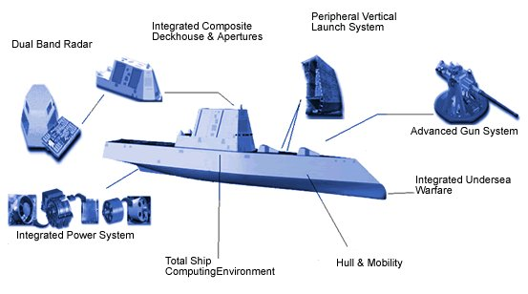
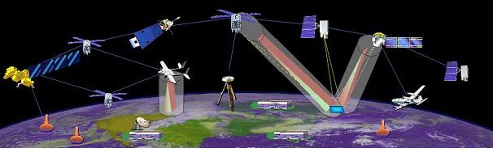

Context: Distributed Real-time Embedded (DRE) Systems
Heterogeneous soft real-time applications
Stringent simultaneous QoS demands
  High availability, Predictability (CPU & network) etc
  Efficient resource utilization
Operation in dynamic & resource-constrained environments
  Process/processor failures
  Changing system loads
Examples
  Total shipboard computing environment
  NASA’s Magnetospheric Multi-scale mission
  Warehouse Inventory Tracking Systems
Component-based application model used due to benefits stemming from:
  Separation of concerns
  Composability
  Reuse of commodity-off-the-shelf (COTS) components
(Images courtesy Google)
Notes:
4

Slide 5
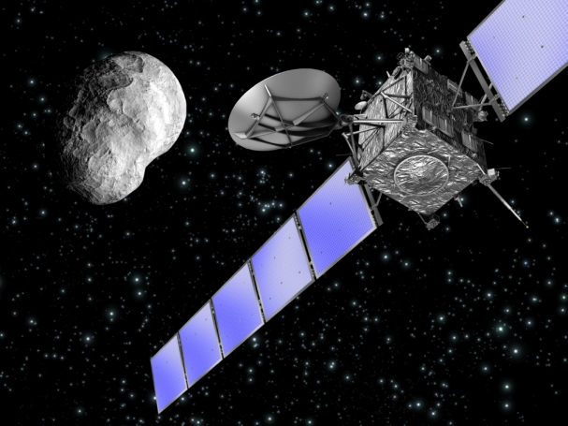
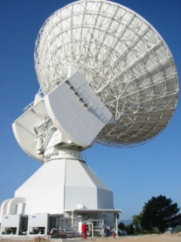

Motivating Case Study
Mission Control System of the European Space Agency (ESA)
  Short connection windows
  No physical access to the satellites
  Software must not crash
  Very heterogeneous infrastructure
  Must ensure correctness of data
Notes:
5

Slide 6
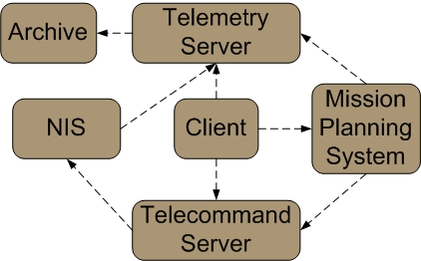
Case Study: ESA Mission Control System
Mission Control Systems are the central means for control & observations of space missions
Simultaneous operations of multiple real-time applications
Stringent simultaneous QoS requirements
  e.g., high availability & satisfactory average response times
Notes:
6

Slide 7
Case Study: ESA Mission Control System
Mission Control Systems are the central means for control & observations of space missions
Simultaneous operations of multiple real-time applications
Stringent simultaneous QoS requirements
  e.g., high availability & satisfactory average response times
A Network Interface System is the WAN gateway to the Ground Station Network
Notes:
7

Slide 8
Case Study: ESA Mission Control System
Mission Control Systems are the central means for control & observations of space missions
Simultaneous operations of multiple real-time applications
Stringent simultaneous QoS requirements
  e.g., high availability & satisfactory average response times
Telemetry Server processes telemetry data from mission satellites
Notes:
8

Slide 9
Case Study: ESA Mission Control System
Mission Control Systems are the central means for control & observations of space missions
Simultaneous operations of multiple real-time applications
Stringent simultaneous QoS requirements
  e.g., high availability & satisfactory average response times
Data stored permanently in an Archive
Notes:
9

Slide 10
Case Study: ESA Mission Control System
Mission Control Systems are the central means for control & observations of space missions
Simultaneous operations of multiple real-time applications
Stringent simultaneous QoS requirements
  e.g., high availability & satisfactory average response times
Telecommand Server sends new operational commands to mission satellites
Notes:
10

Slide 11
Case Study: ESA Mission Control System
Mission Control Systems are the central means for control & observations of space missions
Simultaneous operations of multiple real-time applications
Stringent simultaneous QoS requirements
  e.g., high availability & satisfactory average response times
Mission Planning System configures & observes the other system entities based on the specific mission characteristics
Notes:
11

Slide 12
Case Study: ESA Mission Control System
Mission Control Systems are the central means for control & observations of space missions
Simultaneous operations of multiple real-time applications
Stringent simultaneous QoS requirements
  e.g., high availability & satisfactory average response times
Client access, such as an operator GUI, needs to interact with several components
Notes:
12

Slide 13
Presentation Road Map
Technology Context: DRE Systems
DRE System Lifecycle & FT-RT Challenges
Design-time Solutions
Deployment & Configuration-time Solutions
Runtime Solutions
Ongoing Work
Concluding Remarks
Notes:
13

Slide 14
Component-based Design of DRE Systems
Operational String model of component-based DRE systems
  A multi-tier processing model focused on the end-to-end QoS requirements
  Functionality is a chain of tasks scheduled on a pool of computing nodes
  Resources, QoS, & deployment are managed end-to-end
End-to-end QoS requirements
  Critical Path: The chain of tasks that is time-critical from source to destination
  Need predictable scheduling of computing resources across components
  Need network bandwidth reservations to ensure timely packet delivery
  Failures may compromise end-to-end QoS
Must support highly available operational strings!

Slide 15
A Perspective of Component-based DRE System Lifecycle
Development Lifecycle
QoS (e.g. FT) provisioning should be integrated within this lifecycle
Specification
Gathering and specifying functional and non functional requirements of the system
Composition
Defining the operational strings through component composition
Deploying components onto computing nodes
Configuring the hosting infrastructure to support desired QoS properties
Deployment
Configuration
Mechanisms to provide real-time fault recovery
Mechanisms to deal with the side effects of replication & non-determinism at run-time
Run-time

Slide 16
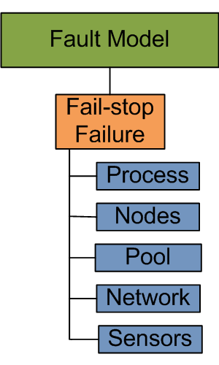

Specification: Fault Tolerance Criteria (1/4)
The fault-model consists of fail-stop failures
  Cause delays & requires software/hardware redundancy
  Recovery must be quick to meet the deadline (soft real-time)
What are reliability alternatives?
  Roll-back recovery
    Transactional
  Roll-forward recovery: replication schemes
    Active replication (multiple concurrent executions)
    Passive replication (primary-backup approach)
Roll-back recovery | Active Replication | Passive Replication
Resources
Needs transaction support (heavy-weight) | Resource hungry (compute & network) | Less resource consuming than active (only network)
Non-determinism
Must compensate non-determinism | Must enforce determinism | Handles non-determinism better
Recovery time
Roll-back & re-execution (slowest recovery) | Fastest recovery | Re-execution (slower recovery)

Slide 17
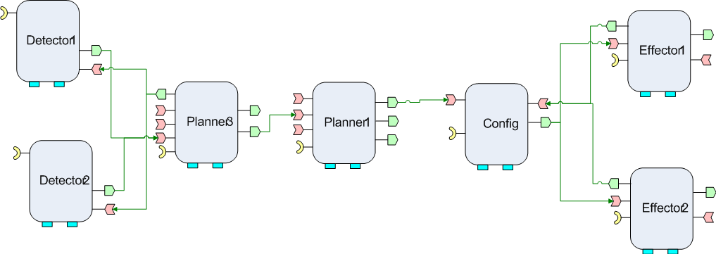
Specification: Fault Tolerance Criteria (2/4)
What is failover granularity for passive replication?
  Single component failover only? or
  Larger than a single component?
Scenario 1: Must tolerate catastrophic faults
  e.g., data center failure, network failure
N
N
N
N
N
N
N
Whole operational string must
failover
Pool 1
N
N
Replica
N
Clients
N
N
N
N
N
Pool 2

Slide 18
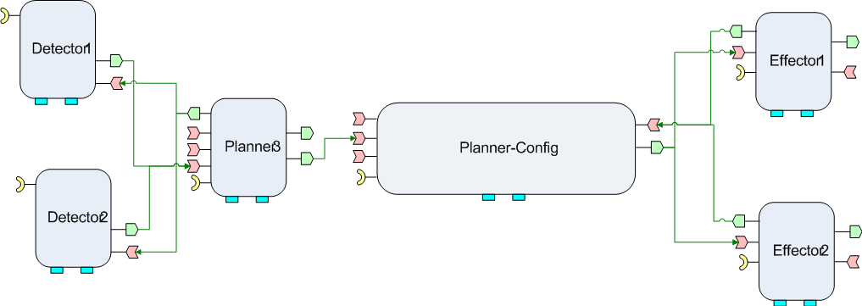
Specification: Fault Tolerance Criteria (3/4)
Scenario 2: Must tolerate Bohrbugs
  A Bohrbug repeats itself predictably when the same state reoccurs
Preventing Bohrbugs by “reliability through diversity”
  Diversity via non-isomorphic replication
Non-isomorphic
work-flow
and
implementation
of Replica
Different
End-to-end
QoS
(thread pools, deadlines, priorities)
Whole operational string must failover

Slide 19
Specification: Fault Tolerance Criteria (4/4)
Scenario 3: Must tolerate non-determinism
  Sources of non-determinism in DRE systems
    Local information (sensors, clocks), thread-scheduling, timers, timeouts, & more
  Enforcing determinism is not always possible
Must tolerate side-effects of replication + non-determinism
  Problem: Orphan request & orphan state
  Solution based on single component failover require costly roll-backs
Fault-tolerance provisioning should be transparent
  Separation of availability concerns from the business logic
  Improves reusability, productivity, & perceived availability of the system
Non-determinism
Replication
Potential orphan state
Need a methodology to capture these requirements and provision them for DRE systems

Slide 20
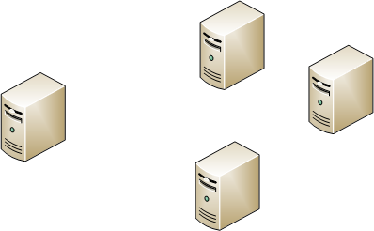
Deployment: Criteria for Fault-tolerance
Deployment of applications & replicas
Notes:
20

Slide 21
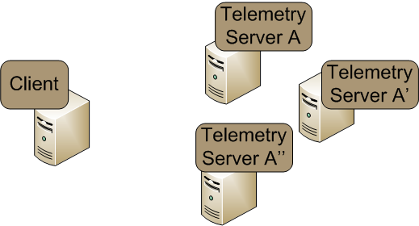
Deployment: Criteria for Fault-tolerance
Deployment of applications & replicas
  Identify different hosts for deploying applications & each of their replicas
    no two replicas of the same application are hosted in the same processor
  allocate resources for applications & replicas
    deploy applications & replicas in the chosen hosts
Notes:
21

Slide 22
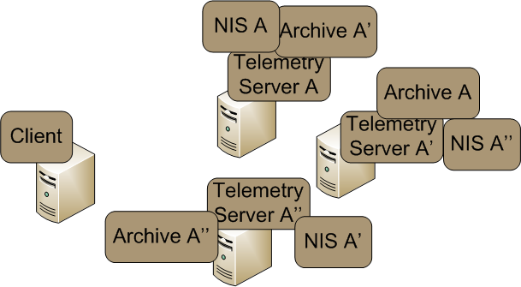
Challenges in Deployment of Fault-tolerant DRE Systems
Ad-hoc allocation of applications & replicas could provide FT
  could lead to resource minimization, however,
    system might not be schedulable
Schedulability depends on the tasks collocated in the same processor
Notes:
22

Slide 23
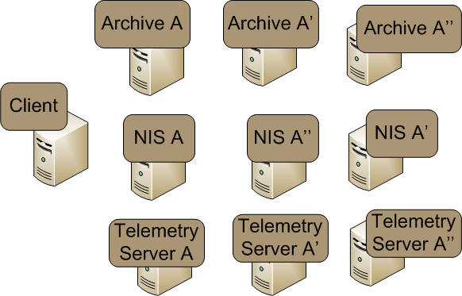
Challenges in Deployment of Fault-tolerant DRE Systems
Ad-hoc allocation of applications & replicas could provide FT
  could lead to resource minimization, however,
    system might not be schedulable
  could lead to system schedulability & high availability, however,
    could miss collocation opportunities => performance suffers
    could cause inefficient resource utilization
A good FT solution – but not a resource efficient RT solution
Notes:
23

Slide 24
Challenges in Deployment of Fault-tolerant DRE Systems
Ad-hoc allocation of applications & replicas could provide FT
  could lead to resource minimization, however,
    system might not be schedulable
  could lead to system schedulability & high availability, however,
    could miss collocation opportunities => performance suffers
    could cause inefficient resource utilization
    inefficient allocations – for both applications & replicas – could lead to resource imbalance & affect soft real-time performance
    applications & their replicas must be deployed in their appropriate physical hosts
      need for resource-aware deployment techniques
Need for Real-time, Fault-aware and Resource-aware Allocation Algorithms
Notes:
24

Slide 25
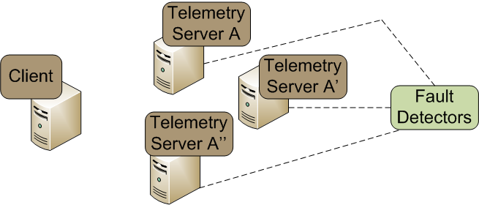
Configuration: Criteria for Fault-tolerance
Configuration of RT-FT Middleware
  Install & configure fault detectors that periodically monitor liveness on each processor
Notes:
25

Slide 26
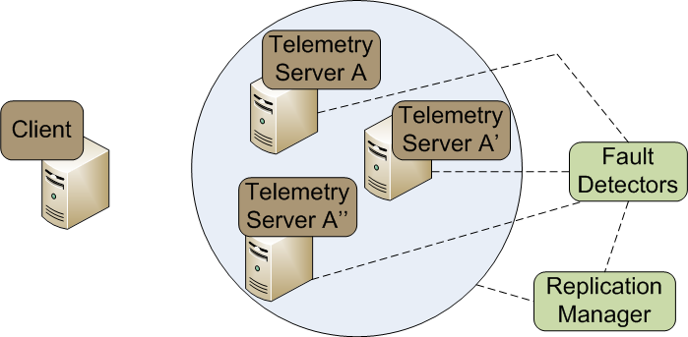
Configuration: Criteria for Fault-tolerance
Configuration of RT-FT Middleware
  Install & configure fault detectors that periodically monitor liveness on each processor
  register all the applications, their replicas, & fault detectors with a replication manager to provide group membership management
Notes:
26

Slide 27
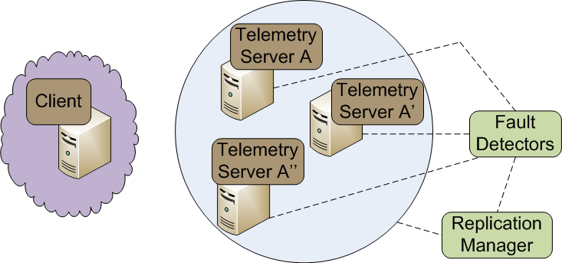
Configuration: Criteria for Fault-tolerance
Configuration of RT-FT Middleware
  Install & configure fault detectors that periodically monitor liveness on each processor
  register all the applications, their replicas, & fault detectors with a replication manager to provide group membership management
  configure client-side middleware to catch failure exceptions & with failure recovery actions
Notes:
27

Slide 28
Configuration: Criteria for Fault-tolerance
Configuration of RT-FT Middleware
  Install & configure fault detectors that periodically monitor liveness on each processor
  register all the applications, their replicas, & fault detectors with a replication manager to provide group membership management
  configure client-side middleware to catch failure exceptions & with failure recovery actions
  bootstrap applications
Notes:
28

Slide 29
Challenges in Configuring Fault-tolerant DRE Systems
Configuring RT-FT middleware is hard
  developers often need to make tedious & error-prone invasive source code changes to manually configure middleware
Code for interacting with middleware-based group management mechanisms
Code for interacting with middleware-based fault detectors coupled with business logic
Code for interacting with middleware-based client-side failure detector & recovery mechanisms
Notes:
29

Slide 30
Challenges in Configuring Fault-tolerant DRE Systems
Configuring RT-FT middleware is hard
  developers often need to make tedious & error-prone invasive source code changes to manually configure middleware
  manual source code modifications require knowledge of underlying middleware – which is hard
Code for interacting with middleware-based client-side failure detector & recovery mechanisms
Notes:
30

Slide 31
Challenges in Configuring Fault-tolerant DRE Systems
Configuring RT-FT middleware is hard
  developers often need to make tedious & error-prone invasive source code changes to manually configure middleware
  manual source code modifications require knowledge of underlying middleware – which is hard
    need to repeat configuration actions as underlying middleware changes
Code for interacting with middleware-based client-side failure detector & recovery mechanisms
Notes:
31

Slide 32
Challenges in Configuring Fault-tolerant DRE Systems
Configuring RT-FT middleware is hard
  developers often need to make tedious & error-prone invasive source code changes to manually configure middleware
  manual source code modifications require knowledge of underlying middleware – which is hard
    need to repeat configuration actions as underlying middleware changes
Scale & complexity of DRE systems make it infeasible to adopt manual techniques
Code for interacting with middleware-based client-side failure detector & recovery mechanisms
Notes:
32

Slide 33
Challenges in Configuring Fault-tolerant DRE Systems
Configuring RT-FT middleware is hard
  developers often need to make tedious & error-prone invasive source code changes to manually configure middleware
  manual source code modifications require knowledge of underlying middleware – which is hard
    need to repeat configuration actions as underlying middleware changes
Applications must seamlessly leverage advances in middleware mechanisms
  QoS goals change, but business logic does not
  need for scalable deployment & configuration techniques
Need for Scalable Deployment & Configuration Middleware
Notes:
33

Slide 34
Runtime: Criteria for Fault-tolerant DRE Systems
Runtime management
  detect failures
Notes:
34

Slide 35
Runtime: Criteria for Fault-tolerant DRE Systems
Runtime management
  detect failures
  transparently failover to alternate replicas & provide high availability to clients
Notes:
35

Slide 36
Challenges in Runtime Management of Fault-tolerant DRE Systems
Providing high availability & soft real-time performance at runtime is hard
  failures need to be detected quickly so that failure recovery actions can proceed
Client-side middleware should catch failure exception
Notes:
36

Slide 37
Challenges in Runtime Management of Fault-tolerant DRE Systems
Providing high availability & soft real-time performance at runtime is hard
  failures need to be detected quickly so that failure recovery actions can proceed
    failure recovery should be fast
Client-side middleware should have sufficient information about replicas to provide fast failover
Notes:
37

Slide 38
Challenges in Runtime Management of Fault-tolerant DRE Systems
Providing high availability & soft real-time performance at runtime is hard
  failures need to be detected quickly so that failure recovery actions can proceed
    failure recovery should be fast
But why failover to Telemetry Server A’’?
Client-side middleware should have sufficient information about replicas to provide fast failover
Notes:
38

Slide 39
Challenges in Runtime Management of Fault-tolerant DRE Systems
Providing high availability & soft real-time performance at runtime is hard
  failures need to be detected quickly so that failure recovery actions can proceed
    failure recovery should be fast
But why failover to Telemetry Server A’’?
why not failover to Telemetry Server A’?
Client-side middleware should have sufficient information about replicas to provide fast failover
Notes:
39

Slide 40
Challenges in Runtime Management of Fault-tolerant DRE Systems
Providing high availability & soft real-time performance at runtime is hard
  failures need to be detected quickly so that failure recovery actions can proceed
    failure recovery should be fast
But why failover to Telemetry Server A’’?
why not failover to Telemetry Server A’?
Decision on where to failover should be taken in a resource-aware manner based on the loads on the replica processors
Notes:
40

Slide 41
Challenges in Runtime Management of Fault-tolerant DRE Systems
Providing high availability & soft real-time performance at runtime is hard
  failures need to be detected quickly so that failure recovery actions can proceed
    failure recovery should be fast
Ad-hoc mechanisms to recover from failures & overloads could affect soft real-time performance of clients
  need for adaptive fault-tolerance techniques
Need for Adaptive Fault-tolerant Middleware
React to dynamic system load changes & adapt system FT-RT configurations
Notes:
41

Slide 42
Summary of FT QoS Provisioning Challenges Across DRE Lifecycle
Development Lifecycle
Our solutions integrate within the traditional DRE system lifecycle
Specification
How to specify FT & other end-to-end QoS requirements?
Composition
How to compose & deploy application components & their replicas with concern for minimizing resources used yet satisfying FT-RT requirements?
How to configure the underlying middleware to provision QoS?
Deployment
Configuration
How to provide real-time fault recovery?
How to deal with the side effects of replication & non-determinism at run-time?
Run-time

Slide 43
Presentation Road Map
Technology Context: DRE Systems
DRE System Lifecycle & FT-RT Challenges
Design-time Solutions
Deployment & Configuration-time Solutions
Runtime Solutions
Ongoing Work
Concluding Remarks
Notes:
43

Slide 44
Specifying FT & Other QoS Properties
Resolves challenges in
Component QoS Modeling Language (CQML)
  Aspect-oriented Modeling for Modularizing QoS Concerns
Specification
Composition
Deployment
Focus on Model-driven Engineering and generative techniques to specify and provision QoS properties
Configuration
Run-time

Slide 45
Related Research: QoS Modeling
Category | Related Research (QoS & FT Modeling)
Using UML | UML Profile for Schedulability, Performance, & Time (SPT) UML Profile for Modeling Quality of Service & Fault Tolerance Characteristics & Mechanisms (QoS&FT) UML Profile for Modeling & Analysis of Real-Time & Embedded Systems (MARTE) Component Quality Modeling Language by J. ÃŸyvind Aagedal Modeling & Integrating Aspects into Component Architectures by L. Michotte, R. France, & F. Fleurey A Model-Driven Development Framework for Non-Functional Aspects in Service Oriented Architecture by H. Wada, J. Suzuki, & K. Oba
Using domain-specific languages (DSL) | Model-based Development of Embedded Systems: The SysWeaver Approach by D. de Niz, G. Bhatia, & R. Rajkumar A Modeling Language & Its Supporting Tools for Avionics Systems by G. Karsai, S. Neema, B. Abbott, & D. Sharp High Service Availability in MaTRICS for the OCS by M. Bajohr & T. Margaria Modeling of Reliable Messaging in Service Oriented Architectures by L. Gönczy & D. Varró Fault tolerance AOP approach by J. Herrero, F. Sanchez, & M. Toro
45

Slide 46
Related Research: QoS Modeling
Category | Related Research (QoS & FT Modeling)
Using UML | UML Profile for Schedulability, Performance, & Time (SPT) UML Profile for Modeling Quality of Service & Fault Tolerance Characteristics & Mechanisms (QoS&FT) UML Profile for Modeling & Analysis of Real-Time & Embedded Systems (MARTE) Component Quality Modeling Language by J. ÃŸyvind Aagedal Modeling & Integrating Aspects into Component Architectures by L. Michotte, R. France, & F. Fleurey A Model-Driven Development Framework for Non-Functional Aspects in Service Oriented Architecture by H. Wada, J. Suzuki, & K. Oba
Using domain-specific languages (DSL) | Model-based Development of Embedded Systems: The SysWeaver Approach by D. de Niz, G. Bhatia, & R. Rajkumar A Modeling Language & Its Supporting Tools for Avionics Systems by G. Karsai, S. Neema, B. Abbott, & D. Sharp High Service Availability in MaTRICS for the OCS by M. Bajohr & T. Margaria Modeling of Reliable Messaging in Service Oriented Architectures by L. Gönczy & D. Varró Fault tolerance AOP approach by J. Herrero, F. Sanchez, & M. Toro
Recovery block modeling
and
QoS for SOA
Lightweight &
Heavyweight
UML extensions
MoC = service logic graphs, state machine,
Java extension
46

Slide 47
QoS Specification: What is Missing for DRE Systems?
Development Lifecycle
  Crosscutting availability requirements
    Tangled with primary structural dimension
    Tangled with secondary dimensions (deployment, QoS)
  Composing replicated & non-replicated functionality
  Example: Replicas must be modeled, composed, & deployed
Imposes modeling overhead
Supporting non-isomorphic replication
  Reliability through diversity (structural & QoS)
  Supporting graceful degradation through diversity
Specification
Composition
Deployment
Imposes modeling overhead
Configuration
Composing connections
Run-time
Composing
replicas

Slide 48
QoS Specification: What is Missing for DRE Systems?
Development Lifecycle
Variable granularity of failover
  Whole operational string, sub-string, or a component group
Variable QoS association granularity
Network-level QoS specification (connection level)
  Differentiated service based on traffic class & flow
    Example: High priority, high reliability, low latency
  Bidirectional bandwidth requirements
Specification
Port-level
Connection-level
Composition
Component-level
Deployment
Configuration
Run-time

Slide 49
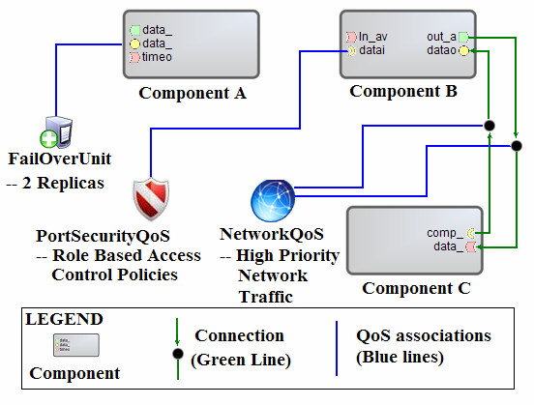
Our Solution: Domain Specific Modeling
Component QoS Modeling Language (CQML)
  A modeling framework for declarative QoS specification
  Reusable for multiple composition modeling languages
Failover unit for Fault-tolerance
  Capture the granularity of failover
  Specify # of replicas
Network-level QoS
  Annotate component connections
  Specify priority of communication traffic
  Bidirectional bandwidth requirements
Security QoS
Real-time CORBA configuration
Event channel configuration

Slide 50
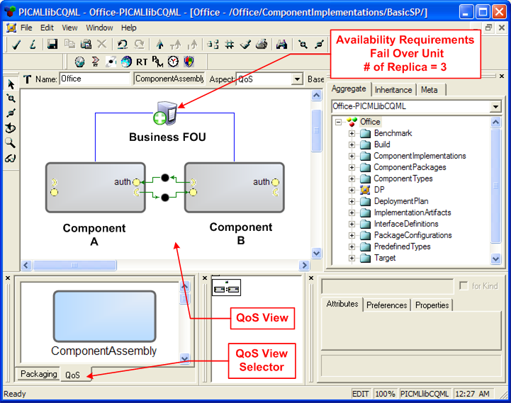
Separation of Concerns in CQML
Resolving tangling of functional composition & QoS concerns
Separate Structural view from the QoS view
GRAFT transformations use aspect-oriented model weaving to coalesce both the views of the model

Slide 51
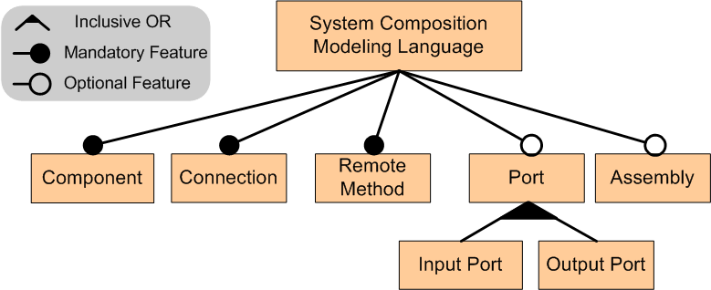
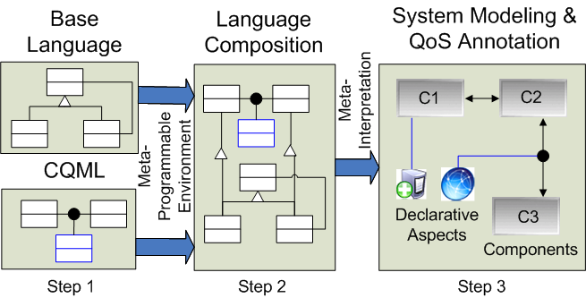
Granularity of QoS Associations in CQML
Commonality/Variability analysis of composition modeling languages
  e.g., PICML for CCM, J2EEML for J2EE, ESML for Boeing Bold-Stroke
Feature model of composition modeling languages
Dictates QoS association granularity
Composition Modeling Language
Enhance composition language to model QoS
  GME meta-model composition

Slide 52
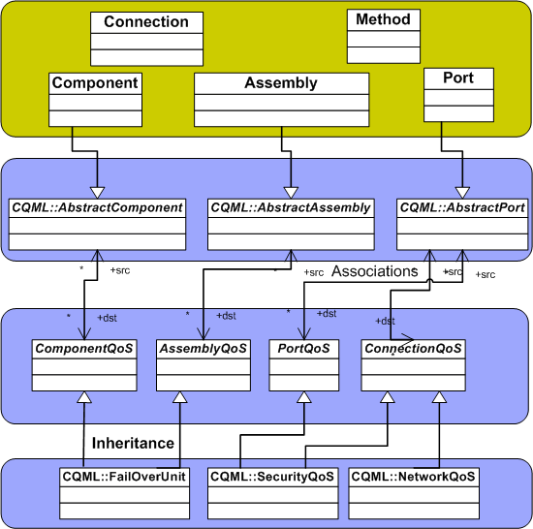



Composing CQML (1/3)
PICML or J2EEML or ESML
Composition Modeling Language
Goal: Create reusable & loosely coupled associations
ConcreteQoS Elements
CQML

Slide 53
Composing CQML (2/3)
PICML or J2EEML or ESML
Composition Modeling Language
Dependency Inversion Principle
CQML Join-point Model
CQML
ConcreteQoS Elements
Notes:
To achieve that we introduce CQML join-point model. It is a layer of abstraction that is a collection of abstract structural elements. This set is based on the feature model of composition modeling languages we saw earlier. The concrete structural elements inherit from the abstract structural elements. This is nothing but an application of DIP at the metamodeling level. DIP says that.…

Slide 54
Composing CQML (3/3)
PICML or J2EEML or ESML
Composition Modeling Language
CQML Join-point Model
Grouping of QoS elements using is-a relationship
Abstract QoS Elements
CQML
ConcreteQoS Elements
Notes:
We still need to connect abstract structural elements to the concrete QoS elements. We simply group the QoS elements depending upon where they can be associated to. For example …. Network QoS can be associated with connections only whereas FOU can be associated with component & assemblies.

Slide 55
Composing CQML (3/3)
PICML or J2EEML or ESML
Composition Modeling Language
CQML Join-point Model
Abstract QoS Elements
CQML
ConcreteQoS Elements
Notes:
This is also an application of DIP at the metamodeling level. This two level indirection allows us to reuse CQML on multiple composition modeling languages.

Slide 56
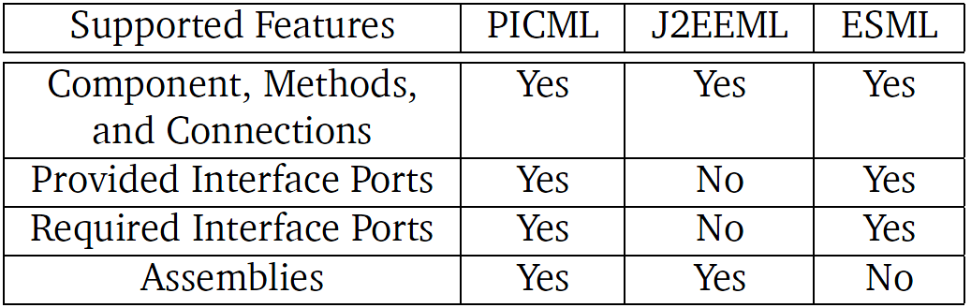
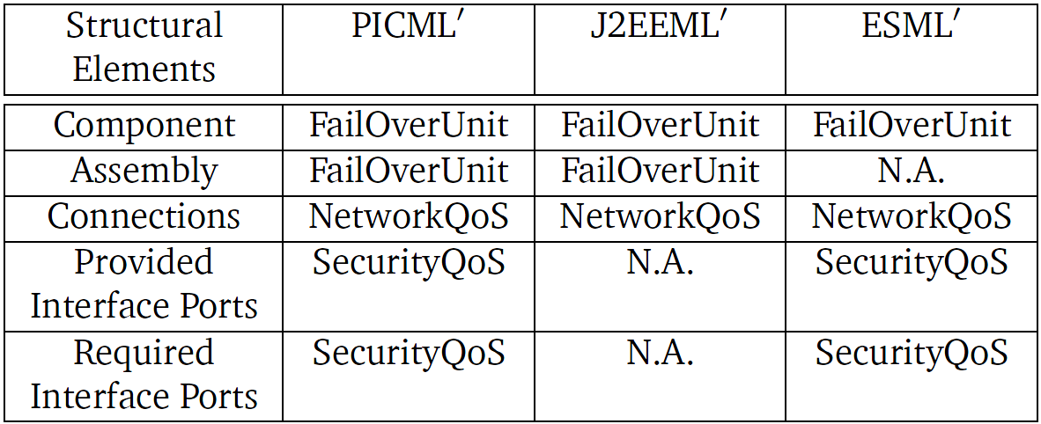
Evaluating Composability of CQML
Three composition modeling languages
  PICML
  J2EEML
  ESML
Available feature-set determines the extent of applicability of the join-point model
Three composite languages with varying QoS modeling capabilities
  PICML’
  J2EEML’
  ESML’

Slide 57
Presentation Road Map
Technology Context: DRE Systems
DRE System Lifecycle & FT-RT Challenges
Design-time Solutions
Deployment & Configuration-time Solutions
Runtime Solutions
Ongoing Work
Concluding Remarks
Notes:
57

Slide 58
Post-Specification Phase: Resource Allocation, Deployment and Configuration
Resolves challenges in
Focus on Resource Allocation Algorithms and Frameworks used in Deployment and Configuration Phases
Specification
Composition
Deployment & Configuration Reasoning & Analysis via Modeling (DeCoRAM)
  Provides a specific deployment algorithm
  Algorithm-agnostic deployment engine
  Middleware-agnostic configuration engine
Deployment
Configuration
Run-time

Slide 59
Related Research
Category | Related Research
CORBA-based Fault-tolerant Middleware Systems | P. Felber et. al., Experiences, Approaches, & Challenges in Building Fault-tolerant CORBA Systems, in IEEE Transactions on Computers, May 2004 T. Bennani et. al., Implementing Simple Replication Protocols Using CORBA Portable Interceptors & Java Serialization, in Proceedings of the IEEE International Conference on Dependable Systems & Networks (DSN 2004), Italy, 2004 P. Narasimhan et. al., MEAD: Support for Real-time Fault-tolerant CORBA, in Concurrency & Computation: Practice & Experience, 2005
Adaptive Passive Replication Systems | S. Pertet et. al., Proactive Recovery in Distributed CORBA Applications, in Proceedings of the IEEE International Conference on Dependable Systems & Networks (DSN 2004), Italy, 2004 P. Katsaros et. al., Optimal Object State Transfer – Recovery Policies for Fault-tolerant Distributed Systems, in Proceedings of the IEEE International Conference on Dependable Systems & Networks (DSN 2004), Italy, 2004 Z. Cai et. al., Utility-driven Proactive Management of Availability in Enterprise-scale Information Flows, In Proceedings of the ACM/IFIP/USENIX Middleware Conference (Middleware 2006), Melbourne, Australia, November 2006 L. Froihofer et. al., Middleware Support for Adaptive Dependability, In Proceedings of the ACM/IFIP/USENIX Middleware Conference (Middleware 2007), Newport Beach, CA, November 2007

Slide 60
Related Research
Category | Related Research
CORBA-based Fault-tolerant Middleware Systems | P. Felber et. al., Experiences, Approaches, & Challenges in Building Fault-tolerant CORBA Systems, in IEEE Transactions on Computers, May 2004 T. Bennani et. al., Implementing Simple Replication Protocols Using CORBA Portable Interceptors & Java Serialization, in Proceedings of the IEEE International Conference on Dependable Systems & Networks (DSN 2004), Italy, 2004 P. Narasimhan et. al., MEAD: Support for Real-time Fault-tolerant CORBA, in Concurrency & Computation: Practice & Experience, 2005
Adaptive Passive Replication Systems | S. Pertet et. al., Proactive Recovery in Distributed CORBA Applications, in Proceedings of the IEEE International Conference on Dependable Systems & Networks (DSN 2004), Italy, 2004 P. Katsaros et. al., Optimal Object State Transfer – Recovery Policies for Fault-tolerant Distributed Systems, in Proceedings of the IEEE International Conference on Dependable Systems & Networks (DSN 2004), Italy, 2004 Z. Cai et. al., Utility-driven Proactive Management of Availability in Enterprise-scale Information Flows, In Proceedings of the ACM/IFIP/USENIX Middleware Conference (Middleware 2006), Melbourne, Australia, November 2006 L. Froihofer et. al., Middleware Support for Adaptive Dependability, In Proceedings of the ACM/IFIP/USENIX Middleware Conference (Middleware 2007), Newport Beach, CA, November 2007
Runtime adaptations to reduce failure recovery times
Middleware building blocks for fault-tolerant systems

Slide 61
Related Research
Category | Related Research
Real-time Fault-tolerance for Transient Failures | H. Aydin, Exact Fault-Sensitive Feasibility Analysis of Real-time Tasks, In IEEE Transactions of Computers, 2007 G. Lima et. al., An Optimal Fixed-Priority Assignment Algorithm For Supporting Fault-Tolerant Hard Real-Time Systems, In IEEE Transactions on Computers, 2003 Y. Zhang et. al., A Unified Approach For Fault Tolerance & Dynamic Power Management in Fixed-Priority Real-Time Systems, in IEEE Transactions on Computer-Aided Design of Integrated Circuits & Systems, 2006
Real-time Fault Tolerance for Permanent Failures | J. Chen et. al., Real-Time Task Replication For Fault-Tolerance in Identical Multiprocessor Systems, In Proceedings of the IEEE Real-Time & Embedded Technology & Applications Symposium (IEEE RTAS), 2007 P. Emberson et. al., Extending a Task Allocation Algorithm for Graceful Degradation of Real-time Distributed Embedded Systems, In Proceedings of the IEEE Real-time Systems Symposium (IEEE RTSS), 2008 A. Girault et. al., An Algorithm for Automatically Obtaining Distributed & Fault-Tolerant Static Schedules, in Proceedings of the IEEE International Conference on Dependable Systems & Networks (IEEE DSN ), 2003 S. Gopalakrishnan et. al., Task Partitioning with Replication Upon Heterogeneous Multiprocessor Systems, in Proceedings of the IEEE Real-Time & Embedded Technology & Applications Symposium (IEEE RTAS), 2006

Slide 62
Related Research
Category | Related Research
Real-time Fault-tolerance for Transient Failures | H. Aydin, Exact Fault-Sensitive Feasibility Analysis of Real-time Tasks, In IEEE Transactions of Computers, 2007 G. Lima et. al., An Optimal Fixed-Priority Assignment Algorithm For Supporting Fault-Tolerant Hard Real-Time Systems, In IEEE Transactions on Computers, 2003 Y. Zhang et. al., A Unified Approach For Fault Tolerance & Dynamic Power Management in Fixed-Priority Real-Time Systems, in IEEE Transactions on Computer-Aided Design of Integrated Circuits & Systems, 2006
Real-time Fault Tolerance for Permanent Failures | J. Chen et. al., Real-Time Task Replication For Fault-Tolerance in Identical Multiprocessor Systems, In Proceedings of the IEEE Real-Time & Embedded Technology & Applications Symposium (IEEE RTAS), 2007 P. Emberson et. al., Extending a Task Allocation Algorithm for Graceful Degradation of Real-time Distributed Embedded Systems, In Proceedings of the IEEE Real-time Systems Symposium (IEEE RTSS), 2008 A. Girault et. al., An Algorithm for Automatically Obtaining Distributed & Fault-Tolerant Static Schedules, in Proceedings of the IEEE International Conference on Dependable Systems & Networks (IEEE DSN ), 2003 S. Gopalakrishnan et. al., Task Partitioning with Replication Upon Heterogeneous Multiprocessor Systems, in Proceedings of the IEEE Real-Time & Embedded Technology & Applications Symposium (IEEE RTAS), 2006
Used active replication schemes
Static allocation algorithms that deal with transient failures

Slide 63
Related Research
Category | Related Research
Passive Replication Based Real-time Fault-Tolerant Task Allocation Algorithms | R. Al-Omari et. al., An Adaptive Scheme for Fault-Tolerant Scheduling of Soft Real-time Tasks in Multiprocessor Systems , In Journal of Parallel & Distributed Computing, 2005 W. Sun et. al., Hybrid Overloading & Stochastic Analysis for Redundant Real-time Multiprocessor Systems, In Proceedings of the IEEE Symposium on Reliable Distributed Systems (IEEE SRDS), 2007 Q. Zheng et. al., On the Design of Fault-Tolerant Scheduling Strategies Using Primary-Backup Approach for Computational Grids with Low Replication Costs, in IEEE Transactions on Computers, 2009

Slide 64
Related Research
Category | Related Research
Passive Replication Based Real-time Fault-Tolerant Task Allocation Algorithms | R. Al-Omari et. al., An Adaptive Scheme for Fault-Tolerant Scheduling of Soft Real-time Tasks in Multiprocessor Systems , In Journal of Parallel & Distributed Computing, 2005 W. Sun et. al., Hybrid Overloading & Stochastic Analysis for Redundant Real-time Multiprocessor Systems, In Proceedings of the IEEE Symposium on Reliable Distributed Systems (IEEE SRDS), 2007 Q. Zheng et. al., On the Design of Fault-Tolerant Scheduling Strategies Using Primary-Backup Approach for Computational Grids with Low Replication Costs, in IEEE Transactions on Computers, 2009
All these algorithms deal with dynamic scheduling

Slide 65
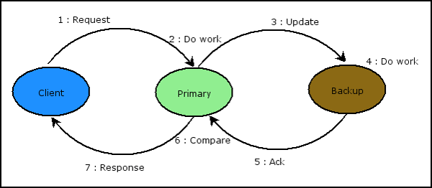
D&C: What is Missing for DRE Systems?
Existing passive replication middleware solutions are not resource-aware
  provide mechanisms – but no intuition on how to use them to obtain the required solution
  timeliness assurances might get affected as failures occur
Existing real-time fault-tolerant task allocation algorithms are not appropriate for closed DRE systems
  they deal with active replication which is not ideal for resource-constrained systems
  those that deal with passive replication
    support only one processor failure
    require dynamic scheduling – which adds extra unnecessary overhead
Notes:
65

Slide 66
Our Solution: The DeCoRAM D&C Middleware
DeCoRAM = “Deployment & Configuration Reasoning via Analysis & Modeling”
DeCoRAM consists of
  Pluggable Allocation Engine that determines appropriate node mappings for all applications & replicas using installed algorithm
  Deployment & Configuration Engine that deploys & configures (D&C) applications and replicas on top of middleware in appropriate hosts
  A specific allocation algorithm that is real time-, fault- and resource-aware
No coupling with allocation algorithm
Middleware-agnostic D&C Engine

Slide 67
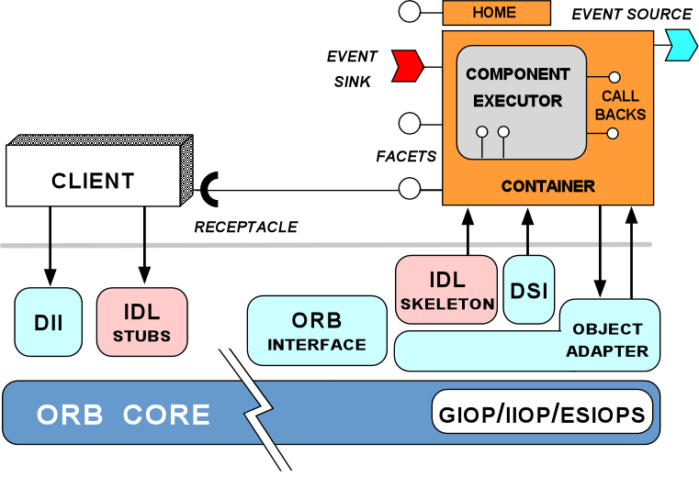
Overview of DeCoRAM Contributions
Provides a replica allocation algorithm that is
  Real time-aware
  Fault-aware
  Resource-aware
Supports a large class of DRE systems => No tight coupling to any single allocation algorithm
Supports multiple middleware technologies => Automated middleware configuration that is not coupled to any middleware
Notes:
67

Slide 68
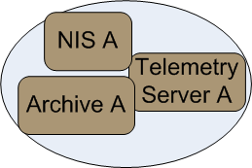
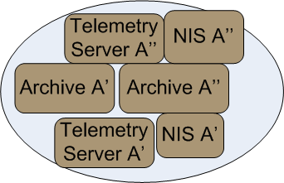
DeCoRAM Allocation Algorithm
System model
  N periodic DRE system tasks
  RT requirements – periodic tasks, worst-case execution time (WCET), worst-case state synchronization time (WCSST)
  FT requirements – K number of processor failures to tolerate (number of replicas)
  Fail-stop processors
How many processors shall we need for a primary-backup scheme? – A basic intuition
Num proc in No-fault case <=
Num proc for passive replication <= Num proc for active replication

Slide 69
DeCoRAM Allocation Algorithm (1/2)
System model
  N periodic DRE system tasks
  RT requirements – periodic tasks, worst-case execution time (WCET), worst-case state synchronization time (WCSST)
  FT requirements – K number of processor failures to tolerate (number of replicas)
  Fail-stop processors
How many processors shall we need for a primary-backup scheme? – A basic intuition
Num proc in No-fault case <=
Num proc for passive replication <= Num proc for active replication

Slide 70
DeCoRAM Allocation Algorithm (2/2)
System objective
  Find a mapping of N periodic DRE tasks & their K replicas so as to minimize the total number of processors utilized
    no two replicas are in the same processor
    All tasks are schedulable both in faulty as well as non-faulty scenarios
DeCoRAM Allocation Engine
Similar to bin-packing, but harder due to combined FT & RT constraints

Slide 71
Designing the DeCoRAM Allocation Algorithm (1/5)
  Basic Step 1: No fault tolerance
  Only primaries exist consuming WCET each
  Apply first-fit optimal bin-packing using the [Dhall:78]* algorithm
  Consider sample task set shown
  Tasks arranged according to rate monotonic priorities
Task | WCET | WCSST | Period | Util
A | 20 | 0.2 | 50 | 40
B | 40 | 0.4 | 100 | 40
C | 50 | 0.5 | 200 | 25
D | 200 | 2 | 500 | 40
E | 250 | 2.5 | 1,000 | 25
    *[Dhall:78] S. K. Dhall & C. Liu, “On a Real-time Scheduling Problem”, Operations Research, 1978

Slide 72
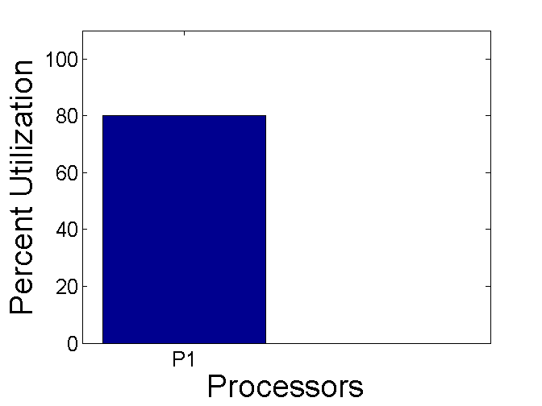
Designing the DeCoRAM Allocation Algorithm (1/5)
  Basic Step 1: No fault tolerance
  Only primaries exist consuming WCET each
  Apply first-fit optimal bin-packing using the [Dhall:78] algorithm
  Consider sample task set shown
  Tasks arranged according to rate monotonic priorities
Task | WCET | WCSST | Period | Util
A | 20 | 0.2 | 50 | 40
B | 40 | 0.4 | 100 | 40
C | 50 | 0.5 | 200 | 25
D | 200 | 2 | 500 | 40
E | 250 | 2.5 | 1,000 | 25

Slide 73
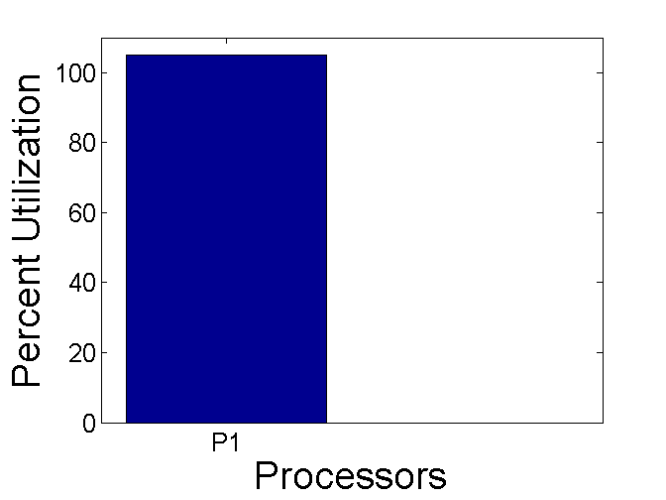

Designing the DeCoRAM Allocation Algorithm (1/5)
  Basic Step 1: No fault tolerance
  Only primaries exist consuming WCET each
  Apply first-fit optimal bin-packing using the [Dhall:78] algorithm
  Consider sample task set shown
  Tasks arranged according to rate monotonic priorities
Task | WCET | WCSST | Period | Util
A | 20 | 0.2 | 50 | 40
B | 40 | 0.4 | 100 | 40
C | 50 | 0.5 | 200 | 25
D | 200 | 2 | 500 | 40
E | 250 | 2.5 | 1,000 | 25

Slide 74
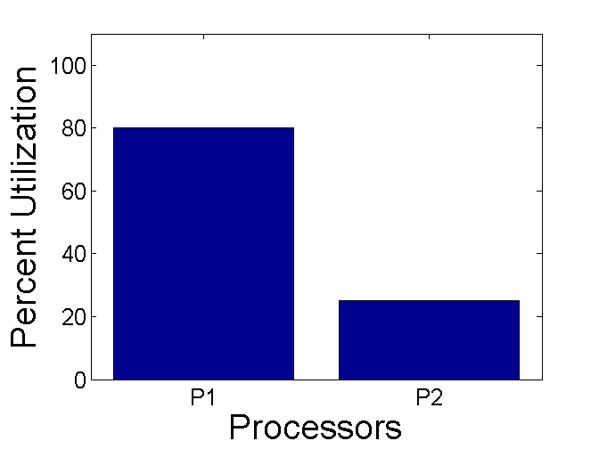
Designing the DeCoRAM Allocation Algorithm (1/5)
  Basic Step 1: No fault tolerance
  Only primaries exist consuming WCET each
  Apply first-fit optimal bin-packing using the [Dhall:78] algorithm
  Consider sample task set shown
  Tasks arranged according to rate monotonic priorities
Task | WCET | WCSST | Period | Util
A | 20 | 0.2 | 50 | 40
B | 40 | 0.4 | 100 | 40
C | 50 | 0.5 | 200 | 25
D | 200 | 2 | 500 | 40
E | 250 | 2.5 | 1,000 | 25

Slide 75
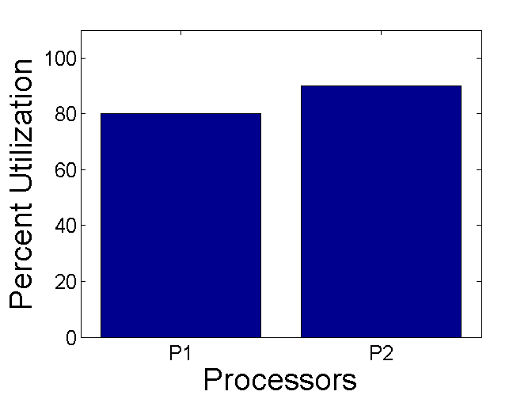
Designing the DeCoRAM Allocation Algorithm (1/5)
  Basic Step 1: No fault tolerance
  Only primaries exist consuming WCET each
  Apply first-fit optimal bin-packing using the [Dhall:78] algorithm
  Consider sample task set shown
  Tasks arranged according to rate monotonic priorities
Task | WCET | WCSST | Period | Util
A | 20 | 0.2 | 50 | 40
B | 40 | 0.4 | 100 | 40
C | 50 | 0.5 | 200 | 25
D | 200 | 2 | 500 | 40
E | 250 | 2.5 | 1,000 | 25

Slide 76
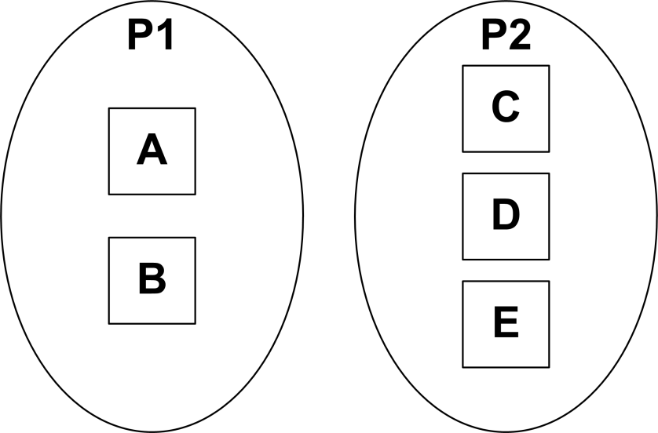
Designing the DeCoRAM Allocation Algorithm (1/5)
  Basic Step 1: No fault tolerance
  Only primaries exist consuming WCET each
  Apply first-fit optimal bin-packing using the [Dhall:78] algorithm
  Consider sample task set shown
  Tasks arranged according to rate monotonic priorities
Task | WCET | WCSST | Period | Util
A | 20 | 0.2 | 50 | 40
B | 40 | 0.4 | 100 | 40
C | 50 | 0.5 | 200 | 25
D | 200 | 2 | 500 | 40
E | 250 | 2.5 | 1,000 | 25
  Outcome -> Lower bound established
  System is schedulable
  Uses minimum number of resources
RT & resource constraints satisfied; but no FT

Slide 77
Designing the DeCoRAM Allocation Algorithm (2/5)
  Refinement 1: Introduce replica tasks
  Do not differentiate between primary & replicas
  Assume tolerance to 2 failures => 2 replicas each
  Apply the [Dhall:78] algorithm
Task | WCET | WCSST | Period
A1,A2,A3 | 20 | 0.2 | 50
B1,B2,B3 | 40 | 0.4 | 100
C1,C2,C3 | 50 | 0.5 | 200
D1,D2,D3 | 200 | 2 | 500
E1,E2,E3 | 250 | 2.5 | 1,000

Slide 78
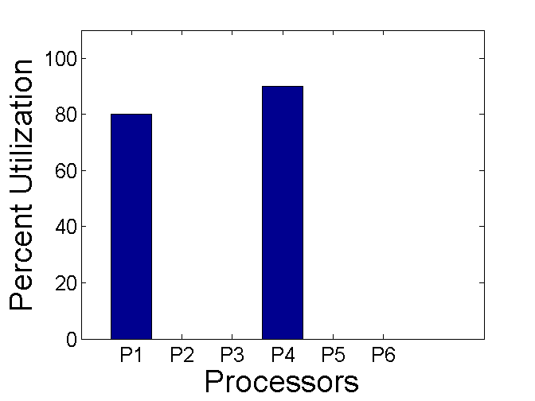
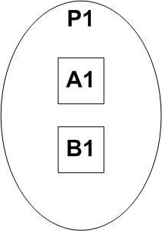
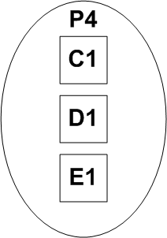
Designing the DeCoRAM Allocation Algorithm (2/5)
  Refinement 1: Introduce replica tasks
  Do not differentiate between primary & replicas
  Assume tolerance to 2 failures => 2 replicas each
  Apply the [Dhall:78] algorithm
Task | WCET | WCSST | Period
A1,A2,A3 | 20 | 0.2 | 50
B1,B2,B3 | 40 | 0.4 | 100
C1,C2,C3 | 50 | 0.5 | 200
D1,D2,D3 | 200 | 2 | 500
E1,E2,E3 | 250 | 2.5 | 1,000

Slide 79
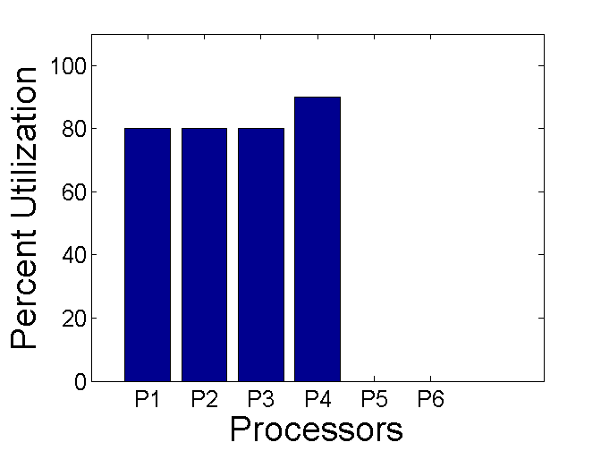
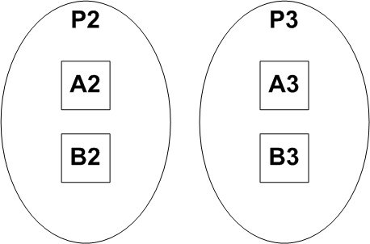
Designing the DeCoRAM Allocation Algorithm (2/5)
  Refinement 1: Introduce replica tasks
  Do not differentiate between primary & replicas
  Assume tolerance to 2 failures => 2 replicas each
  Apply the [Dhall:78] algorithm
Task | WCET | WCSST | Period
A1,A2,A3 | 20 | 0.2 | 50
B1,B2,B3 | 40 | 0.4 | 100
C1,C2,C3 | 50 | 0.5 | 200
D1,D2,D3 | 200 | 2 | 500
E1,E2,E3 | 250 | 2.5 | 1,000

Slide 80
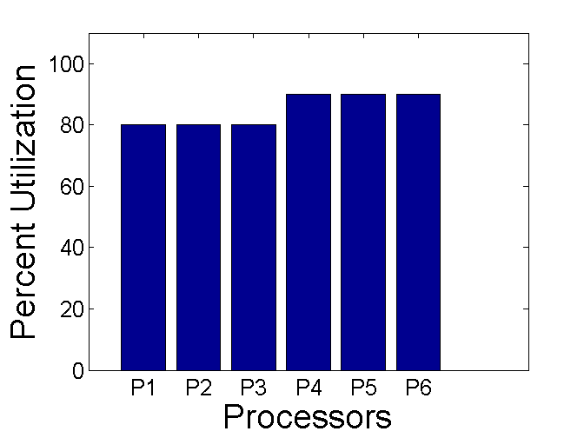
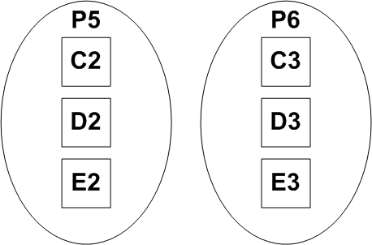
Designing the DeCoRAM Allocation Algorithm (2/5)
  Refinement 1: Introduce replica tasks
  Do not differentiate between primary & replicas
  Assume tolerance to 2 failures => 2 replicas each
  Apply the [Dhall:78] algorithm
Task | WCET | WCSST | Period
A1,A2,A3 | 20 | 0.2 | 50
B1,B2,B3 | 40 | 0.4 | 100
C1,C2,C3 | 50 | 0.5 | 200
D1,D2,D3 | 200 | 2 | 500
E1,E2,E3 | 250 | 2.5 | 1,000

Slide 81
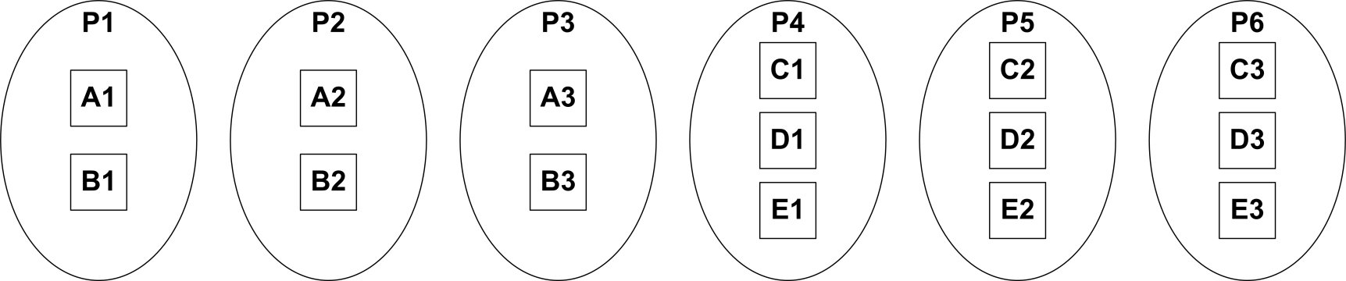
Designing the DeCoRAM Allocation Algorithm (2/5)
  Refinement 1: Introduce replica tasks
  Do not differentiate between primary & replicas
  Assume tolerance to 2 failures => 2 replicas each
  Apply the [Dhall:78] algorithm
Task | WCET | WCSST | Period
A1,A2,A3 | 20 | 0.2 | 50
B1,B2,B3 | 40 | 0.4 | 100
C1,C2,C3 | 50 | 0.5 | 200
D1,D2,D3 | 200 | 2 | 500
E1,E2,E3 | 250 | 2.5 | 1,000
  Outcome -> Upper bound is established
  A RT-FT solution is created – but with Active replication
  System is schedulable
  Demonstrates upper bound on number of resources needed
Minimize resource using passive replication

Slide 82
Designing the DeCoRAM Allocation Algorithm (3/5)
  Refinement 2: Passive replication
  Differentiate between primary & replicas
  Assume tolerance to 2 failures => 2 additional backup replicas each
  Apply the [Dhall:78] algorithm
Task | WCET | WCSST | Period
A1,A2,A3 | 20 | 0.2 | 50
B1,B2,B3 | 40 | 0.4 | 100
C1,C2,C3 | 50 | 0.5 | 200
D1,D2,D3 | 200 | 2 | 500
E1,E2,E3 | 250 | 2.5 | 1,000

Slide 83
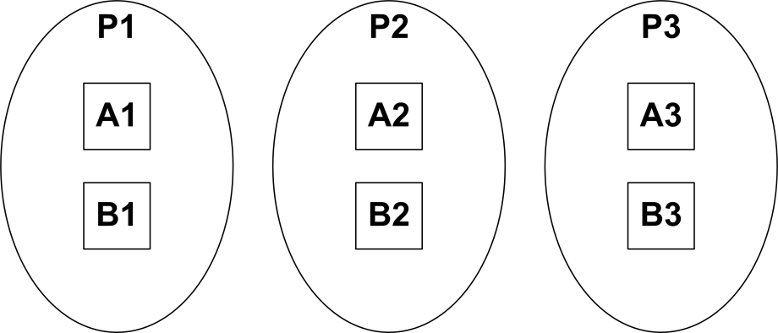
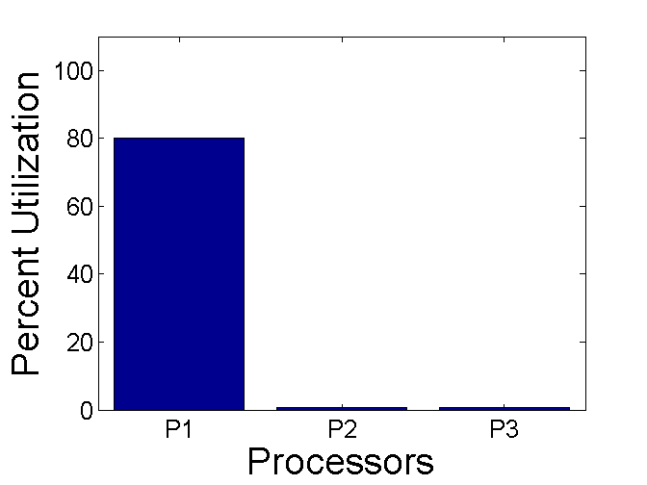
Designing the DeCoRAM Allocation Algorithm (3/5)
  Refinement 2: Passive replication
  Differentiate between primary & replicas
  Assume tolerance to 2 failures => 2 additional backup replicas each
  Apply the [Dhall:78] algorithm
Task | WCET | WCSST | Period
A1,A2,A3 | 20 | 0.2 | 50
B1,B2,B3 | 40 | 0.4 | 100
C1,C2,C3 | 50 | 0.5 | 200
D1,D2,D3 | 200 | 2 | 500
E1,E2,E3 | 250 | 2.5 | 1,000
Backups only contribute WCSST in no failure case
Primaries contribute WCET

Slide 84
Designing the DeCoRAM Allocation Algorithm (3/5)
  Refinement 2: Passive replication
  Differentiate between primary & replicas
  Assume tolerance to 2 failures => 2 additional backup replicas each
  Apply the [Dhall:78] algorithm
Task | WCET | WCSST | Period
A1,A2,A3 | 20 | 0.2 | 50
B1,B2,B3 | 40 | 0.4 | 100
C1,C2,C3 | 50 | 0.5 | 200
D1,D2,D3 | 200 | 2 | 500
E1,E2,E3 | 250 | 2.5 | 1,000
Backups only contribute WCSST in no failure case
Primaries contribute WCET

Slide 85
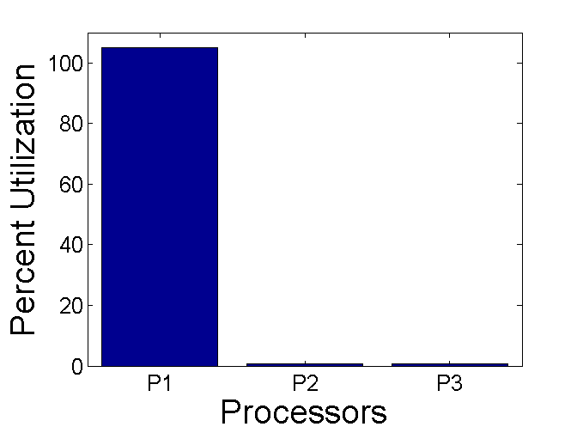
Designing the DeCoRAM Allocation Algorithm (3/5)
  Refinement 2: Passive replication
  Differentiate between primary & replicas
  Assume tolerance to 2 failures => 2 additional backup replicas each
  Apply the [Dhall:78] algorithm
Task | WCET | WCSST | Period
A1,A2,A3 | 20 | 0.2 | 50
B1,B2,B3 | 40 | 0.4 | 100
C1,C2,C3 | 50 | 0.5 | 200
D1,D2,D3 | 200 | 2 | 500
E1,E2,E3 | 250 | 2.5 | 1,000
Backups only contribute WCSST in no failure case
Primaries contribute WCET

Slide 86
Designing the DeCoRAM Allocation Algorithm (3/5)
  Refinement 2: Passive replication
  Differentiate between primary & replicas
  Assume tolerance to 2 failures => 2 additional backup replicas each
  Apply the [Dhall:78] algorithm
Task | WCET | WCSST | Period
A1,A2,A3 | 20 | 0.2 | 50
B1,B2,B3 | 40 | 0.4 | 100
C1,C2,C3 | 50 | 0.5 | 200
D1,D2,D3 | 200 | 2 | 500
E1,E2,E3 | 250 | 2.5 | 1,000
Backups only contribute WCSST in no failure case

Slide 87
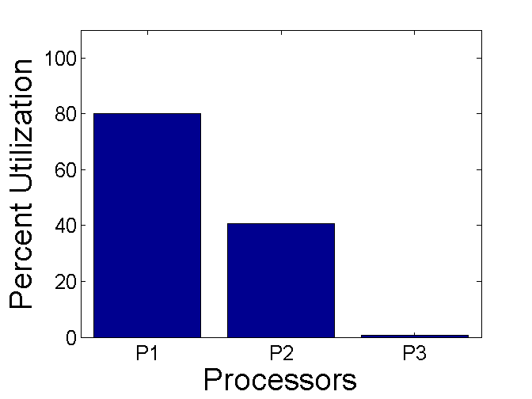
Designing the DeCoRAM Allocation Algorithm (3/5)
  Refinement 2: Passive replication
  Differentiate between primary & replicas
  Assume tolerance to 2 failures => 2 additional backup replicas each
  Apply the [Dhall:78] algorithm
Task | WCET | WCSST | Period
A1,A2,A3 | 20 | 0.2 | 50
B1,B2,B3 | 40 | 0.4 | 100
C1,C2,C3 | 50 | 0.5 | 200
D1,D2,D3 | 200 | 2 | 500
E1,E2,E3 | 250 | 2.5 | 1,000
Backups only contribute WCSST in no failure case
Allocation is fine when A2/B2 are backups
Allocation is fine when A2/B2 are backups

Slide 88

Designing the DeCoRAM Allocation Algorithm (3/5)
  Refinement 2: Passive replication
  Differentiate between primary & replicas
  Assume tolerance to 2 failures => 2 additional backup replicas each
  Apply the [Dhall:78] algorithm
Task | WCET | WCSST | Period
A1,A2,A3 | 20 | 0.2 | 50
B1,B2,B3 | 40 | 0.4 | 100
C1,C2,C3 | 50 | 0.5 | 200
D1,D2,D3 | 200 | 2 | 500
E1,E2,E3 | 250 | 2.5 | 1,000

Slide 89
Designing the DeCoRAM Allocation Algorithm (3/5)
  Refinement 2: Passive replication
  Differentiate between primary & replicas
  Assume tolerance to 2 failures => 2 additional backup replicas each
  Apply the [Dhall:78] algorithm
Task | WCET | WCSST | Period
A1,A2,A3 | 20 | 0.2 | 50
B1,B2,B3 | 40 | 0.4 | 100
C1,C2,C3 | 50 | 0.5 | 200
D1,D2,D3 | 200 | 2 | 500
E1,E2,E3 | 250 | 2.5 | 1,000
Promoted backups now contribute WCET
Failure triggers promotion of A2/B2 to primaries

Slide 90
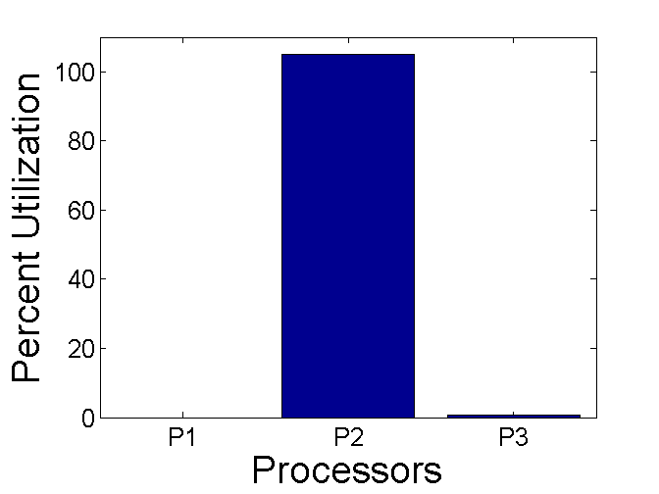
Designing the DeCoRAM Allocation Algorithm (3/5)
  Refinement 2: Passive replication
  Differentiate between primary & replicas
  Assume tolerance to 2 failures => 2 additional backup replicas each
  Apply the [Dhall:78] algorithm
Task | WCET | WCSST | Period
A1,A2,A3 | 20 | 0.2 | 50
B1,B2,B3 | 40 | 0.4 | 100
C1,C2,C3 | 50 | 0.5 | 200
D1,D2,D3 | 200 | 2 | 500
E1,E2,E3 | 250 | 2.5 | 1,000
Backups only contribute WCSST
System unschedulable when A2/B2 are promoted
Allocation is fine when A2/B2 are backups

Slide 91
Designing the DeCoRAM Allocation Algorithm (3/5)
  Refinement 2: Passive replication
  Differentiate between primary & replicas
  Assume tolerance to 2 failures => 2 additional backup replicas each
  Apply the [Dhall:78] algorithm
Task | WCET | WCSST | Period
A1,A2,A3 | 20 | 0.2 | 50
B1,B2,B3 | 40 | 0.4 | 100
C1,C2,C3 | 50 | 0.5 | 200
D1,D2,D3 | 200 | 2 | 500
E1,E2,E3 | 250 | 2.5 | 1,000
C1/D1/E1 may be placed on P2 or P3 as long as there are no failures
C1/D1/E1 cannot be placed here -- unschedulable
  Outcome
  Resource minimization & system schedulability feasible in non faulty scenarios only -- because backup contributes only WCSST
Unrealistic not to expect failures
Need a way to consider failures & find which backup will be promoted to primary (contributing WCET)?

Slide 92
Designing the DeCoRAM Allocation Algorithm (4/5)
  Refinement 3: Enable the offline algorithm to consider failures
  “Look ahead” at failure scenarios of already allocated tasks & replicas determining worst case impact on a given processor
  Feasible to do this because system properties are invariant

Slide 93
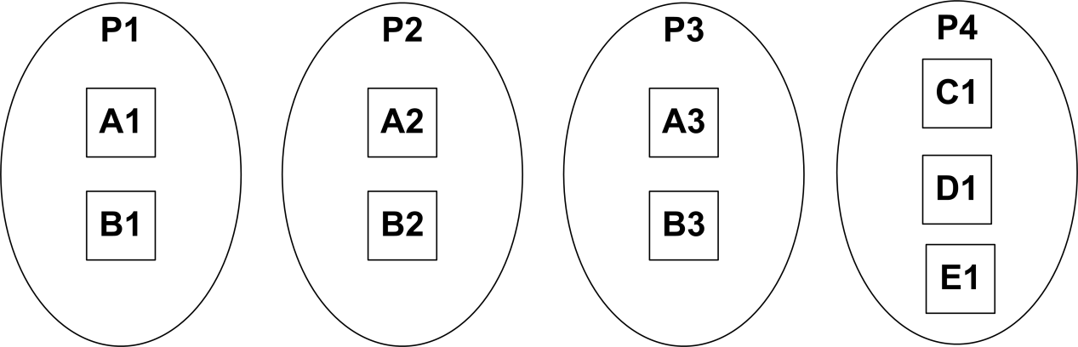
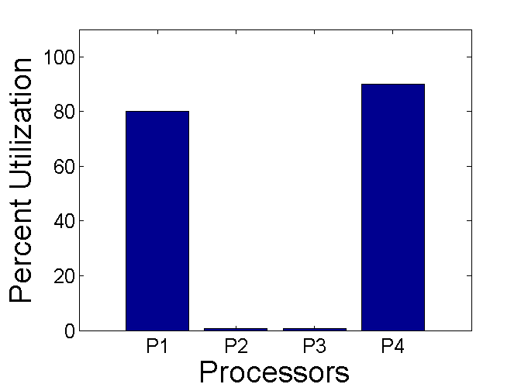
Designing the DeCoRAM Allocation Algorithm (4/5)
  Refinement 3: Enable the offline algorithm to consider failures
  “Look ahead” at failure scenarios of already allocated tasks & replicas determining worst case impact on a given processor
  Feasible to do this because system properties are invariant
Looking ahead that any of A2/B2 or A3/B3 may be promoted, C1/D1/E1 must be placed on a different processor

Slide 94
Designing the DeCoRAM Allocation Algorithm (4/5)
  Refinement 3: Enable the offline algorithm to consider failures
  “Look ahead” at failure scenarios of already allocated tasks & replicas determining worst case impact on a given processor
  Feasible to do this because system properties are invariant
Where should backups of C/D/E be placed? On P2 or P3 or a different processor? P1 is not a choice.

Slide 95
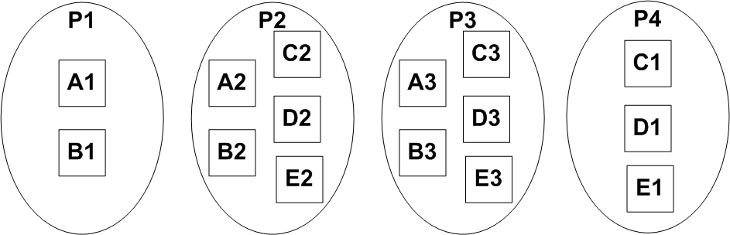
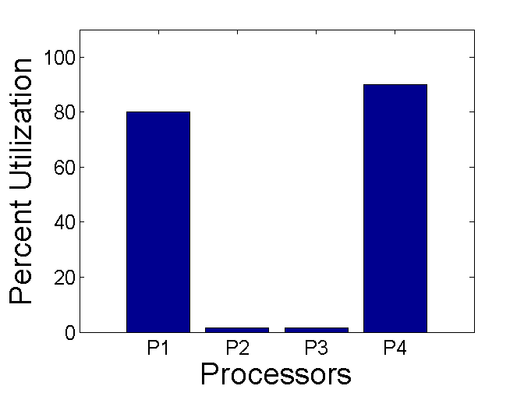
Designing the DeCoRAM Allocation Algorithm (4/5)
  Refinement 3: Enable the offline algorithm to consider failures
  “Look ahead” at failure scenarios of already allocated tasks & replicas determining worst case impact on a given processor
  Feasible to do this because system properties are invariant
  Suppose the allocation of the backups of C/D/E are as shown
  We now look ahead for any 2 failure combinations

Slide 96
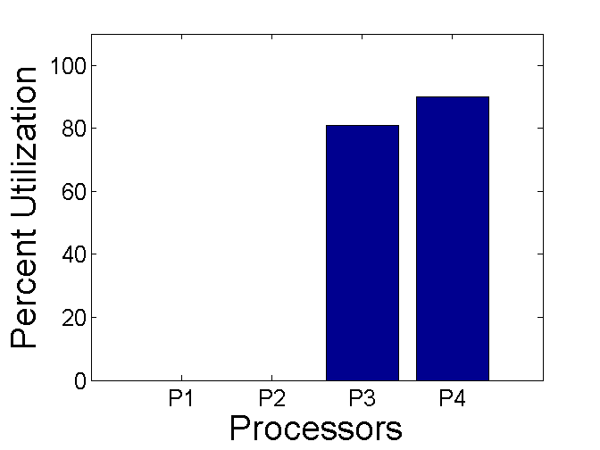
Designing the DeCoRAM Allocation Algorithm (4/5)
  Refinement 3: Enable the offline algorithm to consider failures
  “Look ahead” at failure scenarios of already allocated tasks & replicas determining worst case impact on a given processor
  Feasible to do this because system properties are invariant
Schedule is feasible => original placement decision was OK
  Suppose P1 & P2 were to fail
  A3 & B3 will be promoted

Slide 97
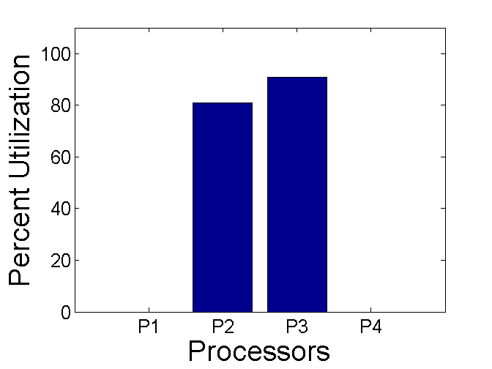
Designing the DeCoRAM Allocation Algorithm (4/5)
  Refinement 3: Enable the offline algorithm to consider failures
  “Look ahead” at failure scenarios of already allocated tasks & replicas determining worst case impact on a given processor
  Feasible to do this because system properties are invariant
Schedule is feasible => original placement decision was OK
  Suppose P1 & P4 were to fail
  Suppose A2 & B2 on P2 were to be promoted, while C3, D3 & E3 on P3 were to be promoted

Slide 98

Designing the DeCoRAM Allocation Algorithm (4/5)
  Refinement 3: Enable the offline algorithm to consider failures
  “Look ahead” at failure scenarios of already allocated tasks & replicas determining worst case impact on a given processor
  Feasible to do this because system properties are invariant
Schedule is not feasible => original placement decision was incorrect
  Suppose P1 & P4 were to fail
  Suppose A2, B2, C2, D2 & E2 on P2 were to be promoted

Slide 99
Designing the DeCoRAM Allocation Algorithm (4/5)
  Refinement 3: Enable the offline algorithm to consider failures
  “Look ahead” at failure scenarios of already allocated tasks & replicas determining worst case impact on a given processor
  Feasible to do this because system properties are invariant
Looking ahead that any of A2/B2 or A3/B3 may be promoted, C1/D1/E1 must be placed on a different processor
  Outcome
  Due to the potential for an infeasible schedule, more resources are suggested by the Lookahead algorithm
Placing backups of C/D/E here points at one potential combination that leads to infeasible schedule
Look-ahead strategy cannot determine impact of multiple uncorrelated failures that may make system unschedulable

Slide 100

Designing the DeCoRAM Allocation Algorithm (5/5)
  Refinement 4: Restrict the order in which failover targets are chosen
  Utilize a rank order of replicas to dictate how failover happens
  Enables the Lookahead algorithm to overbook resources due to guarantees that no two uncorrelated failures will make the system unschedulable
Replica number denotes ordering in the failover process
  Suppose the replica allocation is as shown (slightly diff from before)
  Replica numbers indicate order in the failover process

Slide 101
Designing the DeCoRAM Allocation Algorithm (5/5)
  Refinement 4: Restrict the order in which failover targets are chosen
  Utilize a rank order of replicas to dictate how failover happens
  Enables the Lookahead algorithm to overbook resources due to guarantees that no two uncorrelated failures will make the system unschedulable
  Suppose P1 & P4 were to fail (the interesting case)
  A2 & B2 on P2, & C2, D2, E2 on P3 will be chosen as failover targets due to the restrictions imposed
  Never can C3, D3, E3 become primaries along with A2 & B2 unless more than two failures occur

Slide 102
Designing the DeCoRAM Allocation Algorithm (5/5)
  Refinement 4: Restrict the order in which failover targets are chosen
  Utilize a rank order of replicas to dictate how failover happens
  Enables the Lookahead algorithm to overbook resources due to guarantees that no two uncorrelated failures will make the system unschedulable
For a 2-fault tolerant system, replica numbered 3 is assured never to become a primary along with a replica numbered 2. This allows us to overbook the processor thereby minimizing resources
Resources minimized from 6 to 4 while assuring both RT & FT

Slide 103

DeCoRAM Evaluation Criteria
Hypothesis – DeCoRAM’s Failure-aware Look-ahead Feasibility algorithm allocates applications & replicas to hosts while minimizing the number of processors utilized
  number of processors utilized is lesser than the number of processors utilized using active replication
DeCoRAM Allocation Engine
Notes:
Jai, please fix the diagram so that it matches what’s in the text.
103

Slide 104
DeCoRAM Evaluation Hypothesis
Hypothesis – DeCoRAM’s Failure-aware Look-ahead Feasibility algorithm allocates applications & replicas to hosts while minimizing the number of processors utilized
  number of processors utilized is lesser than the number of processors utilized using active replication
Deployment-time configured real-time fault-tolerance solution works at runtime when failures occur
  none of the applications lose high availability & timeliness assurances
DeCoRAM Allocation Engine
Notes:
Jai, please fix the diagram so that it matches what’s in the text.
104

Slide 105
Experiment Configurations
Determine # of processors utilized by
  varying number of tasks dimension)
  varying the number of replicas (FT dimension)
  varying the maximum CPU utilization of any task in the task set
  periods of tasks randomly generated between 1ms & 1000ms
    each task execution time between 0% & maximum load % of the period
    each task state synchronization time between 1% & 2% of the worst case execution times
DeCoRAM Allocation Engine
Notes:
105

Slide 106
Comparison Schemes
Comparison schemes for evaluation
  lower bound on number of processors utilized
    Implementing the optimal allocation algorithm in [Dhall:78] - uses First Fit bin packing scheme
      Optimal no fault-tolerance scenario (No FT)
DeCoRAM Allocation Engine
No replicas in the task set
Notes:
106

Slide 107
Comparison Schemes
Comparison schemes for evaluation
  lower bound on number of processors utilized
    Implementing the optimal allocation algorithm in [Dhall:78] - uses First Fit bin packing scheme
      Optimal no fault-tolerance scenario (No FT)
  Upper bound on # of processors
    Multiplying # of processors utilized in the No FT case with # of replicas
      Optimal active replication scenario (AFT)
DeCoRAM Allocation Engine
All replicas have same worst case execution times
Notes:
107

Slide 108
Comparison Schemes
Comparison schemes for evaluation
  lower bound on number of processors utilized
    Implementing the optimal allocation algorithm in [Dhall:78] - uses First Fit bin packing scheme
      Optimal no fault-tolerance scenario (No FT)
  Upper bound on # of processors
    Multiplying # of processors utilized in the No FT case with # of replicas
      Optimal active replication scenario (AFT)
  DeCoRAM allocation heuristic
    First Fit (FF-FT) & Best Fit (BF-FT) schemes
      Optimal passive replication (FF-FT & BF-FT)
DeCoRAM Allocation Engine
Replicas with varying execution times
Notes:
108

Slide 109

Experiment Results
Linear increase in # of processors utilized in AFT compared to NO FT
Notes:
109

Slide 110
Experiment Results
Rate of increase is much more slower when compared to AFT
Notes:
110

Slide 111
Experiment Results
DeCoRAM only uses approx. 50% of the number of processors used by AFT
Notes:
111

Slide 112

Experiment Results
As task load increases, # of processors utilized increases
Notes:
112

Slide 113

Experiment Results
As task load increases, # of processors utilized increases
Notes:
113

Slide 114

Experiment Results
As task load increases, # of processors utilized increases
Notes:
114

Slide 115
Experiment Results
DeCoRAM scales well, by continuing to save ~50% of processors
Notes:
115

Slide 116
DeCoRAM Pluggable Allocation Engine Architecture
Design driven by separation of concerns
Use of design patterns
Input Manager component – collects per-task FT & RT requirements
Task Replicator component – decides the order in which tasks are allocated
Node Selector component – decides the node in which allocation will be checked
Admission Controller component – applies DeCoRAM’s novel algorithm
Placement Controller component – calls the admission controller repeatedly to deploy all the applications & their replicas
Input Manager
Allocation Engine implemented in ~7,000 lines of C++ code
Task Replicator
Node Selector
Placement Controller
Output decisions realized by DeCoRAM’s D&C Engine
Admission Controller
Notes:
116

Slide 117

DeCoRAM Deployment & Configuration Engine
Automated deployment & configuration support for fault-tolerant real-time systems
XML Parser
  uses middleware D&C mechanisms to decode allocation decisions
Middleware Deployer
  deploys FT middleware- specific entities
Middleware Configurator
  configures the underlying FT-RT middleware artifacts
Application Installer
  installs the application components & their replicas
Easily extendable
  Current implementation on top of CIAO, DAnCE, & FLARe middleware
DeCoRAM D&C Engine implemented in ~3,500 lines of C++ code

Slide 118
Post-Specification Phase: Generative Techniques to Support Missing Semantics
Resolves challenges in
Focus on Generative Techniques for Introducing New Semantics into Middleware Implementations
Specification
Composition
Generative Aspects for Fault-Tolerance (GRAFT)
  Multi-stage model-driven development process
  Weaving Dependability Concerns in System Artifacts
  Provides model-to-model, model-to-text, model-to-code transformations
Deployment
Configuration
Run-time

Slide 119
Related Research: Transparent FT Provisioning
Category | Related Research (Transparent FT Provisioning)
Model-driven | Aspect-Oriented Programming Techniques to support Distribution, Fault Tolerance, & Load Balancing in the CORBA(LC) Component Model by D. Sevilla, J. M. García, & A. Gómez CORRECT - Developing Fault-Tolerant Distributed Systems by A. Capozucca, B. Gallina, N. Guelfi, P. Pelliccione, & A. Romanovsky Automatic Generation of Fault-Tolerant CORBA-Services by A. Polze, J. Schwarz, & M. Malek Adding fault-tolerance to a hierarchical DRE system by P. Rubel, J. Loyall, R. Schantz, & M. Gillen
Using AOP languages | Implementing Fault Tolerance Using Aspect Oriented Programming by R. Alexandersson & P. Öhman Aspects for improvement of performance in fault-tolerant software by D. Szentiványi Aspect-Oriented Fault Tolerance for Real-Time Embedded Systems by F. Afonso, C. Silva, N. Brito, S. Montenegro
Meta-Object Protocol (MOP) | A Multi-Level Meta-Object Protocol for Fault-Tolerance in Complex Architectures by F. Taiani & J.-C. Fabre Reflective fault-tolerant systems: From experience to challenges by J. C. Ruiz, M.-O. Killijian, J.-C. Fabre, & P. Thévenod-Fosse
119

Slide 120
Related Research: Transparent FT Provisioning
Category | Related Research (Transparent FT Provisioning)
Model-driven | Aspect-Oriented Programming Techniques to support Distribution, Fault Tolerance, & Load Balancing in the CORBA(LC) Component Model by D. Sevilla, J. M. García, & A. Gómez CORRECT - Developing Fault-Tolerant Distributed Systems by A. Capozucca, B. Gallina, N. Guelfi, P. Pelliccione, & A. Romanovsky Automatic Generation of Fault-Tolerant CORBA-Services by A. Polze, J. Schwarz, & M. Malek Adding fault-tolerance to a hierarchical DRE system by P. Rubel, J. Loyall, R. Schantz, & M. Gillen
Using AOP languages | Implementing Fault Tolerance Using Aspect Oriented Programming by R. Alexandersson & P. Öhman Aspects for improvement of performance in fault-tolerant software by D. Szentiványi Aspect-Oriented Fault Tolerance for Real-Time Embedded Systems by F. Afonso, C. Silva, N. Brito, S. Montenegro
Meta-Object Protocol (MOP) | A Multi-Level Meta-Object Protocol for Fault-Tolerance in Complex Architectures by F. Taiani & J.-C. Fabre Reflective fault-tolerant systems: From experience to challenges by J. C. Ruiz, M.-O. Killijian, J.-C. Fabre, & P. Thévenod-Fosse
M2M transformation & code generation
Performance improvement for FT using AOP
Performance improvement for FT using AOP
120

Slide 121
What is Missing? Transparent FT Provisioning
Not all the necessary steps are supported coherently
  Automatic component instrumentation for fault-handling code
  Deciding placement of components & their replicas
  Deploying primaries, replicas, & monitoring infrastructure
  Platform-specific metadata synthesis (XML)
Missing domain-specific recovery semantics (run-time middleware)
  Group failover is DRE-specific & often neglected
  Costly to modify the middleware
  Application-level solutions lose transparency & reusability
Missing transparent network QoS provisioning (D&C middleware)
  Configuration of network resources (edge routers)
  Configuration of containers for correct packet marking
Development Lifecycle
Specification
Composition
Deployment
Configuration
How to add domain-specific recovery semantics in COTS middleware retroactively?
How to automate it to improve productivity & reduce cost?
Run-time
Notes:
-

Slide 122

Soln: Generative Aspects for Fault Tolerance (GRAFT)
Multi-stage model-driven generative process
Incremental model-refinement using transformations
  Model-to-model
  Model-to-text
  Model-to-code
Weaves dependability concerns in system artifacts

Slide 123


Stage 1: Isomorphic M2M Transformation
Step1: Model structural composition of operational string
Step2: Annotate components with
failover unit(s) marking them “fault-tolerant” in the QoS view
Step3: Use aspect-oriented M2M transformation developed using Embedded Constraint Language (ECL) of C-SAW
Step4: Component replicas & interconnections are generated automatically
Step 5: FOU annotations are removed but other QoS annotations are cloned (uses Dependency Inversion Principle of CQML)
Step 6: Isomorphic clone can be modified manually (reliability through diversity)
QoS View
M2M Transformation
Structural View

Slide 124


Stage 2: Determine Component Placement
Strategic placement of components, e.g. using DeCoRAM
  Improves availability of the system
  Several constraint satisfaction algorithms exist
Placement comparison heuristic
  Hop-count between replicas
  Formulation based on the co-failure probabilities captured using Shared Risk Group (SRG)
    E.g., shared power supply, A/C, fire zone
  Reduces simultaneous failure probability
GRAFT transformations weave the decisions back into the model
RootRiskGroup
SRG
SRG
R
P

Slide 125



Stage 3: Synthesizing Fault Monitoring Infrastructure
Transformation Algorithm
Failover unit
QoS View
M2M Transformation
Structural View
Fault Detector
Collocated Heartbeat Components

Slide 126
Stage 4: Synthesizing Code for Group Failover (1/2)
Code generation for fault handling
  Reliable fault detection
  Transparent fault masking
  Fast client failover
Location of failure determines handling behavior
Head
Tail
FOU
Head component failure | Tail component failure
Client-side code detects the failure | Only other FOU participants detect the failure. Client waits.
--- | Trigger client-side exception by forcing FOU to shutdown
Client-side code does transparent failover | Client-side code detects passivation of the head component & does transparent failover
FOU shutdown is achieved using seamless integration with D&C middleware APIs
  e.g., Domain Application Manager (DAM) of CCM
Shutdown method calls are generated in fault-handling code

Slide 127

Stage 4: Synthesizing Code for Group Failover (2/2)
Two behaviors based on component position
FOU participant’s behavior
  Detects the failure
  Shuts down the FOU including itself
FOU client’s behavior
  Detects the failure
  Does an automatic failover to a replica FOU
  Optionally shuts down the FOU to save resources
Generated code: AspectC++
AspectC++ compiler weaves in the generated code in the respective component stubs

Slide 128
Stage 5: Synthesizing Platform-specific Metadata
Component Technologies use XML metadata to configure middleware
Existing model interpreters can be reused without any modifications
  CQML’s FT modeling is opaque to existing model interpreters
  GRAFT model transformations are transparent to the model interpreters
GRAFT synthesizes the necessary artifacts for transparent
FT provisioning for DRE operational strings

Slide 129


Evaluating Modeling Efforts Reduction Using GRAFT
Case-study - Warehouse Inventory Tracking System
GRAFT’s isomorphic M2M transformation eliminates human modeling efforts of replicas
  Components
  Connections
  QoS requirements

Slide 130

Evaluating Programming Efforts Reduction Using GRAFT
GRAFT’s code generator reduces human programming efforts
Code for fault-detection, fault-masking, & failover
  # of try blocks
  # of catch blocks
  Total # of lines

Slide 131



Evaluating Client Perceived Failover Latency Using GRAFT
Client perceived failover latency
  Sensitive to the location of failure
  Sensitive to the implementation of DAM
Head component failure
  Constant failover latency
Tail component failover
  Linear increase in failover latency
Head component failure
Tail component failure

Slide 132
Presentation Road Map
Technology Context: DRE Systems
DRE System Lifecycle & FT-RT Challenges
Design-time Solutions
Deployment & Configuration-time Solutions
Runtime Solutions
Ongoing Work
Concluding Remarks
Notes:
132

Slide 133
Runtime Phase: Real-time Fault Detection & Recovery
Development Lifecycle
Specification
Composition
Deployment
Fault Tolerant Lightweight Adaptive Middleware (FLARe)
  Two algorithms (LAAF and ROME)
Configuration
Run-time

Slide 134
Related Research
Category | Related Research
CORBA-based Fault-tolerant Middleware Systems | P. Felber et. al., Experiences, Approaches, & Challenges in Building Fault-tolerant CORBA Systems, in IEEE Transactions on Computers, May 2004 T. Bennani et. al., Implementing Simple Replication Protocols Using CORBA Portable Interceptors & Java Serialization, in Proceedings of the IEEE International Conference on Dependable Systems & Networks (DSN 2004), Italy, 2004 P. Narasimhan et. al., MEAD: Support for Real-time Fault-tolerant CORBA, in Concurrency & Computation: Practice & Experience, 2005
Adaptive Passive Replication Systems | S. Pertet et. al., Proactive Recovery in Distributed CORBA Applications, in Proceedings of the IEEE International Conference on Dependable Systems & Networks (DSN 2004), Italy, 2004 P. Katsaros et. al., Optimal Object State Transfer – Recovery Policies for Fault-tolerant Distributed Systems, in Proceedings of the IEEE International Conference on Dependable Systems & Networks (DSN 2004), Italy, 2004 Z. Cai et. al., Utility-driven Proactive Management of Availability in Enterprise-scale Information Flows, In Proceedings of the ACM/IFIP/USENIX Middleware Conference (Middleware 2006), Melbourne, Australia, November 2006 L. Froihofer et. al., Middleware Support for Adaptive Dependability, In Proceedings of the ACM/IFIP/USENIX Middleware Conference (Middleware 2007), Newport Beach, CA, November 2007
Runtime adaptations to reduce failure recovery times
Middleware building blocks for fault-tolerant systems

Slide 135
Related Research
Category | Related Research
Load-Aware Adaptations of Fault-tolerance Configurations | T. Dumitras et. al., Fault-tolerant Middleware & the Magical 1%, In Proceedings of the ACM/IFIP/USENIX Middleware Conference (Middleware 2005), Grenoble, France, November 2005 O. Marin et. al., DARX: A Framework for the Fault-tolerant Support of Agent Software, In Proceedings of the IEEE International Symposium on Software Reliability Engineering (ISSRE 2003), Denver, CO, November 2003 S. Krishnamurthy et. al., An Adaptive Quality of Service Aware Middleware for Replicated Services, in IEEE Transactions on Parallel & Distributed Systems (IEEE TPDS), 2003
Real-time Fault-tolerant Systems | D. Powell et. al., Distributed Fault-tolerance: Lessons from Delta-4, In IEEE MICRO, 1994 K. H. Kim et. al., The PSTR/SNS Scheme for Real-time Fault-tolerance Via Active Object Replication & Network Surveillance, In IEEE Transactions on Knowledge & Data Engineering (IEEE TKDE), 2000 S. Krishnamurthy et. al., Dynamic Replica Selection Algorithm for Tolerating Timing Faults, in Proceedings of the IEEE International Conference on Dependable Systems & Networks (DSN 2001), 2001 H. Zou et. al., A Real-time Primary Backup Replication Service, in IEEE Transactions on Parallel & Distributed Systems (IEEE TPDS), 1999
Schedulability analysis to schedule backups in case primary replica fails, faster processing times
Load-aware adaptations – change of replication styles, reduced degree of active replication

Slide 136
Related Research: What is Missing?
Existing passive replication solutions do not deal with overloads
  workload fluctuations & multiple failures could lead to overloads
  response times affected – if overloads not handled
Existing passive replication systems do not deal with resource-aware failovers
  If clients are redirected to heavily loaded replicas upon failure, their response time requirements will not be satisfied
  failover strategies are most often static, which means that clients get a failover behavior that is optimal at deployment-time & not at runtime
Solution Approach: FLARe : Fault-tolerant Middleware with adaptive failover target selection & overload management support
Notes:
136

Slide 137

Our Approach: FLARe RT-FT Middleware
FLARe = Fault-tolerant Lightweight Adaptive Real-time Middleware
  RT-CORBA based lightweight FT
Resource-aware FT
  Resource manager – pluggable resource management algorithms
  FT decisions made in conjunction with middleware replication manager
    manages primary & backup replicas
    provides registration interfaces
    handles failure detection
    starts new replicas

Slide 138
Our Approach: FLARe RT-FT Middleware
Real-time performance during failures & overloads
  monitor CPU utilizations at hosts where primary & backups are deployed
  Load-Aware Adaptive Failover Strategy (LAAF)
    failover targets chosen on the least loaded host hosting the backups
  Resource Overload Management Redirector (ROME) strategy
    clients are forcefully redirected to least loaded backups – overloads are treated as failures
  LAAF & ROME adapt to changing system loads & resource availabilities

Slide 139
Our Approach: FLARe RT-FT Middleware
Transparent & Fast Failover
  Redirection using client-side portable interceptors
  catches processor and process failure exceptions and redirects clients to alternate targets
  Failure detection can be improved with better protocols – e.g., SCTP
    middleware supports pluggable transports

Slide 140
Our Approach: FLARe RT-FT Middleware
Predictable failover
  failover target decisions computed periodically by the resource manager
  conveyed to client-side middleware agents – forwarding agents
  agents work in tandem with portable interceptors
  redirect clients quickly & predictably to appropriate targets
  agents periodically/proactively updated when targets change

Slide 141
FLARe Evaluation Criteria
Hypotheses: FLARe’s
  LAAF failover target selection strategy selects failover targets that maintain satisfactory response times for clients & alleviates processor overloads.
    no processor’s utilization is more than 70%
  ROME overload management strategy reacts to overloads rapidly, selects appropriate targets to redirect clients, & maintains satisfactory response times for clients
    no processor’s utilization is more than 70%
Notes:
141

Slide 142

Experiment Setup
Experiment setup
  6 different clients – 2 clients CL-5 & CL-6 are dynamic clients (start after 50 seconds)
  6 different servers – each have 2 replicas, 2 servers are dynamic as well
  Each client has a forwarding agent deployed – they get the failover target information from the middleware replication manager
  Experiment ran for 300 seconds – each server consumes some CPU load
    some servers share processors – they follow rate-monotonic scheduling for prioritized access to CPU resources
Notes:
142

Slide 143
Experiment Configurations
Static Failover Strategy
  each client knows the order in which they access the server replicas in the presence of failures – i.e., the failover targets are known in advance
  for e.g., CL-2 makes remote invocations on B-1, on B-3 if B-1 fails, & on B-2 if B3-fails
  this strategy is optimal at deployment-time (B-3 is on a processor lightly loaded than the processor hosting B-2)
Notes:
143

Slide 144
Experiment Configurations
LAAF Failover Strategy
  each client knows only the reference of the primary replica
  failover targets are determined at runtime while monitoring the CPU utilizations at all processors – that is why dynamic loads are added in the experiment
Notes:
144

Slide 145




LAAF Algorithm Results
At 50 secs, dynamic loads are introduced
Notes:
145

Slide 146
LAAF Algorithm Results
At 150 secs, failures are introduced
Notes:
146

Slide 147
LAAF Algorithm Results
Till 150 seconds the response times of all the clients are similar in both the strategies
Notes:
147

Slide 148
LAAF Algorithm Results
After failure, response times of both CL-2 & CL-5 increases
After failure, response time of CL-5 remains the same, better yet response time of CL-2 decreases
LAAF makes adaptive failover target decisions that maintain response times !!
Notes:
148

Slide 149
LAAF Algorithm Results
Response times of CL-3 & CL-4 increase after failure – because of rate-monotonic scheduling behavior – they are no longer accessing highest priority servers
Notes:
149

Slide 150
LAAF Algorithm Results
CPU utilizations skewed – some processors are very heavily loaded, while some are not
CPU utilizations are more evenly balanced – none of them more than 70% - LAAF makes sure of that !!
Notes:
150

Slide 151
Summary of Results
FLARe’s LAAF failover strategy maintains client response times & processor utilizations after failure recovery when compared to the static failover strategy (no processor is utilized more than 70%)
  LAAF failover strategy always adapts the failover targets whenever system loads change – client failover to the least loaded backup
  static failover strategy does not change the previously deployment-time optimal failover targets at runtime
    client failover results in overload & hence higher response times
Notes:
151

Slide 152
Summary of FLARe Results
ROME strategy reacts to overloads & maintains client response times – no processor is utilized more than 70%
Notes:
152

Slide 153
Runtime Phase: Component-based Fault Tolerance
Development Lifecycle
Specification
Composition
Deployment
Component Replication-based on Failover Units (CORFU)
  Raise the level of fault tolerance to component level
  Support group failover
Configuration
Run-time

Slide 154
CORFU Contributions
Applications
Component Replication Based on Failover Units (CORFU)
Raises the level of abstraction, from objects to
Domain-Specific
Services
Common
Middleware Services
CORBA 2.x
Lightweight
Fault Tolerance
Distribution
Middleware
Host Infrastructure
Middleware
Operating Systems
& Protocols
Hardware
154
Notes:
154
Friedhelm, please motivate CBSE-based FT by showing how it improves upon DOC-based FT.

Slide 155
CORFU Contributions
Applications
Component Replication Based on Failover Units (CORFU)
Raises the level of abstraction, from objects to
  Fault-tolerance for single components
CORFU
Domain-Specific
Services
Common
Middleware Services
CORBA 2.x
Lightweight
Fault Tolerance
Distribution
Middleware
Host Infrastructure
Middleware
Operating Systems
& Protocols
Hardware
NIS A
NIS A
155
Notes:
155
Friedhelm, please motivate CBSE-based FT by showing how it improves upon DOC-based FT.

Slide 156
CORFU Contributions
Applications
Component Replication Based on Failover Units (CORFU)
Raises the level of abstraction, from objects to
  Fault-tolerance for single components
  Components with Heterogenous State Synchronisation (CHESS)
CORFU
Domain-Specific
Services
Common
Middleware Services
CORBA 2.x
Lightweight
Fault Tolerance
Distribution
Middleware
Host Infrastructure
Middleware
Operating Systems
& Protocols
Hardware
R2
NIS A
R1
CHESS
R3
NIS A
“Archive”
156
Notes:
156
Friedhelm, please motivate CBSE-based FT by showing how it improves upon DOC-based FT.

Slide 157
CORFU Contributions
Applications
Component Replication Based on Failover Units (CORFU)
Raises the level of abstraction, from objects to
  Fault-tolerance for single components
  Components with Heterogenous State Synchronisation (CHESS)
  Fault-tolerance for groups of components
CORFU
Domain-Specific
Services
Common
Middleware Services
CORBA 2.x
Lightweight
Fault Tolerance
Distribution
Middleware
Host Infrastructure
Middleware
Operating Systems
& Protocols
Hardware
Archive A
R2
Archive A
Telemetry
Server A
Telemetry
Server A
NIS A
R1
CHESS
R3
Mission
Planning
System A
“Archive”
Mission
Planning
System A
NIS A
Telecommand
Server A
Telecommand
Server A
Bridges the abstraction gap for fault-tolerance
157
Notes:
157
Friedhelm, please motivate CBSE-based FT by showing how it improves upon DOC-based FT.

Slide 158
Prior Work: Object-based Fault Tolerance
Conventional Fault-Tolerance solutions provide replication capabilities on the granularity of objects
Object :
Interface X
: Client
operation()
Middleware
158

Slide 159
Prior Work: Object-based Fault Tolerance
Conventional Fault-Tolerance solutions provide replication capabilities on the granularity of objects
FLARe takes a lightweight approach for DRE systems based on passive replication
Object :
Interface X
: Client
operation()
Middleware
159

Slide 160
Prior Work: Object-based Fault Tolerance
Conventional Fault-Tolerance solutions provide replication capabilities on the granularity of objects
FLARe takes a lightweight approach for DRE systems based on passive replication
It provides mechanisms for
  Grouping of replica objects as one logical application
R2
Object :
Interface X
: Client
operation()
R1
R3
“TelemetryServer”
Middleware
160

Slide 161
Prior Work: Object-based Fault Tolerance
Conventional Fault-Tolerance solutions provide replication capabilities on the granularity of objects
FLARe takes a lightweight approach for DRE systems based on passive replication
It provides mechanisms for
  Grouping of replica objects as one logical application
  Failure detection
R2
Object :
Interface X
: Client
operation()
R1
R3
“TelemetryServer”
Middleware
161

Slide 162
Prior Work: Object-based Fault Tolerance
Conventional Fault-Tolerance solutions provide replication capabilities on the granularity of objects
FLARe takes a lightweight approach for DRE systems based on passive replication
It provides mechanisms for
  Grouping of replica objects as one logical application
  Failure detection
  Failover to backup replica
R2
Object :
Interface X
: Client
operation()
R1
R3
“TelemetryServer”
Middleware
162

Slide 163
Object-based Server-side Fault Tolerance
CORBA 2.x Server Obligations
server
163

Slide 164
Object-based Server-side Fault Tolerance
CORBA 2.x Server Obligations
Object Implementation
Implementation of get_state/set_state methods Triggering state synchronization through state_changed calls Getter & setter methods for object id & state synchronization agent attributes
server
Servant
164

Slide 165
Object-based Server-side Fault Tolerance
CORBA 2.x Server Obligations
Object Implementation | Initialization
Implementation of get_state/set_state methods Triggering state synchronization through state_changed calls Getter & setter methods for object id & state synchronization agent attributes | Registration of IORInterceptor
server
Servant
IOR
Interceptor
165

Slide 166
Object-based Server-side Fault Tolerance
CORBA 2.x Server Obligations
Object Implementation | Initialization
Implementation of get_state/set_state methods Triggering state synchronization through state_changed calls Getter & setter methods for object id & state synchronization agent attributes | Registration of IORInterceptor HostMonitor thread instantiation Registration of thread with HostMonitor
server
Servant
IOR
Interceptor
HM
thread
Host
Monitor
166

Slide 167
Object-based Server-side Fault Tolerance
CORBA 2.x Server Obligations
Object Implementation | Initialization
Implementation of get_state/set_state methods Triggering state synchronization through state_changed calls Getter & setter methods for object id & state synchronization agent attributes | Registration of IORInterceptor HostMonitor thread instantiation Registration of thread with HostMonitor StateSynchronizationAgent instantiation Registration of State Synchronization Agent with Replication Manager
server
Replication
Manager
Servant
SSA
IOR
Interceptor
HM
thread
Host
Monitor
167

Slide 168
Object-based Server-side Fault Tolerance
CORBA 2.x Server Obligations
Object Implementation | Initialization
Implementation of get_state/set_state methods Triggering state synchronization through state_changed calls Getter & setter methods for object id & state synchronization agent attributes | Registration of IORInterceptor HostMonitor thread instantiation Registration of thread with HostMonitor StateSynchronizationAgent instantiation Registration of State Synchronization Agent with Replication Manager Registration with State Synchronization Agent for each object Registration with Replication Manager for each object
server
Replication
Manager
Servant
SSA
IOR
Interceptor
HM
thread
Host
Monitor
168

Slide 169
Object-based Server-side Fault Tolerance
CORBA 2.x Server Obligations
Object Implementation | Initialization | Configuration
Implementation of get_state/set_state methods Triggering state synchronization through state_changed calls Getter & setter methods for object id & state synchronization agent attributes | Registration of IORInterceptor HostMonitor thread instantiation Registration of thread with HostMonitor StateSynchronizationAgent instantiation Registration of State Synchronization Agent with Replication Manager Registration with State Synchronization Agent for each object Registration with Replication Manager for each object | ReplicationManager reference HostMonitor reference Replication object id Replica role (Primary/Backup)
server
Replication
Manager
Servant
SSA
IOR
Interceptor
HM
thread
Host
Monitor
169

Slide 170
Object-based Client-side Fault Tolerance
CORBA 2.x Client Obligations
client
server
170

Slide 171
Object-based Client-side Fault Tolerance
CORBA 2.x Client Obligations
Initialization
Registration of Client Request Interceptor
client
Request
Interceptor
server
171

Slide 172
Object-based Client-side Fault Tolerance
CORBA 2.x Client Obligations
Initialization
Registration of Client Request Interceptor ForwardingAgent instantiation Registration of ForwardingAgent with ReplicationManager
client
Replication
Manager
Forwarding
Agent
Request
Interceptor
server
172

Slide 173
Object-based Client-side Fault Tolerance
CORBA 2.x Client Obligations
Initialization | Configuration
Registration of Client Request Interceptor ForwardingAgent instantiation Registration of ForwardingAgent with ReplicationManager | ReplicationManager reference
client
Replication
Manager
Forwarding
Agent
Request
Interceptor
server
173

Slide 174
Addressing Limitations with Object-based FT
Object-based fault-tolerance incurs additional development effort for
Object implementation
Initialization and setup of the fault-tolerance infrastructure
Configuration of fault-tolerance properties
This adds additional sources for accidential errors such as missed intialization steps of wrong order of steps.
CORFU uses component-based infrastructure to reduce this effort
174
Notes:
174

Slide 175
Single Component Replication Context
  Component Middleware
  Creates a standard “virtual boundary” around application component implementations that interact only via well-defined interfaces
  Defines standard container mechanisms needed to execute components in generic component servers
  Specifies the infrastructure needed to configure & deploy components throughout a distributed system
Object :
Archive
Archive
Component
Container
175
Notes:
175

Slide 176
Single Component Replication Challenges
Components cause additional complexities for fault tolerance since they …
component Archive
{
provides Stream data;
provides Admin mgt;
};
…
…
…
176
Notes:
176

Slide 177
Single Component Replication Challenges
Components cause additional complexities for fault tolerance since they …
can consist of several objects
component Archive
{
provides Stream data;
provides Admin mgt;
};
Object :
Archive
Object :
Stream
Object :
Admin
…
…
…
177
Notes:
177

Slide 178
Single Component Replication Challenges
Components cause additional complexities for fault tolerance since they …
can consist of several objects
have connections that need to be maintained
component Archive
{
provides Stream data;
provides Admin mgt;
};
Object :
Archive
Object :
Stream
Object :
Admin
…
…
…
178
Notes:
178

Slide 179
Single Component Replication Challenges
Components cause additional complexities for fault tolerance since they …
can consist of several objects
have connections that need to be maintained
are shared objects & have no direct control over their run-time infrastructure
component Archive
{
provides Stream data;
provides Admin mgt;
};
Object :
Archive
Object :
Stream
Object :
Admin
…
…
…
Container
Container
Middleware Bus
179
Notes:
179

Slide 180
Single Component Replication Solutions
Solution Part 1: Hierarchical naming scheme for grouping objects implementing one component
component Archive
{
};
R2
R3
R1
“Archive”
180

Slide 181
Single Component Replication Solutions
Solution Part 1: Hierarchical naming scheme for grouping objects implementing one component
component Archive
{
provides Stream data;
};
R2
R3
R1
“Archive”
R2
R3
R1
“Archive.data”
181

Slide 182
Single Component Replication Solutions
Solution Part 1: Hierarchical naming scheme for grouping objects implementing one component
component Archive
{
provides Stream data;
provides Admin mgt;
};
R2
R3
R1
“Archive”
R2
R3
R1
R2
“Archive.data”
R3
R1
“Archive.mgt”
182

Slide 183
Single Component Replication Solutions
Solution Part 2: Integration of FLARE into a fault tolerant component server
Replication
Manager
Host
Monitor
Host
Monitor
Host
Monitor
Host
Monitor
FLARe infrastructure coexists with Component Runtime Infrastructure
183

Slide 184
Single Component Replication Solutions
Solution Part 2: Integration of FLARE into a fault tolerant component server
Replication
Manager
Host
Monitor
Host
Monitor
Host
Monitor
Component Server
Container
Host
Monitor
Forwarding
Agent
SSA
Request
Interceptor
All client & server side entities related to FLARe are instantiated in a component server
HM
thread
IOR
Interceptor
184

Slide 185
Single Component Replication Solutions
Solution Part 2: Integration of FLARE into a fault tolerant component server
Replication
Manager
Host
Monitor
Host
Monitor
Host
Monitor
Component Server
Container
Host
Monitor
Forwarding
Agent
SSA
Archive
Stream
Admin
Request
Interceptor
Component Implementation Instances are loaded into the Container & are automatically integrated into FLARe
HM
thread
IOR
Interceptor
185

Slide 186
Component State Synchronization w/CHESS
Components maintain internal state that needs to be propagated to backup replicas
State per Component can vary in
Location
Size
Complexity & Distribution
Dynamics of Changes
CHESS = “Components with HEterogeneous State Synchronization”
R2
R1
R3
“Archive”
186
Notes:
186

Slide 187
Component State Synchronization w/CHESS
Components maintain internal state that needs to be propagated to backup replicas
R2
R1
R3
“Archive”
187
Notes:
187
Friedhelm, please replace the notational figure of the chess pieces with something that pertains to your motivating example. Please change the heading of this slide.

Slide 188
Component State Synchronization w/CHESS
Components maintain internal state that needs to be propagated to backup replicas
The CHESS Framework applies the Strategy pattern to allow
Registration of component instances in the local process space
R2
R1
CHESS
R3
“Archive”
188
Notes:
188
Friedhelm, please spell out “CHESS”!!

Slide 189
Component State Synchronization w/CHESS
Components maintain internal state that needs to be propagated to backup replicas
The CHESS Framework applies the Strategy pattern to allow
Registration of component instances in the local process space
Choice of the transport protocol for state dissemination (e.g. CORBA or DDS)
R2
R1
CHESS
R3
“Archive”
189
Notes:
189
Friedhelm, please replace the notational figure of the chess pieces with something that pertains to your motivating example. Please change the heading of this slide.

Slide 190
Component State Synchronization w/CHESS
Components maintain internal state that needs to be propagated to backup replicas
The CHESS Framework applies the Strategy pattern to allow
Registration of component instances in the local process space
Choice of the transport protocol for state dissemination (e.g. CORBA or DDS)
Connection management for communication with other components
R2
R1
CHESS
R3
“Archive”
190
Notes:
190
Friedhelm, please replace the notational figure of the chess pieces with something that pertains to your motivating example. Please change the heading of this slide.

Slide 191
Component State Synchronization w/CHESS
Components maintain internal state that needs to be propagated to backup replicas
The CHESS Framework applies the Strategy pattern to allow
Registration of component instances in the local process space
Choice of the transport protocol for state dissemination (e.g. CORBA or DDS)
Connection management for communication with other components
State Dissemination
R2
R1
CHESS
R3
CHESS gives flexibility in
Serialization of State
Timing Behavior
Protocol Choice
“Archive”
191
Notes:
191
Friedhelm, please replace the notational figure of the chess pieces with something that pertains to your motivating example. Please change the heading of this slide.

Slide 192
Benefits of CORFU FT vs. Object-based FT
CORFU integrates Fault Tolerance mechanisms into component-based systems
Server & client side functionality is both integrated into one container
CCM Component Obligations
Object Implementation | Initialization | Configuration
Implementation of get_state/set_state methods Triggering state synchronization through state_changed calls Getter & setter methods for object id & state synchronization agent attributes | Registration of IORInterceptor HostMonitor thread instantiation Registration of thread with HostMonitor StateSynchronizationAgent instantiation Registration of State Synchronization Agent with Replication Manager Registration with State Synchronization Agent for each object Registration with Replication Manager for each object | ReplicationManager reference HostMonitor reference Replication object id Replica role (Primary/Backup)
192
Notes:
192
Friedhelm, this table is also hard to read!

Slide 193
Benefits of CORFU FT vs. Object-based FT
CORFU integrates Fault Tolerance mechanisms into component-based systems
Server & client side functionality is both integrated into one container
Fault tolerance related tasks are automated
CCM Component Obligations
Object Implementation | Initialization | Configuration
Implementation of get_state/set_state methods Triggering state synchronization through state_changed calls Getter & setter methods for object id & state synchronization agent attributes | Registration of IORInterceptor HostMonitor thread instantiation Registration of thread with HostMonitor StateSynchronizationAgent instantiation Registration of State Synchronization Agent with Replication Manager Registration with State Synchronization Agent for each object Registration with Replication Manager for each object | ReplicationManager reference HostMonitor reference Replication object id Replica role (Primary/Backup)
Initialization is done automatically within the component server & container
Configuration of components is done in the deployment plan through configProperties
Partly automated through code generation
193
Notes:
193
Friedhelm, this table is also hard to read!

Slide 194
Component Group Replication Context
Assemblies of Components with Fault dependencies
Archive A
Archive A
Telemetry
Server A
Mission
Planning
System A
Telecommand
Server A
Telecommand
Server A
194
Notes:
194
Friedhelm, please rephrase the context so that it uses the motivating example to show what’s going on.

Slide 195
Component Group Replication Context
Assemblies of Components with Fault dependencies
Component Assemblies are characterized by a high degree of interactions
Archive A
Archive A
Telemetry
Server A
Mission
Planning
System A
Telecommand
Server A
Telecommand
Server A
195
Notes:
195
Friedhelm, please rephrase the context so that it uses the motivating example to show what’s going on.

Slide 196

Component Group Replication Context
Assemblies of Components with Fault dependencies
Component Assemblies are characterized by a high degree of interactions
Failures of one component can affect other components
Archive A
Faults can propagate across components through
Shared Hardware Infrastructure
Shared Networking Infrastructure
Shared Middleware Services
Component Port Connections
Archive A
Telemetry
Server A
Telemetry
Server A
Mission
Planning
System A
Telecommand
Server A
Telecommand
Server A
196
Notes:
196
Friedhelm, please rephrase the context so that it uses the motivating example to show what’s going on.

Slide 197

Component Group Replication Context
Assemblies of Components with Fault dependencies
Component Assemblies are characterized by a high degree of interactions
Failures of one component can affect other components
Detecting errors early on allows to take correcting means & isolate the fault effects
Archive A
Archive A
Telemetry
Server A
Telemetry
Server A
Mission
Planning
System A
Telecommand
Server A
Telecommand
Server A
197
Notes:
197
Friedhelm, please rephrase the context so that it uses the motivating example to show what’s going on.

Slide 198
Component Group Replication Related Work
Approach | Solution | Reference
Static Dependency Modeling | Cadena Dependency Model | John Hatcliff, Xinghua Deng, Matthew B. Dwyer, Georg Jung, & Venkatesh Prasad Ranganath. “Cadena: An integrated development, analysis, & verification environment for component-based systems.” International Conference on Software Engineering, pages 0 - 160, 2003.
 | Component Based Dependency Modeling (CBDM) | M. Vieira & D. Richardson. “Analyzing dependencies in large component-based systems.” Automated Software Engineering, 2002. Proceedings. ASE 2002. 17th IEEE International Conference on, pages 241–244, 2002.
 | Event Correlation | Boris Gruschke. “A new approach for event correlation based on dependency graphs.” In In 5th Workshop of the OpenView University Association, 1998.
White Box approach where
dependencies are defined declaratively
198
Notes:
198

Slide 199
Component Group Replication Related Work
Approach | Solution | Reference
Static Dependency Modeling | Cadena Dependency Model | John Hatcliff, Xinghua Deng, Matthew B. Dwyer, Georg Jung, & Venkatesh Prasad Ranganath. “Cadena: An integrated development, analysis, & verification environment for component-based systems.” International Conference on Software Engineering, pages 0 - 160, 2003.
 | Component Based Dependency Modeling (CBDM) | M. Vieira & D. Richardson. “Analyzing dependencies in large component-based systems.” Automated Software Engineering, 2002. Proceedings. ASE 2002. 17th IEEE International Conference on, pages 241–244, 2002.
 | Event Correlation | Boris Gruschke. “A new approach for event correlation based on dependency graphs.” In In 5th Workshop of the OpenView University Association, 1998.
Observation based Dependency Modeling | Active Dependecy Discovery (ADD) | A. Brown, G. Kar, A. Keller, “An Active Approach to Characterizing Dynamic Dependencies for Problem Determination in a Distributed Application Environment,” IEEE/IFIP International Symposium on Integrated Network Management, pp. 377-390, 2001.
 | Automatic Failure Path Inference (AFPI) | George Candea, Mauricio Delgado, Michael Chen, & Armando Fox. “Automatic failure-path inference: A generic introspection technique for internet applications.” In WIAPP ’03: Proceedings of the The Third IEEE Workshop on Internet Applications, page 132,Washington, DC, USA, 2003.
Black Box approach where dependencies are detected through fault injection & monitoring
199
Notes:
199

Slide 200
CORFU Requirements
Fault Tolerance dependency information is used to group components according to their dependencies
200
Notes:
200
Friedhelm, please make sure to have parallel structure with the single component replication discussion.

Slide 201
CORFU Requirements
Fault Tolerance dependency information is used to group components according to their dependencies
CORFU is a middleware solution that provides fault tolerance capabilities based on such dependency groups
201
Notes:
201

Slide 202
CORFU Requirements
Fault Tolerance dependency information is used to group components according to their dependencies
CORFU is a middleware solution that provides fault tolerance capabilities based on such dependency groups
Requirements that have to be met are:
Fault Isolation
202
Notes:
202
Friedhelm, can you add a visualization of this?

Slide 203
CORFU Requirements
Fault Tolerance dependency information is used to group components according to their dependencies
CORFU is a middleware solution that provides fault tolerance capabilities based on such dependency groups
Requirements that have to be met are:
Fault Isolation
Fail-Stop Behavior
203
Notes:
203
Friedhelm, can you add a visualization of this?

Slide 204
CORFU Requirements
Fault Tolerance dependency information is used to group components according to their dependencies
CORFU is a middleware solution that provides fault tolerance capabilities based on such dependency groups
Requirements that have to be met are:
Fault Isolation
Fail-Stop Behavior
Server Recovery
204
Notes:
204
Friedhelm, can you add a visualization of this?

Slide 205
Requirement 1: Fault Isolation
Occurrence of Server or Process faults
Such faults need to be detected
To isolate the fault all affected components need to be identified
Archive A
Archive A
Telemetry
Server A
Telemetry
Server A
NIS A
Mission
Planning
System A
Mission
Planning
System A
Telecommand
Server A
Telecommand
Server A
Primary Chain
Primary Chain
Client
Backup Chain
Telecommand
Server B
NIS B
Mission
Planning
System B
Telemetry
Server B
Archive B
205
Notes:
205

Slide 206
Requirement 2: Fail-Stop Behavior
All affected components need to be stopped to prevent inconsistent system state
This has to happen as synchronously as possible in a distributed system and
As close to the detection of the failure as possible
Archive A
Archive A
Telemetry
Server A
Telemetry
Server A
NIS A
Mission
Planning
System A
Mission
Planning
System A
Telecommand
Server A
Telecommand
Server A
Primary Chain
Primary Chain
Client
Backup Chain
Telecommand
Server B
NIS B
Mission
Planning
System B
Telemetry
Server B
Archive B
206
Notes:
206

Slide 207
Requirement 3: Server Recovery
Component failover mechanisms operate on a per component basis
Failover needs to be coordinated for all failed components
The right backup replica needs to be activated for each component to ensure consistent system state after failover
Archive A
Archive A
Telemetry
Server A
Telemetry
Server A
NIS A
Mission
Planning
System A
Mission
Planning
System A
Telecommand
Server A
Telecommand
Server A
Primary Chain
Primary Chain
Client
Backup Chain
Backup Chain
Telecommand
Server B
Telecommand
Server B
Telecommand
Server B
NIS B
Mission
Planning
System B
Mission
Planning
System B
Mission
Planning
System B
Telemetry
Server B
Telemetry
Server B
Telemetry
Server B
Archive B
Archive B
Archive B
207
Notes:
207

Slide 208
Component Group Fault Tolerance Challenges
Standard Interfaces do not provide FT capabilities & cannot be altered
Additional Functionality needs to be standard compatible
Interaction with DAnCE services is necessary to access system structure without reducing component performance significantly
Node
Plan
Launcher
Domain
Application
Node
Manager
create
Node
Application
Manager
Deployment
Plan
start
Component
Server
start
Component
Server
Node
Application
Execution
Manager
create
Domain
Application
Manager
208
Notes:
208

Slide 209
Component Group Fault Tolerance Challenges
Standard Interfaces do not provide FT capabilities & cannot be altered
Additional Functionality needs to be standard compatible
Interaction with DAnCE services is necessary to access system structure without reducing component performance significantly
This includes
  Deployment Plan Preparation
  Integration of Failover Functionality
  Object Replica Ordering
Node
Plan
Launcher
Domain
Application
Node
Manager
create
Node
Application
Manager
Deployment
Plan
start
Component
Server
start
Component
Server
Node
Application
Execution
Manager
create
Domain
Application
Manager
209
Notes:
209

Slide 210
Deployment Plan Preparation Solution
Challenge 1: Deployment Plan Preparation
The Standard format for defining a component systems structure is the Deployment Plan
Fault-tolerance information needs to be added without breaking the data schema
Host
Monitor
Host
Monitor
Host
Monitor
Domain Application Manager
FLARe
Replication
Manager
Domain Application Manager
System structure is captured in Deployment Plans
Domain Application Manager
Deployment
Plans
Plan
Launcher
Execution
Manager
210
Notes:
210

Slide 211
Deployment Plan Preparation Solution
Solution: Failover Units
Host
Monitor
Host
Monitor
Host
Monitor
Domain Application Manager
FLARe
Replication
Manager
Domain Application Manager
Domain Application Manager
Deployment
Plans
Plan
Launcher
Execution
Manager
211
Notes:
211

Slide 212
Deployment Plan Preparation Solution
Solution: Failover Units
Each failover unit is represented by a deployment plan with additional configProperties
Host
Monitor
Failover
Unit
Host
Monitor
Host
Monitor
Domain Application Manager
FLARe
Replication
Manager
Domain Application Manager
Domain Application Manager
Deployment
Plans
Plan
Launcher
Execution
Manager
212
Notes:
212

Slide 213
Deployment Plan Preparation Solution
Solution: Failover Units
Each failover unit is represented by a deployment plan with additional configProperties
Component dependency information is used …
Host
Monitor
Failover
Unit
Dependency
Information
Host
Monitor
Host
Monitor
Domain Application Manager
FLARe
Replication
Manager
Domain Application Manager
Domain Application Manager
Deployment
Plans
Plan
Launcher
Execution
Manager
213
Notes:
213

Slide 214
Deployment Plan Preparation Solution
Solution: Failover Units
Each failover unit is represented by a deployment plan with additional configProperties
Component dependency information is used …
… to split a master deployment plan into failover units
Deployment
Plan
Host
Monitor
SPLIT-FOU
Failover
Unit
Dependency
Information
Host
Monitor
Host
Monitor
Domain Application Manager
FLARe
Replication
Manager
Domain Application Manager
The ExecutionManager starts the deployment process by creating a DomainApplication Manager for each deployment.
Domain Application Manager
Deployment
Plans
Plan
Launcher
Execution
Manager
214
Notes:
214

Slide 215
Deployment Plan Preparation Solution
Solution: Failover Units
Each failover unit is represented by a deployment plan with additional configProperties
Component dependency information is used …
… to split a master deployment plan into failover units
Host
Monitor
One Domain Application Manager represents one Failover Unit
Host
Monitor
Host
Monitor
Domain Application Manager
FLARe
Replication
Manager
Domain Application Manager
Domain Application Manager
Deployment
Plans
Plan
Launcher
Execution
Manager
215
Notes:
215

Slide 216
Integration of Failover Functionality Solution
Challenge 2 : Integration of Failover Functionality
Deployment and configuration entities have standardized interfaces that cannot be altered and have no notion of fault-tolerance
Fault-tolerance capabilities have to be seamlessly integrated without breaking standard compatibility
Host
Monitor
Host
Monitor
Host
Monitor
Domain Application Manager
FLARe
Replication
Manager
Domain Application Manager
Domain Application Manager
Deployment
Plans
Plan
Launcher
Fault
Correlation
Manager
Execution
Manager
216
Notes:
216

Slide 217
Integration of Failover Functionality Solution
Solution: Fault Correlation Manager (FCM)
FCM is added into call chain between Plan Launcher & ExecutionManager
Host
Monitor
Deployment plans are analyzed
Host
Monitor
Host
Monitor
Domain Application Manager
FLARe
Replication
Manager
Domain Application Manager
Domain Application Manager
Deployment
Plans
Plan
Launcher
Fault
Correlation
Manager
Execution
Manager
217
Notes:
217

Slide 218
Integration of Failover Functionality Solution
Solution: Fault Correlation Manager (FCM)
FCM is added into call chain between Plan Launcher & ExecutionManager
Host
Monitor
All requests are passed on the Execution Manager & all replies are intercepted as well
Host
Monitor
Host
Monitor
Domain Application Manager
FLARe
Replication
Manager
Domain Application Manager
Domain Application Manager
Deployment
Plans
Plan
Launcher
Fault
Correlation
Manager
Execution
Manager
218
Notes:
218

Slide 219
Integration of Failover Functionality Solution
Solution: Fault Correlation Manager (FCM)
FCM is added into call chain between Plan Launcher & ExecutionManager
Applies the Decorator Pattern
« interface »
ExecutionManager
+ preparePlan (plan: DeploymentPlan)
: DomainApplicationManager
+ getManagers ()
: DomainApplicationManagers
+ destroyManager (
manager: DomainApplicationManager)
: void
« interface »
FaultCorrelationManager
preparePlan (plan)
{
// …
DomainApplicationManager dam =
exec_mgr->PreparePlan (plan);
// …
return dam;
}
+ preparePlan (plan: DeploymentPlan)
: DomainApplicationManager
+ getManagers ()
: DomainApplicationManagers
+ destroyManager (
manager: DomainApplicationManager)
: void
- exec_mgr: ExecutionManager
219
Notes:
219

Slide 220
Integration of Failover Functionality Solution
Solution: Fault Correlation Manager (FCM)
FCM is added into call chain between Plan Launcher & ExecutionManager
Applies the Decorator Pattern
Integration of FLARe
Host
Monitor
The Replication Manager monitors the component status & reports failures to the FaultCorrelationManager
Host
Monitor
Host
Monitor
Domain Application Manager
FLARe
Replication
Manager
Domain Application Manager
Domain Application Manager
Deployment
Plans
Plan
Launcher
Fault
Correlation
Manager
Execution
Manager
220
Notes:
220

Slide 221
Integration of Failover Functionality Solution
Solution: Fault Correlation Manager (FCM)
FCM is added into call chain between Plan Launcher & ExecutionManager
Applies the Decorator Pattern
Integration of FLARe
Host
Monitor
The FCM maintains data structures to
Associate components with the failover unit deployment they belong to
Associate nodes with components hosted on these nodes
Host
Monitor
Host
Monitor
Domain Application Manager
FLARe
Replication
Manager
Domain Application Manager
Domain Application Manager
Deployment
Plans
Plan
Launcher
Fault
Correlation
Manager
Execution
Manager
221
Notes:
221

Slide 222
Integration of Failover Functionality Solution
Solution: Fault Correlation Manager (FCM)
FCM is added into call chain between Plan Launcher & ExecutionManager
Applies the Decorator Pattern
Integration of FLARe
Host
Monitor
The DomainApplication Manager is instructed by the FaultCorrelation Manager to shutdown all components within its deployment & is then destroyed itself.
Host
Monitor
Host
Monitor
Domain Application Manager
FLARe
Replication
Manager
Domain Application Manager
Domain Application Manager
Deployment
Plans
Plan
Launcher
Fault
Correlation
Manager
Execution
Manager
222
Notes:
222

Slide 223
Replica Failover Ordering Challenges
Challenge 3: Replica Failover Ordering
Failovers happen on a per component /object basis
A
B
C
A’
B’
C’
A’’
B’’
C’’
223
Notes:
223

Slide 224
Replica Failover Ordering Challenges
Challenge 3: Replica Failover Ordering
Failovers happen on a per component /object basis
FLARe uses a client side failover mechanism
  An ordered list determines the failover order
primary failover unit
A
B
C
backup failover unit 1
A’
B’
!
C’
backup failover unit 2
A’’
B’’
C’’
224
Notes:
224

Slide 225
Replica Failover Ordering Challenges
Challenge 3: Replica Failover Ordering
Failovers happen on a per component /object basis
FLARe uses a client side failover mechanism
  An ordered list determines the failover order
The ReplicationManager needs to provide correct ordering
primary failover unit
A
B
C
backup failover unit 1
A’
B’
!
C’
backup failover unit 2
A’’
B’’
C’’
225
Notes:
225

Slide 226
Replica Failover Ordering Solution
Solution: Failover Constraints
Separation of Concerns
Fault Correlation Manager is responsible for Failover Unit level
Host
Monitor
A
B
C
A’
B’
C’
A’’
B’’
C’’
Host
Monitor
Host
Monitor
Domain Application Manager
FLARe
Replication
Manager
Domain Application Manager
Domain Application Manager
FCM creates constraints based on failover units
Deployment
Plans
Plan
Launcher
Fault
Correlation
Manager
Execution
Manager
226

Slide 227
Replica Failover Ordering Solution
Solution: Failover Constraints
Separation of Concerns
Fault Correlation Manager is responsible for Failover Unit level
ReplicationManager is responsible for object failover
Host
Monitor
A
B
C
A’
B’
C’
A’’
B’’
C’’
Host
Monitor
Host
Monitor
A
The algorithm for ordering replicas in the Replication Manager uses the constraints as input to create RankLists.
Domain Application Manager
B
FLARe
Replication
Manager
Domain Application Manager
Domain Application Manager
1. A’
C
Deployment
Plans
1. B’
2. A’’
1. C’
2. B’’
2. C’’
Plan
Launcher
Fault
Correlation
Manager
Execution
Manager
227

Slide 228
Replica Failover Ordering Solution
RankLists are distributed to the Components for Failover
Solution: Failover Constraints
Separation of Concerns
Fault Correlation Manager is responsible for Failover Unit level
ReplicationManager is responsible for object failover
Host
Monitor
A
B
C
A’
B’
C’
A’’
B’’
C’’
Host
Monitor
Host
Monitor
A
Domain Application Manager
B
FLARe
Replication
Manager
Domain Application Manager
Domain Application Manager
1. A’
C
Deployment
Plans
1. B’
2. A’’
1. C’
2. B’’
2. C’’
Plan
Launcher
Fault
Correlation
Manager
Execution
Manager
228

Slide 229

Experimental Evaluation of CORFU
Testing Environment
ISISLab LAN virtualization environment
Identical blades with two 2.8GHz Xeon CPUs, 1 GB of RAM, 40 GB HDD, & 4 Gbps network interfaces (only one CPU used by kernel)
Fedora Core 6 linux with rt11 real-time kernel patches
Compiler gcc 3.4.6
CORBA Implementation: TAO branch based on version 1.6.8 with FLARe
CCM Implementation: CIAO branch based on version 0.6.8 with CORFU additions
229
Notes:
229

Slide 230
Experimental Evaluation of CORFU
Experiment 1 - Overhead of Client Failover
server
primary
client
server
backup
Replicated Server is called periodically by a client
(period = 200 ms)
230
Notes:
230

Slide 231
Experimental Evaluation of CORFU
Experiment 1 - Overhead of Client Failover
Two Setups: CORBA 2.x based executables & components
server
primary
client
server
backup
CUTS CPU Worker on the server side
(execution time = 20 ms)
231
Notes:
231

Slide 232
Experimental Evaluation of CORFU
Experiment 1 - Overhead of Client Failover
Two Setups: CORBA 2.x based executables & components
After a defined number of calls a fault is injected in the server that causes it to finish
server
primary
client
server
backup
232
Notes:
232

Slide 233
Experimental Evaluation of CORFU
Experiment 1 - Overhead of Client Failover
Two Setups: CORBA 2.x based executables & components
After a defined number of calls a fault is injected in the server that causes it to finish
Measure server response times in the client during failover
server
primary
client
server
backup
client
server
t_{c}
t_{s}
Communication Overhead t_{r} = t_{c} - t_{s}
233
Notes:
233

Slide 234
Experimental Evaluation of CORFU
Experiment 1 - Overhead of Client Failover
Two Setups: CORBA 2.x based executables & components
After a defined number of calls a fault is injected in the server that causes it to finish
Measure server response times in the client during failover
Compare response times between both versions
Three experiment configurations: 1 server application (10% load), 2 server applications (20%) & 4 server applications (40%)
server
primary
client
server
backup
client
server
t_{c}
t_{s}
Communication Overhead t_{r} = t_{c} - t_{s}
234
Notes:
234

Slide 235

Experiment 1 - Results
Default Communication Overhead is between 0 & 1ms
235
Notes:
235

Slide 236
Experiment 1 - Results
After 10 invocations the server shuts down & a failover with 4ms latency occurs
236
Notes:
236

Slide 237
Experiment 1 - Results
The backup server responds in the same interval as the primary
237
Notes:
237

Slide 238

Experiment 1 - Results
CORBA 2.x scenarios
238
Notes:
238

Slide 239
Experiment 1 - Results
CCM scenarios
239
Notes:
239

Slide 240
Experiment 1 - Results
3 ms failover latency with 10% load
240
Notes:
240

Slide 241
Experiment 1 - Results
3 ms failover latency with 10% load
4ms latency with 10% load
→ 1ms overhead
241
Notes:
241

Slide 242
Experimental Evaluation
Experiment 2:
Fail-Stop shutdown latency
Five Failover Units on Five Nodes
Node 6
HM
FOU 0
FOU 1
FOU 2
FOU 3
FOU 4
E₀
D₁
C₂
B₃
A₄
Node 5
HM
D₀
C₁
B₂
A₃
E₄
Node 4
HM
C₀
B₁
A₂
E₃
D₄
Node 3
HM
B₀
A₁
E₂
D₃
C₄
Node 2
HM
A₀
E₁
D₂
C₃
B₄
Node 1
RM
FCM
EM
DAM
DAM
242
Notes:
242

Slide 243
Experimental Evaluation
Experiment 2:
Fail-Stop shutdown latency
Five Failover Units on Five Nodes
Use ReplicationManager as point of measurement for ‘failure roundtrip’
Measure time between detection of initial failure & shutdown of components in the same failover unit.
Node 6
HM
FOU 0
FOU 1
FOU 2
FOU 3
FOU 4
E₀
D₁
C₂
B₃
A₄
Node 5
HM
D₀
C₁
B₂
A₃
E₄
Node 4
HM
C₀
B₁
A₂
E₃
D₄
Node 3
HM
B₀
A₁
E₂
D₃
C₄
Node 2
HM
A₀
E₁
D₂
C₃
B₄
t₄-t₁ = t_{roundtrip} ~70ms
t₃-t₂ = t_{shutdown} ~56ms
1
2
3
Node 1
RM
FCM
EM
DAM
DAM
4
243
Notes:
243

Slide 244
Presentation Road Map
Technology Context: DRE Systems
DRE System Lifecycle & FT-RT Challenges
Design-time Solutions
Deployment & Configuration-time Solutions
Runtime Solutions
Ongoing Work
Concluding Remarks
Notes:
244

Slide 245
Ongoing Work (1): Tunable State Consistency
Development Lifecycle
Specification
Composition
Deployment
TACOMA Adaptive State Consistency Middleware
  Tune frequency of update and number of replicas with which state is made consistent
Configuration
Run-time

Slide 246
Related Research
Category | Related Research
Optimizations in Real-time Systems | H. Zou et. al., A Real-time Primary Backup Replication Service, in IEEE Transactions on Parallel & Distributed Systems (IEEE TPDS), 1999 S. Krishnamurthy et. al., An Adaptive Quality of Service Aware Middleware for Replicated Services, in IEEE Transactions on Parallel & Distributed Systems (IEEE TPDS), 2003 T. Dumitras et. al., Architecting & Implementing Versatile Dependability, in Architecting Dependable Systems Vol. III, 2005
Optimizations in Distributed Systems | T. Marian et. al., A Scalable Services Architecture, in Proceedings of the IEEE Symposium on Reliable Distributed Systems (SRDS 2006), Leeds, UK, 2006 Z. Cai et. al., Utility-driven Proactive Management of Availability in Enterprise-scale Information Flows, In Proceedings of the ACM/IFIP/USENIX Middleware Conference (Middleware 2006), Melbourne, Australia, November 2006 X. Zhang et. al., Customizable Service State Durability for Service-Oriented Architectures, In Proceedings of the 6th European Dependable Computing Conference (EDCC 2006), Portugal, 2006
Optimizations in Real-time Databases | M. Xiong et. al., A Deferrable Scheduling Algorithm for Real-time Transactions Maintaining Data Freshness, in Proceedings of the IEEE International Real-time Systems Symposium (RTSS 2005), Lisbon, 2005 T. Gustafsson et. al., Data Management in Real-time Systems: A Case of On-demand Updates in Vehicle Control Systems, in Proceedings of the IEEE Real-time Embedded Technology & Applications Symposium (RTAS 2004), Toronto, 2004

Slide 247
Related Research
Category | Related Research
Optimizations in Real-time Systems | H. Zou et. al., A Real-time Primary Backup Replication Service, in IEEE Transactions on Parallel & Distributed Systems (IEEE TPDS), 1999 S. Krishnamurthy et. al., An Adaptive Quality of Service Aware Middleware for Replicated Services, in IEEE Transactions on Parallel & Distributed Systems (IEEE TPDS), 2003 T. Dumitras et. al., Architecting & Implementing Versatile Dependability, in Architecting Dependable Systems Vol. III, 2005
Optimizations in Distributed Systems | T. Marian et. al., A Scalable Services Architecture, in Proceedings of the IEEE Symposium on Reliable Distributed Systems (SRDS 2006), Leeds, UK, 2006 Z. Cai et. al., Utility-driven Proactive Management of Availability in Enterprise-scale Information Flows, In Proceedings of the ACM/IFIP/USENIX Middleware Conference (Middleware 2006), Melbourne, Australia, November 2006 X. Zhang et. al., Customizable Service State Durability for Service-Oriented Architectures, In Proceedings of the 6th European Dependable Computing Conference (EDCC 2006), Portugal, 2006
Optimizations in Real-time Databases | M. Xiong et. al., A Deferrable Scheduling Algorithm for Real-time Transactions Maintaining Data Freshness, in Proceedings of the IEEE International Real-time Systems Symposium (RTSS 2005), Lisbon, 2005 T. Gustafsson et. al., Data Management in Real-time Systems: A Case of On-demand Updates in Vehicle Control Systems, in Proceedings of the IEEE Real-time Embedded Technology & Applications Symposium (RTAS 2004), Toronto, 2004
resource optimizations – lazy update propagation, where to store state? database or process?
schedule lazy updates based on data values
resource optimizations – number of active replicas processing requests, available resources to schedule updates, change of replication styles

Slide 248



Related Research: What is Missing?
Optimizations related to replication management restricted to tuning & optimizing frequency of checkpoints
  lack of optimizations related to tuning & optimizing the depth of consistency
    number of replicas that are made consistent with the primary replica - more time spent if more replicas are synchronized
  lack of offline analysis of the operating region
    e.g., if performance needs to be optimized, how much FT can be provided? (vice-versa for FT)
  lack of adaptive and configurable middleware architectures to tune optimizations related to consistency depth
Need middleware architecture & optimization algorithms to optimize resource usage related to managing replica consistency
Notes:
248

Slide 249

Missing Capabilities in Our Prior Work
Performance versus Fault-tolerance – optimize resource usage
  Need for configurable application consistency management
    support for range of consistency assurances – weak to strong
  Need for analyzing & selecting trade-offs among FT & performance
    resource usage for FT versus resource usage for performance
  Need for multi-modal operations – degraded levels of FT & performance
    dynamic adaptations to system loads & failures
Current Work: Resource-aware Replica Consistency Management
Notes:
249

Slide 250

Replica & State Management in Passive Replication
Replica Management
  synchronizing the state of the primary replicas with the state of the backup replicas
Resource consumption trade-offs
  performance (response times) versus fault-tolerance
  e.g., if goal is better performance => lesser resources for state management => lesser levels of FT
  e.g., if goal is better fault-tolerance => response time suffers until all replicas are made consistent
Resource consumption for FT affects performance assurances provided to applications & vice versa
Notes:
250

Slide 251
Replica & State Management in Passive Replication
Diverse application QoS requirements
  for some applications, FT important
  for others, performance important
Need tunable adaptive fault-tolerance
  cater to the needs of variety of applications
    no point solutions
  configurable per-application fault-tolerance properties
    optimized for desired performance
  monitor available system resources
    auto-configure fault-tolerance levels provided for applications
Focus on operating region for FT as opposed to an operating point
251
Notes:
251
251

Slide 252
Replica & State Management in Passive Replication
Diverse application QoS requirements
  for some applications, FT important
  for others, performance important
Need tunable adaptive fault-tolerance
  input → available system resources
  control → per-application fault-tolerance properties
  output → desired application performance/reliability
  fairness → optimize resource consumption to provide minimum QoS
  trade-offs needed in resource-constrained environments
    goal → maximize both performance and fault-tolerance
    degrade QoS – either of FT or performance – as resource levels decrease
252
Focus on operating region as opposed to an operating point
Notes:
252
252

Slide 253
Resource Optimizations in Fault-tolerant Systems
Different applications have different requirements
  e.g., FT more important than performance and vice-versa
Configurable resource consumption needed on per-application basis
Under resource constraints
  trade-offs need to be made to balance the use of available resources for
    fault-tolerance
    response times
Need mechanisms that can focus on an operating region rather than an operating point to tune state management
Notes:
253

Slide 254
Solution Approach: TACOMA
Tunable Adaptive COnsistency Management middlewAre (TACOMA)
  built on top of the FLARe middleware
  configurable consistency management middleware
    resource-aware tuning of application consistency – i.e., number of replicas made consistent with the primary replica
    use of different transports to manage consistency – e.g., CORBA AMI, DDS
Local Resource Manager – TACOMA agent
  added on each processor hosting primary replicas
  application informs the agent when state changes
  agents synchronize the state of the backup replicas
    works with FLARe replication manager to obtain object references

Slide 255
TACOMA: Configurable Consistency Management (1/2)
Determine configurable consistency for each application
  to respond to a client within a certain deadline, the state of how many backup replicas can be made consistent with the primary replica by the TACOMA agent?
  Time taken to make one backup replica consistent equals
    the worst case execution time of an update task initiated by the TACOMA agent in the primary replica
  Sum of worst case execution times of update tasks at all backup replicas + processing time at primary replica = client response time
Notes:
255

Slide 256
TACOMA: Configurable Consistency Management (2/2)
Determine worst case execution times of update tasks
  use time-demand analysis
Tunable consistency management
  input → available system resources
  control → per-application consistency depth
  output → desired application performance/reliability
  fairness → provide minimum QoS assurances
Configure TACOMA agents with the consistency depth determined
256
Notes:
256
256

Slide 257
TACOMA Evaluation Criteria
Hypotheses: TACOMA
  is customizable & can be applied to a wide range of DRE systems
    consistency depth range (1 to number of replicas)
  utilizes available CPU & network resources in the system efficiently, & provides applications with the required QoS (performance or high availability)
    response times are always met – no deadline misses
  tunes application replication consistency depth at runtime, as resource availability fluctuates
    consistency depth decreases from MAX (number of replicas) to MIN (1)
Notes:
257

Slide 258
Ongoing Work (2): End-to-end Reliability of
Non-deterministic Stateful Components
Development Lifecycle
Specification
Composition
Deployment
End-to-end Reliability of Non-deterministic Stateful Components
  Address the orphan state problem
Configuration
Run-time

Slide 259
Execution Semantics & High Availability
Execution semantics in distributed systems
  May-be – No more than once, not all subcomponents may execute
  At-most-once – No more than once, all-or-none of the subcomponents will be executed (e.g., Transactions)
    Transaction abort decisions are not transparent
  At-least-once – All or some subcomponents may execute more than once
    Applicable to idempotent requests only
  Exactly-once – All subcomponents execute once & once only
    Enhances perceived availability of the system
Exactly-once semantics should hold even upon failures
  Equivalent to single fault-free execution
  Roll-forward recovery (replication) may violate exactly-once semantics
    Side-effects of replication must be rectified
State Update
State Update
State Update
Partial
execution
should seem
like no-op
upon recovery

Slide 260


Exactly-once Semantics, Failures, & Determinism
Deterministic component A
  Caching of request/reply at component B is sufficient
Caching of
request/reply
rectifies the problem
Non-deterministic component A
Two possibilities upon failover
  No invocation
  Different invocation
Caching of request/reply does not help
  Non-deterministic code must re-execute
Orphan request & orphan state

Slide 261
Related Research: End-to-end Reliability
Category | Related Research (QoS & FT Modeling)
Integrated transaction & replication | Reconciling Replication & Transactions for the End-to-End Reliability of CORBA Applications by P. Felber & P. Narasimhan Transactional Exactly-Once by S. Frølund & R. Guerraoui ITRA: Inter-Tier Relationship Architecture for End-to-end QoS by E. Dekel & G. Goft Preventing orphan requests in the context of replicated invocation by Stefan Pleisch & Arnas Kupsys & Andre Schiper Preventing orphan requests by integrating replication & transactions by H. Kolltveit & S. olaf Hvasshovd
Enforcing determinism | Using Program Analysis to Identify & Compensate for Nondeterminism in Fault-Tolerant, Replicated Systems by J. Slember & P. Narasimhan Living with nondeterminism in replicated middleware applications by J. Slember & P. Narasimhan Deterministic Scheduling for Transactional Multithreaded Replicas by R. Jimenez-peris, M. Patino-Martínez, S. Arevalo, & J. Carlos A Preemptive Deterministic Scheduling Algorithm for Multithreaded Replicas by C. Basile, Z. Kalbarczyk, & R. Iyer Replica Determinism in Fault-Tolerant Real-Time Systems by S. Poledna Protocols for End-to-End Reliability in Multi-Tier Systems by P. Romano
Database in the last tier
Deterministic scheduling
Program analysis to compensate nondeterminism
261

Slide 262
Unresolved Challenges: End-to-end Reliability of
Non-deterministic Stateful Components
Integration of replication & transactions
  Applicable to multi-tier transactional web-based systems only
  Overhead of transactions (fault-free situation)
    Join operations in the critical path
    2 phase commit (2PC) protocol at the end of invocation
Join
Join
Join
State Update
State Update
State Update

Slide 263
Unresolved Challenges: End-to-end Reliability of
Non-deterministic Stateful Components
Integration of replication & transactions
  Applicable to multi-tier transactional web-based systems only
  Overhead of transactions (fault-free situation)
    Join operations in the critical path
    2 phase commit (2PC) protocol at the end of invocation
  Overhead of transactions (faulty situation)
    Must rollback to avoid orphan state
    Re-execute & 2PC again upon recovery
  Complex tangling of QoS: Schedulability & Reliability
    Schedulability of rollbacks & join must be ensured
  Transactional semantics are not transparent
    Developers must implement: prepare, commit, rollback (2PC phases)
State Update
State Update
State Update
Potential
orphan
state
growing
Orphan state bounded in B, C, D

Slide 264
Unresolved Challenges: End-to-end Reliability of
Non-deterministic Stateful Components
Integration of replication & transactions
  Applicable to multi-tier transactional web-based systems only
  Overhead of transactions (fault-free situation)
    Join operations in the critical path
    2 phase commit (2PC) protocol at the end of invocation
  Overhead of transactions (faulty situation)
    Must rollback to avoid orphan state
    Re-execute & 2PC again upon recovery
  Complex tangling of QoS: Schedulability & Reliability
    Schedulability of rollbacks & join must be ensured
  Transactional semantics are not transparent
    Developers must implement all: commit, rollback, 2PC phases
Enforcing determinism
  Point solutions: Compensate specific sources of non-determinism
    e.g., thread scheduling, mutual exclusion
  Compensation using semi-automated program analysis
    Humans must rectify non-automated compensation

Slide 265
Ongoing Research: Protocol for End-to-end Exactly-once Semantics with Rapid Failover
Rethinking Transactions
  Overhead is undesirable in DRE systems
  Alternative mechanism needed to rectify the orphan state
Proposed research: A distributed protocol that
  Supports exactly-once execution semantics in presence of
    Nested invocations
    Non-deterministic stateful components
    Passive replication
  Ensures state consistency of replicas
  Does not require intrusive changes to the component implementation
    No need to implement prepare, commit, & rollback
  Supports fast client failover that is insensitive to
    Location of failure in the operational string
    Size of the operational string
Evaluation Criteria
  Less communication overhead during fault-free & faulty situations
  Nearly constant client-perceived failover delay irrespective of the location of the failure
Notes:
So for this dissertation, I would like to propose a protocol for end-to-end exactly-once semantics with fast failover. To resolve this problem we need to rethink transactions.

Slide 266
Concluding Remarks
Operational string is a component-based model of distributed computing focused on end-to-end deadline
Operational strings need group failover
  Not provided out-of-the-box in contemporary middleware
Solution:
  Component QoS Modeling Language (CQML) for end-to-end QoS specification
    Failover unit modeling
  Generative Aspects for Fault-Tolerance (GRAFT) for transparent FT provisioning
    M2M, M2C, & M2T transformations
Proposed research: End-to-end reliability of non-deterministic stateful components
  Protocol to rectify orphan state problem allowing fast failover

Slide 267

Questions

