Slide 1



Towards a Holistic Approach for Integrating Middleware with Software Product Lines Research
Aniruddha Gokhale, Akshay Dabholkar and Sumant Tambe
a.gokhale@vanderbilt.edu
www.dre.vanderbilt.edu/~gokhale
Presented at McGPLE Workshop (OOPSLA/GPCE 2008)
Nashville, TN
Oct 23, 2009
Institute for Software Integrated Systems
Dept of EECS, Vanderbilt University
Nashville, TN, USA

Slide 2
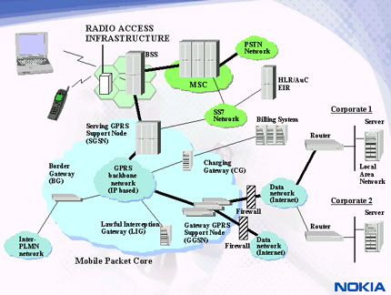
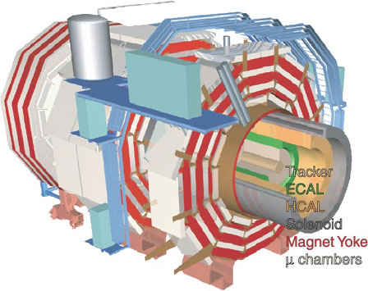
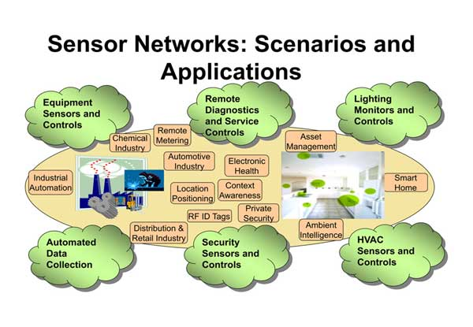
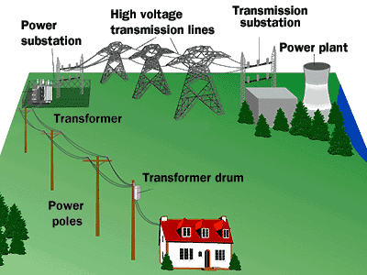
Next Generation of Applications & Product Lines
Growth of sophisticated and complex network-centric applications & product lines across all domains
Numerous functional and QoS commonalities across applications within a domain
  e.g., telecom applications need high reliability, high throughput, high volume
  e.g., enterprise applns need reliability, security and transactional guarantees
  e.g., sensor network applications must focus on energy conservation and improving data dissemination capabilities
  e.g., scientific applications need strict QoS guarantees, large storage
Middleware provides the reusable functional/non functional capabilities

Slide 3
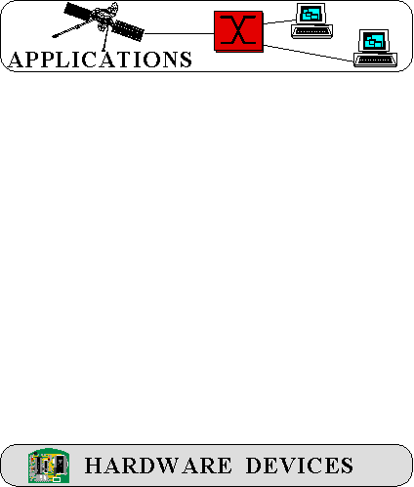





Middleware Structure & Capabilities
Software product-lines need to be supported on different hardware
& OS
Problem - direct deployment is tedious, error-prone, & costly over lifecycles
There are layers of middleware, just like there are layers of networking protocols
Standards-based COTS middleware helps to:
    Control end-to-end resources & QoS
    Leverage hardware & software technology advances
    Evolve to new environments & requirements
    Provide a wide array of reusable, off-the-shelf developer-oriented services

Slide 4
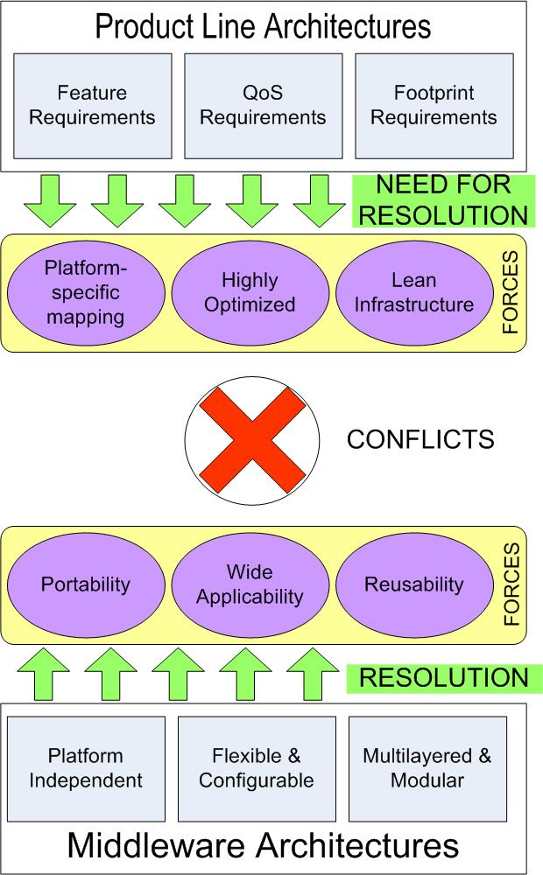
Technology Gaps in Middleware for SPLs
SPLs have very “focused but crosscutting” requirements of the underlying middleware infrastructure
  Optimized for the platform
  Lean footprint
  Efficient configuration & deployment
  Support run-time adaptations & reconfigurations
Standards middleware development & optimizations philosophy catered to maintaining “generality, wide applicability, portability & reusability”
  OS, compiler and hardware independent
  e.g., CORBA, J2EE. .NET
These technology gaps are hindering PLA progress => adverse economic and societal consequences
Need for a new research agenda that subsumes middleware within software product line research

Slide 5
Bridging the Technology Gap
Product-line architecture & product variants
Product-lines and product variants will need to be deployed on different OS-hardware-network combinations
Standards middleware will need to be used to eliminate numerous accidental complexities dealing with the variability in OS, hardware & networks
Highly optimized paths through layers of standard middleware are desired
Approaches to Specialization
  (1) Design-time
  Specialize for the commonalities displayed by product-lines
  Configure to address the variabilities displayed by product variants
  (2) Deployment & Run-time
  Optimize for the product component reassembly & redeployment variability incurred due to dynamic adaptations
  Support layer-wise middleware replacement & update capability
PLA₁
PLA₂
PLA₃
PLA_{K}
OS₁
OS₂
OS₃
OS_{N}
HW₁
HW₂
HW₃
HW_{M}
How do we achieve this?

Slide 6
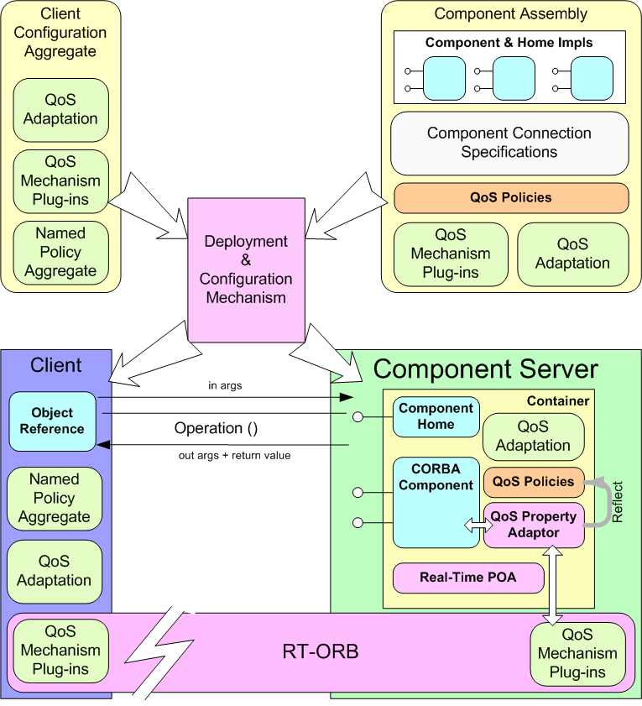
Feature Perspective of Middleware (1/3)
Configuration of components & assemblies
COTS component middleware is highly configurable & flexible
  At the level of application components & containers, component servers, & middleware services & infrastructure
Configuration of component server
Configuration of event notifiers
Configuration of the middleware bus
Configuration of component containers
Let us treat these as features that can be manipulated
Notes:
This is the CCM Solution. Don’t go into details here…. Just emphasize that components are just local interface implementations, as we will see later
Container mediated CORBA services

Slide 7
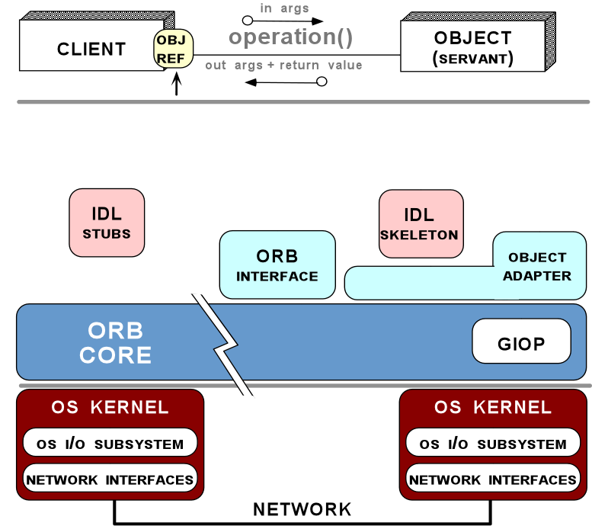
Feature Perspective of Middleware (2/3)
Component middleware is characterized by a large configuration space that maps known variations in the application requirements space to known variations in the middleware solution space
Feature for marshaling strategy
Feature for the request demuxing strategy
Feature for the event demuxing strategy
Feature for the connection management strategy
Feature for the concurrency strategy
Feature for the underlying transport strategy

Slide 8
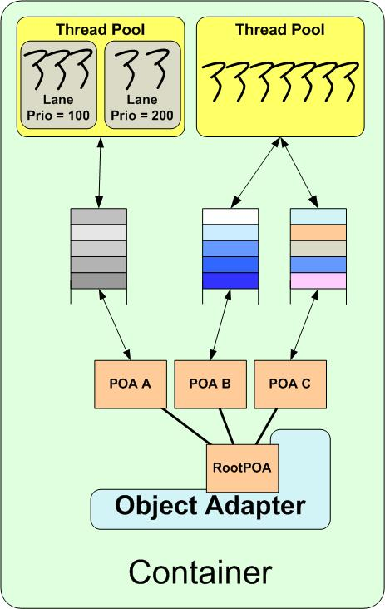
Feature Perspective of Middleware (3/3)
Determine various middleware policies for server objects e.g., security, lifetime, replication
Determine thread pool sizes; how are they shared; number of lanes and their priorities; if borrowing is enabled
Determine right buffer sizes
Determine end-to-end priority propagation model to use
Determine the server object management policies
Ensure semantic compatibility among chosen configurations
server object
management
middleware
SPL developers rely on ad hoc manual configurations, e.g., CORBA server-side programming
This “glue code” is traditionally handcrafted
Notes:
This is the CCM Solution. Don’t go into details here…. Just emphasize that components are just local interface implementations, as we will see later
Container mediated CORBA services

Slide 9
Taxonomy of Middleware Specialization Techniques
Based on literature survey
Overlapping dimensions share concepts, e.g. MDE/AOP includes both feature pruning & augmentation and can be used for customization as well as tuning
Dimensions can be combined to produce new variants of specialization
Serves as a guideline for synthesis of tools for design, V&V, analysis of specializations
When?
How?
What?
Three dimensional Taxonomy
of
Middleware Specializations
How do we realize this taxonomy in tools for middleware specialization?
Notes:
Lets take a look at some of the approaches taken in the survey papers which do a good job of combining the various dimensions of the taxonomy.
Limitations of traditional middleware specialization techniques
Focused on per-component basis
Does not span all stages of development life cycle
Does not support newer specialization techniques e.g. AOP, CBD, MDE, etc
Not integrated to support testing and analysis
Need for augmentation with new, existing approaches

Slide 10
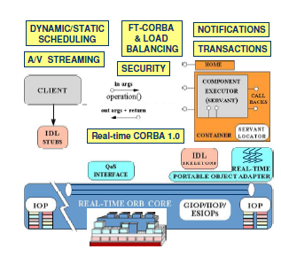
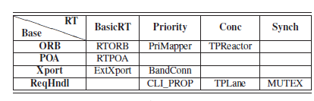
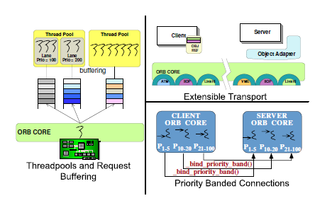
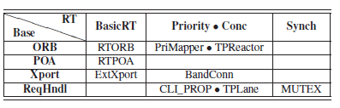
Enhancing Feature Algebra to Middleware
Approach based on Batory’s work on GenVoca and AHEAD
Apel et. al.’s Feature Algebra
Original Origami Matrix
Need to enhance the algebra in the design, deployment and runtime dimensions of SPL lifecycle
Folding of 3rd and 4th column

Slide 11
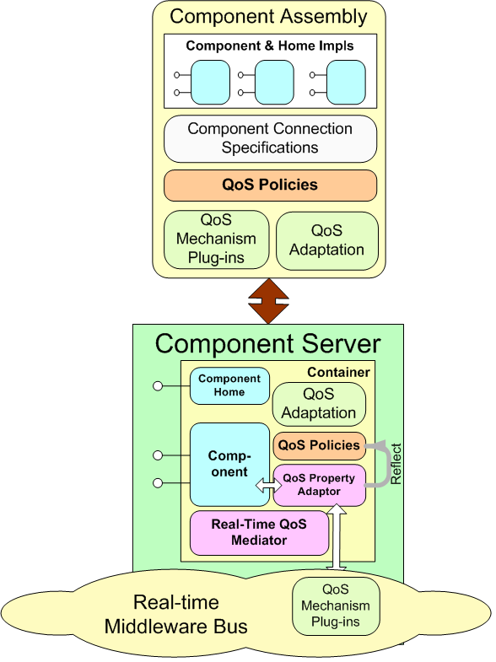
Staged Approach to Middleware Specialization
Multiple levels of abstraction required for middleware specializations
Model driven engineering (MDE) provides intuitive variability management in the problem space
Resource allocation and control framework decouples problem space from solution space
Deployment and configuration tools transparently map problem space needs to solution space artifacts
QoS-enabling component middleware provides hosting environment and runtime adaptation features
www.dre.vanderbilt.edu

