Slide 1
An Approach to Middleware Specialization for Cyber Physical Systems
Akshay Dabholkar and Aniruddha Gokhale
a.gokhale@vanderbilt.edu
www.dre.vanderbilt.edu/~gokhale
Presented at WCPS Workshop (ICDCS 2009)
Montreal, Canada
June 22nd, 2009
Research supported by NSF CAREER Award 0845789
Institute for Software Integrated Systems
Dept of EECS, Vanderbilt University
Nashville, TN, USA

Slide 2
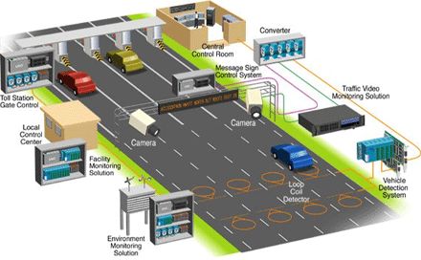
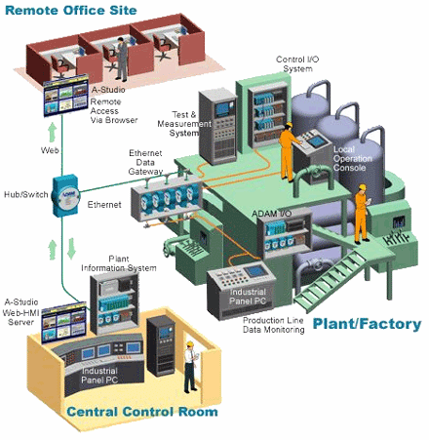
Developing Services in Cyber Physical Systems
Cyber Physical Systems exist across multiple domains
Tight integration of cyber, networking & physics
Software controls the physics; physics impacts software
Many services envisioned within a CPS domain
e.g., intelligent transportation systems have over 20+ services expected to be available
Services are essentially application product lines for that domain
Need
Middleware provides the reusable functional/non functional capabilities

Slide 3
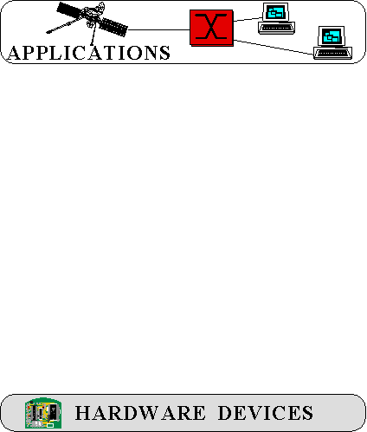
Middleware Structure & Capabilities
CPS product-lines need to be supported on different hardware
& OS
Problem - direct deployment is tedious, error-prone, & costly over lifecycles
There are layers of middleware, just like there are layers of networking protocols
COTS middleware helps to:
Control end-to-end resources & QoS
Leverage hardware & software technology advances
Evolve to new environments & requirements
Provide a wide array of reusable, off-the-shelf developer-oriented services

Slide 4
Challenges in Middleware for CPS Product Lines
CPS product lines have very “focused but crosscutting” requirements of the underlying middleware infrastructure
Optimized for the platform
Lean footprint
Support run-time adaptations & reconfigurations
But, standards COTS middleware catered to maintaining “generality, wide applicability, portability & reusability”
OS, compiler and hardware independent
Cannot reinvent the wheel – Reuse !
High development, maintenance costs
Need new principles and techniques that reuse but specialize COTS middleware for CPS product lines

Slide 5
What is involved in Middleware Specialization?
Product-line architecture & product variants
Need only certain capabilities at each layer
How to identify these code paths?
Need to optimize these paths for performance and memory footprint
Optimal packing on resources
Address endogenous & exogenous systemic issues
PLA₁
PLA₂
PLA₃
PLA_{K}
A feature-oriented view of middleware lends itself well
Makes it amenable to algebraic manipulations
OS₁
OS₂
OS₃
OS_{N}
HW₁
HW₂
HW₃
HW_{M}

Slide 6
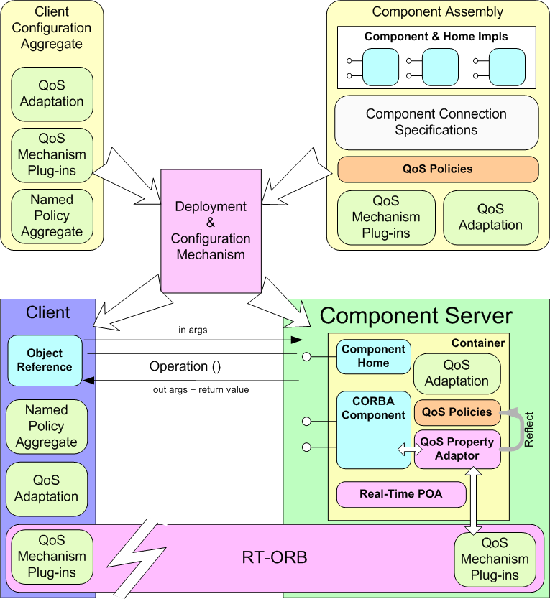
Feature Perspective of Middleware (1/3)
Configuration of components & assemblies
Traditionally, features are OO classes
COTS middleware is highly configurable and flexible
Configurability as an indicator of features
Configuration of component server
Configuration of event notifiers
Configuration of the middleware bus
Configuration of component containers
Let us treat configurability as features that can be manipulated
Notes:
This is the CCM Solution. Don’t go into details here…. Just emphasize that components are just local interface implementations, as we will see later
Container mediated CORBA services

Slide 7
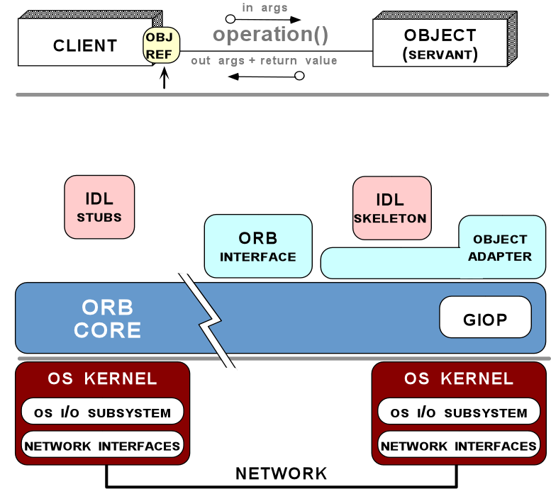
Feature Perspective of Middleware (2/3)
Component middleware is characterized by a large configuration space that maps known variations in the application requirements space to known variations in the middleware solution space
marshaling strategy
Request demuxing
Event demuxing
Concurrency
Connection management
Underlying transport

Slide 8
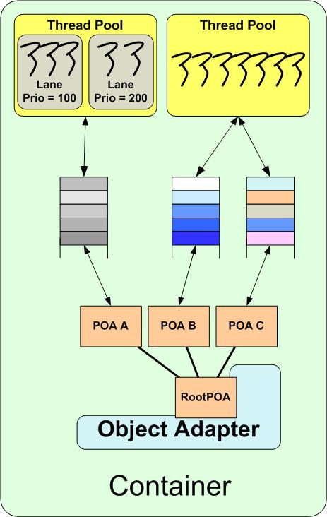
Feature Perspective of Middleware (3/3)
Various middleware policies for server objects e.g., security, lifetime, replication
Thread pool sizes; how are they shared; number of lanes and their priorities; if borrowing is enabled
Right buffer sizes
End-to-end priority propagation model to use
Server object management policies
Ensure semantic compatibility among chosen configurations
server object
management
middleware
Data structures and configuration parameters
Policy sets
Specialization can synthesize only the desired features
Notes:
This is the CCM Solution. Don’t go into details here…. Just emphasize that components are just local interface implementations, as we will see later
Container mediated CORBA services

Slide 9
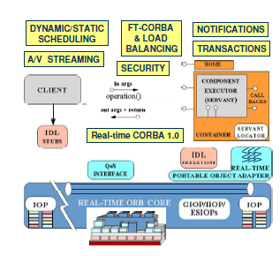
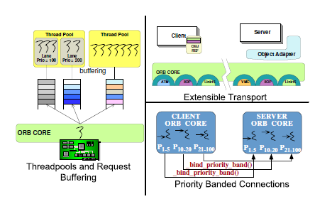
Algebraic Manipulations of Middleware
Approach based on Batory’s work on GenVoca and AHEAD
Apel et. al.’s Feature Algebra
Original Origami Matrix
Folding of 3rd and 4th column
Enhance the algebra in the design, deployment and runtime dimensions

Slide 10
Current Status: Build-time Specializations
CPS developer is provided an intuitive feature model for feature selection
Map the selections to middleware-specific features
Build-time specializations
Source navigator collects info about middleware code
User inputs used to find closure set of all functionality needed
Closure set of features built
Dependencies analyzed
Run it thru project builders that synthesize Makefiles for just the needed features
Result is a specialized stack

Slide 11
Longer-term Goals: Multiple Dimensions
Overlapping dimensions share concepts
Dimensions can be combined to produce new variants of specialization
Serves as a guideline for synthesis of tools for design, V&V, analysis of specializations, etc
Current focus on Intelligent Transportation Systems
When?
How?
What?
Three dimensional Taxonomy
of
Middleware Specializations
Notes:
Lets take a look at some of the approaches taken in the survey papers which do a good job of combining the various dimensions of the taxonomy.
Limitations of traditional middleware specialization techniques
Focused on per-component basis
Does not span all stages of development life cycle
Does not support newer specialization techniques e.g. AOP, CBD, MDE, etc
Not integrated to support testing and analysis
Need for augmentation with new, existing approaches

Slide 12
Concluding Remarks
Leverage the benefits of COTS middleware but specialize it for CPS applications [No reinvention of the wheel; Reuse]
An approach to algebraic manipulations is most promising
Current focus on build-time specializations
Goal is to extend it to deployment and runtime
Open source project called GAMMA (Generators and Aspects for Manipulation of Middleware Architectures)
Research funded by NSF CAREER Award (March 2009)

