Slide 1


Managing the Quality of Software Product Lines Through Reusable Model Transformations
Amogh Kavimandan, Aniruddha Gokhale, Gabor Karsai & Jeff Gray
Presented at QoSA 2011, Boulder, CO
June 21, 2011
Vanderbilt University & Univ of Alabama
R&D supported by NSF CAREER Awards

Slide 2
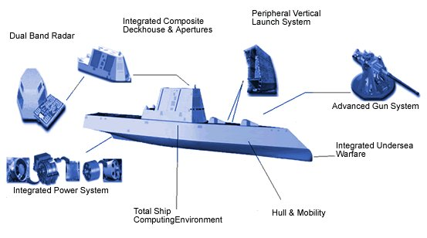
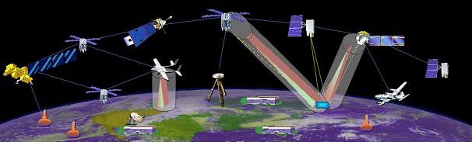

Distributed Real-time Embedded (DRE) Systems
Heterogeneous soft real-time applications
Large-scale
Stringent simultaneous QoS demands
High-availability, Predictability (CPU & network)
Efficient resource utilization
Operation in dynamic & resource-constrained environments
Process/processor failures
Changing system loads
Component-based development
Separation of Concerns
Composability
Reuse of COTS components
(Images courtesy Google)
Notes:
2

Slide 3
Evolution of Software Architecture of DRE Systems
Development lifecycle incrementally refines the software architecture of DRE systems
Model-driven Engineering paradigm is in predominant use
Model Transformations enable refinements through successive stages of the development lifecycle
Both intra- and inter-layer transformations are possible
Specification
Composition
Deployment
Configuration
Run-time
Need to focus on the quality of software architecture at each stage
3

Slide 4
Basics of Model Transformations
Model transformation rules dictate how elements of source modeling language are transformed to elements of target modeling language
e.g, Model-driven Architecture’s PIM to PSM approach
User provides an instance of the source model
Transformation tool produces a model instance in target modeling language

Slide 5
Challenges Imposed by Product Lines
In Product Lines, the process is repeated per variant
Too much needless effort spent in writing transformation rules per variant
Impacts S/W Quality – a Second Order Effect !

Slide 6
Example: Middleware QoS Configuration in DRE SPL
Buffer request invocations
Dynamically allocated
thread resources
Prioritized connections
Transformations exhibit significant commonalities in configuration between individual family variants => rules are duplicated!
Variability is observed to be in the mapping => hard to extend the mapping approach without re-writing the entire set of transformation rules
Notes:
6/20/2011
6

Slide 7
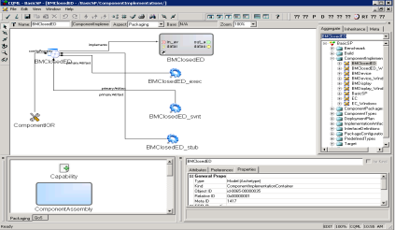

Need for Reuse in Model Transformaions
if (multi_service_levels == true)
create one Lane per client component
if (multi_service_levels == true)
create two Lanes per client component
&&
assign ten threads per Lane
if (multi_service_levels == true)
create one Lane
Input DSML is QoS Requirements metamodel, output DSML is QoS configuration metamodel
Transformation rules are written in terms of these metamodels
Finally, transformation is applied on input requirements model to create configuration model
To extend it for a product family, transformation rules written per variant
Results in redoing the “Edit-Compile-Execute-Test” Cycle for each variant
Notes:
6/20/2011
7

Slide 8
Recap: Where We Are & Where We Need to Be
EFFORT REPEATED FOR EACH VARIANT
Transformations Development Efforts with Existing State-of-the-Art
8
Notes:
6/20/2011
8

Slide 9
Recap: Where We Are & Where We Need to Be
MINIMAL EFFORT
DESIRED NEW CAPABILITY IN MODEL TRANSFORMATIONS
ALL AUTOMATED
Hypothesis: Second-order Solns Will Improve Software Quality
9
Notes:
6/20/2011
9

Slide 10
Reuse: Desired Properties and Constraints
Desired properties and constraints on Reuse Capabilities:
How can the commonalities be factored out & decoupled from transformations?
How can existing transformations be applied to new variants with minimal invasive changes?
How can support for reuse be built within existing transformation tool chains with none to minimal modifications to the tool chains?
Solution Approach: Model Transformation Templatization and Specialization (MTS)
10
Notes:
6/20/2011
10

Slide 11
MTS at a Conceptual Level
4 Step Process
Decouple Variabilities from Commonalities in Rules
Generate Variability Metamodels
Synthesize Specialization Repository
Specializing the Transformation Instance

Slide 12
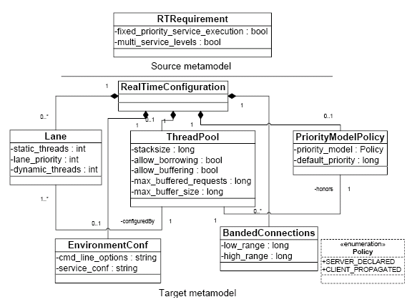
Explaining MTS via a Case Study: QoS Configuration
Middleware QoS configuration
Source model – two Boolean attributes
Target model – RT-CCM QoS configuration policies
12
Notes:
6/20/2011
12

Slide 13
Representative Transformation Tool: GReAT
Transformation rules specified in a visual language
Additional rules captured in C++
Built on top of Generic Modeling Environment (GME)

Slide 14
GReAT Screen Snapshot

Slide 15
Step I: Decouple Variabilities from Commonalities
No first class support to separate commonalities from variabilities in transformation rules => How to achieve this non-invasively to the tool?
We expect developers to conduct Scope-Commonality-Variability Analysis Ahead-of-time
Define transformation rules for commonalities as before
MTS defines a tool-agnostic textual notation to capture variabilities in transformation rules as “parametrized rules”
2 types of variability blocks defined in MTS
Structural – where variation in a family member stems from dissimilarities in their structural composition
Quantitative – where variation in a family member stems from the value of the parameter
Other forms of variability blocks are possible (future work)

Slide 16
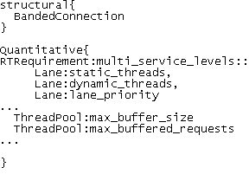
MTS Step I: Application to Case Study
BandedConnections in Structural => they are introduced in target instance
Data values of static threads, etc vary and are evaluated lazily, and show up as Quantitative

Slide 17
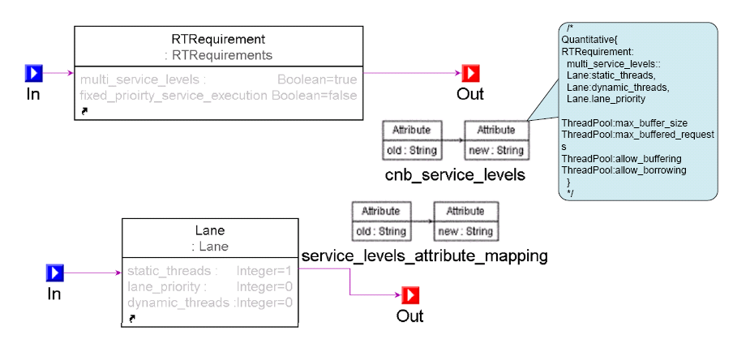
MTS Step I: Realizing Parametrized Rules in GReAT
Use “tunneling” approach to introduce parametrized rules
In GReAT, we leveraged the C++ code block associated with attributes
Introduced the rules as comment blocks in the C++ code block
17
Notes:
6/20/2011
17

Slide 18
MTS Step II: Generate Variability Metamodels
Recall that the parametrized transformation rules are agnostic to the transformation tool
In GReAT, these were captured as comments in C++ blocks
Need to convert them to a tool-understandable form
Solution Approach: Use Higher Order Transformations
Tool-agnostic parametrized rules are transformed into artifacts understandable to the tool
In GReAT this becomes a metamodel we call the “Variability MetaModel (VMM)”

Slide 19
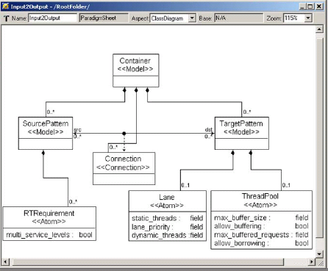
MTS Step II: Logic for Generating VMM
For every structural variability, the algorithm creates the corresponding model objects in VMM
For every quantitative variability, the algorithm creates model objects and their attributes as well
Type information deduced from original (source/target) metamodel
19
Notes:
6/20/2011
19

Slide 20
MTS Step II: Generated VMM in GReAT

Slide 21
MTS Step III: Synthesizing Specialization Repository
In step II, VMMs were created from the variabilities
VMM must be used to create instances of variabilities according to those in the family variants – instance of variability is a model instance of VMM
A collection of models of variants is specialization repository of family
Attribute values must be provided at this stage in the VMM model instance
Collection of VMM instances is a specialization repository
21
Notes:
6/20/2011
21

Slide 22
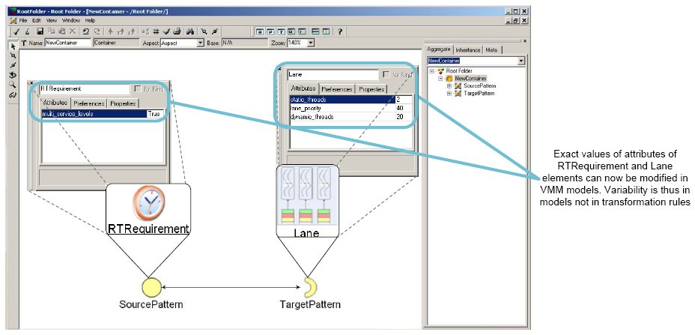
MTS Step III: Specialization Repository for Case Study
Transformation developers create VMM models, for every application instance
Exact cardinalities, values of attributes etc. chosen at the time VMM models are created
Partial specializations of the application variant
Application instance-specific details can vary without need to recompile, relink transformation
22
Notes:
6/20/2011
22

Slide 23
MTS at a Conceptual Level
4 Step Process
Decouple Variabilities from Commonalities in Rules
Generate Variability Metamodels
Synthesize Specialization Repository
Specializing the Transformation Instance

Slide 24
MTS Step IV: Specializing Transformations
Recall that transformation rules for commonalities were specified separately
We now have VMMs and specialization repository of model instances for individual variabilities
How to weave variabilities represented in VMMs with commonalities?
Need a concept akin to a joinpoint model in AOP
MTS defines a second higher order transformation to generate a complete set of transformation rules for a variant

Slide 25
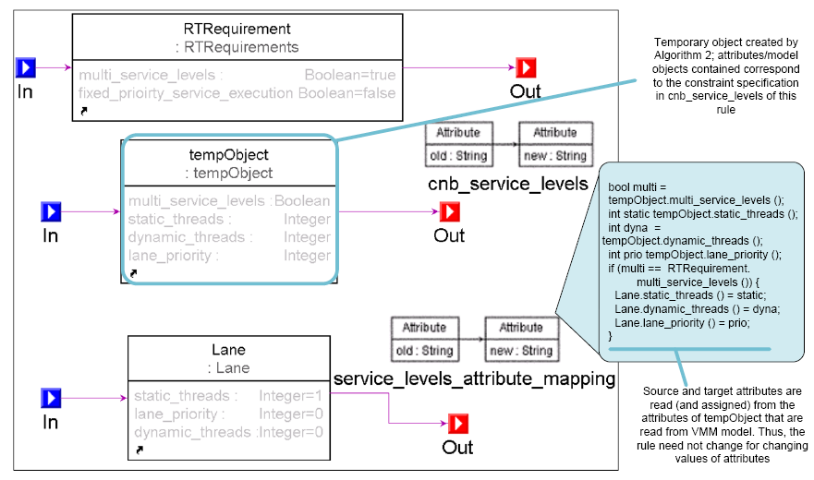
MTS Step IV: Logic for Specializing Transformations
Adds temporary objects at appropriate points in the parametrized transformation rules
Serve as placeholders to insert the instantiated variability of a family member
Combined with commonality rules to produce entire transformation rules
25
Notes:
Step IV is…
In the last step we said we have created incomplete transformations – here we will put these back into the original Xformation to create variant-specific Xformation.
MTS defines another hot to do that – it adds temporary objects at appropriate points, these objects have pre-parsed the respective model objects from VMM model – ready to be used by the rule.
We will see this how…
6/21/2011
25

Slide 26
Concluding Remarks
Lack of Reuse in Transformation tools indirectly impacts s/w quality
Particularly crucial for product lines
MTS supports a tool-agnostic process to support transformations reuse
Demonstrated in GReAT
Benefits amortized over the number of variants
Future work is investigating applicability in ATL and other tools

Slide 27
Evaluating MTS: Experimental Setup
Experiments were conducted on Windows XP SP2 node
2.66 GHz Intel Xeon dual processor
2 GB physical memory
Used CoSMIC version 0.5.7, GME version 6.11.9 and GReAT version 1.6.0
27
Notes:
6/21/2011
27

Slide 28
Evaluating MTS: Metrics for Evaluation
MTS evaluated across two dimensions:
Reduction in effort to write the transformation rules – measure of reusability
Overhead incurred by MTS – due to the use of higher-order transformations in MTS
28
Notes:
6/21/2011
28

Slide 29
Evaluating MTS: Comparison with Traditional Tools
1
2
3
GRengine execution involves the following steps
Executing the master interpreter that generates the necessary intermediate files containing all the rules in the current transformation,
Compile these intermediate files, and
Run the generated executable
A change in transformation changes its rules and necessitates regeneration of its intermediate files => need to execute 1,2, and 3
29
Notes:
6/21/2011
29

Slide 30
Evaluating MTS: Overhead of Traditional Approaches
1
2
3
Without MTS, developers need to expend effort in all these steps
Steps 1 and 2 must always be performed at the time a new variant is added
Can be extremely slow for very large metamodels
30
Notes:
6/21/2011
30

Slide 31
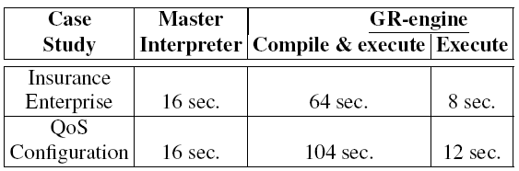
Evaluating MTS: Reduction in Development Effort
1
2
3
With MTS and its use of variability metamodel, two cases are possible:
Case 1: New variant subsumed by existing constraint specification
Steps 1 & 2 performed only once, Step 3 repeated each time new variant added/changed => several times faster
Savings of over 90% (when MTS was used) in time taken for single transformation to run
31
Notes:
Amortized.
Add another figure of steps 1,2, 3…have diff. slide one for subsumed, one for with modifications to constraint notation.
Add another slide for I-1/I
6/21/2011
31

Slide 32
Evaluating MTS: Reduction in Development Effort
Rn rules for all variants
Rn rules per variant
With MTS and its use of variability metamodel, two cases are possible:
Case 1: New variant subsumed by existing constraint specification
Steps 1 & 2 performed only once, Step 3 repeated each time new variant added/changed => several times faster
Savings of over 90% (when MTS was used) in time taken for single transformation to run
Total number of rules to be maintained will be reduced by a fraction of (I-1)/I, for I instances
32
Notes:
Amortized.
Add another figure of steps 1,2, 3…have diff. slide one for subsumed, one for with modifications to constraint notation.
Add another slide for I-1/I
6/21/2011
32

Slide 33
Evaluating MTS: Reduction in Development Effort
1
2
3
With MTS and its use of variability metamodel, two cases are possible:
Case 2: New variant introduces additional variabilities in the family
Requires additional constraint specification, performing Steps 1 & 2 to generate new VMM – old VMM models would still work
33
Notes:
Amortized.
Add another figure of steps 1,2, 3…have diff. slide one for subsumed, one for with modifications to constraint notation.
Add another slide for I-1/I
6/21/2011
33

Slide 34
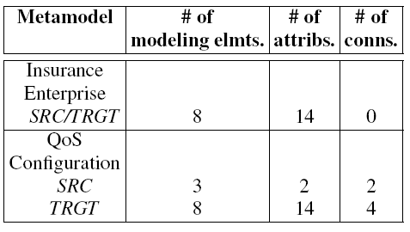
Evaluating MTS: Overhead of Higher-order Transformations
Measure performance overhead placed by MTS higher-order transformations for the two case studies
Overhead measured in terms of time taken for each transformation to run
34
Notes:
6/21/2011
34

Slide 35
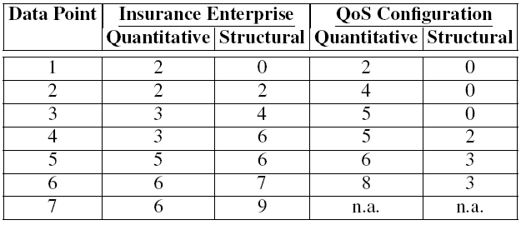
Evaluating MTS: Overhead of Higher-order Transformations
Measure performance overhead placed by MTS higher-order transformations for the two case studies
Overhead measured in terms of time taken for each transformation to run
Measure overhead as the number of variabilities are increased
Study how higher-order transformations behave under increasing variabilities
Variabilities were increased from data point 1 through 6/7
35
Notes:
6/21/2011
35

Slide 36
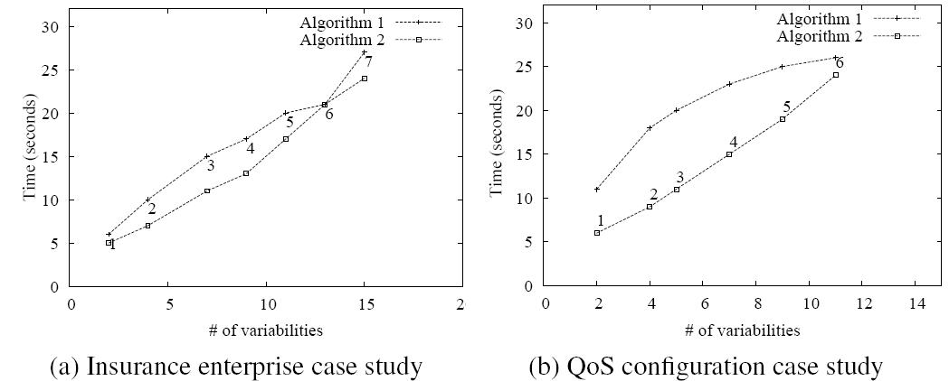
Evaluating MTS: Overhead of Higher-order Transformations
Scale well to increasing variabilities
Algorithms take slightly more time for QoS configuration case study due to larger metamodel
One-time expense for every change in constraint notation specification
Once to generate new VMM, once to create temporary objects in transformation
36
Notes:
Algorithm 1 was observed to be generally more sensitive to variations in structural variabilities for constant # of quantitative variabilities
6/21/2011
36

