Slide 1



Deployment and Runtime Techniques for Fault-tolerance in Distributed, Real-time and Embedded Systems
Aniruddha Gokhale
Associate Professor, Dept of EECS, Vanderbilt Univ, Nashville, TN, USA
www.dre.vanderbilt.edu/~gokhale
Based on work done by Jaiganesh Balasubramanian and Sumant Tambe
Presented at Dept of CS, IUPUI, April 15, 2011
Work supported in part by by NSF CAREER, NSF SHF/CNS
Notes:
1

Slide 2
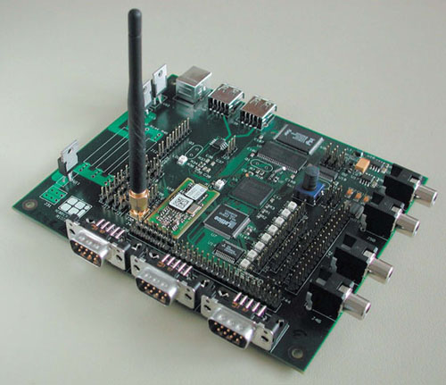
Focus: Distributed Real-time and Embedded Systems
Is this a Distributed, Real-time and Embedded (DRE) System?
Just an embedded system => Not a DRE system
Highly resource-constrained
Notes:
2

Slide 3
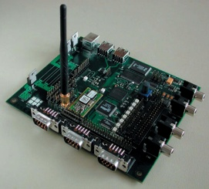
Focus: Distributed Real-time and Embedded Systems
Is this a Distributed, Real-time and Embedded (DRE) System?
A composition of embedded systems => Not DRE yet
Highly resource-constrained
Real-time requirements on interactions among individual embedded systems
Failures of individual systems possible
Other QoS requirements
Notes:
3

Slide 4
Focus: Distributed Real-time and Embedded Systems
Networked systems of systems => is DRE
Highly resource-constrained
Real-time requirements on intra- and inter subsystem interactions
Failures of individual subsystems possible
Other QoS requirements
Network with constraints on bandwidth
Workloads can fluctuate
Notes:
4

Slide 5
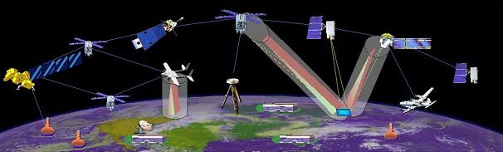
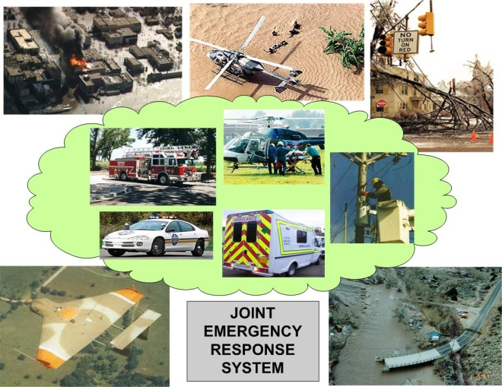

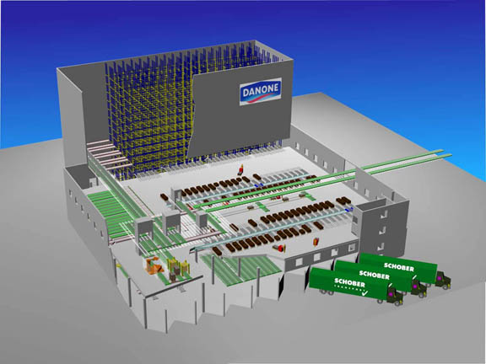
Focus: Distributed Real-time and Embedded Systems
OPEN
Multiple tasks with real-time requirements
Resource-constrained environment
Resource fluctuations and faults are a norm => maintain high availability
Uses COTS component middleware technologies, e.g., RTCORBA/CCM
CLOSED
Objective: Highly available DRE systems
Resource-aware
Fault-tolerant
QoS-aware (soft real-time)
Notes:
5

Slide 6
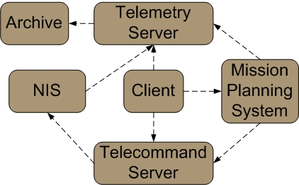
Challenge 1: Satisfy Multi-objective Requirements
Soft real-time performance must be assured despite failures
Notes:
6

Slide 7
Challenge 1: Satisfy Multi-objective Requirements
Soft real-time performance must be assured despite failures
Passive (primary-backup) replication is preferred due to low resource consumption
Notes:
7

Slide 8
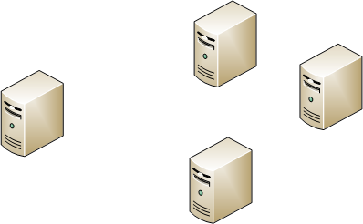
Challenge 1: Satisfy Multi-objective Requirements
Soft real-time performance must be assured despite failures
Passive (primary-backup) replication is preferred due to low resource consumption
Replicas must be allocated on minimum number of resources => task allocation that minimizes resources used
Notes:
8

Slide 9
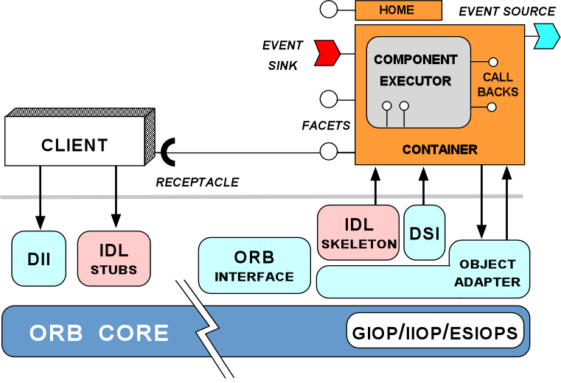
Challenge 2: Dealing with Failures & Overloads
Context
One or more failures at runtime in processes, processors, links, etc
Mode changes in operation may occur
System overloads are possible
Solution Needs
Maintain QoS properties maximally
Minimize impact
Require middleware-based solutions for reuse and portability
Notes:
9

Slide 10
Challenge 3: Replication with End-to-end Tasks
DRE systems often include end-to-end workflows of tasks organized in a service oriented architecture
  A multi-tier processing model focused on the end-to-end QoS requirements
  Critical Path: The chain of tasks with a soft real-time deadline
  Failures may compromise end-to-end QoS (response time)
Non determinism in behavior leads to orphan components
Notes:
Particularly of interest is the component-based operational string model….
An important notion in operational string is that of a critical path….
To ensure critical path meets its deadline, two things have to happen.

Slide 11
Non-determinism and the Side Effects of Replication
Many sources of non-determinism in DRE systems
  e.g., Local information (sensors, clocks), thread-scheduling, timers, and more
  Enforcing determinism is not always possible
Side-effects of replication + non-determinism + nested invocation => Orphan request & orphan state Problem
Hard to support exactly-once semantics
Non-determinism
Nested Invocation
Orphan Request Problem
Passive Replication
Notes:
When you use replication for high-availability, you have to deal with the side-effects of replication.

Slide 12
Execution Semantics & Replication
Execution semantics in distributed systems
  May-be – No more than once, not all subcomponents may execute
  At-most-once – No more than once, all-or-none of the subcomponents will be executed (e.g., Transactions)
    Transaction abort decisions are not transparent
  At-least-once – All or some subcomponents may execute more than once
    Applicable to idempotent requests only
  Exactly-once – All subcomponents execute once & once only
    Enhances perceived availability of the system
Exactly-once semantics should hold even upon failures
  Equivalent to single fault-free execution
  Roll-forward recovery (replication) may violate exactly-once semantics
    Side-effects of replication must be rectified
State Update
State Update
State Update
Partial
execution
should seem
like no-op
upon recovery
Notes:
To understand the run-time issues, we have to closely examine execution semantics in distributed systems…. Even in case of failures, it should appear that everything executed exactly once. However, roll-forward recovery makes it particularly harder. Although parts of the request are executed multiple time physically, the outcome should be as if everything executed exactly once.

Slide 13
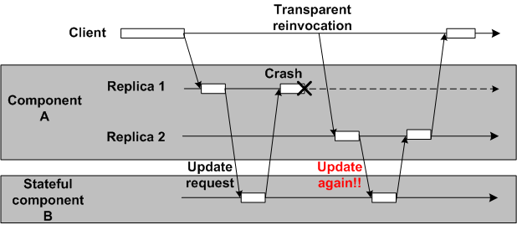
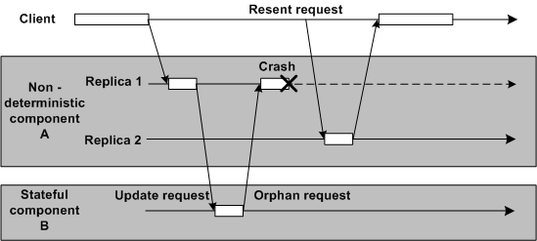
Exactly-once Semantics, Failures, & Determinism
Deterministic component A
  Caching of request/reply at component B is sufficient
Caching of
request/reply
rectifies the problem
Non-deterministic component A
Two possibilities upon failover
  No invocation
  Different invocation
Caching of request/reply does not help
  Non-deterministic code must re-execute
Orphan request & orphan state
Notes:
Solution to rectify the side-effects of replication depends upon whether system is deterministic or non-deterministic.

Slide 14
Challenge 4: Engineering Challenges
Context
Solutions to challenges 1 thru 3 require system (re)configuration and (re)deployment
Manual efforts at configuring middleware must be avoided
Solution Needs
Maximally automate the configuration and deployment => Leads to systems that are “correct-by-construction”
Autonomous adaptive capabilities
Notes:
14

Slide 15
Contributions within the Lifecycle of DRE Systems
Lifecycle
Algorithms + Systems + S/W Engineering
Specification
CQML to provide expressive capabilities to capture requirements
CoSMIC MDE toolsuite
Composition
DeCoRAM task allocation to balance resources, real-time and faults
GRAFT to automatically inject FT logic
DAnCE for deployment & configuration
Deployment
Configuration
FLARe adaptive middleware for RT+FT
CORFU middleware for componentizing FLARe
The Group-failover Protocol for orphan requests
Run-time
15
Notes:
Let me quickly review what I’ve presented in the past. During my proposal I presented CQML and GRAFT, which address the challenges in earlier phases of the development lifecycle. The group-failover was the proposed topic addressing the challenges in the run-time phase.

Slide 16
Contributions within the Lifecycle of DRE Systems
Lifecycle
Algorithms + Systems + S/W Engineering
Specification
Composition
DeCoRAM task allocation to balance resources, real-time and faults
DAnCE for deployment & configuration
Deployment
Configuration
Run-time
16
Notes:
Let me quickly review what I’ve presented in the past. During my proposal I presented CQML and GRAFT, which address the challenges in earlier phases of the development lifecycle. The group-failover was the proposed topic addressing the challenges in the run-time phase.

Slide 17
Resolving Challenges 1 & 4: DeCoRAM
Provides a replica allocation algorithm that is
  Real time-aware
  Fault-aware
  Resource-aware
Supports a large class of DRE systems => No tight coupling to any single allocation algorithm
Supports multiple middleware technologies => Automated middleware configuration that is not coupled to any middleware
Notes:
17

Slide 18
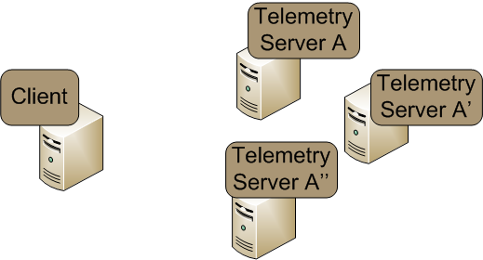
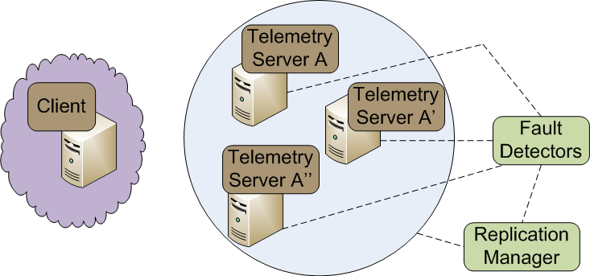
Our Solution: The DeCoRAM D&C Middleware
DeCoRAM = “Deployment & Configuration Reasoning via Analysis & Modeling”
DeCoRAM consists of
  Pluggable Allocation Engine that determines appropriate node mappings for all applications & replicas using installed algorithm
  Deployment & Configuration Engine that deploys & configures (D&C) applications and replicas on top of middleware in appropriate hosts
  A specific allocation algorithm that is real time-, fault- and resource-aware
No coupling with allocation algorithm
Middleware-agnostic D&C Engine
This talk focuses on the allocation algorithm

Slide 19
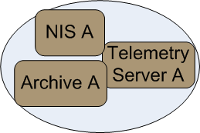
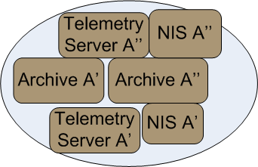
DeCoRAM Allocation Algorithm
System model
  N periodic DRE system tasks
  RT requirements – periodic tasks, worst-case execution time (WCET), worst-case state synchronization time (WCSST)
  FT requirements – K number of processor failures to tolerate (number of replicas)
  Fail-stop processors
How many processors shall we need for a primary-backup scheme?
An intuition
Num proc in No-fault case <=
Num proc for passive replication <= Num proc for active replication

Slide 20
DeCoRAM Allocation Algorithm (1/2)
System model
  N periodic DRE system tasks
  RT requirements – periodic tasks, worst-case execution time (WCET), worst-case state synchronization time (WCSST)
  FT requirements – K number of processor failures to tolerate (number of replicas)
  Fail-stop processors
How many processors shall we need for a primary-backup scheme? – A basic intuition
Num proc in No-fault case <=
Num proc for passive replication <= Num proc for active replication

Slide 21
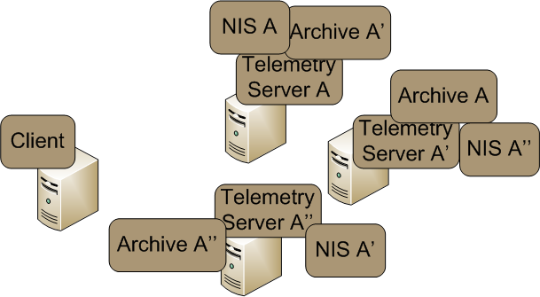
DeCoRAM Allocation Algorithm (2/2)
System objective
  Find a mapping of N periodic DRE tasks & their K replicas so as to minimize the total number of processors utilized
    no two replicas are in the same processor
    All tasks are schedulable both in faulty as well as non-faulty scenarios
DeCoRAM Allocation Engine
Similar to bin-packing, but harder due to combined FT & RT constraints

Slide 22
Designing the DeCoRAM Allocation Algorithm (1/5)
  Basic Step 1: No fault tolerance
  Only primaries exist consuming WCET each
  Apply first-fit optimal bin-packing using the [Dhall:78]* algorithm
  Consider sample task set shown
  Tasks arranged according to rate monotonic priorities
Task | WCET | WCSST | Period | Util
A | 20 | 0.2 | 50 | 40
B | 40 | 0.4 | 100 | 40
C | 50 | 0.5 | 200 | 25
D | 200 | 2 | 500 | 40
E | 250 | 2.5 | 1,000 | 25
    *[Dhall:78] S. K. Dhall & C. Liu, “On a Real-time Scheduling Problem”, Operations Research, 1978

Slide 23
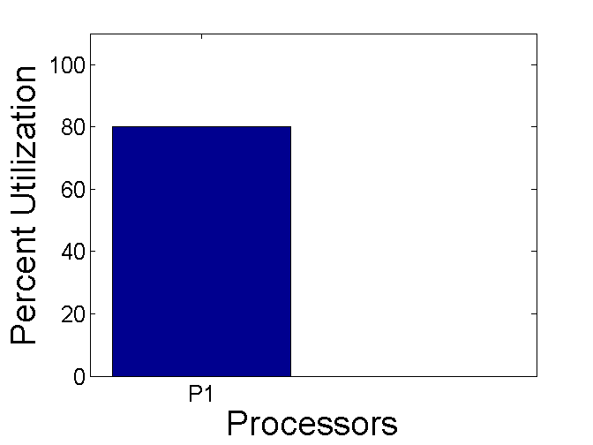
Designing the DeCoRAM Allocation Algorithm (1/5)
  Basic Step 1: No fault tolerance
  Only primaries exist consuming WCET each
  Apply first-fit optimal bin-packing using the [Dhall:78] algorithm
  Consider sample task set shown
  Tasks arranged according to rate monotonic priorities
Task | WCET | WCSST | Period | Util
A | 20 | 0.2 | 50 | 40
B | 40 | 0.4 | 100 | 40
C | 50 | 0.5 | 200 | 25
D | 200 | 2 | 500 | 40
E | 250 | 2.5 | 1,000 | 25

Slide 24
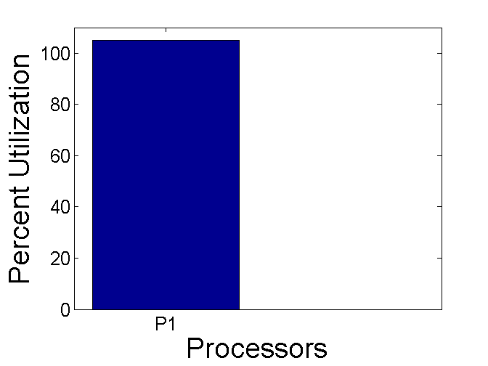

Designing the DeCoRAM Allocation Algorithm (1/5)
  Basic Step 1: No fault tolerance
  Only primaries exist consuming WCET each
  Apply first-fit optimal bin-packing using the [Dhall:78] algorithm
  Consider sample task set shown
  Tasks arranged according to rate monotonic priorities
Task | WCET | WCSST | Period | Util
A | 20 | 0.2 | 50 | 40
B | 40 | 0.4 | 100 | 40
C | 50 | 0.5 | 200 | 25
D | 200 | 2 | 500 | 40
E | 250 | 2.5 | 1,000 | 25

Slide 25
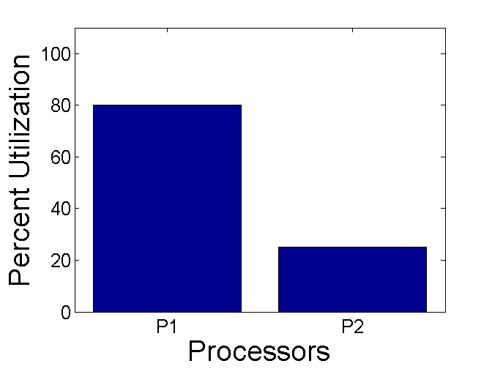
Designing the DeCoRAM Allocation Algorithm (1/5)
  Basic Step 1: No fault tolerance
  Only primaries exist consuming WCET each
  Apply first-fit optimal bin-packing using the [Dhall:78] algorithm
  Consider sample task set shown
  Tasks arranged according to rate monotonic priorities
Task | WCET | WCSST | Period | Util
A | 20 | 0.2 | 50 | 40
B | 40 | 0.4 | 100 | 40
C | 50 | 0.5 | 200 | 25
D | 200 | 2 | 500 | 40
E | 250 | 2.5 | 1,000 | 25

Slide 26
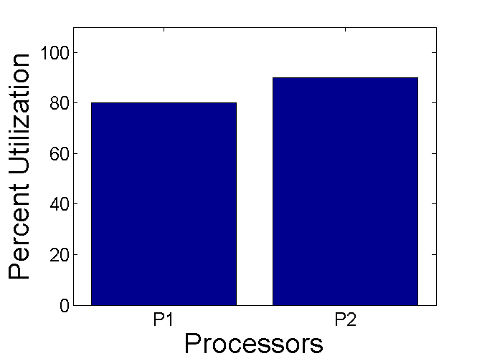
Designing the DeCoRAM Allocation Algorithm (1/5)
  Basic Step 1: No fault tolerance
  Only primaries exist consuming WCET each
  Apply first-fit optimal bin-packing using the [Dhall:78] algorithm
  Consider sample task set shown
  Tasks arranged according to rate monotonic priorities
Task | WCET | WCSST | Period | Util
A | 20 | 0.2 | 50 | 40
B | 40 | 0.4 | 100 | 40
C | 50 | 0.5 | 200 | 25
D | 200 | 2 | 500 | 40
E | 250 | 2.5 | 1,000 | 25

Slide 27
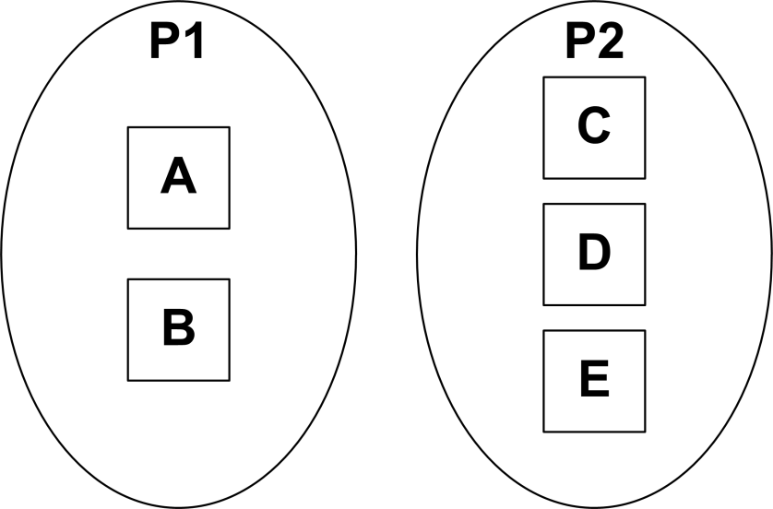
Designing the DeCoRAM Allocation Algorithm (1/5)
  Basic Step 1: No fault tolerance
  Only primaries exist consuming WCET each
  Apply first-fit optimal bin-packing using the [Dhall:78] algorithm
  Consider sample task set shown
  Tasks arranged according to rate monotonic priorities
Task | WCET | WCSST | Period | Util
A | 20 | 0.2 | 50 | 40
B | 40 | 0.4 | 100 | 40
C | 50 | 0.5 | 200 | 25
D | 200 | 2 | 500 | 40
E | 250 | 2.5 | 1,000 | 25
  Outcome -> Lower bound established
  System is schedulable
  Uses minimum number of resources
RT & resource constraints satisfied; but no FT

Slide 28
Designing the DeCoRAM Allocation Algorithm (2/5)
  Refinement 1: Introduce replica tasks
  Do not differentiate between primary & replicas
  Assume tolerance to 2 failures => 2 replicas each
  Apply the [Dhall:78] algorithm
Task | WCET | WCSST | Period
A1,A2,A3 | 20 | 0.2 | 50
B1,B2,B3 | 40 | 0.4 | 100
C1,C2,C3 | 50 | 0.5 | 200
D1,D2,D3 | 200 | 2 | 500
E1,E2,E3 | 250 | 2.5 | 1,000

Slide 29
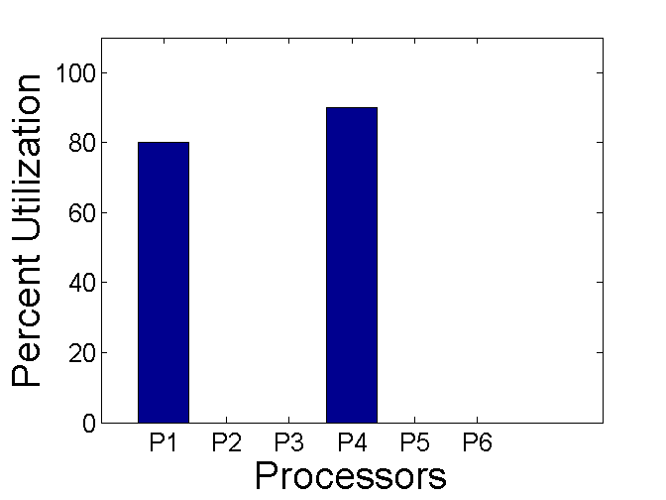
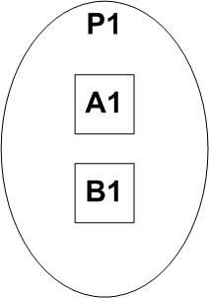
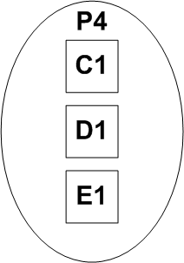
Designing the DeCoRAM Allocation Algorithm (2/5)
  Refinement 1: Introduce replica tasks
  Do not differentiate between primary & replicas
  Assume tolerance to 2 failures => 2 replicas each
  Apply the [Dhall:78] algorithm
Task | WCET | WCSST | Period
A1,A2,A3 | 20 | 0.2 | 50
B1,B2,B3 | 40 | 0.4 | 100
C1,C2,C3 | 50 | 0.5 | 200
D1,D2,D3 | 200 | 2 | 500
E1,E2,E3 | 250 | 2.5 | 1,000

Slide 30
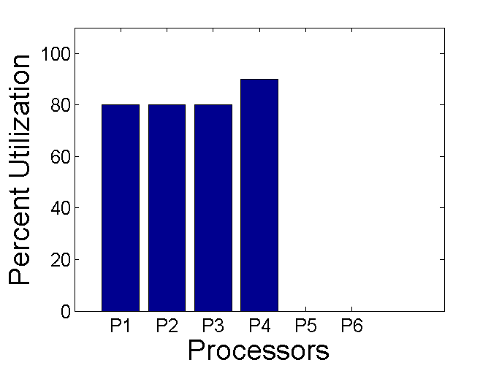
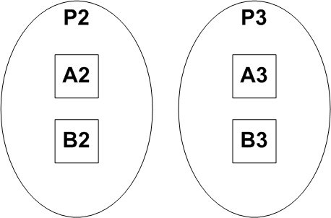
Designing the DeCoRAM Allocation Algorithm (2/5)
  Refinement 1: Introduce replica tasks
  Do not differentiate between primary & replicas
  Assume tolerance to 2 failures => 2 replicas each
  Apply the [Dhall:78] algorithm
Task | WCET | WCSST | Period
A1,A2,A3 | 20 | 0.2 | 50
B1,B2,B3 | 40 | 0.4 | 100
C1,C2,C3 | 50 | 0.5 | 200
D1,D2,D3 | 200 | 2 | 500
E1,E2,E3 | 250 | 2.5 | 1,000

Slide 31
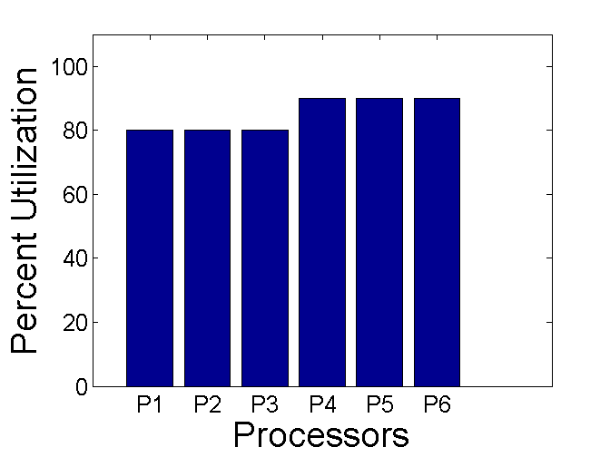
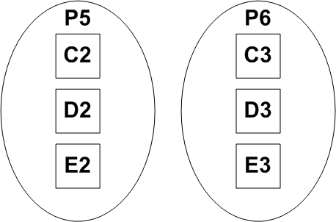
Designing the DeCoRAM Allocation Algorithm (2/5)
  Refinement 1: Introduce replica tasks
  Do not differentiate between primary & replicas
  Assume tolerance to 2 failures => 2 replicas each
  Apply the [Dhall:78] algorithm
Task | WCET | WCSST | Period
A1,A2,A3 | 20 | 0.2 | 50
B1,B2,B3 | 40 | 0.4 | 100
C1,C2,C3 | 50 | 0.5 | 200
D1,D2,D3 | 200 | 2 | 500
E1,E2,E3 | 250 | 2.5 | 1,000

Slide 32
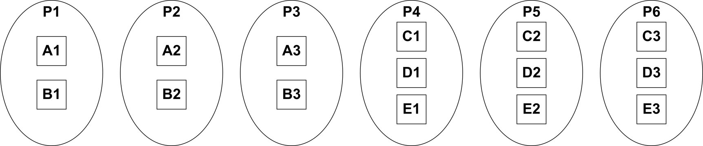
Designing the DeCoRAM Allocation Algorithm (2/5)
  Refinement 1: Introduce replica tasks
  Do not differentiate between primary & replicas
  Assume tolerance to 2 failures => 2 replicas each
  Apply the [Dhall:78] algorithm
Task | WCET | WCSST | Period
A1,A2,A3 | 20 | 0.2 | 50
B1,B2,B3 | 40 | 0.4 | 100
C1,C2,C3 | 50 | 0.5 | 200
D1,D2,D3 | 200 | 2 | 500
E1,E2,E3 | 250 | 2.5 | 1,000
  Outcome -> Upper bound is established
  A RT-FT solution is created – but with Active replication
  System is schedulable
  Demonstrates upper bound on number of resources needed
Minimize resource using passive replication

Slide 33
Designing the DeCoRAM Allocation Algorithm (3/5)
  Refinement 2: Passive replication
  Differentiate between primary & replicas
  Assume tolerance to 2 failures => 2 additional backup replicas each
  Apply the [Dhall:78] algorithm
Task | WCET | WCSST | Period
A1,A2,A3 | 20 | 0.2 | 50
B1,B2,B3 | 40 | 0.4 | 100
C1,C2,C3 | 50 | 0.5 | 200
D1,D2,D3 | 200 | 2 | 500
E1,E2,E3 | 250 | 2.5 | 1,000

Slide 34
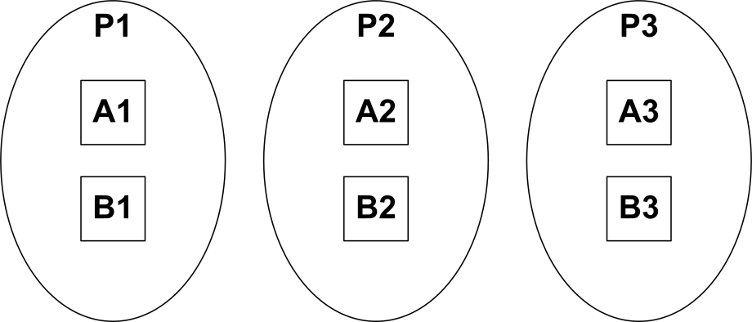
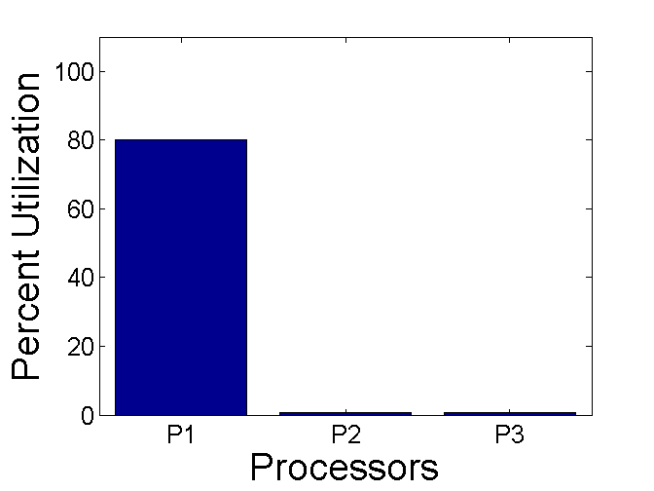
Designing the DeCoRAM Allocation Algorithm (3/5)
  Refinement 2: Passive replication
  Differentiate between primary & replicas
  Assume tolerance to 2 failures => 2 additional backup replicas each
  Apply the [Dhall:78] algorithm
Task | WCET | WCSST | Period
A1,A2,A3 | 20 | 0.2 | 50
B1,B2,B3 | 40 | 0.4 | 100
C1,C2,C3 | 50 | 0.5 | 200
D1,D2,D3 | 200 | 2 | 500
E1,E2,E3 | 250 | 2.5 | 1,000
Backups only contribute WCSST in no failure case
Primaries contribute WCET

Slide 35
Designing the DeCoRAM Allocation Algorithm (3/5)
  Refinement 2: Passive replication
  Differentiate between primary & replicas
  Assume tolerance to 2 failures => 2 additional backup replicas each
  Apply the [Dhall:78] algorithm
Task | WCET | WCSST | Period
A1,A2,A3 | 20 | 0.2 | 50
B1,B2,B3 | 40 | 0.4 | 100
C1,C2,C3 | 50 | 0.5 | 200
D1,D2,D3 | 200 | 2 | 500
E1,E2,E3 | 250 | 2.5 | 1,000
Backups only contribute WCSST in no failure case
Primaries contribute WCET

Slide 36
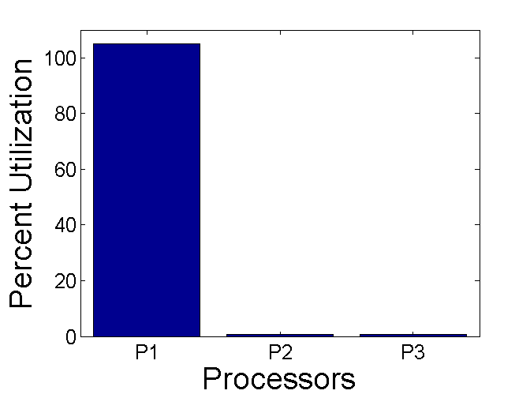
Designing the DeCoRAM Allocation Algorithm (3/5)
  Refinement 2: Passive replication
  Differentiate between primary & replicas
  Assume tolerance to 2 failures => 2 additional backup replicas each
  Apply the [Dhall:78] algorithm
Task | WCET | WCSST | Period
A1,A2,A3 | 20 | 0.2 | 50
B1,B2,B3 | 40 | 0.4 | 100
C1,C2,C3 | 50 | 0.5 | 200
D1,D2,D3 | 200 | 2 | 500
E1,E2,E3 | 250 | 2.5 | 1,000
Backups only contribute WCSST in no failure case
Primaries contribute WCET

Slide 37
Designing the DeCoRAM Allocation Algorithm (3/5)
  Refinement 2: Passive replication
  Differentiate between primary & replicas
  Assume tolerance to 2 failures => 2 additional backup replicas each
  Apply the [Dhall:78] algorithm
Task | WCET | WCSST | Period
A1,A2,A3 | 20 | 0.2 | 50
B1,B2,B3 | 40 | 0.4 | 100
C1,C2,C3 | 50 | 0.5 | 200
D1,D2,D3 | 200 | 2 | 500
E1,E2,E3 | 250 | 2.5 | 1,000
Backups only contribute WCSST in no failure case

Slide 38
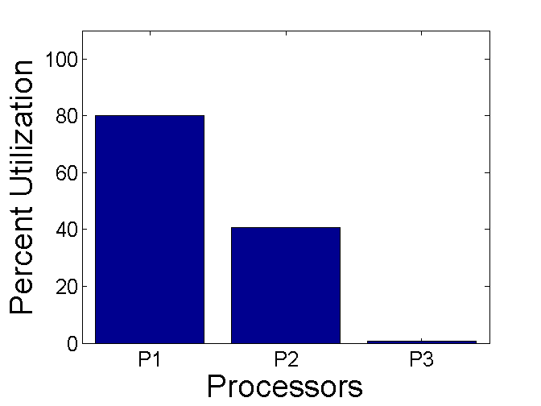
Designing the DeCoRAM Allocation Algorithm (3/5)
  Refinement 2: Passive replication
  Differentiate between primary & replicas
  Assume tolerance to 2 failures => 2 additional backup replicas each
  Apply the [Dhall:78] algorithm
Task | WCET | WCSST | Period
A1,A2,A3 | 20 | 0.2 | 50
B1,B2,B3 | 40 | 0.4 | 100
C1,C2,C3 | 50 | 0.5 | 200
D1,D2,D3 | 200 | 2 | 500
E1,E2,E3 | 250 | 2.5 | 1,000
Backups only contribute WCSST in no failure case
Allocation is fine when A2/B2 are backups
Allocation is fine when A2/B2 are backups

Slide 39

Designing the DeCoRAM Allocation Algorithm (3/5)
  Refinement 2: Passive replication
  Differentiate between primary & replicas
  Assume tolerance to 2 failures => 2 additional backup replicas each
  Apply the [Dhall:78] algorithm
Task | WCET | WCSST | Period
A1,A2,A3 | 20 | 0.2 | 50
B1,B2,B3 | 40 | 0.4 | 100
C1,C2,C3 | 50 | 0.5 | 200
D1,D2,D3 | 200 | 2 | 500
E1,E2,E3 | 250 | 2.5 | 1,000

Slide 40
Designing the DeCoRAM Allocation Algorithm (3/5)
  Refinement 2: Passive replication
  Differentiate between primary & replicas
  Assume tolerance to 2 failures => 2 additional backup replicas each
  Apply the [Dhall:78] algorithm
Task | WCET | WCSST | Period
A1,A2,A3 | 20 | 0.2 | 50
B1,B2,B3 | 40 | 0.4 | 100
C1,C2,C3 | 50 | 0.5 | 200
D1,D2,D3 | 200 | 2 | 500
E1,E2,E3 | 250 | 2.5 | 1,000
Promoted backups now contribute WCET
Failure triggers promotion of A2/B2 to primaries

Slide 41
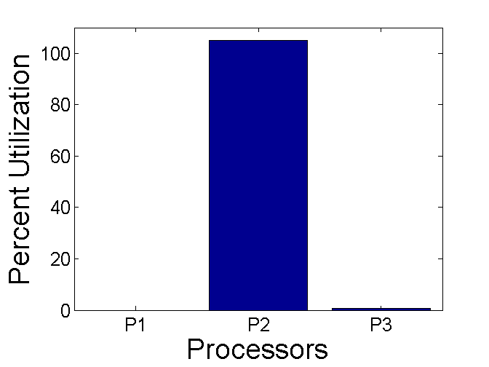
Designing the DeCoRAM Allocation Algorithm (3/5)
  Refinement 2: Passive replication
  Differentiate between primary & replicas
  Assume tolerance to 2 failures => 2 additional backup replicas each
  Apply the [Dhall:78] algorithm
Task | WCET | WCSST | Period
A1,A2,A3 | 20 | 0.2 | 50
B1,B2,B3 | 40 | 0.4 | 100
C1,C2,C3 | 50 | 0.5 | 200
D1,D2,D3 | 200 | 2 | 500
E1,E2,E3 | 250 | 2.5 | 1,000
Backups only contribute WCSST
System unschedulable when A2/B2 are promoted
Allocation is fine when A2/B2 are backups

Slide 42
Designing the DeCoRAM Allocation Algorithm (3/5)
  Refinement 2: Passive replication
  Differentiate between primary & replicas
  Assume tolerance to 2 failures => 2 additional backup replicas each
  Apply the [Dhall:78] algorithm
Task | WCET | WCSST | Period
A1,A2,A3 | 20 | 0.2 | 50
B1,B2,B3 | 40 | 0.4 | 100
C1,C2,C3 | 50 | 0.5 | 200
D1,D2,D3 | 200 | 2 | 500
E1,E2,E3 | 250 | 2.5 | 1,000
C1/D1/E1 may be placed on P2 or P3 as long as there are no failures
C1/D1/E1 cannot be placed here -- unschedulable
  Outcome
  Resource minimization & system schedulability feasible in non faulty scenarios only -- because backup contributes only WCSST
Unrealistic not to expect failures
Need a way to consider failures & find which backup will be promoted to primary (contributing WCET)?

Slide 43
Designing the DeCoRAM Allocation Algorithm (4/5)
  Refinement 3: Enable the offline algorithm to consider failures
  “Look ahead” at failure scenarios of already allocated tasks & replicas determining worst case impact on a given processor
  Feasible to do this because system properties are invariant

Slide 44
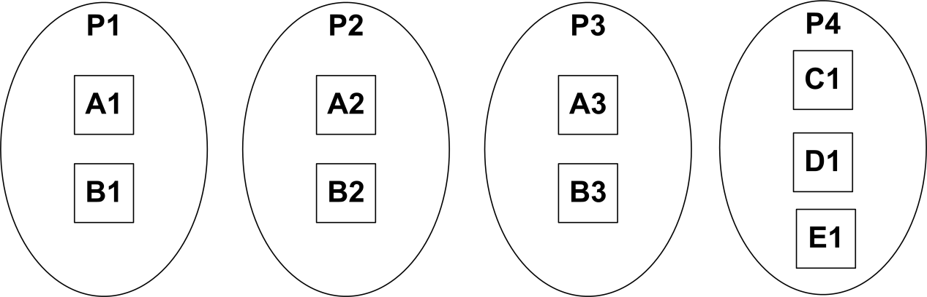
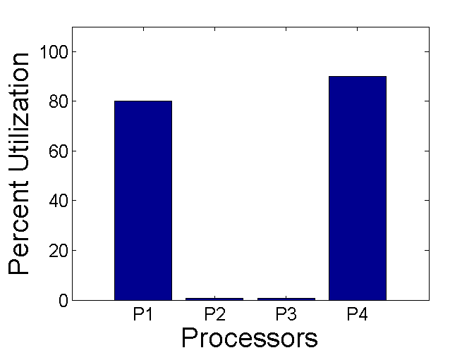
Designing the DeCoRAM Allocation Algorithm (4/5)
  Refinement 3: Enable the offline algorithm to consider failures
  “Look ahead” at failure scenarios of already allocated tasks & replicas determining worst case impact on a given processor
  Feasible to do this because system properties are invariant
Looking ahead that any of A2/B2 or A3/B3 may be promoted, C1/D1/E1 must be placed on a different processor

Slide 45
Designing the DeCoRAM Allocation Algorithm (4/5)
  Refinement 3: Enable the offline algorithm to consider failures
  “Look ahead” at failure scenarios of already allocated tasks & replicas determining worst case impact on a given processor
  Feasible to do this because system properties are invariant
Where should backups of C/D/E be placed? On P2 or P3 or a different processor? P1 is not a choice.

Slide 46
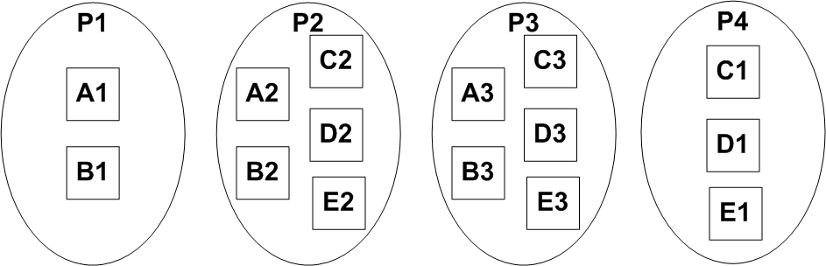
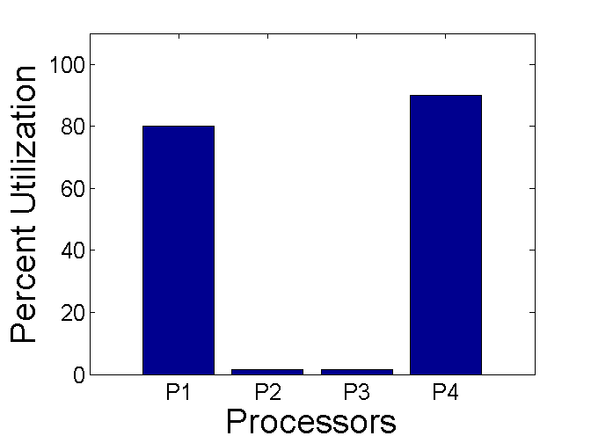
Designing the DeCoRAM Allocation Algorithm (4/5)
  Refinement 3: Enable the offline algorithm to consider failures
  “Look ahead” at failure scenarios of already allocated tasks & replicas determining worst case impact on a given processor
  Feasible to do this because system properties are invariant
  Suppose the allocation of the backups of C/D/E are as shown
  We now look ahead for any 2 failure combinations

Slide 47
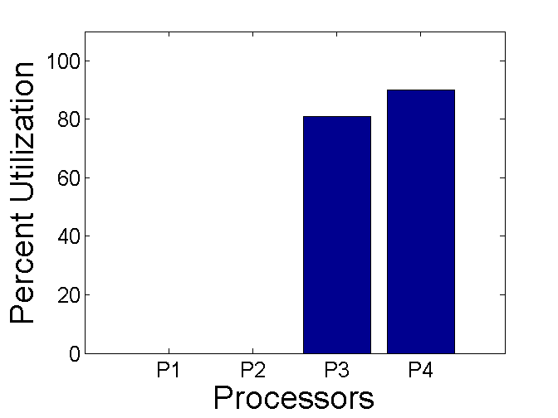
Designing the DeCoRAM Allocation Algorithm (4/5)
  Refinement 3: Enable the offline algorithm to consider failures
  “Look ahead” at failure scenarios of already allocated tasks & replicas determining worst case impact on a given processor
  Feasible to do this because system properties are invariant
Schedule is feasible => original placement decision was OK
  Suppose P1 & P2 were to fail
  A3 & B3 will be promoted

Slide 48
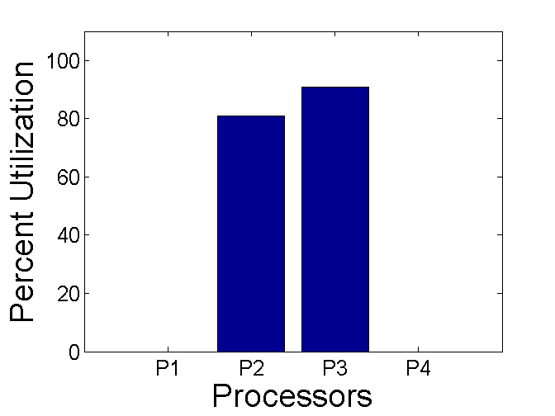
Designing the DeCoRAM Allocation Algorithm (4/5)
  Refinement 3: Enable the offline algorithm to consider failures
  “Look ahead” at failure scenarios of already allocated tasks & replicas determining worst case impact on a given processor
  Feasible to do this because system properties are invariant
Schedule is feasible => original placement decision was OK
  Suppose P1 & P4 were to fail
  Suppose A2 & B2 on P2 were to be promoted, while C3, D3 & E3 on P3 were to be promoted

Slide 49
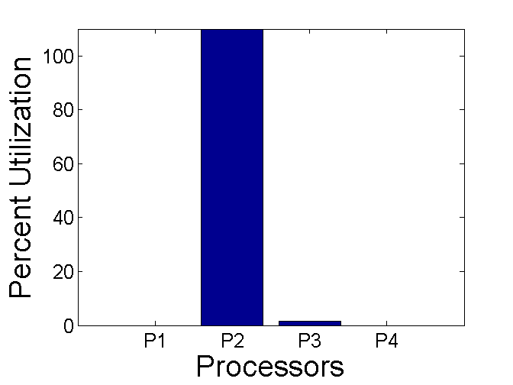
Designing the DeCoRAM Allocation Algorithm (4/5)
  Refinement 3: Enable the offline algorithm to consider failures
  “Look ahead” at failure scenarios of already allocated tasks & replicas determining worst case impact on a given processor
  Feasible to do this because system properties are invariant
Schedule is not feasible => original placement decision was incorrect
  Suppose P1 & P4 were to fail
  Suppose A2, B2, C2, D2 & E2 on P2 were to be promoted

Slide 50
Designing the DeCoRAM Allocation Algorithm (4/5)
  Refinement 3: Enable the offline algorithm to consider failures
  “Look ahead” at failure scenarios of already allocated tasks & replicas determining worst case impact on a given processor
  Feasible to do this because system properties are invariant
Looking ahead that any of A2/B2 or A3/B3 may be promoted, C1/D1/E1 must be placed on a different processor
  Outcome
  Due to the potential for an infeasible schedule, more resources are suggested by the Lookahead algorithm
Placing backups of C/D/E here points at one potential combination that leads to infeasible schedule
Look-ahead strategy cannot determine impact of multiple uncorrelated failures that may make system unschedulable

Slide 51
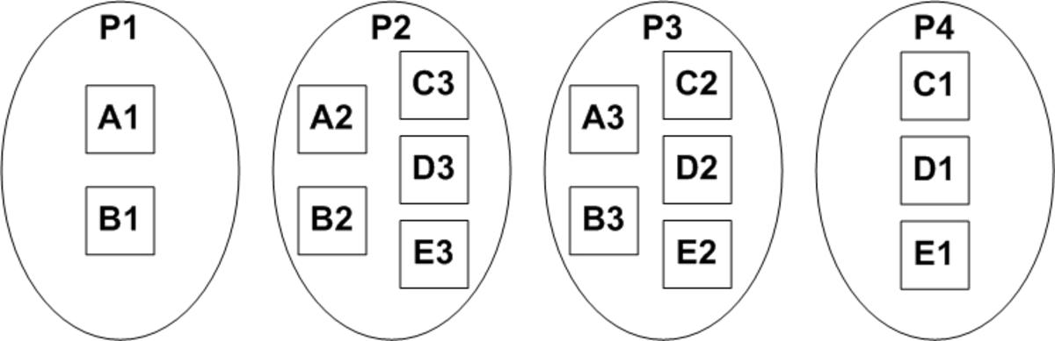
Designing the DeCoRAM Allocation Algorithm (5/5)
  Refinement 4: Restrict the order in which failover targets are chosen
  Utilize a rank order of replicas to dictate how failover happens
  Enables the Lookahead algorithm to overbook resources due to guarantees that no two uncorrelated failures will make the system unschedulable
Replica number denotes ordering in the failover process
  Suppose the replica allocation is as shown (slightly diff from before)
  Replica numbers indicate order in the failover process

Slide 52
Designing the DeCoRAM Allocation Algorithm (5/5)
  Refinement 4: Restrict the order in which failover targets are chosen
  Utilize a rank order of replicas to dictate how failover happens
  Enables the Lookahead algorithm to overbook resources due to guarantees that no two uncorrelated failures will make the system unschedulable
  Suppose P1 & P4 were to fail (the interesting case)
  A2 & B2 on P2, & C2, D2, E2 on P3 will be chosen as failover targets due to the restrictions imposed
  Never can C3, D3, E3 become primaries along with A2 & B2 unless more than two failures occur

Slide 53
Designing the DeCoRAM Allocation Algorithm (5/5)
  Refinement 4: Restrict the order in which failover targets are chosen
  Utilize a rank order of replicas to dictate how failover happens
  Enables the Lookahead algorithm to overbook resources due to guarantees that no two uncorrelated failures will make the system unschedulable
For a 2-fault tolerant system, replica numbered 3 is assured never to become a primary along with a replica numbered 2. This allows us to overbook the processor thereby minimizing resources
Resources minimized from 6 to 4 while assuring both RT & FT

Slide 54

DeCoRAM Evaluation Criteria
Hypothesis – DeCoRAM’s Failure-aware Look-ahead Feasibility algorithm allocates applications & replicas to hosts while minimizing the number of processors utilized
  number of processors utilized is lesser than the number of processors utilized using active replication
DeCoRAM Allocation Engine
Notes:
Jai, please fix the diagram so that it matches what’s in the text.
54

Slide 55
DeCoRAM Evaluation Hypothesis
Hypothesis – DeCoRAM’s Failure-aware Look-ahead Feasibility algorithm allocates applications & replicas to hosts while minimizing the number of processors utilized
  number of processors utilized is lesser than the number of processors utilized using active replication
Deployment-time configured real-time fault-tolerance solution works at runtime when failures occur
  none of the applications lose high availability & timeliness assurances
DeCoRAM Allocation Engine
Notes:
Jai, please fix the diagram so that it matches what’s in the text.
55

Slide 56
Experiment Configurations
Determine # of processors utilized by
  varying number of tasks dimension)
  varying the number of replicas (FT dimension)
  varying the maximum CPU utilization of any task in the task set
  periods of tasks randomly generated between 1ms & 1000ms
    each task execution time between 0% & maximum load % of the period
    each task state synchronization time between 1% & 2% of the worst case execution times
DeCoRAM Allocation Engine
Notes:
Jai, please fix the diagram so that it matches what’s in the text.
56

Slide 57
Comparison Schemes
Comparison schemes for evaluation
  lower bound on number of processors utilized
    Implementing the optimal allocation algorithm in [Dhall:78] - uses First Fit bin packing scheme
      Optimal no fault-tolerance scenario (No FT)
DeCoRAM Allocation Engine
No replicas in the task set
Notes:
57

Slide 58
Comparison Schemes
Comparison schemes for evaluation
  lower bound on number of processors utilized
    Implementing the optimal allocation algorithm in [Dhall:78] - uses First Fit bin packing scheme
      Optimal no fault-tolerance scenario (No FT)
  Upper bound on # of processors
    Multiplying # of processors utilized in the No FT case with # of replicas
      Optimal active replication scenario (AFT)
DeCoRAM Allocation Engine
All replicas have same worst case execution times
Notes:
58

Slide 59
Comparison Schemes
Comparison schemes for evaluation
  lower bound on number of processors utilized
    Implementing the optimal allocation algorithm in [Dhall:78] - uses First Fit bin packing scheme
      Optimal no fault-tolerance scenario (No FT)
  Upper bound on # of processors
    Multiplying # of processors utilized in the No FT case with # of replicas
      Optimal active replication scenario (AFT)
  DeCoRAM allocation heuristic
    First Fit (FF-FT) & Best Fit (BF-FT) schemes
      Optimal passive replication (FF-FT & BF-FT)
DeCoRAM Allocation Engine
Replicas with varying execution times
Notes:
Jai, this diagram doesn’t make sense here. Please add a diagram & animate the bullets accordingly.
59

Slide 60
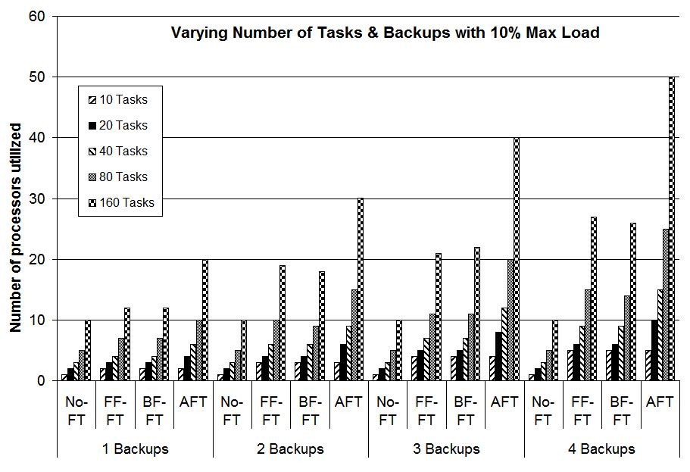
Experiment Results
Linear increase in # of processors utilized in AFT compared to NO FT
Notes:
60

Slide 61
Experiment Results
Rate of increase is much more slower when compared to AFT
Notes:
61

Slide 62
Experiment Results
DeCoRAM only uses approx. 50% of the number of processors used by AFT
Notes:
62

Slide 63
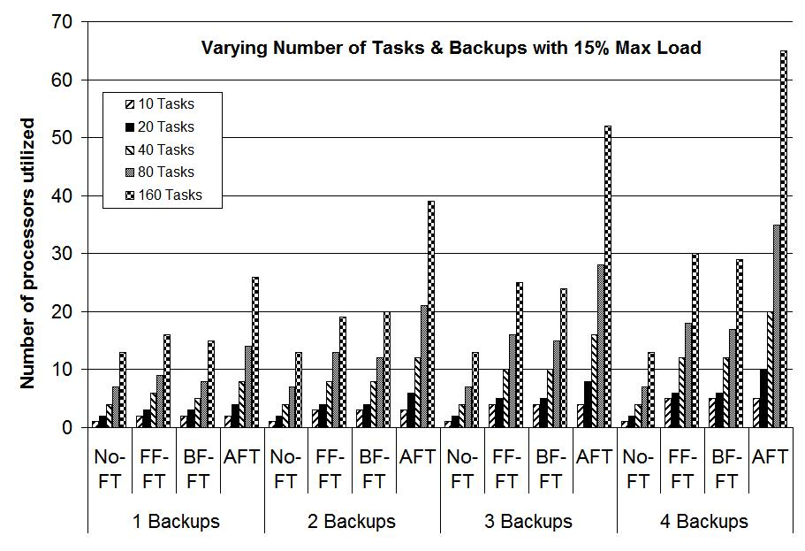
Experiment Results
As task load increases, # of processors utilized increases
Notes:
63

Slide 64
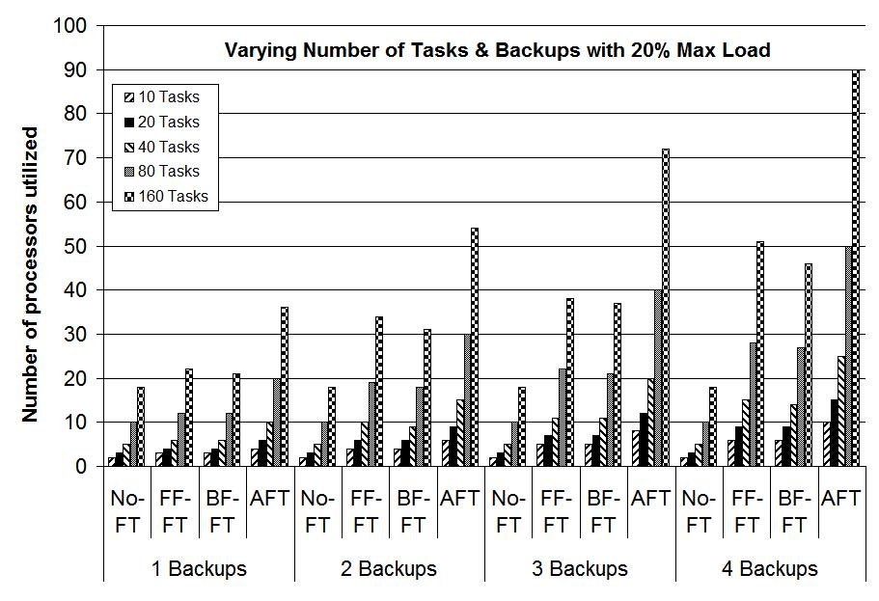
Experiment Results
As task load increases, # of processors utilized increases
Notes:
64

Slide 65
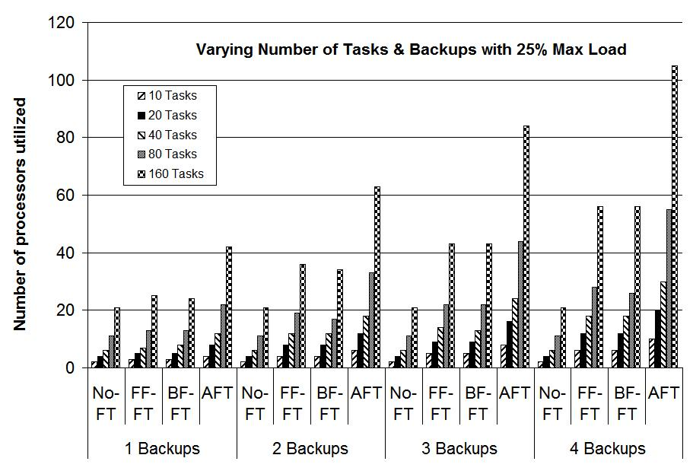
Experiment Results
As task load increases, # of processors utilized increases
Notes:
65

Slide 66
Experiment Results
DeCoRAM scales well, by continuing to save ~50% of processors
Notes:
66

Slide 67
DeCoRAM Pluggable Allocation Engine Architecture
Design driven by separation of concerns
Use of design patterns
Input Manager component – collects per-task FT & RT requirements
Task Replicator component – decides the order in which tasks are allocated
Node Selector component – decides the node in which allocation will be checked
Admission Controller component – applies DeCoRAM’s novel algorithm
Placement Controller component – calls the admission controller repeatedly to deploy all the applications & their replicas
Input Manager
Allocation Engine implemented in ~7,000 lines of C++ code
Task Replicator
Node Selector
Placement Controller
Output decisions realized by DeCoRAM’s D&C Engine
Admission Controller
Notes:
67

Slide 68
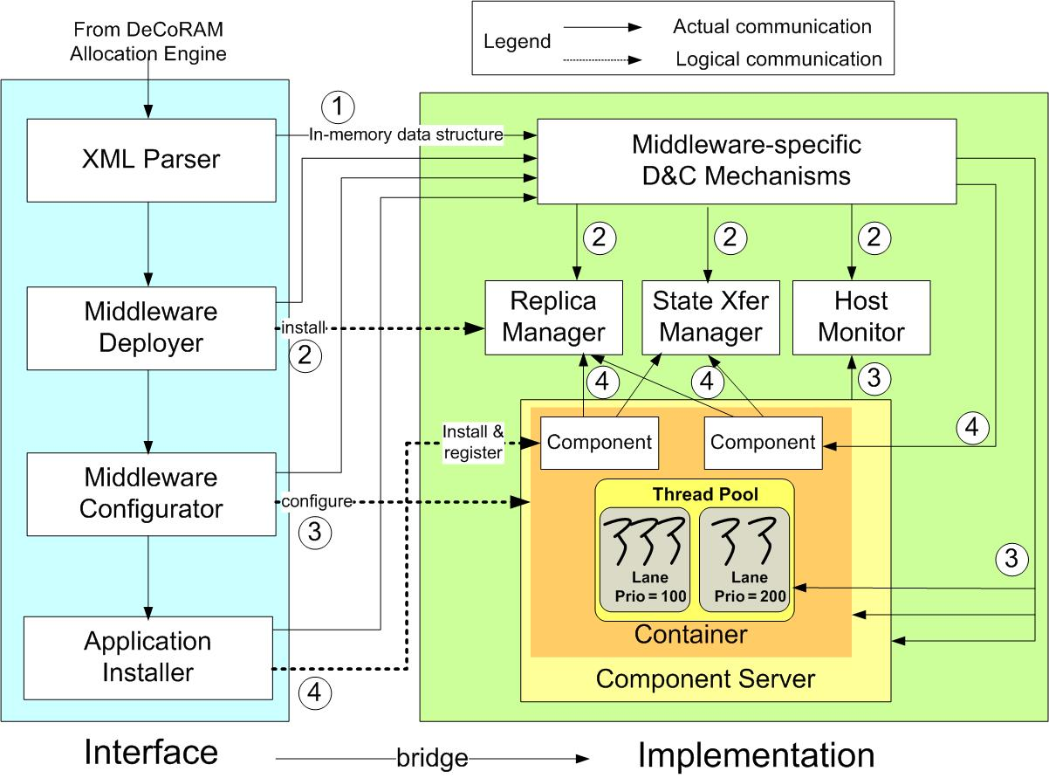
DeCoRAM Deployment & Configuration Engine
Automated deployment & configuration support for fault-tolerant real-time systems
XML Parser
  uses middleware D&C mechanisms to decode allocation decisions
Middleware Deployer
  deploys FT middleware- specific entities
Middleware Configurator
  configures the underlying FT-RT middleware artifacts
Application Installer
  installs the application components & their replicas
Easily extendable
  Current implementation on top of CIAO, DAnCE, & FLARe middleware
DeCoRAM D&C Engine implemented in ~3,500 lines of C++ code

Slide 69
Summary of DeCoRAM Contributions
DeCoRAM allocation algorithm saves number of resources used via clever resource overbooking of backup replicas
DeCoRAM allocation engine can execute many different allocation algorithms
DeCoRAM D&C engine requires a concrete bridge implemented for the underlying middleware => cost is amortized over number of uses.
Existing fault tolerant middleware runtimes can leverage DeCoRAM decisions
  For closed DRE systems, runtimes can be very simple and obey all the decisions determined at design-time
  For closed DRE systems, runtimes can use DeCoRAM results for initial deployment.
www.dre.vanderbilt.edu/CIAO

Slide 70
Contributions within the Lifecycle of DRE Systems
Lifecycle
Specification
Algorithms + Systems + S/W Engineering
Composition
Deployment
Configuration
FLARe adaptive middleware for RT+FT
Run-time
70
Notes:
Let me quickly review what I’ve presented in the past. During my proposal I presented CQML and GRAFT, which address the challenges in earlier phases of the development lifecycle. The group-failover was the proposed topic addressing the challenges in the run-time phase.

Slide 71
Resolving Challenges 2 & 4: FLARe
Key Ideas
Load-Aware Adaptive Failover (LAAF) Target Selection
  Load-aware → maintain desired soft real-time performance after recovery
  Adaptive → handle dynamic load due to workload changes and multiple failures
Resource Overload Management and rEdirection (ROME)
  maintain soft real-time performance during overloads

Slide 72
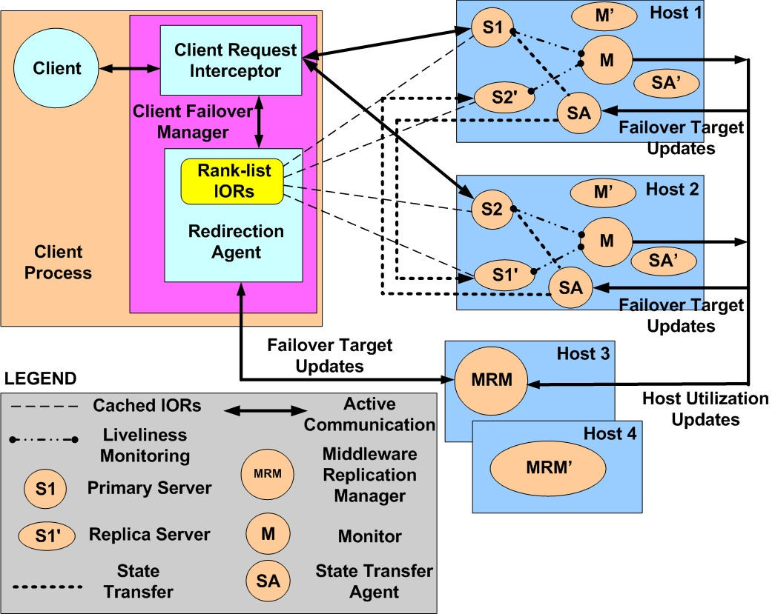
Fault-Tolerant Load-Aware and Adaptive MiddlewaRe
Failure model
  multiple processor/process failures
  fail-stop
Replication Model
  passive replication
  asynchronous state updates
Implemented on top of TAO Real-time CORBA Middleware

Slide 73
Middleware Architecture
Client Failover Manager
  catches processor/process failure exceptions
  redirects clients to failover targets
Monitors
  periodically monitor liveness and CPU utilization of each processor
Replication Manager
  collects system utilizations from monitors
  calculates ranked-list of failover targets using LAAF
  updates client-side with ranked list of targets
  manages overloads using ROME

Slide 74
Load-Aware Adaptive Failover (LAAF)
  monitor CPU utilization of each processor
  rank backup processors based on load
  distribute failover targets of objects on a same processor → avoid overload after processor failure
  proactively update clients

Slide 75
Resource Overload Management & rEdirection (ROME)
  overloads can occur due to multiple processor failures
  soft real-time → treat overloads as failures
  redirect clients of high utilization objects to backups on lightly loaded processors
  distributes overloads across multiple processors
75
Notes:
75

Slide 76
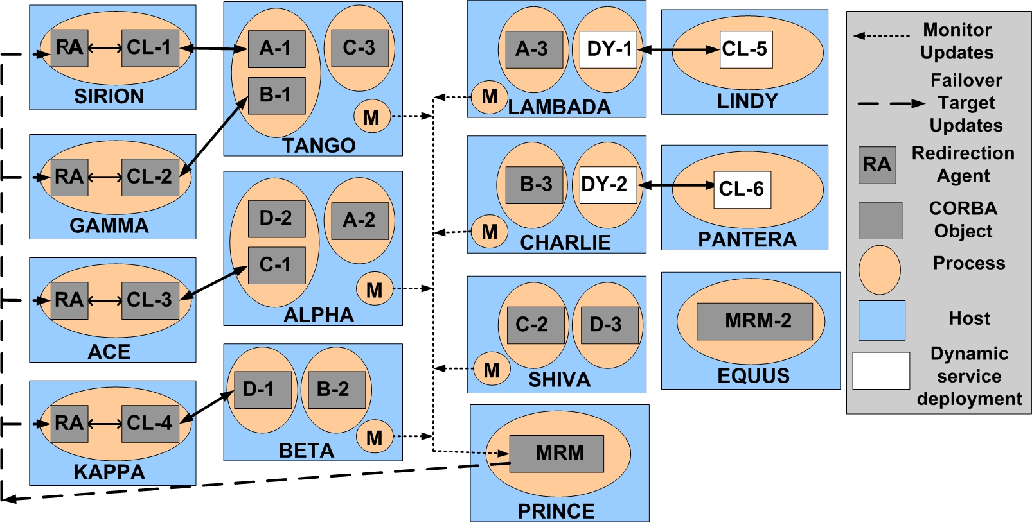
Experiment Setup
Linux clusters at ISISLab
6 clients – 2 clients CL-5 & CL-6 are dynamic clients (start after 50 seconds)
6 different servers – each have 2 replicas
Experiment ran for 300 seconds – each server consumes some CPU load
Rate Monotonic scheduling on each processor
Notes:
76

Slide 77
Experiment Configurations
Static Failover Strategy
  each client knows the order in which they access the server replicas in the presence of failures – i.e., the failover targets are known in advance
  this strategy is optimal at deployment time
Notes:
77

Slide 78
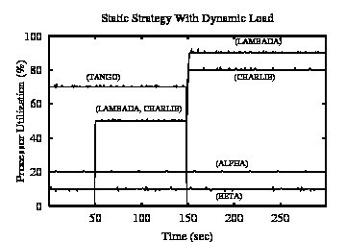
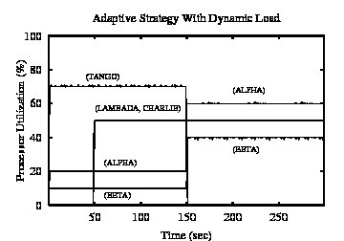
LAAF Algorithm Results
At 50 secs, dynamic loads are introduced
Notes:
78

Slide 79
LAAF Algorithm Results
At 150 seconds failures are introduced
79
Notes:
79
79

Slide 80
LAAF Algorithm Results
static strategy increases CPU utilizations to 90% and 80% - could cause system crashes
80
Notes:
80
80

Slide 81
LAAF Algorithm Results
LAAF modifies failover targets at 50 seconds – prevents overloads when failure occurs by choosing different failover targets
81
Notes:
81
81

Slide 82
Contributions within the Lifecycle of DRE Systems
Lifecycle
Specification
Algorithms + Systems + S/W Engineering
Composition
Deployment
Configuration
Group Failover to handle orphan requests
Run-time
82
Notes:
Let me quickly review what I’ve presented in the past. During my proposal I presented CQML and GRAFT, which address the challenges in earlier phases of the development lifecycle. The group-failover was the proposed topic addressing the challenges in the run-time phase.

Slide 83
Resolving Challenges 3 & 4: Group Failover
Enforcing determinism
  Point solutions: Compensate specific sources of non-determinism
    e.g., thread scheduling, mutual exclusion
  Compensation using semi-automated program analysis
    Humans must rectify non-automated compensation
Enforce Determinism

Slide 84
Unresolved Challenges: End-to-end Reliability of
Non-deterministic Stateful Components
Integration of replication & transactions
  Applicable to multi-tier transactional web-based systems only
  Overhead of transactions (fault-free situation)
    Messaging overhead in the critical path (e.g., create, join)
    2 phase commit (2PC) protocol at the end of invocation
Transaction Manager
Create
Join
Join
Join

Slide 85
Unresolved Challenges: End-to-end Reliability of
Non-deterministic Stateful Components
Integration of replication & transactions
  Applicable to multi-tier transactional web-based systems only
  Overhead of transactions (fault-free situation)
    Messaging overhead in the critical path (e.g., create, join)
    2 phase commit (2PC) protocol at the end of invocation
  Overhead of transactions (faulty situation)
    Must rollback to avoid orphan state
    Re-execute & 2PC again upon recovery
  Transactional semantics are not transparent
    Developers must implement: prepare, commit, rollback
State Update
State Update
State Update
Potential
orphan
state
growing
Orphan state bounded in B, C, D

Slide 86
Solution: The Group-failover Protocol
Orphan state bounded in a group of components
Group
failover
Passive Replica
Protocol characteristics:
  Supports exactly-once execution semantics in presence of
    Nested invocation, non-deterministic stateful components, passive replication
  Ensures state consistency of replicas
  Does not require intrusive changes to the component implementation
    No need to implement prepare, commit, & rollback
  Supports fast client failover that is insensitive to
    Location of failure in the operational string
    Size of the operational string
Notes:
We came up with the group-failover protocol. The key characteristic of group-failover protocol is that the failover granularity is greater than 1. Instead of a single component failover, there is group-failover.

Slide 87
The Group-failover Protocol (1/3)
Constituents of the group-failover protocol
  Accurate failure detection
  Transparent failover
  Identifying orphan components
  Eliminating orphan components
  Ensuring state consistency
Timely fashion
Notes:
To ensure these characteristics, five things must take place accurately in group-failover

Slide 88
The Group-failover Protocol (1/3)
Constituents of the group-failover protocol
  Accurate failure detection
  Transparent failover
  Identifying orphan components
  Eliminating orphan components
  Ensuring state consistency
Accurate failure detection
  Fault-monitoring infrastructure based on heart-beats
  Synthesized using model-to-model transformations in GRAFT
Timely fashion
Notes:
To ensure these characteristics, five things must take place accurately in group-failover

Slide 89

The Group-failover Protocol (1/3)
Constituents of the group-failover protocol
  Accurate failure detection
  Transparent failover
  Identifying orphan components
  Eliminating orphan components
  Ensuring state consistency
Accurate failure detection
  Fault-monitoring infrastructure based on heart-beats
  Synthesized using model-to-model transformations in GRAFT
Transparent failover alternatives
  Client-side request interceptors
    CORBA standard
  Aspect-oriented programming (AOP)
    Fault-masking code generation using model-to-code transformations in GRAFT
Timely fashion
Notes:
To ensure these characteristics, five things must take place accurately in group-failover

Slide 90
The Group-failover Protocol (2/3)
Identifying orphan components
  Without transactions, the run-time stage of a nested invocation is opaque
Transaction Manager
Create
Join
Join
Join

Slide 91

The Group-failover Protocol (2/3)
Identifying orphan components
  Without transactions, the run-time stage of a nested invocation is opaque
  Strategies for determining the extent of the orphan group (statically)
    The whole operational string
Potentially
non-isomorphic operational strings
Tolerates catastrophic faults
  Pool Failure
  Network failure
Tolerates Bohrbugs
  A Bohrbug repeats itself predictably when the same state reoccurs
Preventing Bohrbugs
  Reliability through diversity
  Diversity via non-isomorphic replication
  Different implementation, structure, QoS
Notes:
For identifying orphan components as well, we can exploit model-driven techniques …. To overcome that problem we came up with static strategies to determine the extent of the orphan group.

Slide 92

The Group-failover Protocol (2/3)
Identifying orphan components
  Without transactions, the run-time stage of a nested invocation is opaque
  Strategies for determining the extent of the orphan group (statically)
    The whole operational string
    Dataflow-aware component grouping

Slide 93
The Group-failover Protocol (3/3)
Eliminating orphan components
  Using deployment and configuration (D&C) infrastructure
  Invoke component life-cycle operations (e.g., activate, passivate)
  Passivation:
    Discards the application-specific state
    Component is no longer remotely addressable
Ensuring state consistency
  Must assure exactly-once semantics
  State must be transferred atomically
  Strategies for state synchronization
Strategies | Eager | Lag-by-one
Fault-free scenario | Messaging overhead | No overhead
Faulty scenario (recovery) | No overhead | Messaging overhead

Slide 94

Eager State Synchronization Strategy
State synchronization in two explicit phases
Fault-free Scenario messages: Finish , Precommit (phase 1), State transfer, Commit (phase 2)
Faulty-scenario: Transparent failover

Slide 95

Lag-by-one State Synchronization Strategy
No explicit phases
Fault-free scenario messages: Lazy state transfer
Faulty-scenario messages: Prepare, Commit, Transparent failover
Notes:
Talk in terms of laps and race-track analogy. On a race-track if you see a car’s lap is in the progress, the previous lap must have been successful. You are not at the finish line but somewhere in the middle of the track.

Slide 96


Evaluation: Overhead of the State Synchronization Strategies
Experiments
  CIAO middleware
  2 to 5 components
Eager state synchronization
  Insensitive to the # of components
  Concurrent state transfer using CORBA AMI (Asynchronous Messaging)
Lag-by-one state synchronization
  Insensitive to the # of components
  Fault-free overhead less than the eager protocol

Slide 97

Evaluation: Client-perceived failover latency of the Synchronization Strategies
The Lag-by-one protocol has messaging (low) overhead during failure recovery
The eager protocol has no overhead during failure recovery
(Jitter +/- 3%)

Slide 98
Relevant Publications
GroupFailOver, CBSE 2011 To Appear, Boulder, CO, June 2011
DeCoRAM, IEEE RTAS 2010, Stockholm, Sweden, 2010.
Adaptive Failover for Real-time Middleware with Passive Replication, IEEE RTAS 2009
Component Replication Based on Failover Units, IEEE RTCSA 2009
Towards Middleware for Fault-tolerance in Distributed Real-time Embedded Systems, IFIP DAIS 2008
FLARe: A Fault-tolerant Lightweight Adaptive Real-time Middleware for Distributed Real-time Embedded Systems, ACM Middleware Conference Doctoral Symposium (MDS 2007), 2007
MDDPro: Model-Driven Dependability Provisioning in Enterprise Distributed Real-time & Embedded Systems, ISAS 2007
A Framework for (Re)Deploying Components in Distributed Real-time Embedded Systems, ACM SAC 2006
Middleware Support for Dynamic Component Updating, DOA 2005
Model-driven QoS Provisioning for Distributed Real-time & Embedded Systems, Under Submission, IEEE Transactions on Software Engineering, 2009
NetQoPE: A Model-driven Network QoS Provisioning Engine for Distributed Real-time & Embedded Systems, IEEE RTAS 2008
Model-driven Middleware: A New Paradigm for Deploying & Provisioning Distributed Real-time & Embedded Applications: Elsevier Jour. of Science & Comp. Prog., 2008
DAnCE: A QoS-enabled Deployment & Configuration Engine, CD 2005

Slide 99
Concluding Remarks & Future Work
Satisfying multiple QoS properties simultaneously in DRE systems is hard
Resource constraints and fluctuating workloads/operating conditions make the problem even harder
DOC Group at Vanderbilt/ISIS has made significant R&D contributions in this area
Technologies we have developed are part of our ACE/TAO/CIAO/DAnCE middleware suites
www.dre.vanderbilt.edu
Future work seeks to address issues in cyber physical systems
Needs interdisciplinary expertise

