Slide 1
Cyber Physical Systems Perspective for Timely and Reliable Information Dissemination in Intelligent Transportation Systems
Aniruddha Gokhale
a.gokhale@vanderbilt.edu
www.dre.vanderbilt.edu/~gokhale
Assistant Professor,
Dept of EECS & ISIS,
Vanderbilt University
Nashville, TN, USA
Civil Engineering Seminar, Vanderbilt University, Nashville, TN
March 1, 2010
Collaborative Research with Prof. Mark McDonald
Research Supported by the AFRL VFRP and Vanderbilt Discovery Grant

Slide 2
Talk Outline
Motivation
Applicability of CPS
Why ITS CPS R&D is hard?
Insights gained and proposed solutions
An interdisciplinary research and education agenda
Concluding Remarks

Slide 3
The “Wish I had known before” Scenario 1 (1/2)
Imagine heading out to work in the morning
Traffic News on TV showed no traffic problems
You find the traffic moving smoothly so you are happy

Slide 4
The “Wish I had known before” Scenario 1 (2/2)
But soon you find yourself in a traffic jam
And you just passed the exit ramp so you are stuck ☹

Slide 5
A Tricky and Dangerous Scenario
One lane bridge
Cannot see oncoming traffic behind the blind curve

Slide 6
Many More Use Cases of Societal Impact
Safety:
An intersection where one road has a stop sign, and cross traffic does not stop
Automated lane change
Automated collision avoidance
Red light running; Sudden traffic light behind a hill
Estimating icy roads
Entertainment: Kids in a vehicle want to watch a movie streamed over the network
Maintenance: Vehicle sends periodic health status to mechanic
Law enforcement: Police car queries your car for registration and emission status
Intelligent Transportation Systems (ITS) is an emerging area of research tailored to address these requirements

Slide 7
ITS Applications: Common Traits
Substantial sensing and control of physical artifacts
Real-time and reliable dissemination of information
Dealing with unanticipated events
Human factors
Requires interdisciplinary expertise to tackle hard problems

Slide 8
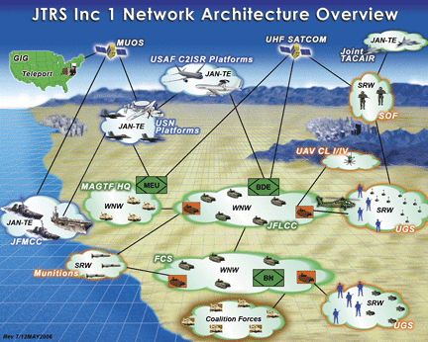
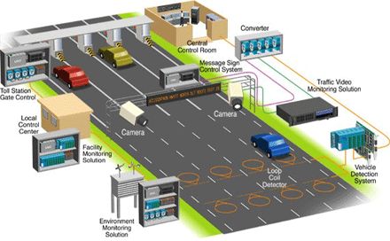
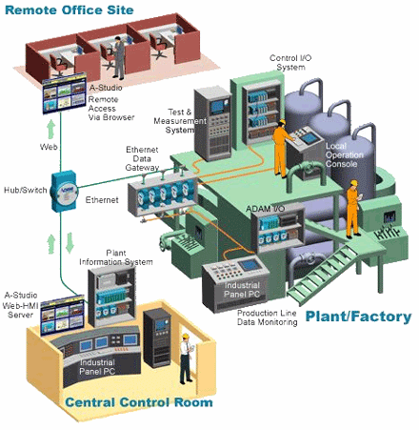
Cyber Physical Systems: A Promising Framework
Tight integration of cyber, networking & physics, & even human factors
Software controls the physics; physics impacts software design and its operation
Sensing & actuation
Multiple QoS properties: real-time, fault-tolerance, security

Slide 9
Why ITS CPS R&D is hard?
Highly interdisciplinary – no single expertise suffices
Networking (wireless, mobile)
Sensing/control
Real-time, reliable computing
Design optimization
Development and testing is hard – very hard to create a testbed to test the solutions
Need mobile devices that can be controlled
Networking technologies and software
Simulations are a promising initial approach – but no single simulation tool suffices
Traffic modeling (e.g., SUMO does microscopic traffic modeling)
Network simulation (e.g., OMNeT++, NS2 for networks)
Embedded control (e.g., Matlab/Simulink, Ptolemy)

Slide 10
Preliminary Work (Simulation-based)
Objective: Understand the impediments to real-time and reliable information dissemination
Preliminary work based on simulations
Used the OMNeT++ simulator
Focus on networking between vehicles (V2V) and vehicles to infrastructure (V2I) only
No actual traffic patterns tested but made up
Due to disparate tools for testing
Focus on interstate traffic
No obstacles
No hilly terrain
Straight road segments
Experimented with increasingly complex scenarios to gain insights and pinpoint challenges that need innovative solutions

Slide 11
What is OMNeT++ ?
Modular discrete event simulator
Objective modular network testbed in C++
Eclipse-based specialized IDE
Hierarchically nested modules communicate by message passing
Capabilities for viewing events and collecting statistics
Large community of users; Google group for Q&A
www.omnetpp.org

Slide 12
INETMANET Framework in OMNeT++
INETMANET : Framework built on top of OMNET++
Available from a GIT repository
Supports many different layers of network protocols and network technologies
Developed and tested multiple scenarios using INETMANET

Slide 13
Impediments due to RSU Association Experiment 1 – Vehicular Speed (1/2)
Context: Road-side Unit infrastructure elements provide connectivity to network services
Challenge: Wireless protocols like 802.11x require complex associations between wireless nodes and access points
Objective: Understand the impact of vehicle speed on association (=>vary the speed)
Vehicle speed varied between 15 and 75 mph
Importance: Associating with RSU consumes time that can otherwise be used for application-level communication

Slide 14
Impediments due to RSU Association Experiment 1 –Vehicular Speed (2/2)
Observations:
Faster speed => less time window available for communication
Slower speed => more time to get associated but more time in contact
CPS Factors
Physics: vehicular speed
Cyber: Vagaries of the 802.11x MAC protocol
ITS is standardizing the 802.11p DSRC standard to address this problem
Leverage RSU connectivity of slow moving vehicles?

Slide 15
Impediments due to RSU Association Experiment 2 – Vehicular Radio Power (1/2)
Context: Road-side Unit infrastructure elements provide connectivity to network services
Challenge: Wireless protocols like 802.11x require complex associations between wireless nodes and access points
Objective: Understand the impact of wireless radio power on association times (=>vary the radio transceiver power)
Vehicle speed maintained at 60 mph
Importance: Associating with RSU consumes time that can otherwise be used for application-level communication

Slide 16
Impediments due to RSU Association Experiment 2 – Vehicular Radio Power (2/2)
Observations:
Higher power => faster association and more time window available for communication
Lower power => other way round
CPS Factors
Physics: Radio Power
Cyber: Vagaries of the 802.11x MAC protocol
Dynamic radio power adaptation could be utilized to maximize connectivity
What happens when multiple vehicles do the same?

Slide 17
Impediments due to RSU Association Experiment 3 – Vehicular Density (1/2)
Context:
Platoons of vehicles in both directions
Single RSU placed on the median
Platoon size varied from 1 to 16
Speed set to 60 mph
No acceleration
Challenge: Wireless medium is shared
Objective: Understand the impact of collisions on RSU association resulting from sharing the wireless medium
Importance: ITS have no choice but use wireless networks

Slide 18
Impediments due to RSU Association Experiment 3 – Vehicular Density (2/2)
Observations:
Jittery behavior observed
Collisions among association messages
CPS Factors
Physics: shared medium
Cyber: retransmissions in 802.11x MAC protocol
Allow subset of vehicles to use V2I; others use V2V
Need dynamic leader election
What happens when vehicles (leader) accelerate?

Slide 19
Impediments due to Higher Level Protocols Experiment 4 – Data Link Issues (1/3)
Context:
Application-level data must be communicated
Single vehicle
Speed set to 60 mph
No acceleration
Very simple application (request-response)
Challenge: RSU association may impact behavior of higher level protocols
Objective: Understand the behavior of higher level protocols in wireless, mobile environments
Importance: Need to support a variety of applications

Slide 20
Impediments due to Higher Level Protocols Experiment 4 – Data Link Issues (2/3)
Observations:
Opening a TCP connection results in a SYN message
SYN message results in a data link-layer ARP message
Timeouts result in retransmissions
Need techniques to eliminate ARP overhead

Slide 21
Impediments due to Higher Level Protocols Experiment 4 – Data Link Issues (3/3)
Observations:
Packets transmitted/received decrease with increasing speed
Due to decreasing RSU association times
Due to ARP overhead
RSU associations eliminated via 802.11p – not available yet
ARP overhead eliminated via static route planning ?
What happens when routes change?

Slide 22
Impediments due to Higher Level Protocols Experiment 5 – Vehicular Density (1/2)
Context:
Very simple application (request-response) as before
Multiple vehicles in platoons (varied from size 1 to 16) in both directions
RSU deployed on the median
Challenge: Shared wireless medium results in packet collisions
Objective: Understand the impact on packet throughput
Importance: Need to support a variety of applications for realistic traffic scenarios involving multiple vehicles

Slide 23
Impediments due to Higher Level Protocols Experiment 5 –Vehicular Density (2/2)
Observations:
Significant variability in packets transmitted/received
Throughput is acceptable up to a certain level
Partition applns into QoS-sensitive, best-effort
V2I for subset of vehicles, V2V for others beyond the threshold
Behavior observed in ideal conditions only.

Slide 24
Impediments due to Higher Level Protocols Experiment 6 – RSU Handoff (1/2)
Context: Roads will contain RSUs deployed at intervals
Challenge: Handoffs between RSUs
Objective: Study the impact of handoffs on communication
Importance: How many RSUs should be deployed and how?

Slide 25
Impediments due to Higher Level Protocols Experiment 6 – RSU Handoff (2/2)
Observations:
RSU association overhead
ARP resolution after RSU handoff
Routing table entries no longer valid
Handoff solutions from 3G not viable
Need for home agent and foreign agent => substantial messaging overhead
Need for autonomous refresh of routing tables
Periodicity much larger than traditional internet routing
Must scale to large number of mobile vehicles

Slide 26
Research & Education Agenda (1/4)
Interdisciplinary Research Collaborations:
With Prof. Mark McDonald and his students
Supported by Vanderbilt Discovery Grant; Plans to submit NSF proposal next week
Co-advising each other’s students on ITS CPS-related topics
Current Focus Areas
RSU deployment
Integrated traffic + network simulations by bridging SUMO (microscopic traffic simulator) with OMNeT++/INETMANET
Realistic traffic scenarios (hills, curves, obstacles, acceleration)
More realistic wireless scenarios (signal fading, propagation)
Study traffic density and determine appropriate usage of V2V, V2I

Slide 27
Research and Education Agenda (2/4)
Example Research Approach
Study the signal-to-noise curves
Observe the window of time available to associate with RSU
Dynamically adapt the radio power and/or use V2V to offload activity to slow moving vehicle

Slide 28
Research & Education Agenda (3/4)
Interdisciplinary Educational Focus:
My students and I attend Prof. Mark McDonald’s CE 311 course
Prof. McDonald and his students attend my course on Real-time systems
Real-time systems course is teaching the RT concepts, and software packages to actually develop a working system
Example is drawn from ITS
Demonstrates different models of computation
Students are learning to use these packages
We are keeping an eye on the challenges faced by students to learn interdisciplinary ideas
Need to make CE 311, Real-time & Fault-tolerant Computing core courses for grad education

Slide 29
Research & Education Agenda (4/4)
Interdisciplinary R&D Testbed:
The BUG from BUGLABS for “in-vehicle” computer for safety-critical applications
Contains GPS, Accelerometer, A/D-D/A converter for sensors/actuators
Dell Netbooks for “in-vehicle” computer for soft real-time systems
Netgear Open source Wireless Router for RSU
Investigating using Smartphones, other robots like LEGO Mindstrom
Real-time CORBA, OMG Data Distribution Service, Erlang Messaging, RT Java middleware to build applications

Slide 30
Concluding Remarks (1/2)
Developing reliable ITS CPS applications is hard
Multiple expertise in multiple fields necessary
Systems-level issues
Developing algorithms at application level that understand the physics
No effective development and testing environment
Multiple, disparate tooling environments
Numerous software engineering issues
Composition, configuration at multiple layers
Deployment issues
Need a combination of systems-level and software-engineering solutions blended with expertise from Transportation engineering

Slide 31
Concluding Remarks (2/2)
My current research at Vanderbilt University
NSF CAREER – investigating issues at specializing middleware stacks
NSF CNS Core – investigating effective deployment algorithms
Vanderbilt Discovery grant with Prof. McDonald – to investigate ITS solutions
Geared towards interdisciplinary research
Spring 2010 courses covering some of the ITS issues
CS396: Special topics on Real-time Systems (offered by me)
CE 311 (offered by Dr. Mark McDonald)
EECS 262 (offered by Dr. Jules White)

