Slide 1



Open Challenges in Real-time and Reliable Information Dissemination in Intelligent Transportation Systems
Aniruddha Gokhale
a.gokhale@vanderbilt.edu
www.dre.vanderbilt.edu/~gokhale
Assistant Professor,
ISIS & Dept of EECS,
Vanderbilt University
Nashville, TN, USA
CS WithIT Talk, Vanderbilt University, Nashville, TN
Nov 19, 2009
Research Supported by the AFRL Visiting Faculty Research Program

Slide 2
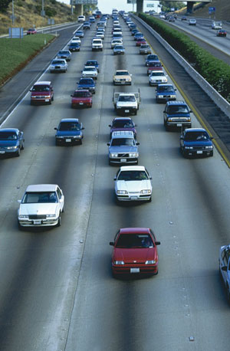
The “Wish I had known before” Moments
Scenario 1
Imagine heading out to work in the morning
Traffic News on TV showed no traffic problems
You find the traffic moving smoothly so you are happy

Slide 3
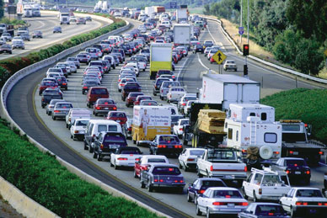
The “Wish I had known before” Moments
Scenario 1
But soon you find yourself in a traffic jam
And you just passed the exit ramp so you are stuck ☹

Slide 4
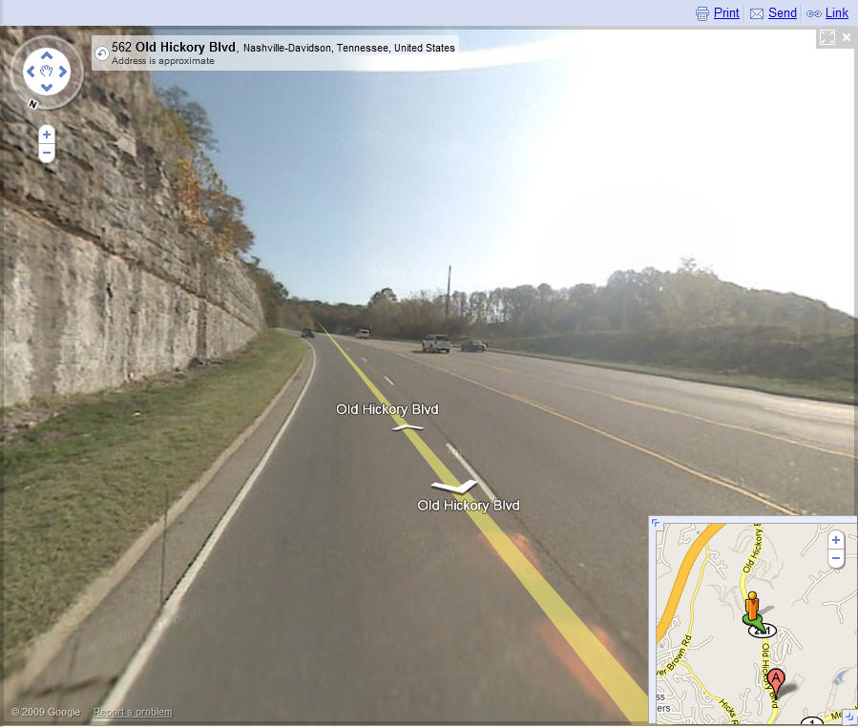
The “Wish I had known before” Moments
Scenario 2
Imagine going uphill and pressing hard on the gas pedal
Road curves as you go uphill creating a blind alley

Slide 5
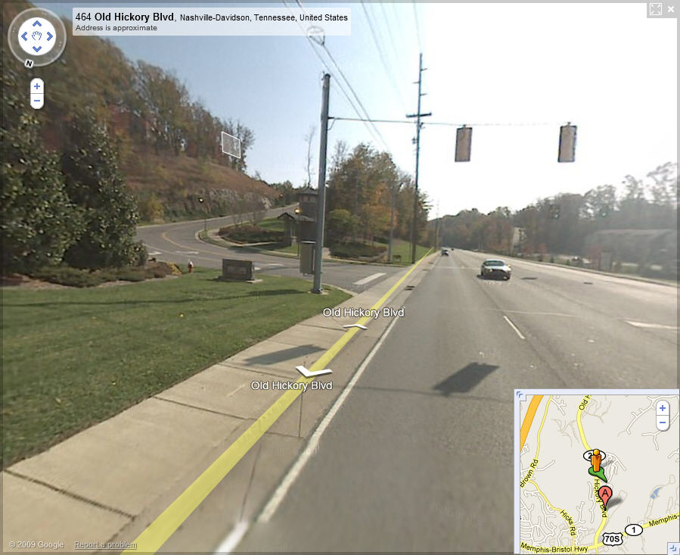
The “Wish I had known before” Moments
Scenario 2
All of a sudden a traffic light shows up with a red light
You press hard on the brakes and hope not to crash on to some other vehicle
What if roads are slippery due to rain or ice?

Slide 6
Many More Use Cases
Safety:
  An intersection where one road has a stop sign, and cross traffic does not stop
  Automated lane change
  Automated collision avoidance
  Red light running
Entertainment: Kids in a vehicle want to watch a movie streamed over the network
Maintenance: Vehicle send periodic health status to mechanic
Law enforcement: Police car queries your car for registration and emission status
Intelligent Transportation Systems is an emerging area of research tailored to address these requirements

Slide 7
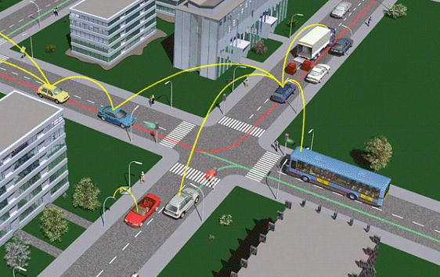
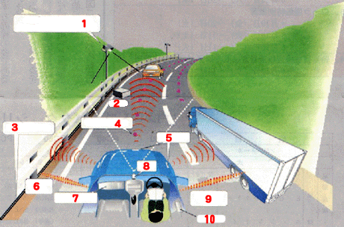
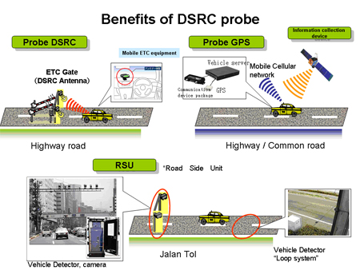
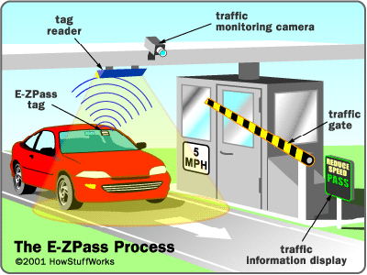
Intelligent Transportation Systems (ITS)
The Many Different Possibilities
Vehicle-to-vehicle (V2V) and Vehicle-to-infrastructure (V2I) communication is a key requirement in these scenarios

Slide 8
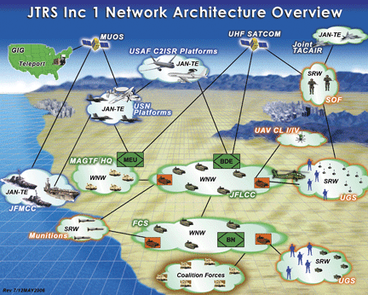
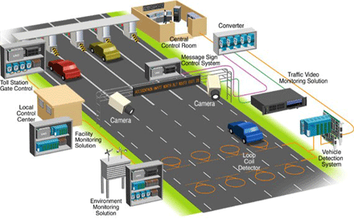
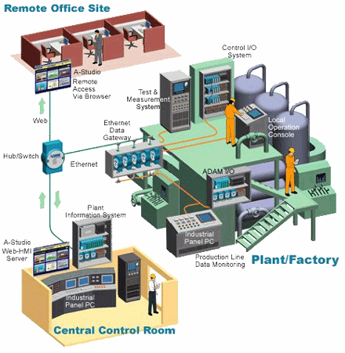
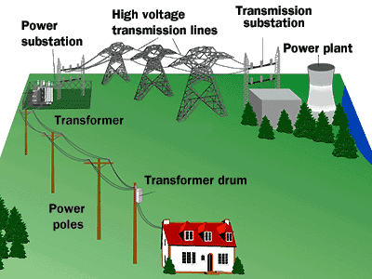
ITS: An Example of Cyber Physical Systems
Cyber Physical Systems exist in multiple domains
Tight integration of cyber, networking & physics
Software controls the physics; physics impacts software design and its operation
Sensing & actuation
Multiple QoS properties: real-time, fault-tolerance, security

Slide 9

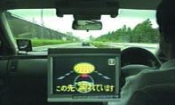
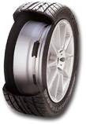
ITS: An Interdisciplinary Area of Study
Scenario: A traffic light is hidden from view
Light announces its presence periodically over the wireless communication =>networking, real-time dissemination
Vehicle determines rate of deceleration => physics (mobility, friction, slope, curvature)
Tires on vehicles should sense road conditions => sensing
Also depends on traffic pattern => traffic engineering
Driver alert & autonomous control => HMI, control engineering

Slide 10
Talk Outline
Why ITS research at AFRL?
Why ITS R&D is hard?
Simulation scenarios and problems uncovered
Software producibility challenges
Work-in-progress
Concluding Remarks

Slide 11
US Air Force CPS Scenarios of Interest
Airborne Networking
Multiple participants
Large-scale, systems-of-systems
Heterogeneous modes of communication (wireless, wireline)
High degree of mobility
Constant fluctuation of resource availability and contention for resources
Mission mode changes
Design challenges: Software Producibility
Operational challenges: real-time and reliable info dissemination

Slide 12
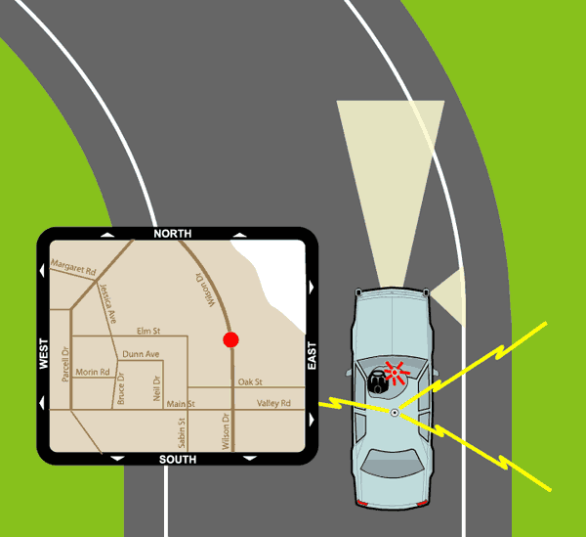
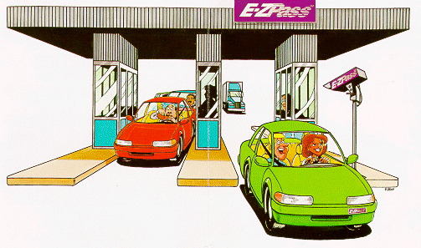
Synergies between USAF Scenarios & ITS
ITS demonstrates traits similar to USAF scenarios
Somewhat more tractable domain to experiment with
  Speed of vehicles much slower
  Mobility patterns more restricted
  Use of standardized protocols and middleware => better availability of tools
Synergistic with my research at Vanderbilt

Slide 13
Why ITS CPS R&D is hard?
Highly interdisciplinary – no single expertise suffices
Development and testing is hard – very hard to create a testbed to test the solutions
  Need mobile devices that can be controlled
  Networking technologies and software
Simulations are a promising initial approach – but no single simulation tool suffices
  Traffic modeling (e.g., SUMO does microscopic traffic modeling)
  Network simulation (e.g., OMNeT++, NS2 for networks)
  Embedded control (e.g., Matlab/Simulink, Ptolemy)
My work focuses on network-level simulations in OMNeT++ (www.omnetpp.org)
Eventually will need software wind tunnel-like capabilities

Slide 14
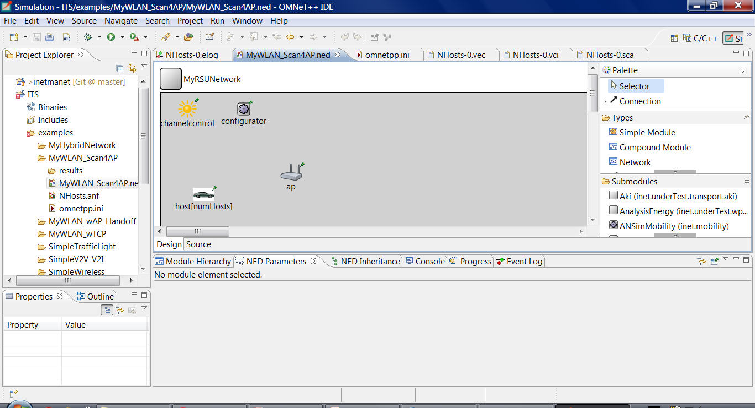
What is OMNeT++ ?
  Modular discrete event simulator
  Objective modular network testbed in C++
  Eclipse-based specialized IDE
  Hierarchically nested modules communicate by message passing
  Capabilities for viewing events and collecting statistics
  Large community of users; Google group for Q&A
  www.omnetpp.org

Slide 15
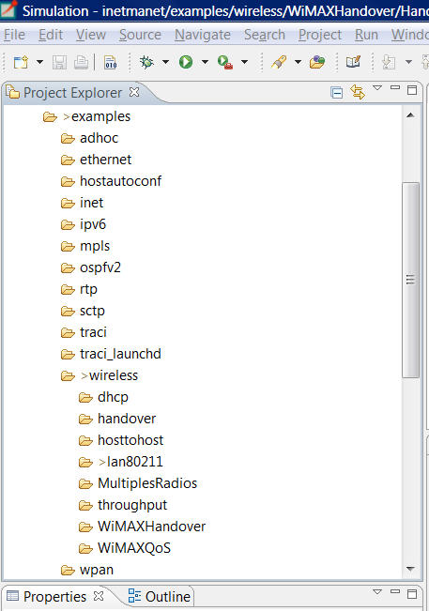
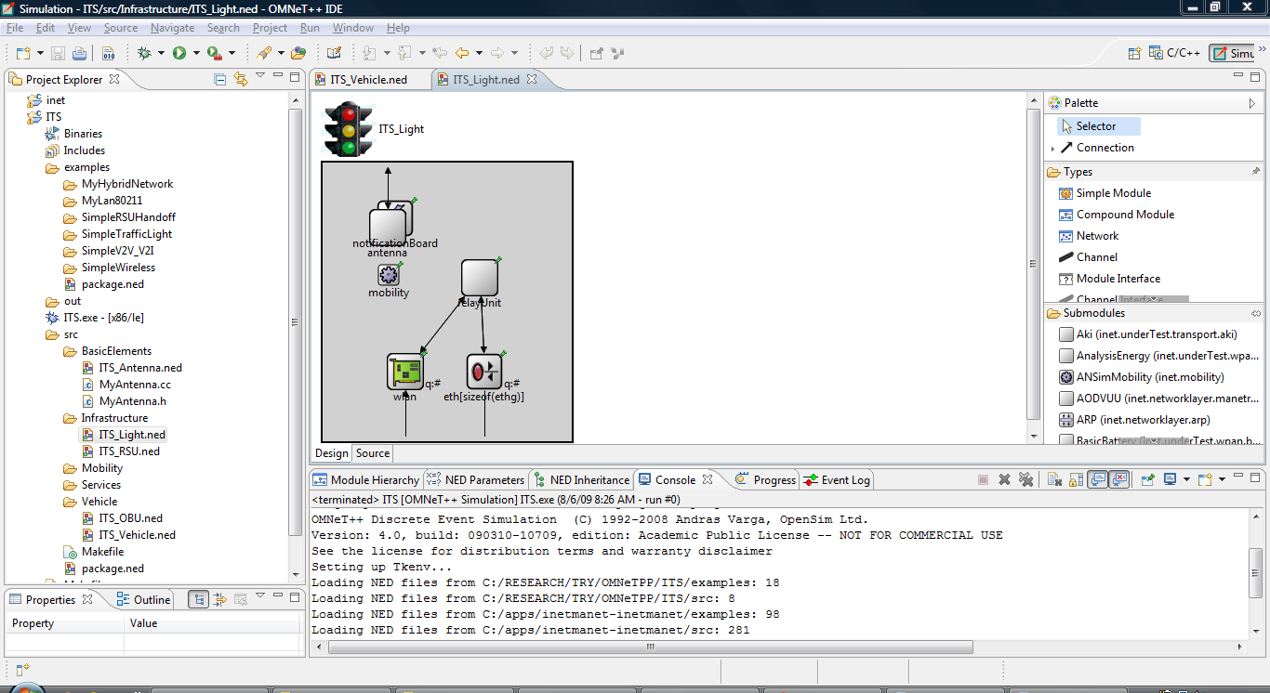
INETMANET Framework in OMNeT++
  INETMANET : Framework built on top of OMNET++
  Available from a GIT repository
  Supports many different layers of network protocols and network technologies
  We developed and tested multiple scenarios using INETMANET
Experiment with increasingly complex scenarios and uncover new problems that need innovative solutions

Slide 16
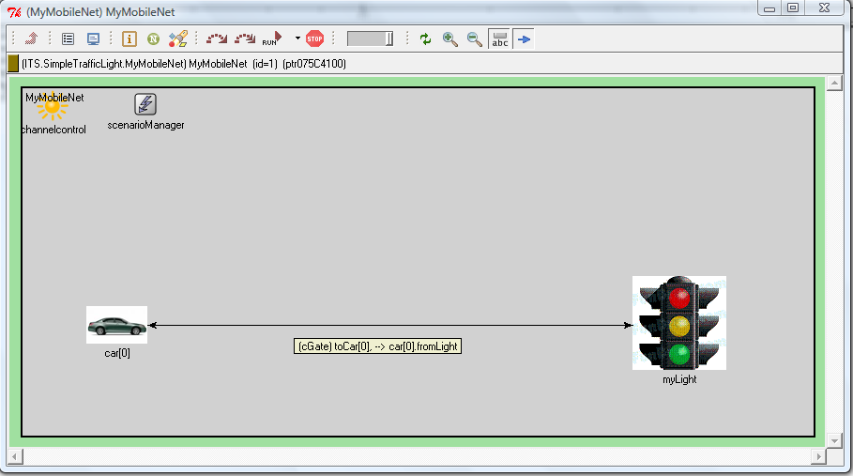
Scenario 1: Simple Traffic Light (1/2)
Setup
Single car directly connected to a traffic light
No wireless
Linear mobility
Real-time communication
Experiment
Car accelerates and approaches the light
Light sends a “red” signal message to car
Car determines deceleration based on distance to light
Car stops at the light
Light sends a “green” signal message to car
Car accelerates and then assumes uniform velocity

Slide 17
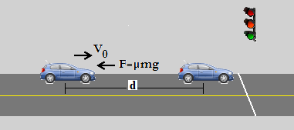
Scenario 1: Simple Traffic Light (2/2)
Next Steps
Multiple vehicles
Use wireless
Emergency vehicles => priority
Simulate an intersection
Experiment
Wireless => cars must associate themselves with the light as they approach it
Density => avoid collisions with other vehicles
Reliability => leverage both the V2I and V2V communications to deal with congestions, overloads
Road conditions => deal with frictional forces, slopes, curves

Slide 18
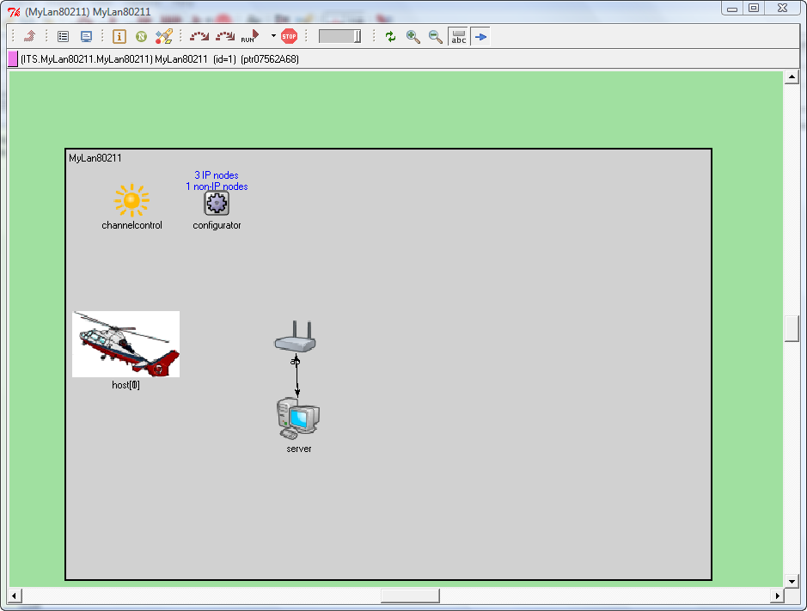
Scenario 2: Simple Wireless LAN (1/3)
Setup
Multiple mobile vehicles with wireless connectivity (802.11)
Vehicles demonstrate mass mobility
One access point
One internet-based server
Experiment
Simple TCP data transfer from hosts to server and back
  imagine UAVs talking to C2 Node
Measure the throughput and potential packet loss due to wireless medium

Slide 19
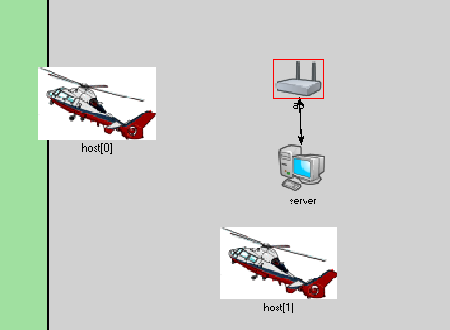
Scenario 2: Simple Wireless LAN (2/3)
Observations & Open Issues
802.11 requires wireless hosts to associate and authenticate with access points via
  Beacon messages
  Probe requests
Without a preconfigured access point address, too much overhead of beacon and association messages => impact on real-time
Impact of speed and distance?
Impact of number of vehicles?
IEEE is working to standardize 802.11p (WAVE/DSRC) standard

Slide 20
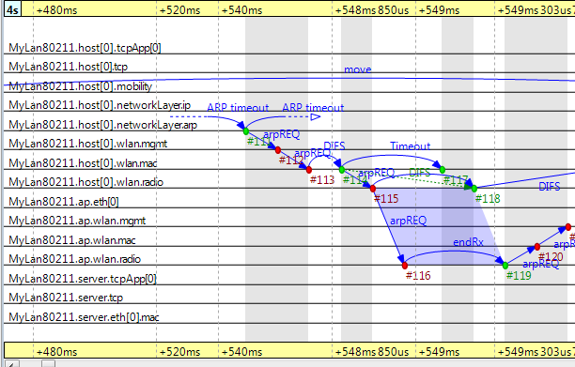
Scenario 2: Simple Wireless LAN (3/3)
Observations & Open Issues
ARP messages seen in the event log
  Needed to decide where to forward a packet
  Adverse impact on real-time info dissemination
Need to somehow pre-configure ARP tables
How should ARP tables adapt as a result of handoffs?

Slide 21
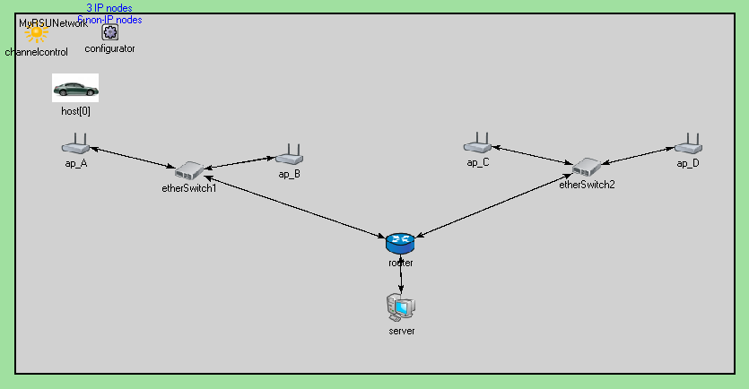
Scenario 3: Simple RSU Handoff (1/2)
Setup & Experiment
Single vehicle with linear mobility (speed can be varied)
Multiple access points (beacon messaging disabled) serving as road side units (RSUs)
Vehicles preconfigured with RSU address
RSUs connected via switches and a router to a server
Simple TCP traffic – idea is for vehicle to keep exchanging info with server despite handoffs

Slide 22
Scenario 3: Simple RSU Handoff (2/2)
Observations & Open Issues
In addition to ARP tables, routing tables had to be manually set up
  Should IP address be same throughout the system or should we use a DHCP-style IP address assignment
  Do we then need a NAT solution?
Handoff requires modifying the pre-configured access point address in the vehicle
  Higher layer should sense the handoff and change the AP address
As density of vehicles increases, more collisions and less number of packets sent/received successfully
  Need an adaptive approach at the higher layers to change channel at the radio level and/or use V2V/V2I hybrid solns

Slide 23
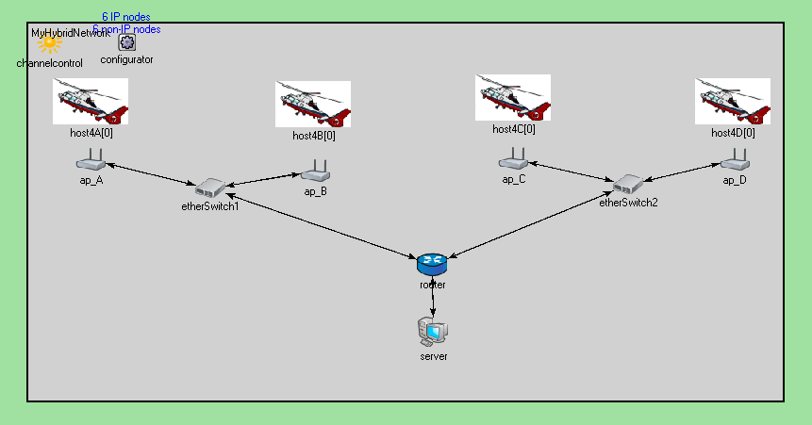
Scenario 4: Multi-vehicle, Mass Mobility (1/2)
Setup & Experiment
Multiple groups of vehicles
Each group associated with a specific access point
Each group uses a different radio channel to reduce collisions
Vehicles demonstrate mass mobility; no handoffs
All vehicles exchange information with a server

Slide 24
Scenario 4: Multi-vehicle, Mass Mobility (2/2)
Observations & Open Issues
Similar issues faced as in Scenario 3
Vehicles cannot stray too far away from their access points else S/N ratio degrades
Poor data throughput observed as group size increases due to collisions
  Need higher level policies to load balance across other access points
  Use V2V to communicate via neighboring vehicles
  How to support this behavior at higher layers?
  How do lower layers inform upper layers of conditions?

Slide 25
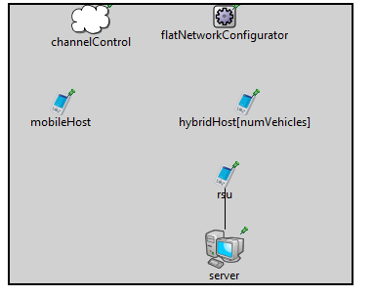
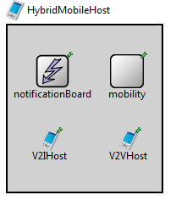
Scenario 5: V2V and V2I – Separate Stacks (1/3)
Setup & Experiment
Goal is to demonstrate V2V (ad hoc) and V2I communication
Host with hybrid capabilities implemented with two separate protocols stacks for V2V and V2I – each having its radio
V2V uses AODV protocol
V2V part receives data from a mobile host, which is relayed from the V2I part to the server

Slide 26
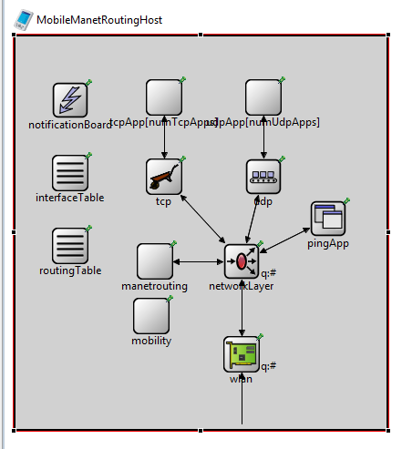
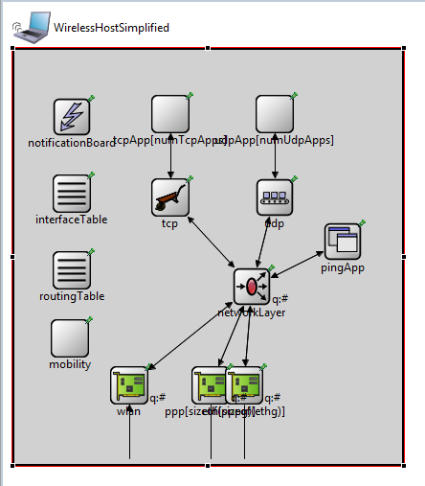
Scenario 5: V2V and V2I – Separate Stacks (2/3)
Observations & Open Issues
Due to separate stacks, relaying between the two stacks must take place in the application layer
  Need extensions to the application layer functionality
AODV data throughput observed to be poor
Performance with handoff capabilities to be tested.
  Need some form of administrative domains

Slide 27
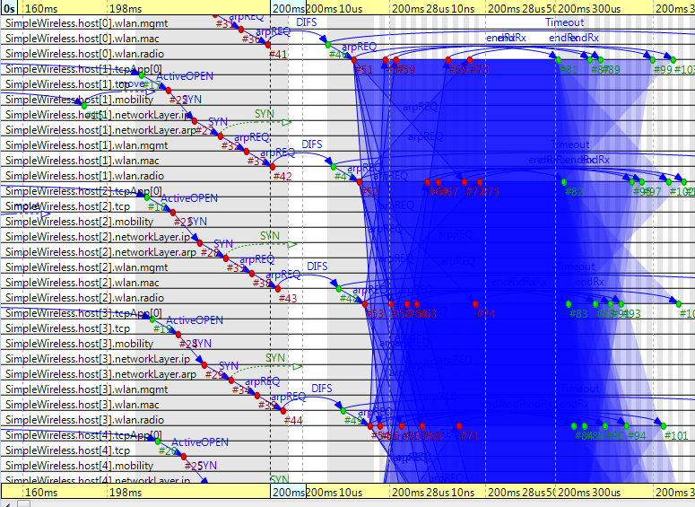
Scenario 5: V2V and V2I – Separate Stacks (3/3)
Impact of collisions seen in the event log as a connection establishment message is sent out by multiple hosts

Slide 28
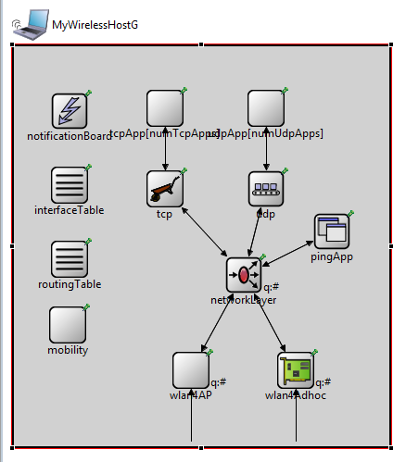
Scenario 6: V2V and V2I – Single Stack
Setup & Experiment
Multiple radios – one for V2I, one for V2V
Single stack of network, transport and application layer
Need to have capabilities to selectively send data from the application layer to the desired wireless interface
  Currently missing in INETMANET
  New configuration parameter added after my posting to the newsgroup

Slide 29
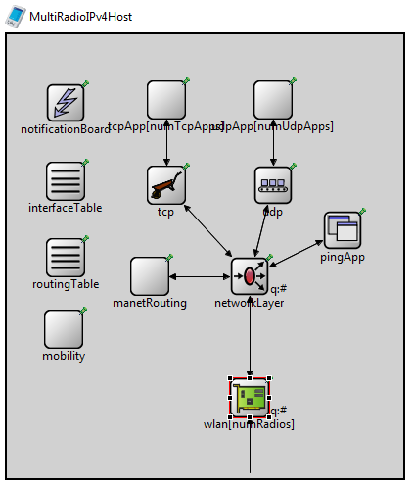
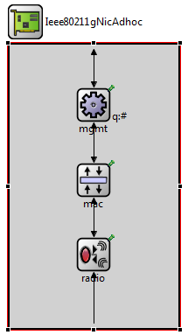
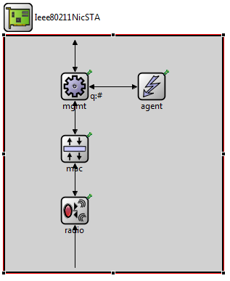
Software Producibility Challenges (1/4)
Composition of modules should be semantically compatible
Modules can be hierarchical – any inconsistency deeply nested may render application-level algorithms useless
Must deal with compositional commonalities and variabilities

Slide 30
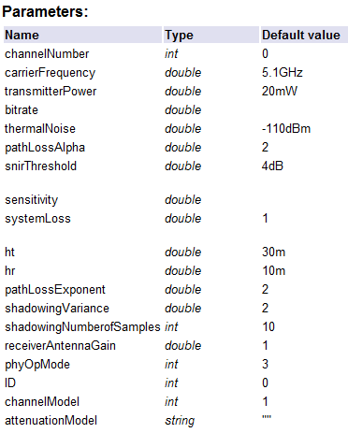
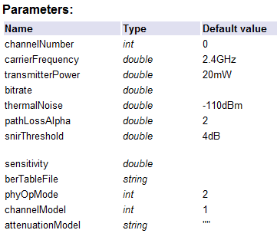
Software Producibility Challenges (2/4)
Each module can be configured in many ways
Choice of module and its configuration impacts appln-level algorithms
Must deal with configuration commonalities and variabilities at multiple layers

Slide 31
Software Producibility Challenges (3/4)
Sensing and actuation capabilities at all levels
Information should be able to flow vertically in both directions
Potential to use advanced s/w engineering capabilities like aspect weaving, feature composition

Slide 32
Software Producibility Challenges (4/4)
Multiple deployment challenges
Where to place the road side units? How many are needed in a region? How to leverage alternate mechanisms like cell towers/WiMAX?
Solution should be cost-effective yet enable high confidence CPS
How much additional electronics inside a vehicle? How can we maximally pack functionality?
How to ensure system schedulability? Overloads?

Slide 33
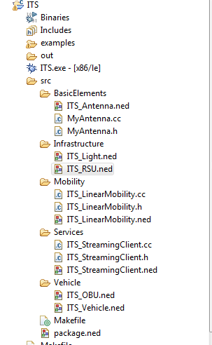
Work-in-Progress: Build a Product Line of Reusable Modules for ITS
Repository of functionality being developed
  An on-board unit on a vehicle
  The vehicle itself
  A traffic light
  A road side unit
  Streaming application
  Mobility models
Goal is to deploy and configure larger scenarios
Develop algorithms

Slide 34
Student Research To-Date
Deepti Thopte (MS Comp Sc) – worked on traffic light simulations in OMNeT++
Tina Devkota (MS Comp Sc) – worked on a simple broker network for information dissemination using OMNeT++
Mohammad Aminuddin (VUSRP research) – worked on bridging OMNeT++ with SUMO microscopic traffic simulator
Anushi Shah (current student) – working on Electronic Toll Plaza simulations in OMNeT++
Kyoungho An (current student) – getting started with work in this area

Slide 35
Collaborations (Ongoing & Planned)
With AFRL mentors (Steve Drager and Bill McKeever)
With Prof. Mark McDonald (Civil Eng, Vanderbilt) – funded though a Vanderbilt Discovery grant to conduct interdisciplinary research in ITS
With Dr. Jules White (EECS, Vanderbilt) – funded though an NSF grant
  Exploring the use of SmartPhone technologies in ITS
  Addressing deployment and configuration challenges
Looking for interested graduate student(s)
Research opportunity for interested undergraduate students

Slide 36
Acknowledgments
AFRL and Visiting Faculty Research Program (VFRP) for the opportunity
  Mentors: Steve Drager and Bill McKeever
  VFRP coordinators: John Graniero, Cynthia Cooley
  Other AFRL researchers: Bob Hillman, Jim Hanna, Mark Linderman, John Matijas, Mike Medley, Guna Seetharaman
  Faculty colleagues: Sanjay Madria, Vijay Kumar, Bharat Bhargava, Yuan Xue, many others
  Student colleagues: Thomas Levy, Andrea DeSanto
  RIT-A/B staff and other researchers

Slide 37
Concluding Remarks (1/2)
Developing reliable ITS CPS applications is hard
Multiple expertise in multiple fields necessary
Systems level issues
  Developing algorithms at application level that understand the physics
  No effective development and testing environment
  Multiple, disparate tooling environments
Numerous software engineering issues
  Composition, configuration at multiple layers
  Deployment issues
Need a combination of systems-level and software-engineering solutions

Slide 38
Concluding Remarks (2/2)
My research at Vanderbilt University
  NSF CAREER – investigating issues at specializing middleware stacks
    Useful in specializing the ITS product line
  NSF CNS Core – investigating effective deployment algorithms
    Many issues in ITS (e.g., RSU placement)
  Vanderbilt Discovery grant with Prof. McDonald – to investigate ITS solutions
    Geared towards interdisciplinary research
Spring 2010 courses covering some of the ITS issues
  CS396: Special topics on Real-time Systems (offered by me)
  EECS 262 (offered by Dr. Jules White)

